Slide 1
FPGA Design Flow using Vivado
Sponsored by : Si-Vision
Presentation date: May 25, 2021

Slide 2
Outline
FPGA flow
Design idea and RTL
Functional simulation
Synthesis and implementation
Post implementation simulation
Timing constraints

Slide 3
FPGA design flow
Design and RTL
Simulation
synthesis
implementation
Testing
Programming
Timing analysis
Post implementation simulation

Slide 4
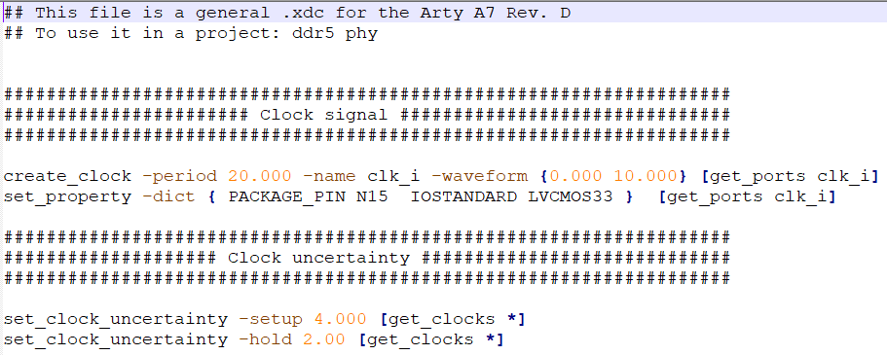
Source files
RLTs of all system
Test-bench
Constraint file:
Clock period
Clock uncertainty (setup, hold)
Input and output delays
I/O ports placement

Slide 5
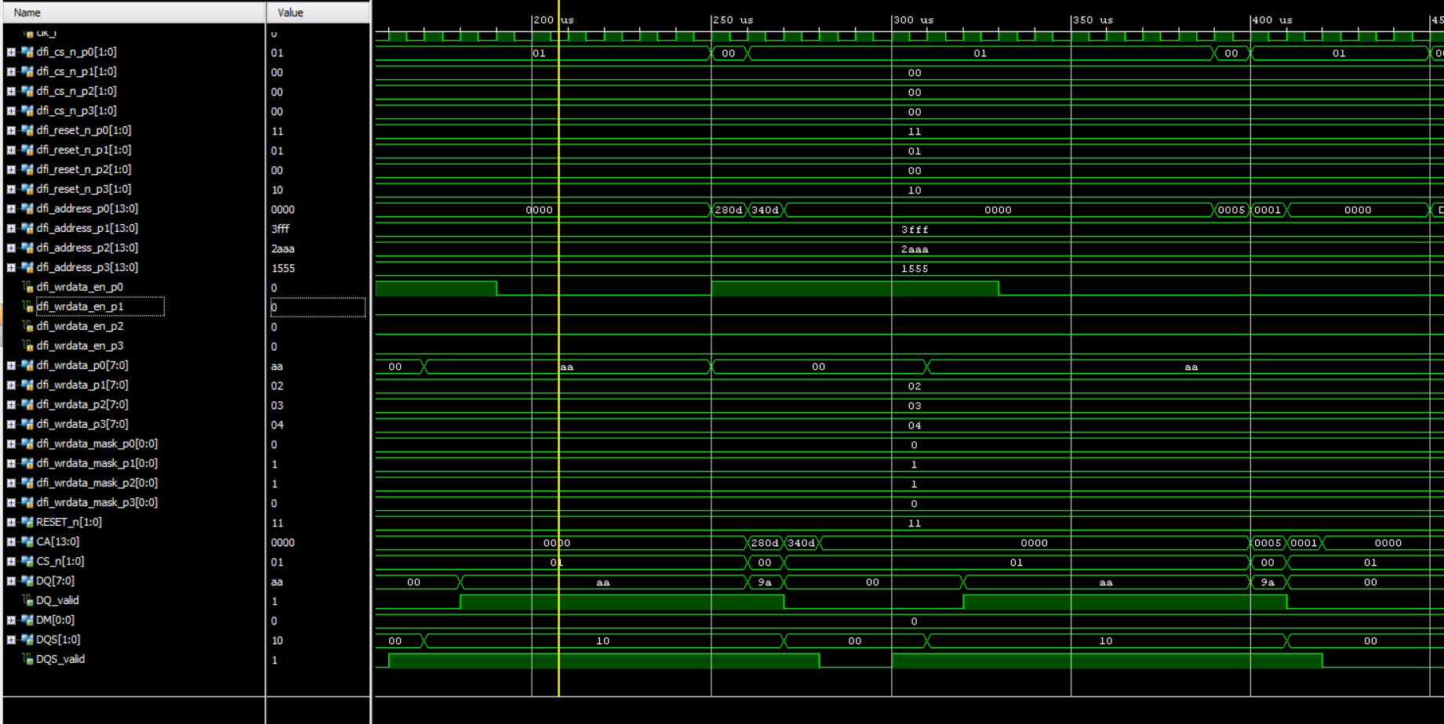
Functional simulation result

Slide 6
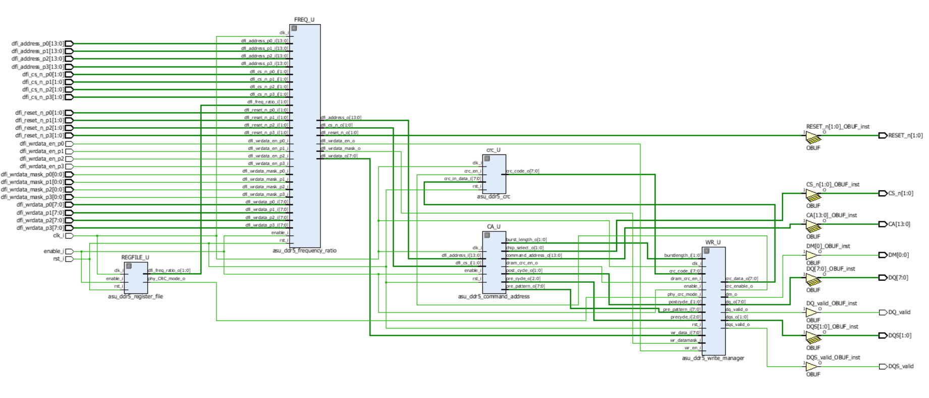
Logic level schematic

Slide 7
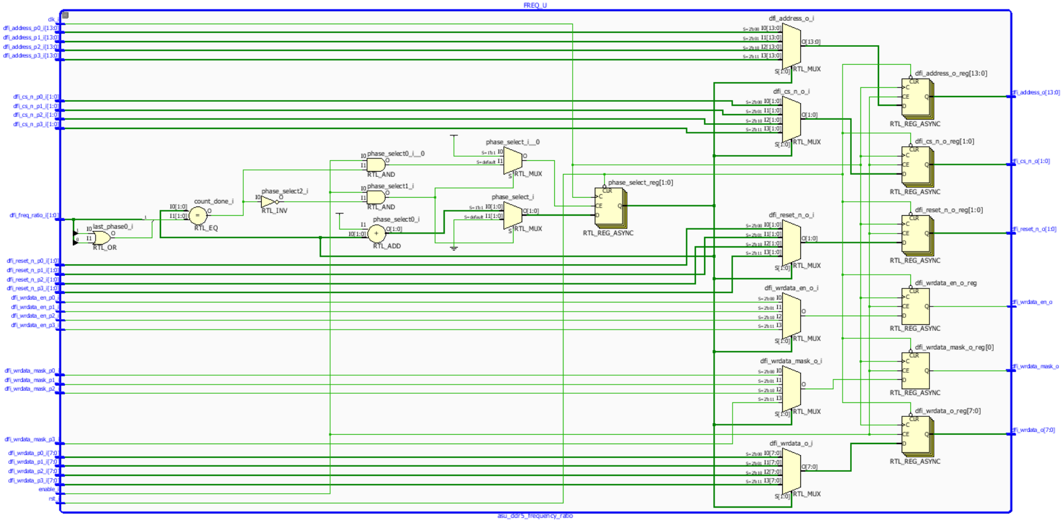
Frequency ratio block logic level

Slide 8
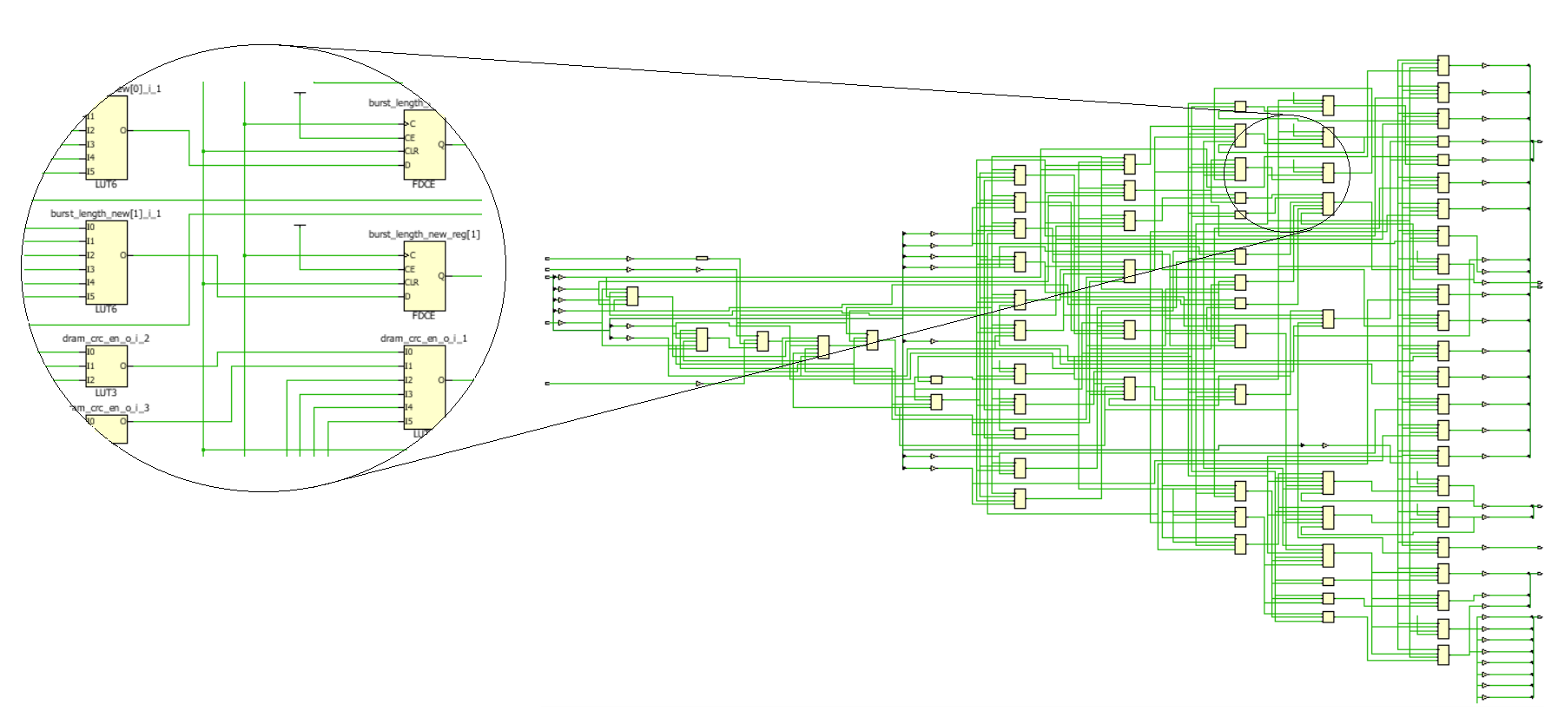
Schematic of the design
After running the synthesis, the code is converted into LUTs to be placed on FPGA

Slide 9
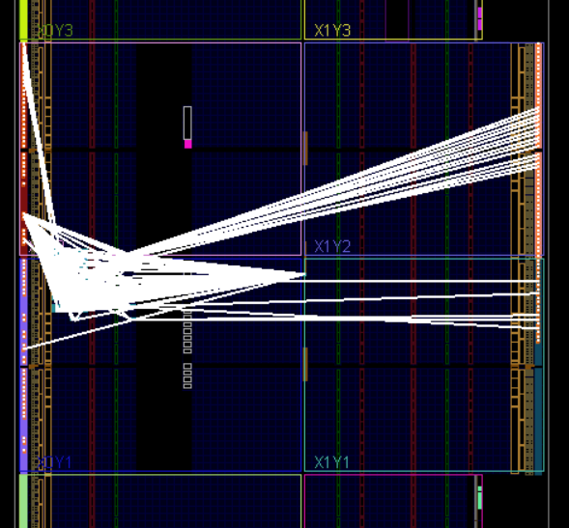
FPGA netlist

Slide 10
Post implementation simulation

Slide 11
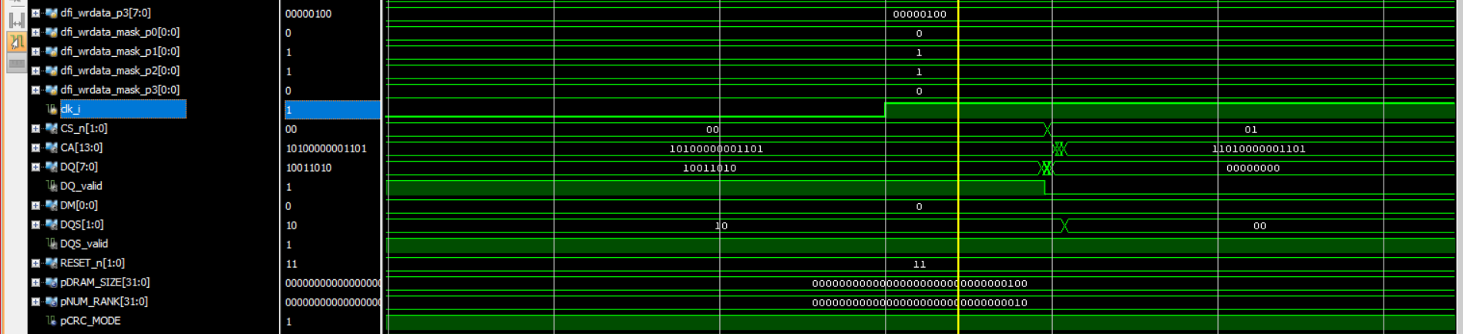
Post implementation simulation (zoomed)
The output changes after rising edge by 10 ps.

Slide 12
Generating bit stream
The next step is generating the bit stream file and download it on the FPGA kit.
The last step is perform testing on the FPGA.

Slide 13
THANK YOU..

