Slide 1

Ain Shams University
Faculty of Engineering, Ain shams University.
Electronics and Communication systems Department
ECE 481: Integrated Circuits
FPGA-Based Bank ATM System

Slide 2
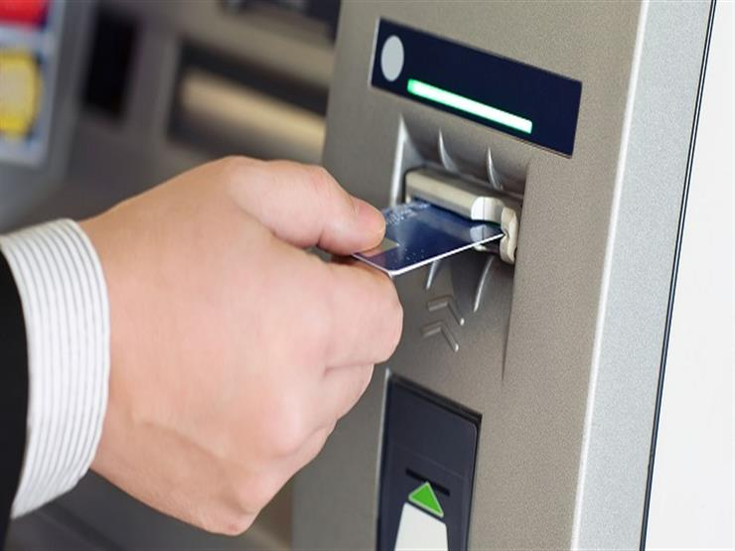
FPGA-Based Bank ATM System
The project aims at practicing the complete FPGA flow by implementing the core of the bank ATM on FPGA.
Group Number
26
Members
Abdelrahman Mohamed (1700755)
Mark Ashraf (1701081)
Omar Mohamed (1700899)
Metwaly Yahia (1701122)

Slide 3
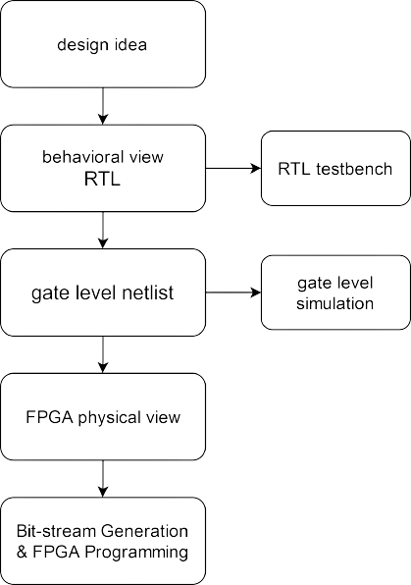
DESIGN FLOW
3

Slide 4
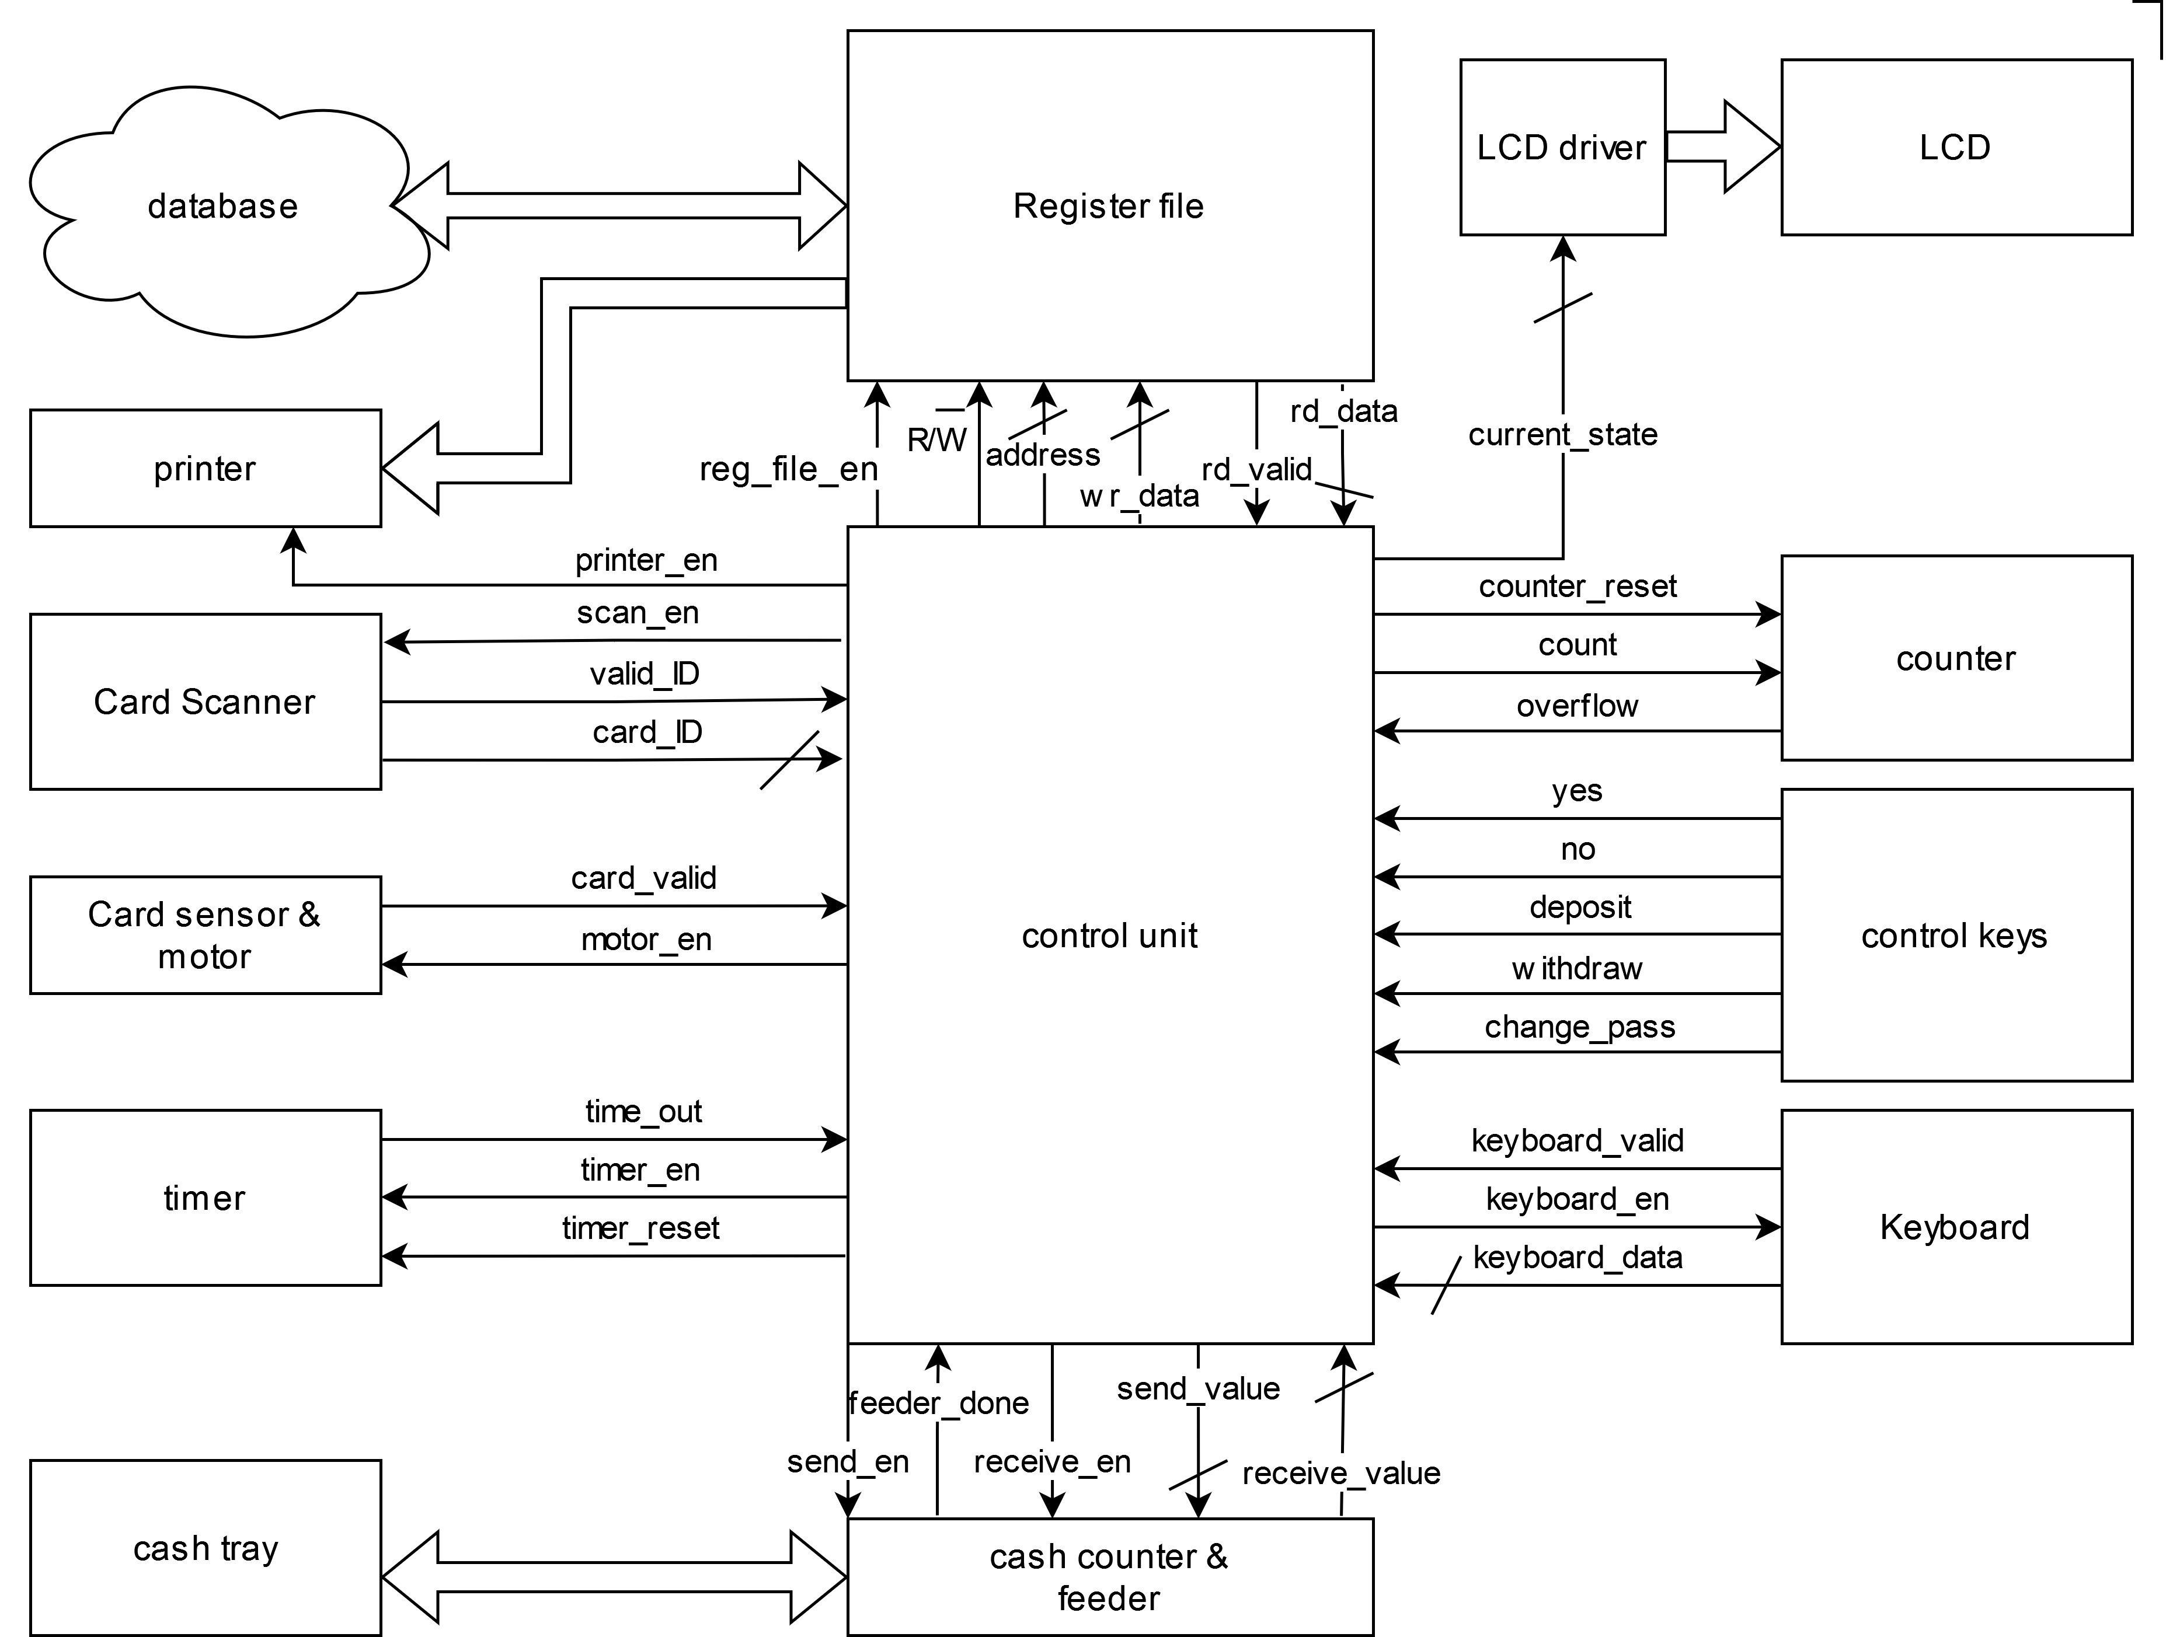
BLOCK DIAGRAM
Printer: It is used to print the receipt if requested by the user and linked to the register file and control unit.
Card scanner: It is used to scan the card and read the card ID.
Card sensor & motor: A unit that determines the validity of the card, and a motor to move the card.
Timer

Slide 5
BLOCK DIAGRAM
Cash counter & feeder: It is used to count cash in case of withdraw or deposit and it is linked to the cash tray.
Keyboard: It is commonly 3x4 keypad so the user can enter the password of the card.
Control keys: Keys to handle the operation entered by the user.
Counter: Count the number of wrong password trials entered by the user.

Slide 6
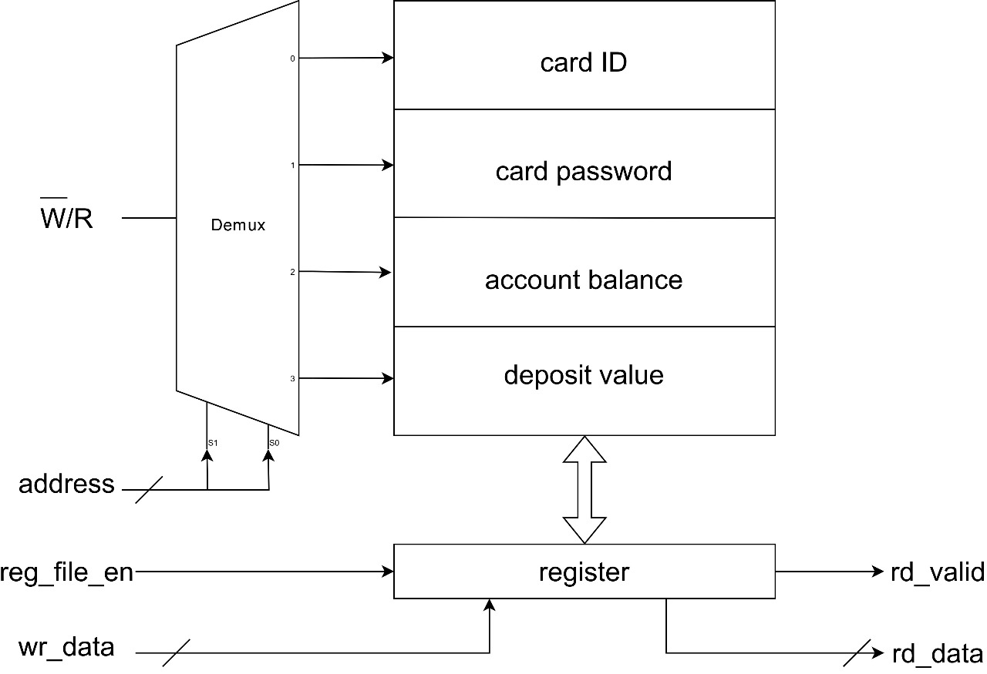
REGISTER FILE
Demux: Select the address of the register in case of reading or writing in the register file.
Register: Hold data to be written in /or read from the register file.

Slide 7
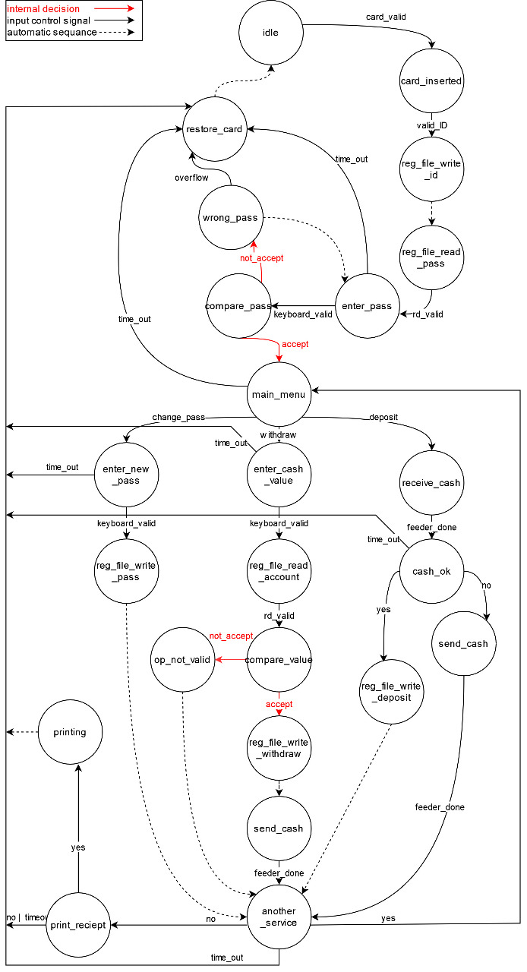
FSM
Idle: is the normal state when there is no card in ATM.
Card_Inserted: is the state that ATM enters when a card is inserted.
Enter_Pass: is the state that ATM enters after checking card id and getting card password from database.
Compare_Pass: is the state that ATM enters to check if the password that the user entered is the same as the password in database.
Restore_Card: is the state that ATM enters if time_out signal is the input or overflow which happens after entering wrong password 5 times in a row.
Main_Menu: is the state that ATM enters when user enter the right password or if the user has finished a service and wants another service.
Receive_Cash: is the state that ATM enter when user wants to deposit money.
Enter_Cash_Value: is the state that ATM enter when user wants to withdraw money.
Enter_New_Pass: is the state that ATM enters when user wants to change card password.
Another_Service: is the state that ATM enters when it finishes a service completely to check if the user wants another service.
Print_Reciept: is the state that ATM enters after the user finishes all the services he wanted to do to check if user wants a printed paper of all the services that ATM did.

Slide 8
RTL Implementation:
Code Link: https://drive.google.com/drive/folders/1ycq6pd7r_aH3pZjjqxNf30KWi8r-LRZc
Test Bench Implementation:
Code Link: https://drive.google.com/drive/folders/1kaMzGarV6T4rIi6v-Cp_zzIR2HtjmbIF

Slide 9
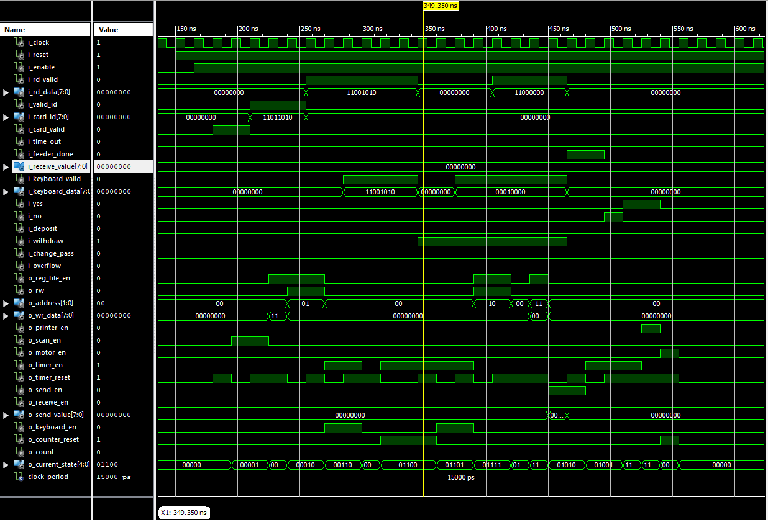
TESTBENCH WAVEFORM

Slide 10
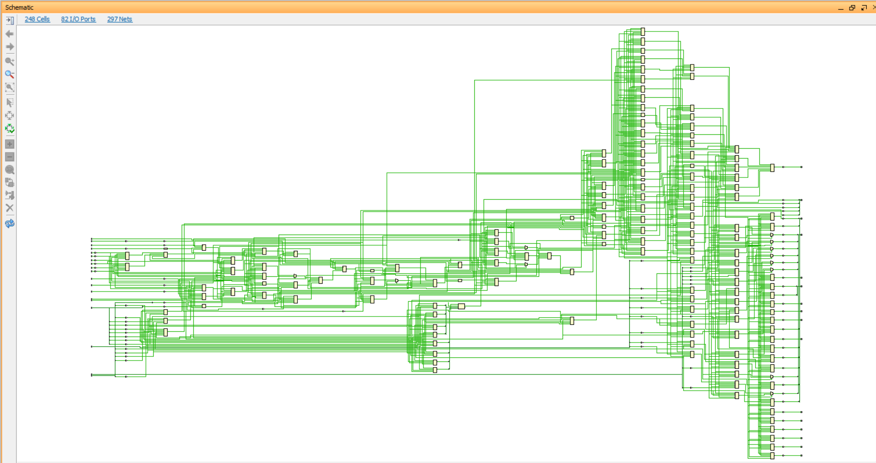
GATE LEVEL NETLIST

Slide 11
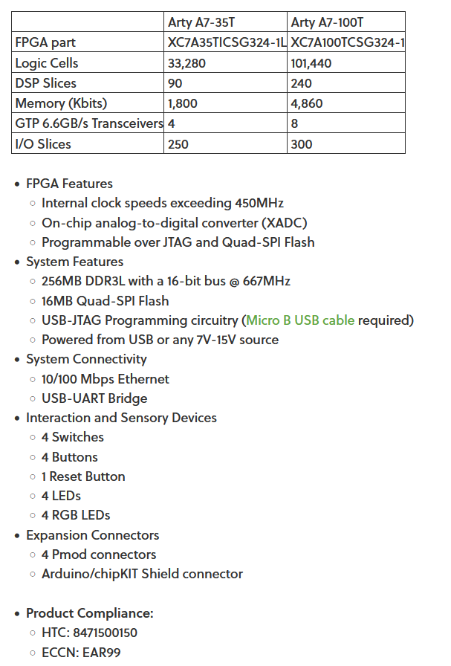
FPGA DATASHEET

Slide 12
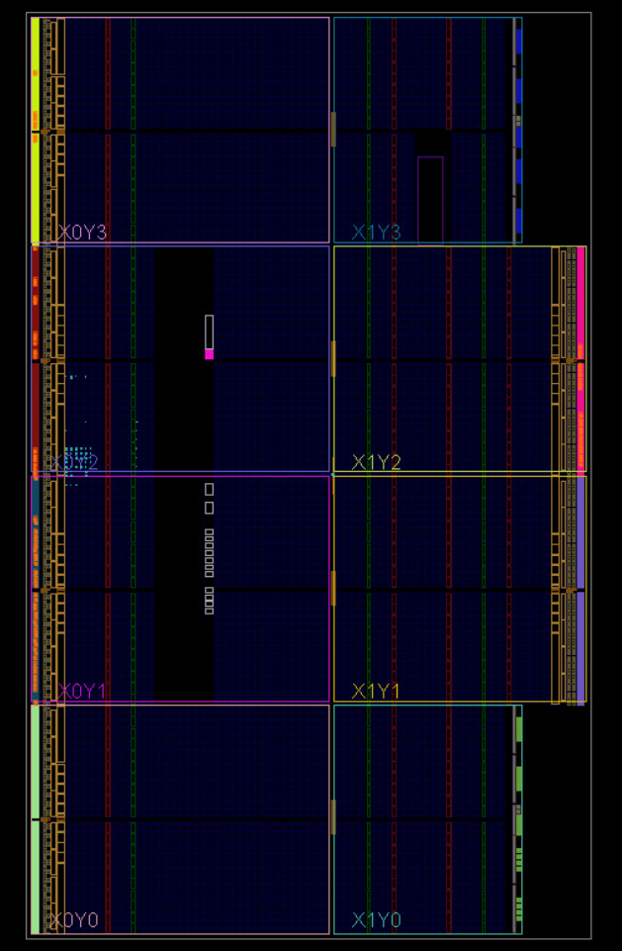
FPGA
PHYSICAL VIEW

Slide 13
FPGA Implementation Reports:
Reports’ Link: https://drive.google.com/drive/folders/1Mp8BIlDhBRjyhDB5wW9fNJ908i3e4GLK
Bit Stream:
Document Link: https://drive.google.com/drive/folders/1VRh6ABEQwkqt6cV56UJY4zDTbIXYf8Xr

Slide 14
Thanks. . .

