Slide 1

KNN Algorithm
Table of Contents:
Introduction.
Overview of KNN.
Distance Metrics.
How does KNN work?
How to choose a K value?
KNN model implementation.

Slide 2

Introduction
K-Nearest Neighbors is the supervised machine learning algorithm used for classification and regression. It manipulates the training data and classifies the new test data based on distance metrics. It finds the k-nearest neighbors to the test data, and then classification is performed by the majority of class labels.

Slide 3
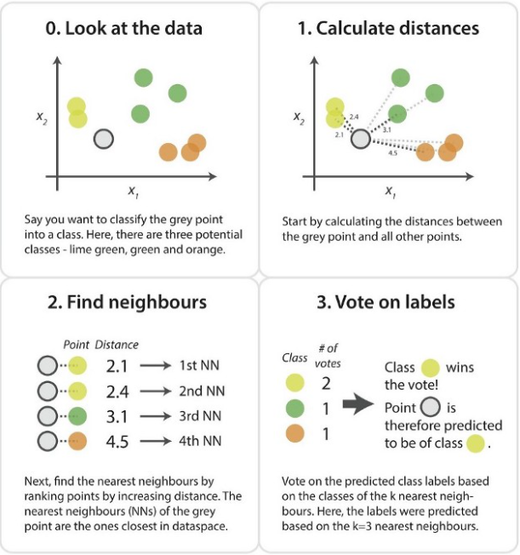
Overview of KNN

Slide 4
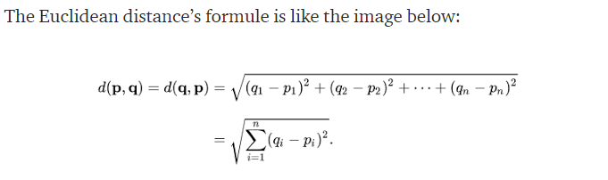
Distance Metrics
Usually, we use the Euclidean approach, which is the most widely used distance measure to calculate the distance between test samples and trained data values. We measure the distance along a straight line from point (x1, y1) to point (x2, y2).

Slide 5
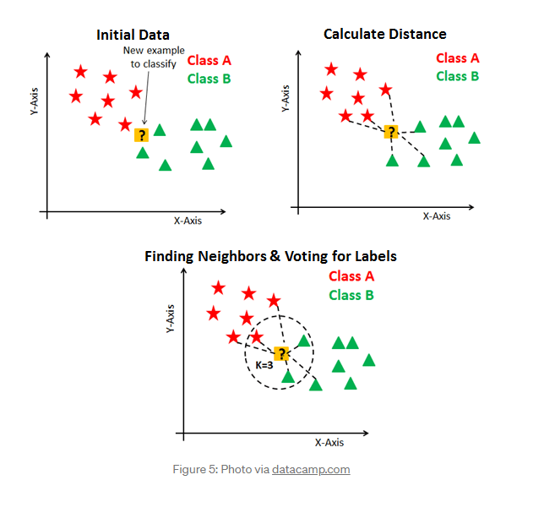
To classify an unknown record:
Initialize the K value.
Calculate the distance between test input and K trained nearest neighbors.
Check class categories of nearest neighbors and determine the type in which test input falls.
Classification will be done by taking the majority of votes.
Return the class category.

Slide 6
How does KNN work?
The KNN working can be explained on the basis of the below algorithm:
Step-1: Select the number K of the neighbors
Step-2: Calculate the Euclidean distance of K number of neighbors
Step-3: Take the K nearest neighbors as per the calculated Euclidean distance.
Step-4: Among these k neighbors, count the number of the data points in each category.
Step-5: Assign the new data points to that category for which the number of the neighbor is maximum.
Step-6: Our model is ready.

Slide 7
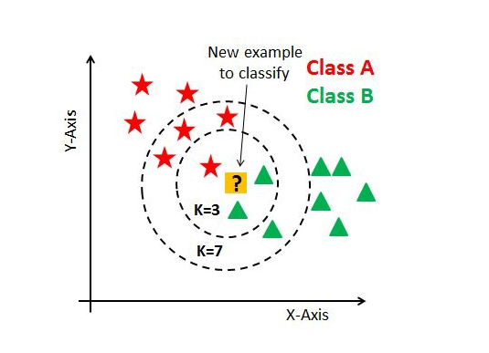
How to choose a K value?
K value indicates the count of the nearest neighbors. We have to compute distances between test points and trained labels points. Updating distance metrics with every iteration is computationally expensive, and that’s why KNN is a lazy learning algorithm.
As you can verify from the above image, if we proceed with K=3, then we predict that test input belongs to class B, and if we continue with K=7, then we predict that test input belongs to class A.
That’s how you can imagine that the K value has a powerful effect on KNN performance.

Slide 8
how to select the optimal K value?
There are no pre-defined statistical methods to find the most favorable value of K.
Initialize a random K value and start computing.
Choosing a small value of K leads to unstable decision boundaries.
The substantial K value is better for classification as it leads to smoothening the decision boundaries.
Derive a plot between error rate and K denoting values in a defined range. Then choose the K value as having a minimum error rate.
Note: The optimal K value usually found is the square root of N, where N is the total number of samples.
Odd value of K is selected to avoid confusion between two classes of data

Slide 9


