Slide 1

Regression Algorithm
Introduction
Hypothesis
Cost Function
Gradient Descent
Algorithm Implementation

Slide 2

Introduction
Linear regression is an approach for modeling the relationship between a scalar dependent variable y and one or more explanatory variables (or independent variables) denoted X.
The case of one explanatory variable is called simple linear regression or univariate linear regression.
For more than one explanatory variable, the process is called multiple linear regression.
In linear regression, the relationships are modeled using linear predictor functions whose unknown model parameters are estimated from the data. Such models are called linear models.

Slide 3
Hypothesis
The hypothesis for a univariate linear regression model is given by,
hθ(x) = θ0 + θ1X
Where:
  hθ(x) is the hypothesis function, also denoted as h(x) sometimes
  x is the independent variable
  θ0 and θ1 are the parameters of the linear regression that need to be learnt
Parameters of the Hypothesis:
In the above case of the hypothesis, θ0 and θ1 are the parameters of the hypothesis. In case of a univariate linear regression, θ0 is the y-intercept and θ1 is the slope of the line.
Different values for these parameters will give different hypothesis function based on the values of slope and intercepts.

Slide 4
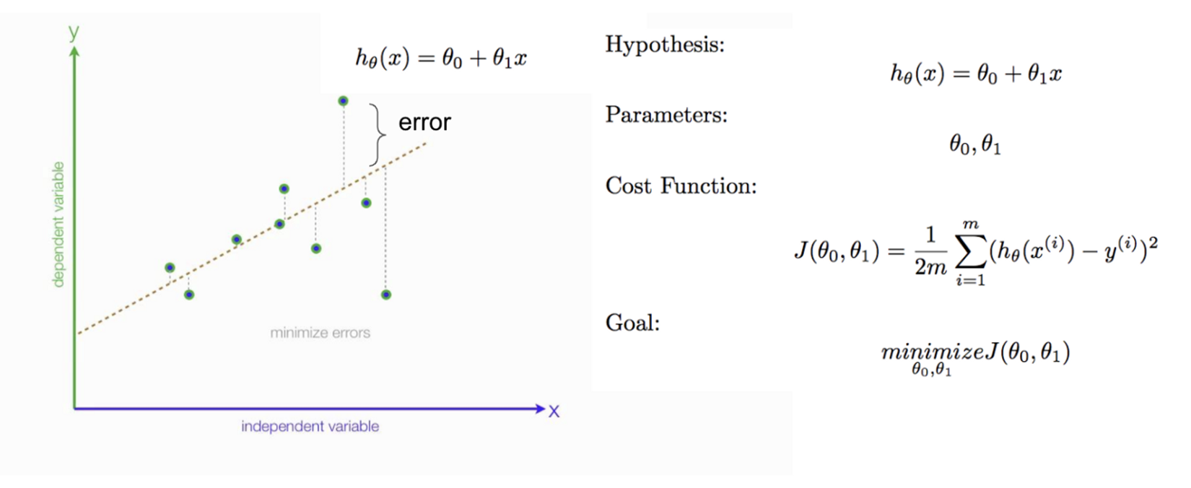
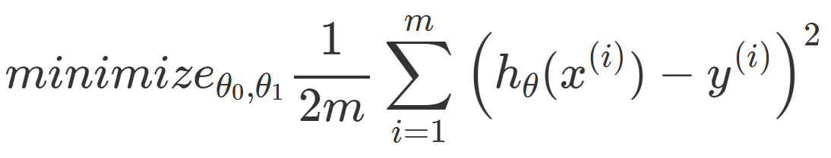


Cost Function
Assume we are given a dataset as plotted by the ‘x’ marks in the plot above. The aim of the linear regression is to find a line similar to the blue line in the plot above that fits the given set of training example best. Internally this line is a result of the parameters θ0 and θ1. So the objective of the learning algorithm is to find the best parameters to fit the dataset i.e. choose θ0 and θ1 so that hθ(x) is close to y for the training examples (x, y). This can be mathematically represented as:
Where:
hθ(xi) = θ0 + θ1Xi
(xi,yi) is the $i^{th}$ training data
m is the number of training example
$\frac{1}{2}$ is a constant that helps cancel 2 in derivative of the function when doing calculations for gradient descent
So, cost function is defined as follows:

Slide 5
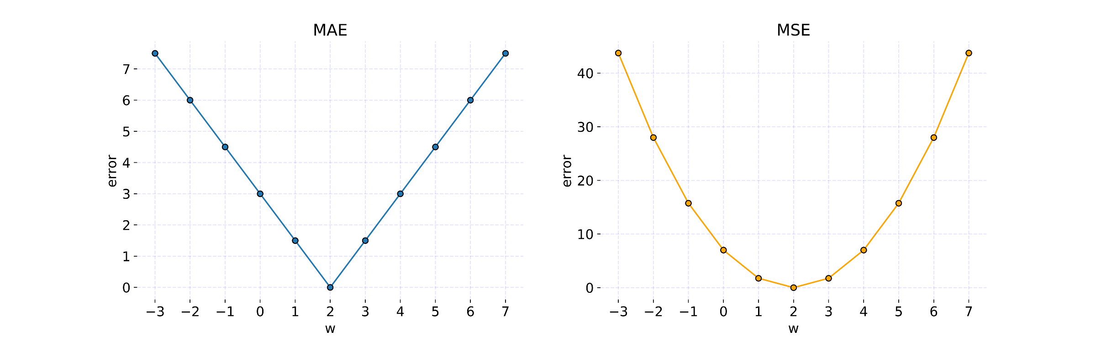
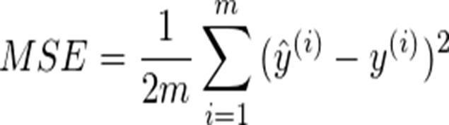
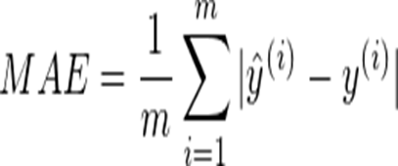
Types of Cost function
This cost function is also called the squared error function because of obvious reasons. It is the most commonly used cost function for linear regression as it is simple and performs well.
Mean Squared Error(MSE):
Mean Absolute Error(MAE):

Slide 6
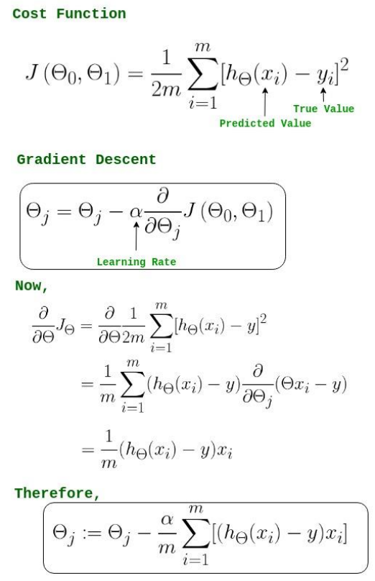
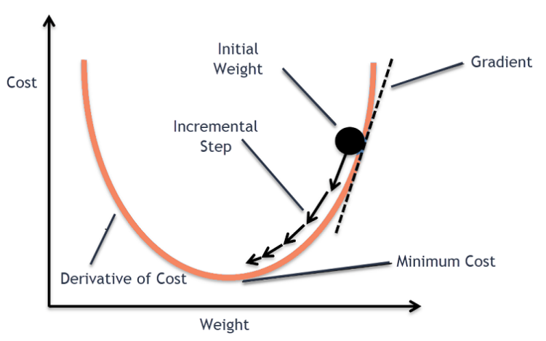
Gradient Descent
To minimize MSE we use Gradient Descent to calculate the gradient of our cost function. Gradient descent consists of looking at the error that our weight currently gives us, using the derivative of the cost function to find the gradient (The slope of the cost function using our current weight), and then changing our weight to move in the direction opposite of the gradient. We need to move in the opposite direction of the gradient since the gradient points up the slope instead of down it, so we move in the opposite direction to try to decrease our error.

Slide 7
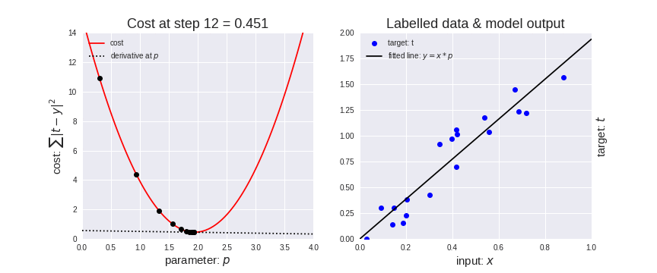
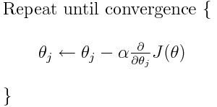
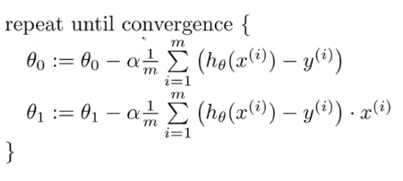

Slide 8
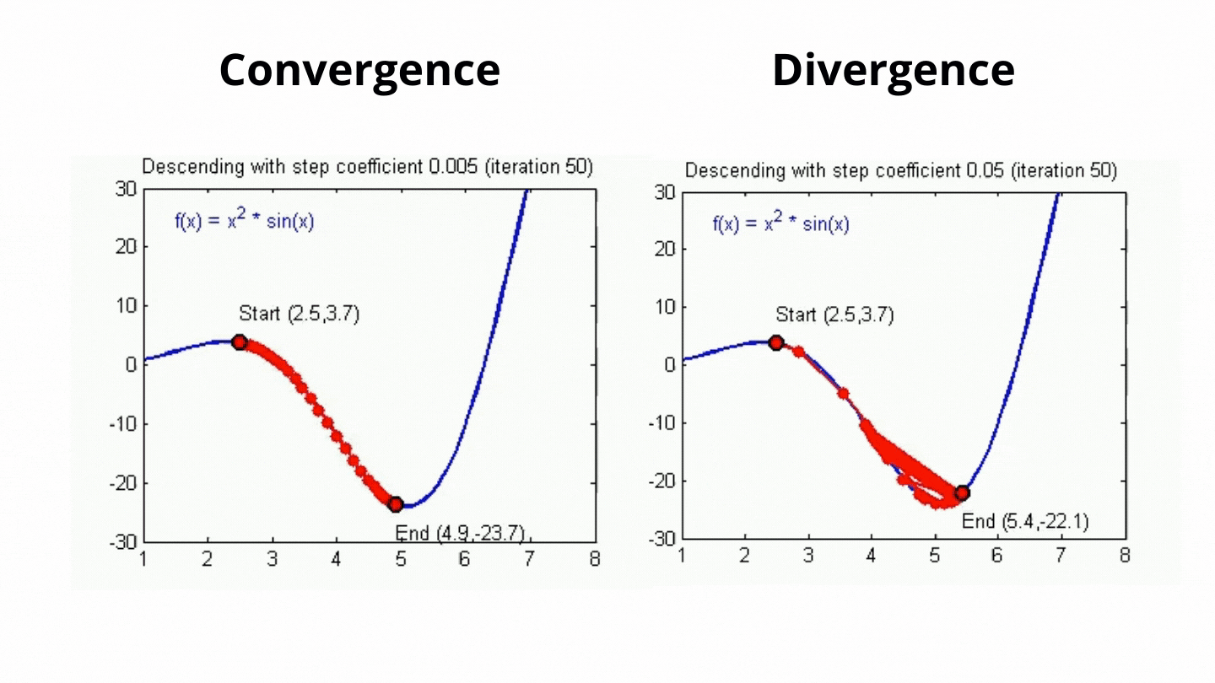
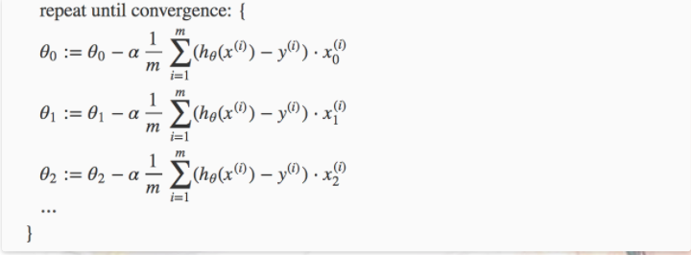

Slide 9


