Slide 1

Web Vulnerability scanner
الاسم | رقم الكشف
طه حسن عبدالمؤمن بدران | 55
عبدالرحمن عبدالمنصف محمد | 65
عبدالله هشام خالد عبدالحميد | 74
محمود احمد محمود احمد | 125
محمود محمد محمود الشعراوي | 136

Slide 2
Table of content
Introduction
Problem definition
AIMS
$
Scenario & Tools
analysis and design
The Phases of vulnerability scanner
Reconnaissance
Scanning
Exploitation
Reporting
What is next
Conclusion

Slide 3
Introduction
There's no denying that technology has become an integral part of our lives today. With humans being inherently social creatures, the invention of the internet was a natural progression to meet this need.
While technology has greatly enhanced human life, making it more comfortable and convenient, it's clear that this increase in comfort has also led to changes in human behavior and ethics.
The deep penetration of technology into every corner of life, even into the infrastructure of countries, necessitates the protection of these systems from interference by enemies or those with malicious intentions. This is where the field of information security comes into play.
In today's interconnected digital world, organizations face an ever-growing array of cybersecurity threats .Traditional security measures, while essential, often struggle to keep pace with the rapidly evolving threat landscape.
Evaluating systems to identify their vulnerabilities and the potential dangers if these weaknesses were exploited is a critical aspect of security, which includes what is known as web application assessments.

Slide 4
Problem definition
One of the significant challenges organizations encounter is the identification and mitigation of vulnerabilities within their digital infrastructures.
Vulnerabilities, ranging from software flaws to misconfigurations, create potential entry points for cyber attackers to exploit.
Manual detection and remediation of vulnerabilities are time-consuming, resource-intensive, and prone to human error. Furthermore, the complexity and diversity of modern IT environments exacerbate the challenge, making it difficult for security teams to maintain an accurate and up-to-date inventory of vulnerabilities.
As a result, organizations are increasingly turning to automated vulnerability scanning solutions to enhance their cyber defense capabilities . However, existing vulnerability scanners often suffer from limitations such as high costs, complexity, and lack of customization . Thus, there is a critical need for an innovative vulnerability scanner project that addresses these challenges and provides organizations with a scalable, cost-effective, and user-friendly solution.
In our presentation, we will explore how our Web Vulnerability Scanner Project aims to tackle these challenges and empower organizations to strengthen their cyber defenses effectively.

Slide 5
AIMS
Our goal is to create an automated Web vulnerability scanner, starting from information gathering process to reporting process, the details of processes as below:
Information Gathering : We aim to collect relevant data about the target environment
Finger-Printing
identify the OS (operating system ) type and version
open ports & services discovery
subdomains discovery
framwork discovery
resourses enumerations (directories , end-points, parameters)
Exploitation
Owasp top 10 check-list
Assesment & Reporting
scanning and analyzing, we aim to pinpoint weaknesses that could be exploited by attackers.
Identify Vulnerabilities : The primary aim is to detect security vulnerabilities within systems, networks, and applications.
Manual checks are time-consuming; automation ensures timely detection.
OSINT techniques help us understand the system’s context and potential risks.
Prioritize Remediation : Not all vulnerabilities are equal.
Our scanner will prioritize fixes based on severity.
Efficiently allocate resources for effective risk mitigation.

Slide 6
Scenario & Tools
Utilizes python code and Various Libraries for Vulnerability Scanning.
Performs subdomain enumeration, alive subdomain detection, port scanning, and vulnerability assessment.
Integrates with external tools such as Nmap, Subfinder , Wayback Machine, and Nuclei for comprehensive scanning.
Developed to enhance cybersecurity practices and identify potential vulnerabilities in web applications and infrastructure.

Slide 7
Scenario & Tools
To make this happen, we've utilized a set of powerful tools and technologies. From Python and Subfinder to Nmap and Nuclei, we've integrated various components to ensure a robust scanning process. Which we will describe it at the next slide

Slide 8
Scenario & Tools
Tools Used:
Subfinder : To Collecting Subdomains
Nmap : To Detect Open Ports
Wayback Machine
dirsearch
Nuclei
Sqlmap : To Find SQL Injection
Technologies Utilized:
HTTP protocol for web communication
DNS resolution for domain information retrieval
Web scraping for extracting data from web pages
Command-line interface for executing external tools and scripts.

Slide 9
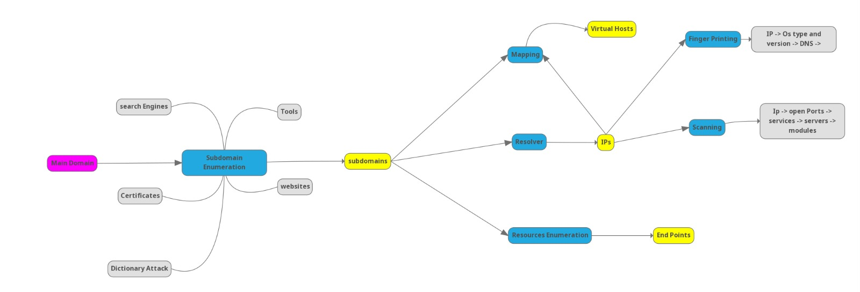
analysis and design

Slide 10
The Phases of vulnerability scanner
Reconnaissance
Scanning
Exploitation

Slide 11
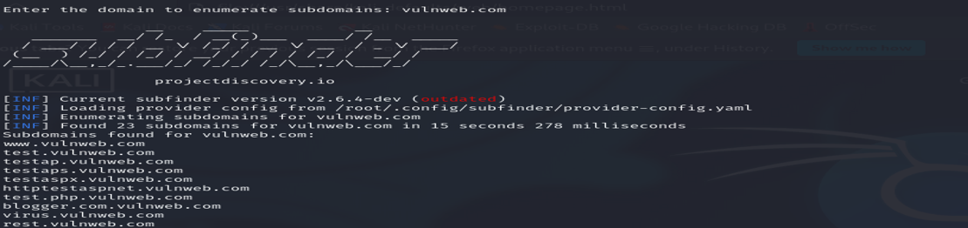
Reconnaissance
Subdomain Enumeration:
Tools/Processes Used: Subfinder
Description: The enumerate_subdomains() function enumerates subdomains associated with the target domain using multiple methods.

Slide 12

Reconnaissance
Live Subdomain Identification:
Tool Used: HTTPx
Description: The run_httpx_from_file() function checks the accessibility of subdomains obtained from the enumeration process. It sends HTTP requests to each subdomain to determine if it is live and accessible. Live subdomains are then saved to a file for further analysis.

Slide 13
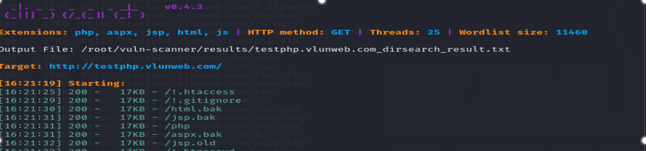
Reconnaissance
Directory Enumeration:
Tool Used: Dirsearch
Description: The run_dirsearch_for_domains() function performs directory enumeration on discovered subdomains using the Dirsearch tool.

Slide 14
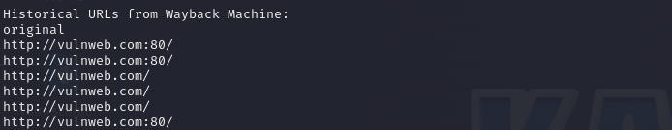
Reconnaissance
Historical URL Lookup:
Tool/Process Used: Wayback Machine API
Description: The wayback_machine_lookup() function queries the Wayback Machine API to retrieve historical URLs associated with the target domain. It searches for archived snapshots of web pages and saves the URLs to a file for reference..

Slide 15
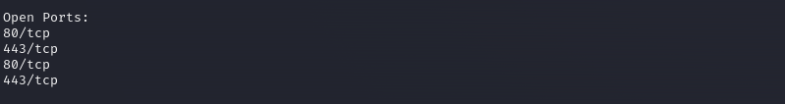
Scanning
Port Scanning:
Tool Used: Nmap
Description: The nmap_scan() function conducts port scanning on live subdomains using Nmap. It scans a range of ports (1-1000) to identify open ports and services running on them. The results are saved to an output file for analysis.

Slide 16
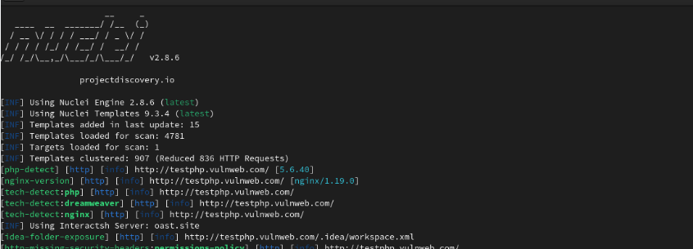
Exploitation
Tool Used: Nuclei
Description: The run_nuclei() function performs vulnerability scanning on live subdomains using the Nuclei tool. It scans for known vulnerabilities, misconfigurations, and security issues in web applications and services. The scan results are saved to an output file for review.

Slide 17
Reporting
Reporting and Documentation:
Report Generation: Generate comprehensive vulnerability assessment reports that document the findings, including identified vulnerabilities, risk ratings, recommended remediation actions, and supporting evidence.

Slide 18
What is next
Dynamic GUI for the Scanner
Sending notification message for the customer or user included weaknesses founded
Improving implementations
Final Documentation

Slide 19
Conclusion
Vulnerability scanners help identify weaknesses, security holes, and potential risks within a system.
They automate the process of discovering vulnerabilities, which is particularly important in large and complex environments.

