Slide 1
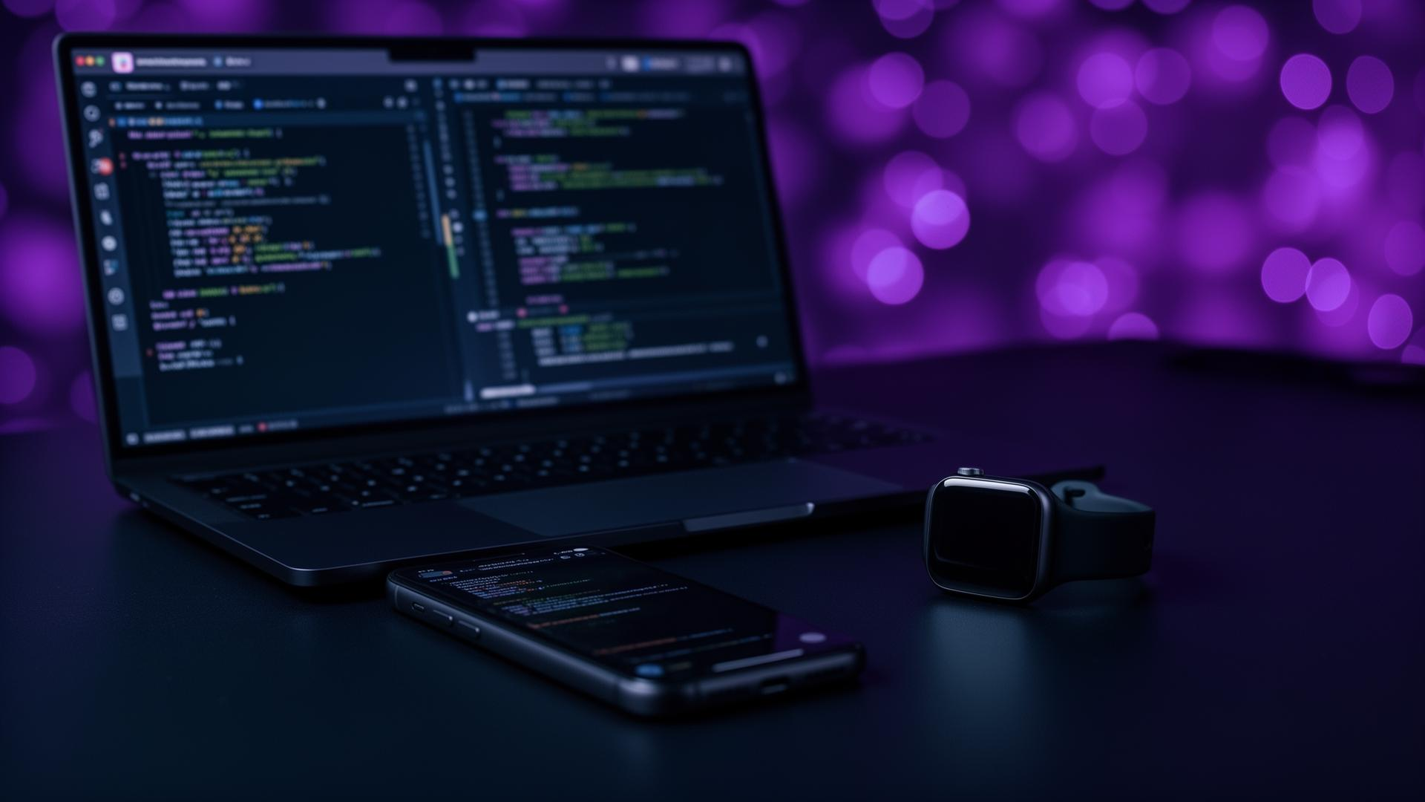
Techstore
Presented by: Abdelrhman Abdo Taghyain
3rd Year - Applied Technology / Insite

Slide 2


Project Idea
Techstore is an e-commerce website for purchasing electronic devices such as phones, laptops, and smartwatches.
Built with React
Modern JavaScript Framework

Slide 3



Technologies Used
React
Frontend UI Library
JavaScript
Programming Language
CSS
Styling & Layout
HTML
Page Structure

Slide 4
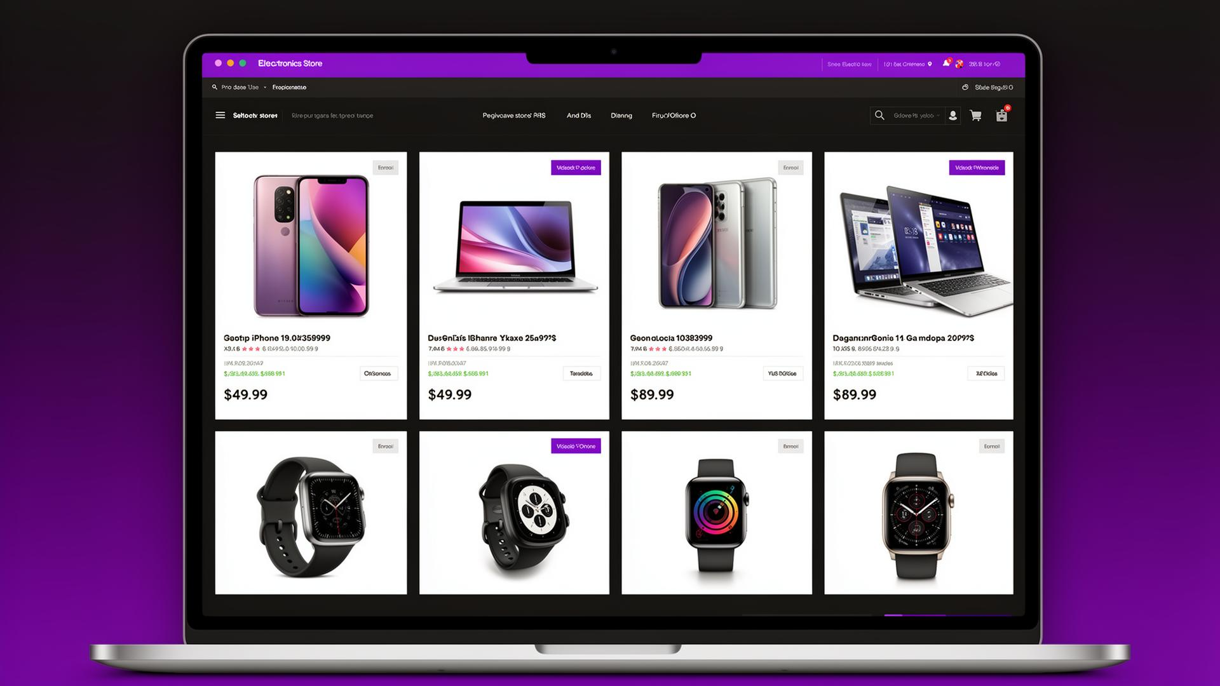

Design
Simple and user-friendly interface
Comfortable color palette
Clear section organization

Slide 5



Key Features
Search for Devices
Filter by Type or Price
View Device Details
Quickly find any electronic device by name or keyword
Narrow results by category, brand, or price range
See full specifications, images, and pricing for each product

Slide 6


Challenges
React Issues
Understanding component lifecycle and state management
Code Errors
Debugging runtime errors and fixing broken layouts
File Organization
Structuring the project folders and components properly

Slide 7


What I Learned
Using React
Building reusable components and managing application state
Project Organization
Structuring files and folders for scalability and maintainability
Problem Solving
Debugging issues and finding solutions through research

Slide 8


Links
GitHub Repository
github.com/BasmalaAbdo/techstore
Live Website
techstore.vercel.app

Slide 9
Thank You!
Thanks for listening

