Slide 1
Machine to Machine communication
Done by:
Khalid Mosaad
Moataz Tarek
Abdelrahman Elgharib

Slide 2

Table of Contents
Introduction
M2M view
Block Diagram
Circuit Diagram
Flowchart
Static Design
2

Slide 3
Introduction

Slide 4
Introduction
The project is a machine to machine communication.
Two different control units (CUs) are communicating together using Bluetooth interface.
First one get data from sensors and get orders from user.
Second one display data.

Slide 5
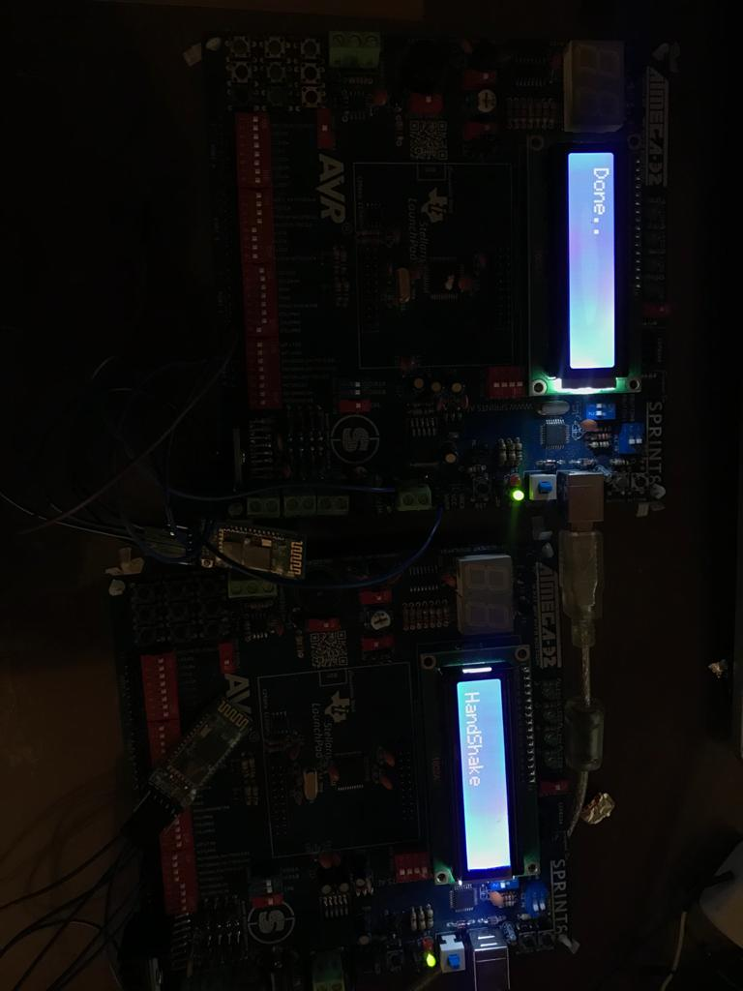
M2M view

Slide 6
Block Diagram
LCD
AVR
ATMEGA32
AVR
ATMEGA32
Bluetooth
module
Keypad
Bluetooth
module

Slide 7
Key Elements
AVR ATMEGA32
Bluetooth Module
Keypad
LCD

Slide 8
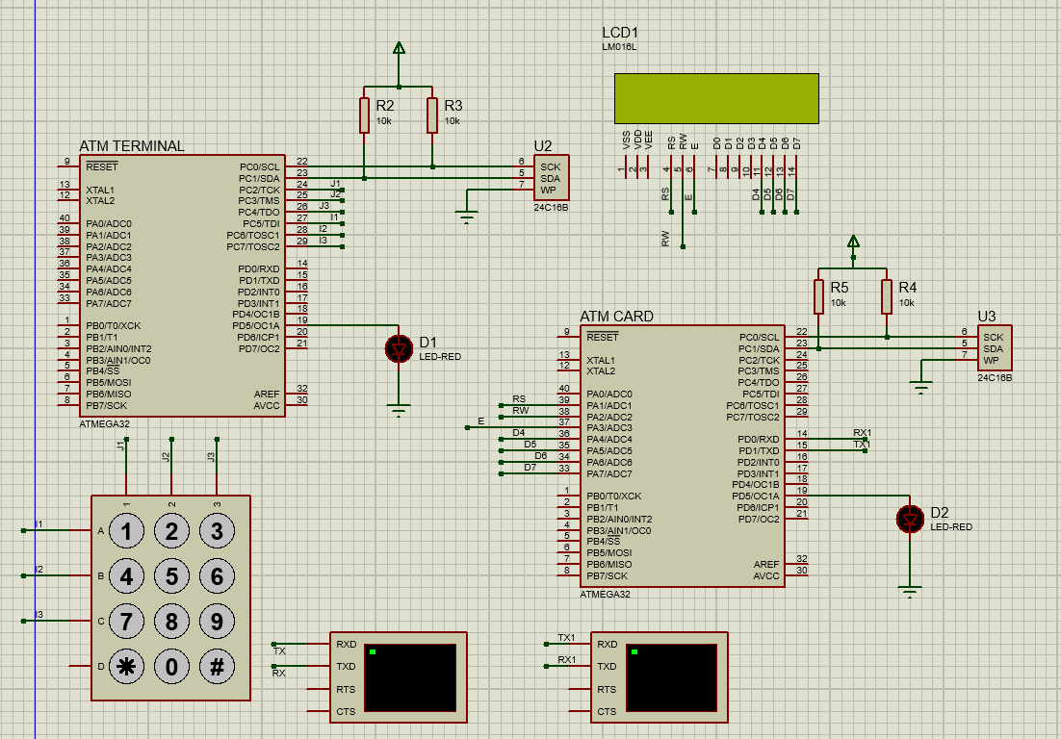
Circuit Diagram

Slide 9
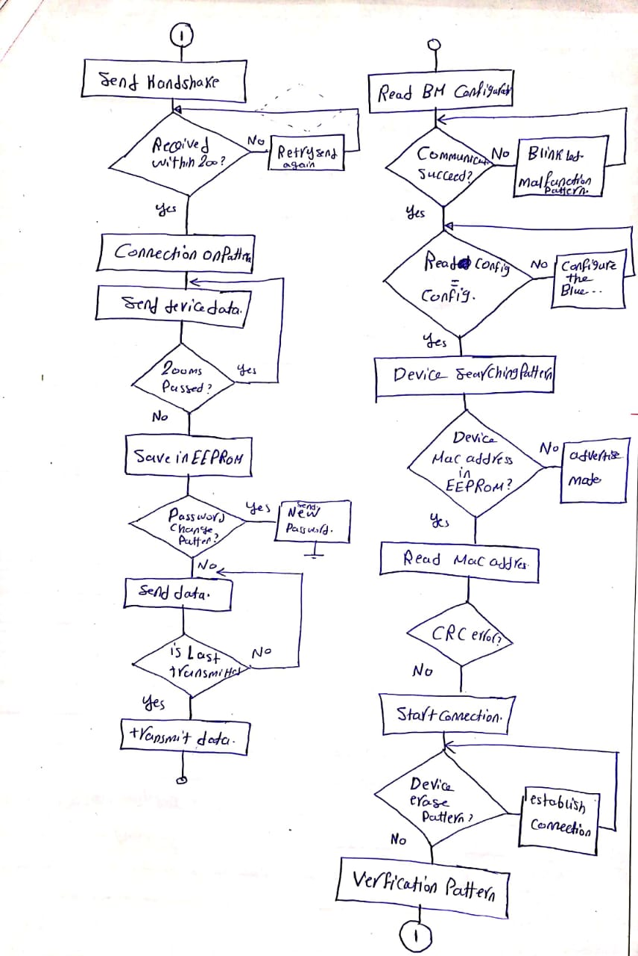
Flowchart

Slide 10
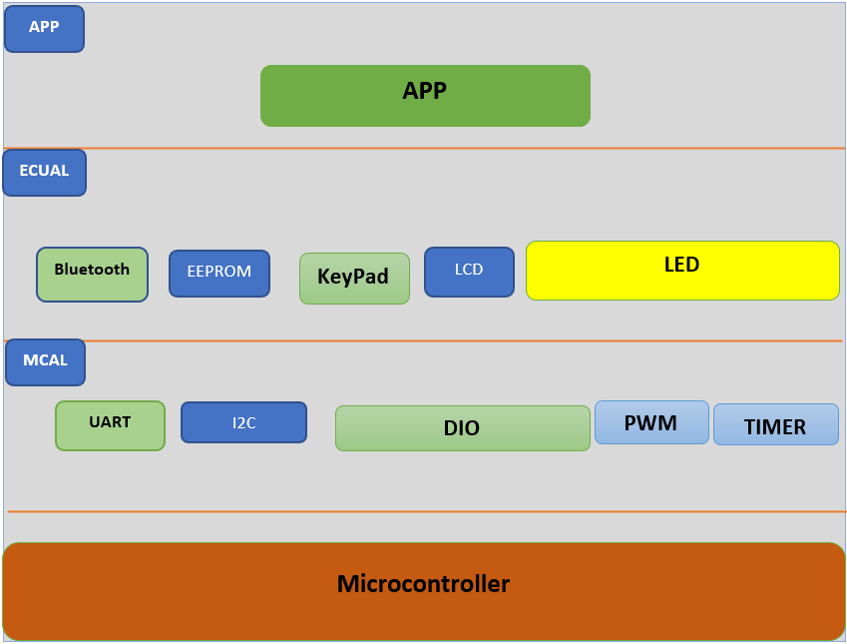

Static Design
Layered Architecture

Slide 11
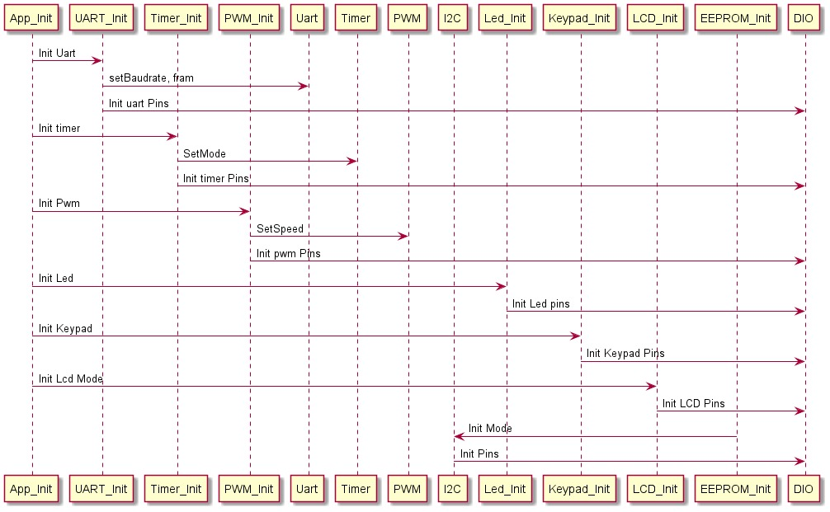
Init Sequence

Slide 12
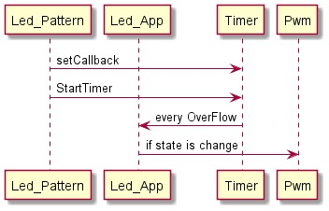
Search Pattern Sequence

Slide 13
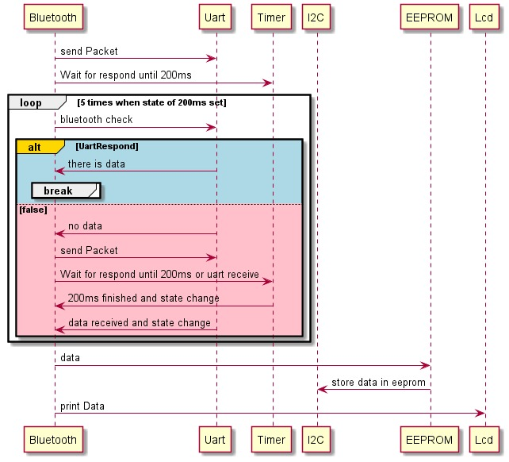
Data Packet Sequence

Slide 14
Thank You!

