Slide 1




Arabic Text-to-Speech (TTS) System
A Deep Learning Approach for Generating Clear and Natural Arabic Speech, presented by:
Ahmed Mostafa AbdEl-Rahman 20221372883
AbdelRahman Mohamed Abdel-Hadi 2022513643
Mazen Gaber Mahmoud 20221372110
AbdelRahman Tarek Zaki 20221442265

Slide 2
Objective: Develop a high-quality Arabic TTS system using deep learning.
Process
Collected audio data from YouTube.
Preprocessed data into phonemes for training.
Trained Tacotron 2 for Arabic phonetics.
Outcome: The model generates natural and clear Arabic speec

Slide 3

What is TTS? Text-to-Speech (TTS) systems convert written text into spoken words.
Challenges in Arabic:
Complex phonetics and dialect variations.
Goals:
Build an Arabic TTS model.
Streamline data preparation.
Ensure phonetic accuracy and naturalness in output.

Slide 4
Data Collection
Extracted audio and subtitles from YouTube using API.
Standardized audio to WAV format at 16 kHz.
Steps:
Search using Arabic keywords.
Filter videos with Arabic transcripts.
Download and convert audio to WAV format.
Collect metadata for training. Challenges: Repeated words in subtitles due to YouTube’s segmentation.

Slide 5
Data Preproccesing
Steps:
Renaming: Standardized file names
Segmentation: Split audio into <15-second segments.
Normalization:
Resampled to 22,050 Hz.
Removed silence and standardized amplitude.
Transcription: Generated Arabic text using Whisper.
Conversion:
Arabic to Buckwalter transliteration.
Buckwalter to phoneme sequences. Outcome: Clean, aligned audio and text pairs.

Slide 6
Model Training
Model Used: Tacotron 2. Key Steps:
Repository: Cloned TTS_Arabic_PyTorch repo.
Training Adjustments:
Configured dataset paths.
Adjusted batch sizes (8 to 64) for optimization.
Resumed training from saved checkpoints. Hardware: Utilized Google Drive and GPUs for faster training.

Slide 7
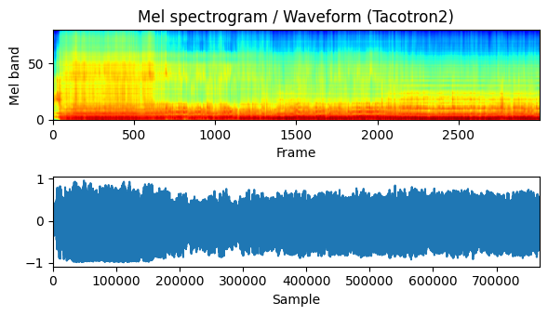
Results and Evaluation
Model Trained from Scratch (5 Epochs):
Generated sound had poor quality with noticeable noise.
Spectrogram showed low red color, indicating weak signal strength.
Waveform plot was dominated by blue, suggesting low energy or silence.

Slide 8
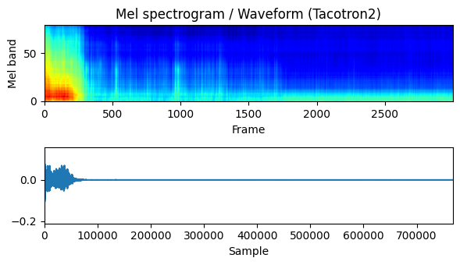
Results and Evaluation
Model Trained with Pretrained Weights (5 Epochs):
Produced poor-quality sound with low volume, followed by silence.
Spectrogram showed low red color in the first 100 frames, indicating low signal activity.
Waveform plot started with medium-height blue but later thinned out, suggesting a lack of sustained sound energy.

Slide 9

Challenges
Transcription Quality Issues (Phase 1):
Transcriptions from YouTube videos contained invalid characters, unsuitable for conversion to the Buckwalter format.
Repeated Words in Transcriptions (Phase 1):
Existing captions in VTT files, when converted to TXT format, had numerous repeated words requiring extensive preprocessing.
Memory Limitations with Batch Size:
Batch size of 32 caused memory exhaustion. Resolved by using a GPU with higher memory capacity.
Training Time:
Training a single epoch took 2 to 3 hours, making the process time-intensive and resource-demanding.

