Slide 1
Name: Abdelrhman Mohamed Abdelhady
Id: 2022513643

Slide 2


Slide 3


Slide 4



1957:Introduction of Perceptron
Frank Rosenblatt introduced the Perceptron,a type of artificial neural network.
1969:Limitations of Perceptron
Marvin Minsky and Seymour Papert showed the limitations of single-layer Perceptrons for complex problems.
1986:Multi-layer Perceptron
The development of the multi-layer Perceptron with backpropagation algorithm allowed training deep neural networks.

Slide 5
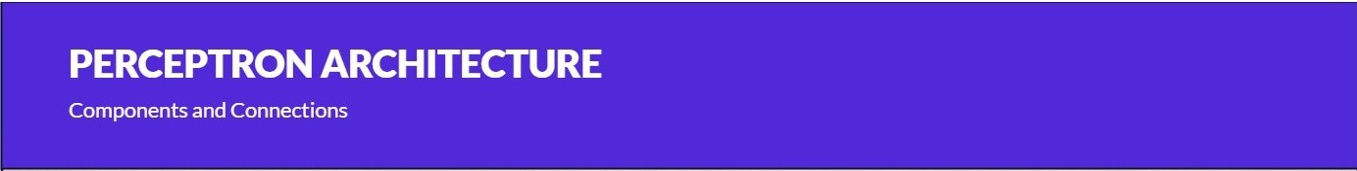


I
Inputs
Perceptron receives inputs from the external environment or other neurons.
Weights
Each input is associated with a weight that determines its importance in the
output calculation.
W
Bias
Bias is an additional input with a fixed weight that helps adjust the output.

Slide 6

WORKING PRINCIPLE
Processingand Output
Weighted Sum
The inputs are multiplied by their corresponding weights and summed up.
Activation Function
The weighted sum is passed through an activation function to produce the output.

Slide 7

ACTIVATION FUNCTIONS
Determining Neuron Output
Sigmoid Function
The output is a continuous va lue between 0 and 1,representing the probability of a certain class.
Step Function
The output is binary,either 0 or 1, based on a threshold.
ReLU Function
The output is 0 for negative inputs and the input value for positive inputs.

Slide 8
ADVANTAG E S AND LIMITATIONS
Pros and Cons

Slide 9
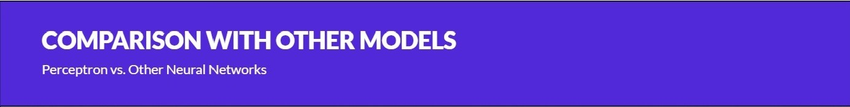

Single-Layer Perceptron
Perceptron is a single-layer neural network, 01
whereas other models like MLP have
multiple layers.
TrainingAlgorithm
Perceptron uses a simple learn ing rule, while other models have more advanced training algorithms.
02
Complexity
Other models can handle more complex problems compared to the limited capabilities of Perceptron.
03

Slide 10


Pattern Recognition
Perceptron can be used for image and speech
recognition tasks.
Classification
It is widely used for binary classification problems like spam detection and sentiment analysis.
Prediction
Perceptron can be trained to make predictions based on
historical data.

Slide 11
CNN

Slide 12

Introduction
CNN Definition: Convolutional Neural Networks are a specialized type of deep neural networks designed primarily for analyzing visual data, particularly images
Architecture Overview: CNNs comprise layers that perform operations like convolution, pooling, and fully connected layers for feature extraction, dimensionality reduction, and classification

Slide 13
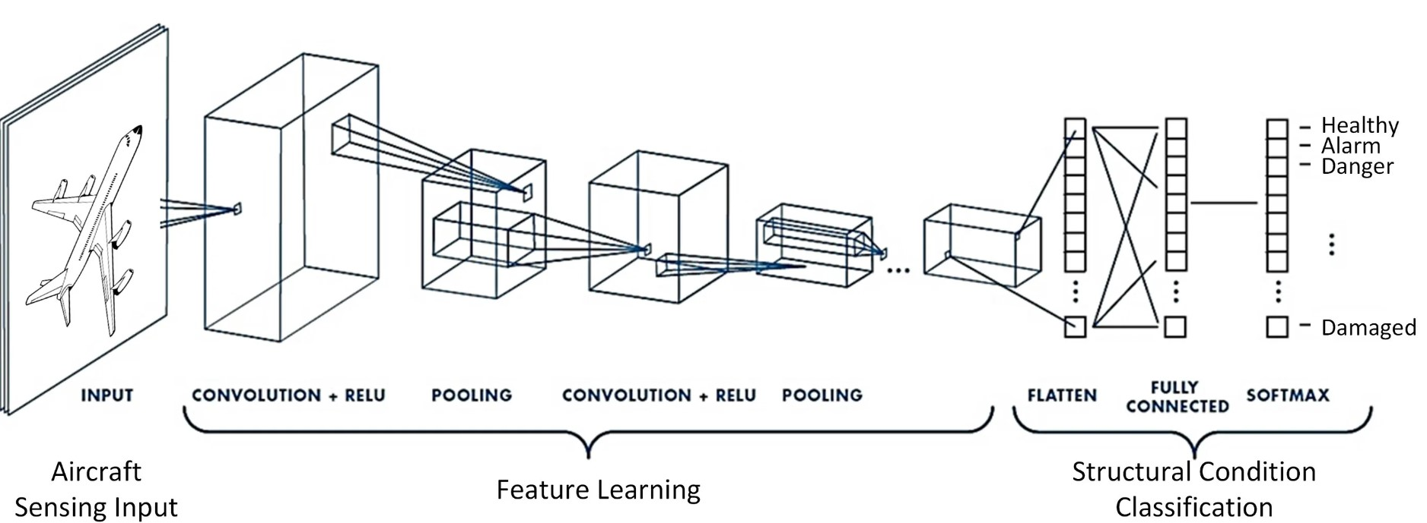
Key Components of CNNs
Convolutional Layers: These layers apply convolutional filters to extract features like edges, textures, or patterns from images
Pooling Layers: They perform downsampling, reducing the dimensions of extracted features while retaining critical information
Fully Connected Layers: The final layers that perform classification or regression based on the extracted features

Slide 14
Differences(CNN VS. Perceptron)
Depth: CNNs are deeper, allowing them to learn hierarchical representations and understand spatial relations in images.
Functionality: CNNs' ability to understand spatial features enables better image analysis compared to SLPs.

Slide 15
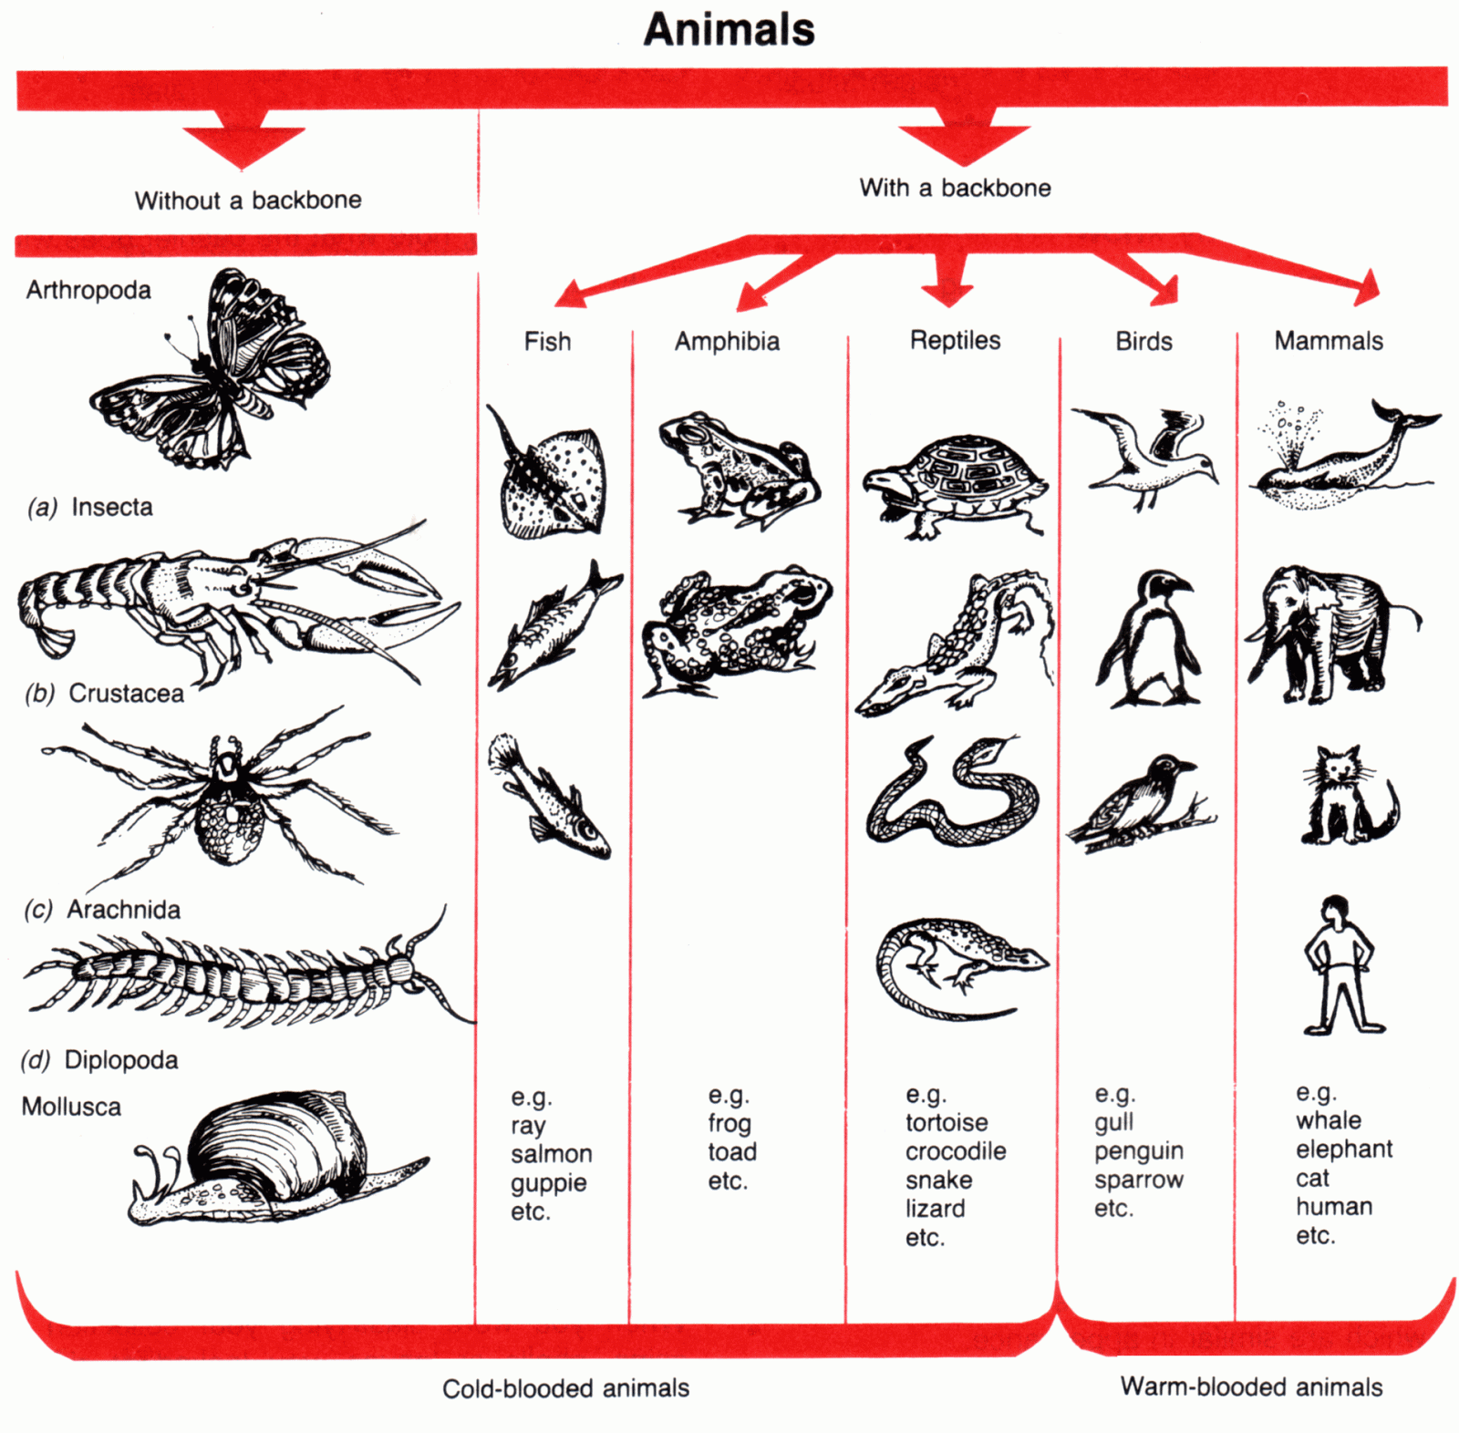
Applications of CNNs
Image Classification
Real-world Examples: Showcases where CNNs have been effectively applied, such as medical imaging , natural language processing , and autonomous vehicles

