Slide 1
Computer and its supply website

Slide 2
Idea of the project :
A company sells and fixes the computer and it’s supply in a shop and wants to improve their business by setting up a new website to be reached by more people.

Slide 3
System request
Project sponsor:
The stakeholders of the company.
Business needs:
The name of the company be popular.
Increase the rate of sales.
Take the biggest share of the market.
The company provide more people with computers.
The company name spread among youth.

Slide 4
Business requirements:
The website visited by more than 30,000 people in the month.
A database about the customers that buy from us.
Weekly reports about the most sold products and least ones.
Questionnaires for the visitors to know their opinions about our services.
The website should be secured and avoid failing.
The website should be provided with customer service.

Slide 5
Business value:
Ease the way of selling the products.
The website will increase our sales rate.
Take a share from the online shopping in this field.
Raise our reputation in fixing the computer and its supply.
Special issue:
Deadline on 10th of December.
System can be visited by more than 10,000 people in the same time.

Slide 6
Feasibility study
Technical feasibility:
The company has good computers can run the website fast.
There are skilled people that can control the website.
They don’t have a good network service.
Economic feasibility:
The website will cost 50,000 L.E to be implemented.
It will cost 1,000 L.E yearly wages as a regular maintenance.
The system will be visited by approximately 50,000 user per month.

Slide 7
Operational feasibility:
The website pages will be loaded in 0.01 sec for good networks.
It will have a good design for youth people.
The prices and installment conditions will be obvious.
Schedule feasibility:
The system will be ready in 2 months and 10 days.
There will be a trial for 1st version in 15 days.

Slide 8
Methodology
We will use agile development as we want a continuous communication with the stakeholders about our versions.

Slide 9
Time estimation
The percentage of phases time is:
Planning → 30%
Analysis → 20%
Design → 20%
Implementation → 30%

Slide 10
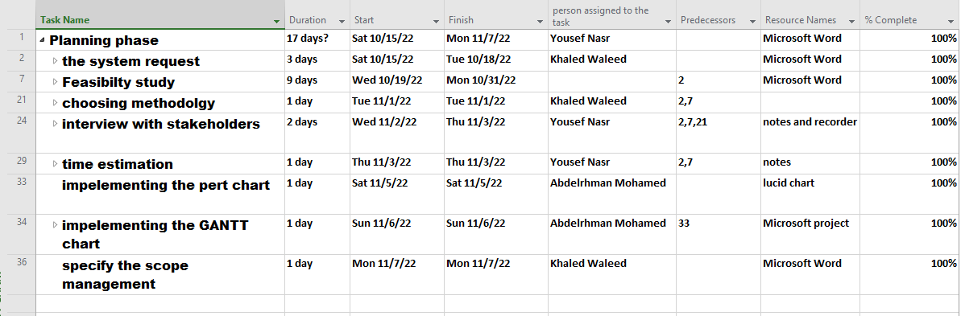
Task identification

Slide 11
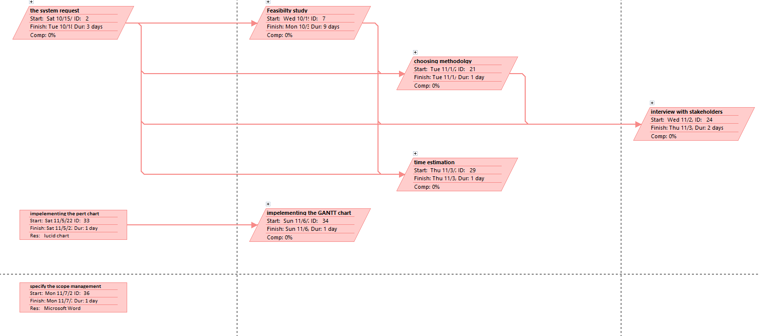
Pert chart

Slide 12
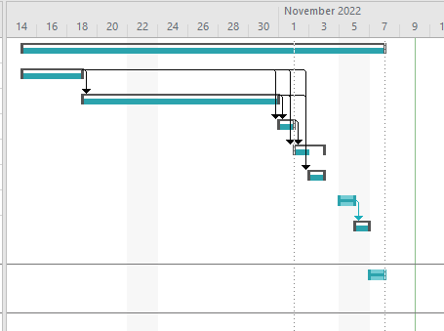
GANTT CHART

Slide 13
Scope management
Yousef Nasr
Junior Analyst
Khaled Waleed
Junior Designer
Junior Analyst
Abd-Elrhman Mohamed
Junior Designer
Junior Developer
Senior developer
Junior Developer

Slide 14
Names
Yousef Moamen Nasr
20201080834
Khaled Waleed Ibrahim
20201495194
Abd-Elrhman Mohamed Abd-Elhady
2022513643

