Slide 1
2nd presentation of the project

Slide 2
Idea of the project
A company sells and fixes the computer and it’s supply in a shop and wants to improve their business by setting up a new website to be reached by more people.

Slide 3
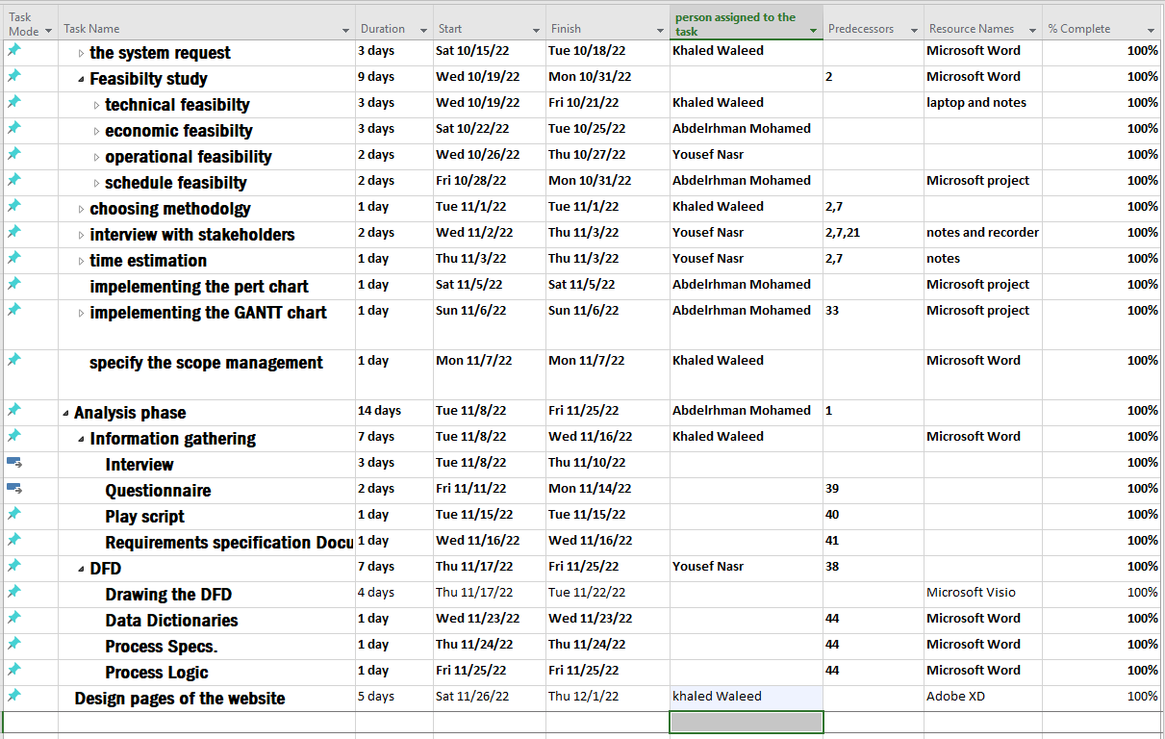
Task identification (Updated)

Slide 4
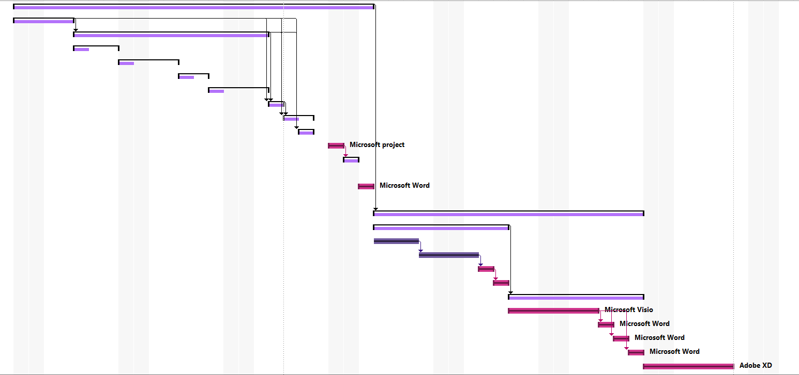
Gantt chart (updated)

Slide 5
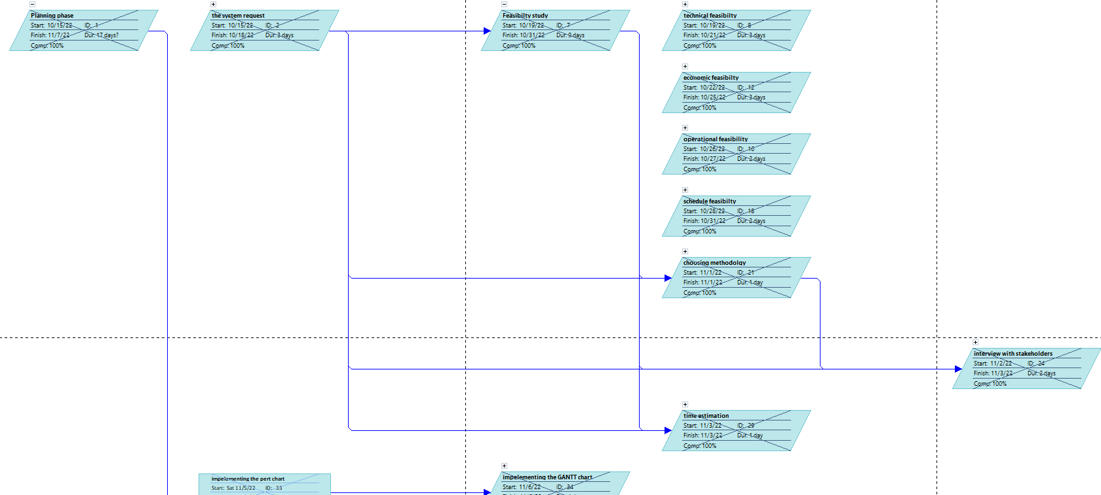
Pert Diagram (updated)

Slide 6
Interview Questions
We have used funnel structure in our interview as we wanted the client to feel emotionally towards his company ?
We asked him questions like :
Why do you want to build the system ?
Why do you see that the competitors are better than you ?
Why do you prefer to implement a website not a app?
Do you have skilled people that will control the system

Slide 7
Interview Report
we deduced from our interview that :
our client wants The name of the company be popular.
Increase the rate of sales.
The company provide more people with computers.
The company name spread among youth.

Slide 8
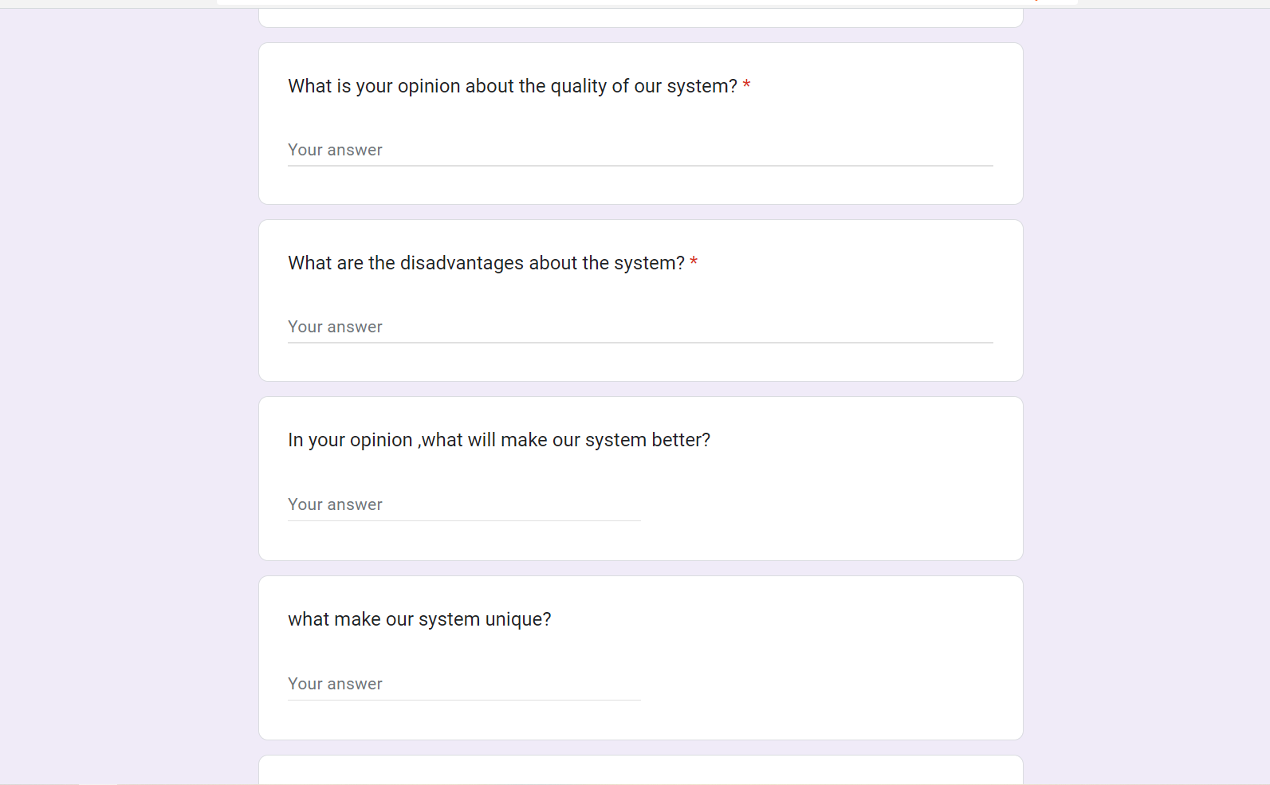
Questionnaire (google Form)
Our questionnaire will concentrate on the opinions of the customers about the website:

Slide 9
Play script
After we sit with the stakeholders, we deduced that we will have 5 main actors, we will discuss them:
Fixers:
They check the damaged computers and know what is the damage.
They know if the problem about software or hardware.
Sales representatives:
They marketing for the new accessories in the computer.
They convince people to buy parts that will increase the speed and performance of their computers.
Managers:
They supervise all the employees in the company.
They receive reports from all the departments.

Slide 10
Play script
Sellers:
They are responsible for the selling operation.
They present monthly reports about the sales.
Consultants:
They present creative ideas to increase popularity of the company periodically.
They use their experience to discuss the plans of the company.

Slide 11
Requirements Specs
Purpose
Have a website for selling laptops and computer peripherals
1.Project Scope
Increase sales by reaching a large number of users
2.Overall Description
2.1 Product Perspective
It is a new website for company sells laptops and computer peripherals
2.2 Product Functions
we need function to sign up for new users and sign in for current users
we need function for search for products
2.3 User Classes and Characteristics
Administrators :Administrators are people who add products
End Users :Customers who visits website and orders products
2.4 Operating Environment
The software will work in Computers and mobiles , so we need a server Online

Slide 12
Requirements specs
2.5 Design and Implementation Constrains
Website should be design by using HTML ,CSS, JS
3.External Interface Requirements
3.1 User Interfaces
We need a friendly interface and use buttons to make website ease for use and quick
3.2 Hardware Interfaces
Processor: Dual core
Ram :2GB
3.3 Software Interfaces
Operating System: Windows , Mac , Linux
Database: MySQL
3.4 Communication Interface
The website should sent an email confirmation and mobile SMS after order confirmation
4. System Features
we can use website from mobile
website have search function

Slide 13
Requirements specs
5.Function requirements and non-function requirement
5.1 Function Requirements
The Products for sale must be listed on the system
The system ought to generate a list of all laptops sold each day.
The Product information should be added to the system (price, no. of cores, laptop type)
The website must have a variety of payment methods
The system shouldn't put any users in conflict with one another
The user's review and feedback could be added by the system
The system would like to know how many visitors came each day

Slide 14
Requirements specs
5.2 Non-Function Requirements
Efficiency
Any page of Website should not take more than 6 seconds.
The Website should be able to support 100 concurrent users without any performance degradation.
Usability
The user interface of the system should be very friendly.
It should not take more than 120 seconds for a new user to register for an account
Reliability
In case of failure that leads to a system outrange, the matter should not take more than 2 hours.
Security
Each person that goes to the system’s website will be required to register if they want to do more than just read.
Organization Rule
The system must follow the company policy of sale

Slide 15
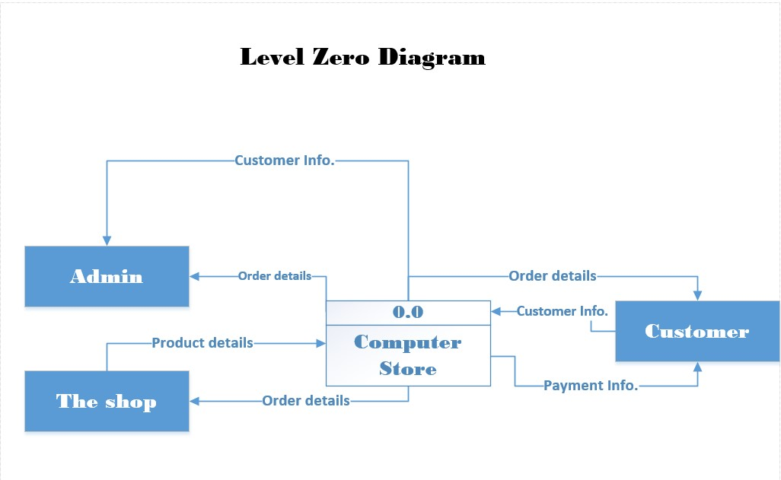
DFD diagram

Slide 16
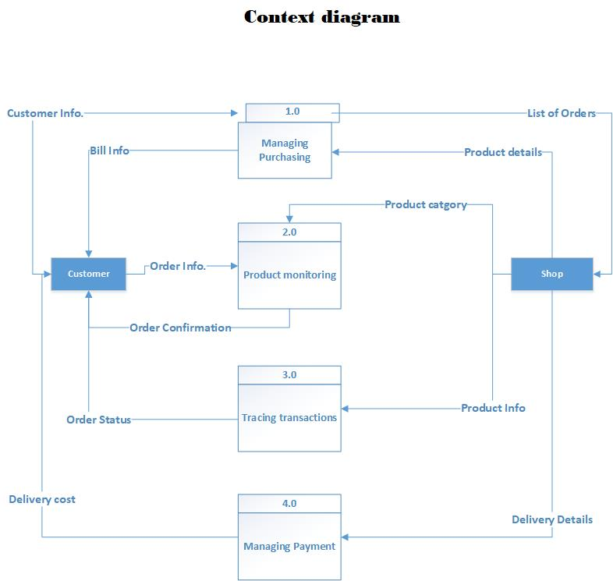
DFD diagram

Slide 17
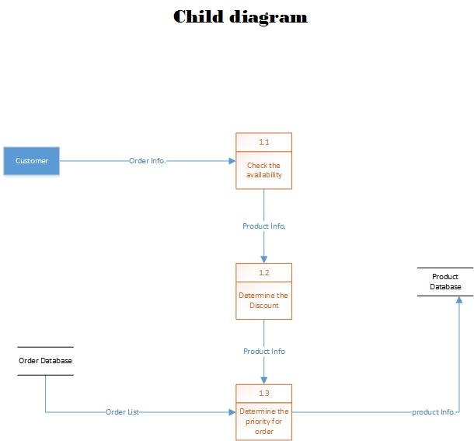
DFD diagram

Slide 18
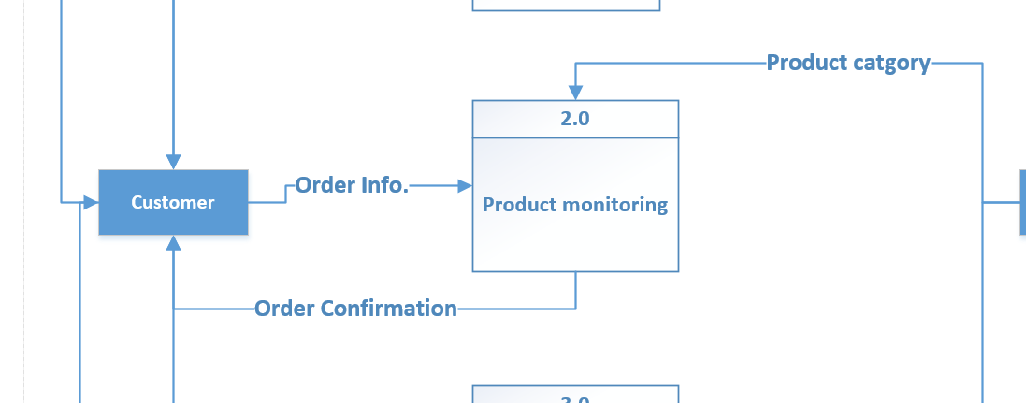
Data dictionaries
Description Form
Id: 1
Name: Order Info.
Description: It contains all the data about the order from price, the number of the products, and the type of the order.
Data Structure
Order Info = price + No. of products + place of the order + (cash)
Data Element
Name: price
Alias: product price
Type: Number

Slide 19
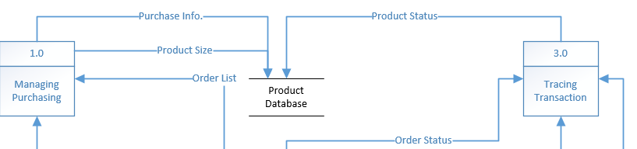
Data dictionaries
Description Form:
Id: D1
Name: Product Database
Alias: The database of products.
Description: It contains information about all the products of the shop.
File type: Computer
File format: Database
Record size (Characters): 500
Number of records: 3000
Dataset name: Products
Data structure: product data
Primary key: product ID
Comments: The database updated automatically by selling the products.

Slide 20
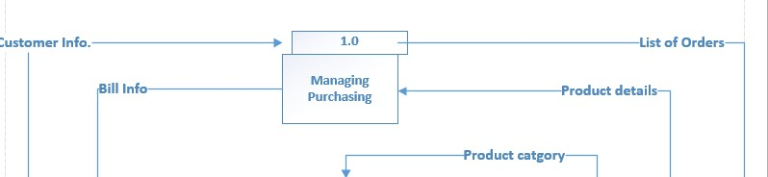
Process Specs form
Process Specification Form
Number: 1.0
Name: Managing Purchasing
Description: Collect Order details and Customer Information and Send Order status bills to customer
Input Data Flow: (1) Customer Information from external Entity Customer (2) Order Details from external entity Shop
Output Data Flow: Order statuses Bill information
Type of Process: online
Unresolved Issues: no
Process Logic:
BEGIN IF
IF We have Customer Information:
First Name and Last Name and Customer ID and Location
And
We have Order details
Then
Send Order status Bill Information
END IF

Slide 21
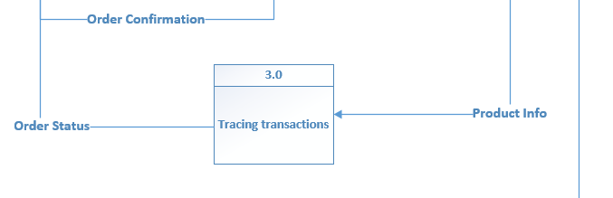
Process Specs form
Process Specification Form
Number: 3.0
Name: Tracking transactions
Description: Collect Product information from external entity shop and send order status to customer
Input Data Flow: Product information from External Entity Shop
Output Data Flow: Order Statue
Type of Process: Online
Unresolved Issues: no
Process Logic:
BEGIN IF
IF We have Product Information:
Description of Product and Available amount
Then
Order statuses
END IF

Slide 22

Web pages with adobe XD

Slide 23
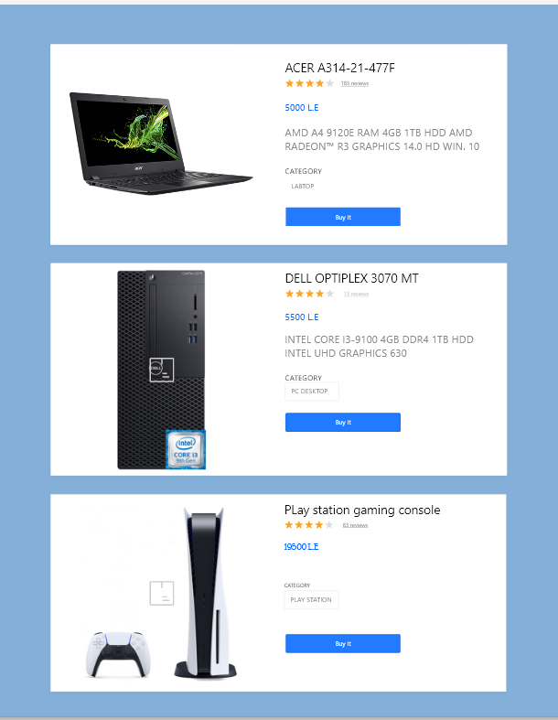
Web pages with adobe XD

Slide 24
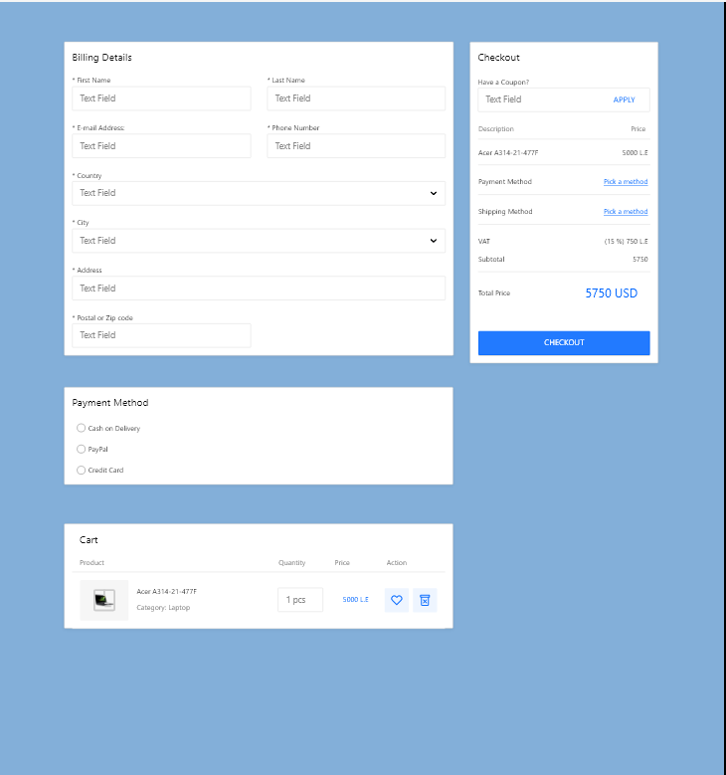
Web pages with adobe XD

Slide 25
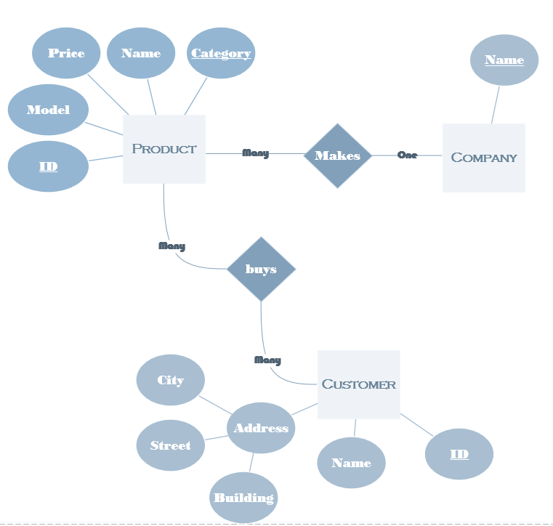
ER diagram

Slide 26
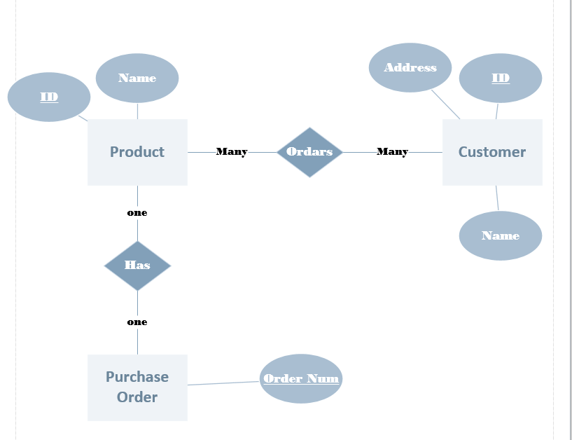
ER diagram

Slide 27
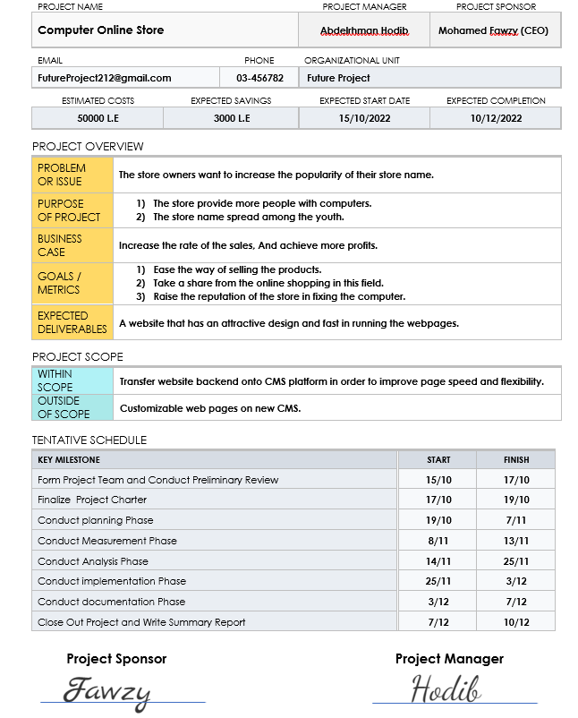
Project Charter

Slide 28
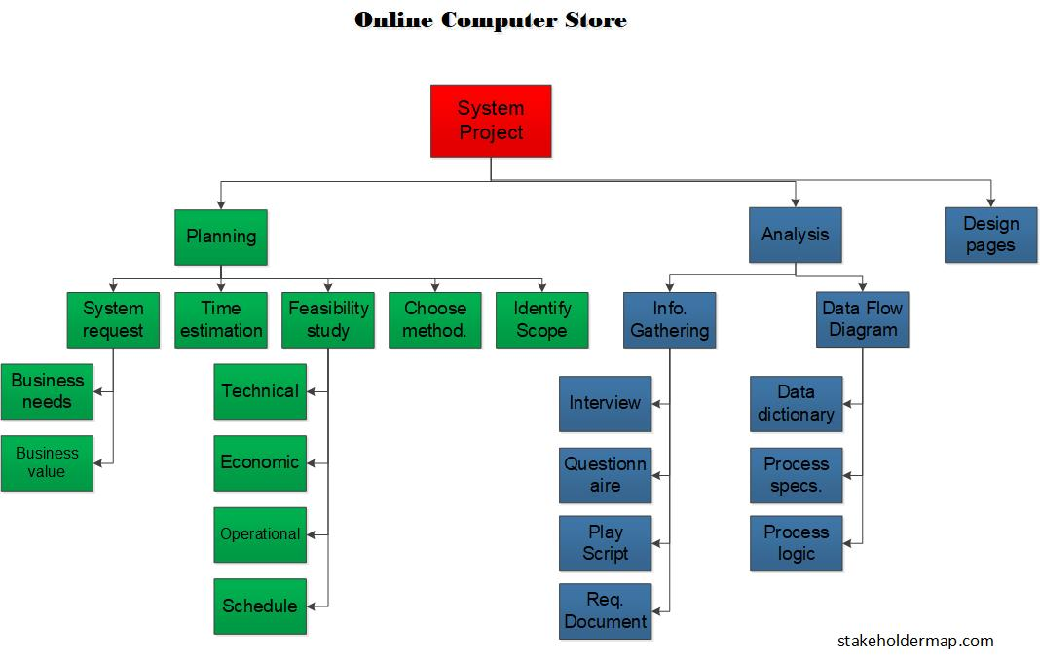
Work break down Structure

Slide 29
Thanks

