Slide 1


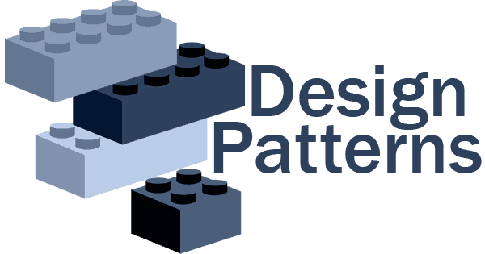

Slides for…
Eng / Ryhab Farouq

Slide 2



OOP Concepts
SOLID Principles
Prerequisites

Slide 3


WHAT IS Object Oriented Programming?
OOP
Is a programming paradigm that relies on the concept of classes and objects, It is used to structure a software program into simple, reusable pieces of code blueprints (usually called classes), which are used to create individual instances of objects.

Slide 4

Inheritance (is-a)
Refers to the capability of creating a new class from an existing class. It is a relationship between classes where one class is a parent (super or base) of another (Child, subclass, derived).
Inheritance Hierarchy
The relationship between super classes and subclasses.
Multi-Level Inheritance
In Multilevel Inheritance a derived class can also inherited by another class.

Slide 5
✘ Virtual Function
A virtual function is a member function that you expect to be redefined in derived classes.
✘ Abstract Method (Pure Virtual Function)
An abstract method is a method that is declared, but contains no implementation, without body, It is needed to be overridden by the subclasses .

Slide 6
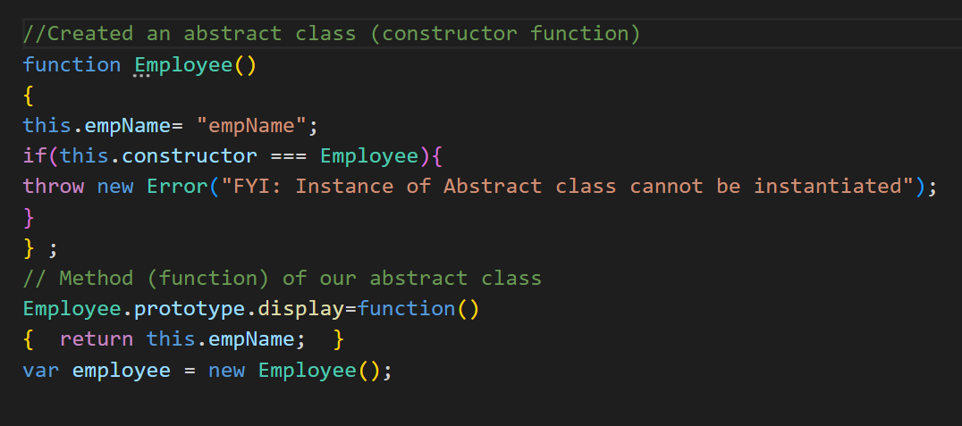
✘ Abstract Class
Abstract classes are distinguished by the fact that you may not directly construct objects from them, An abstract class may have one or more abstract methods, Abstract classes may not be instantiated.
✘ Concrete Class
Any class can be initiating objects directly from it, it is not abstract class.

Slide 7
✘ Interface
capable of describing the wide range of shapes that JavaScript objects can take.

Slide 8


Slide 9
SOLID Principles
The SOLID design principles help us create maintainable, reusable, and flexible software designs.
Each letter in the acronym SOLID stands for a specific principle.
Single responsibility principle
Open–closed principle
Liskov substitution principle
Interface segregation principle
Dependency inversion principle

Slide 10
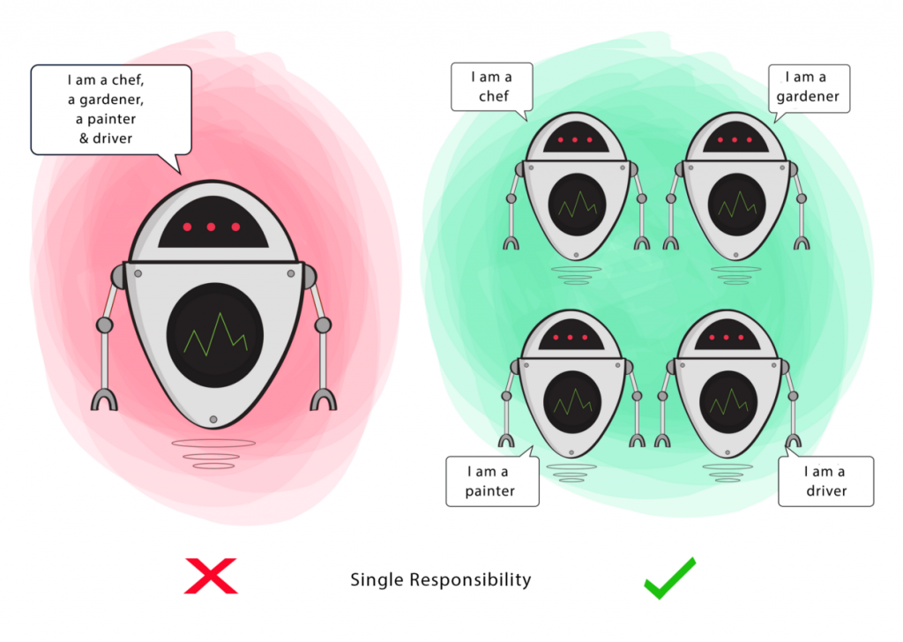
Single Responsibility Principle
“Do one thing and do it well”
A class should have only one reason to change , meaning that a class should have only one job .

Slide 11
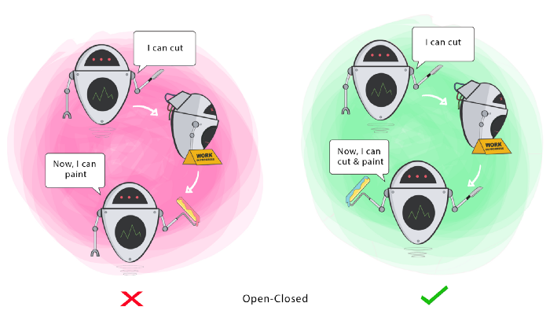
Open/Closed Principle
“Software entities classes , modules , functions should be opened for extension , but closed for modification”
Any new functionality should be done by adding new classes instead of changing existing one .

Slide 12
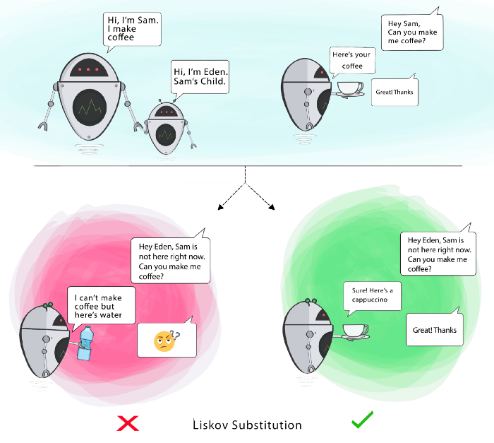
Liskov Substitution Principle
“If you have class B inherits from class A then class A should be replaced by class B without any changes ”

Slide 13
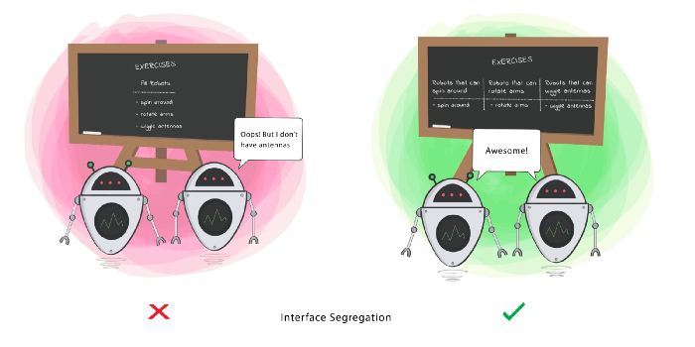
Interface Segregation Principle
“Clients should not be forced to depend on methods they don’t use”
Avoid fat interface

Slide 14
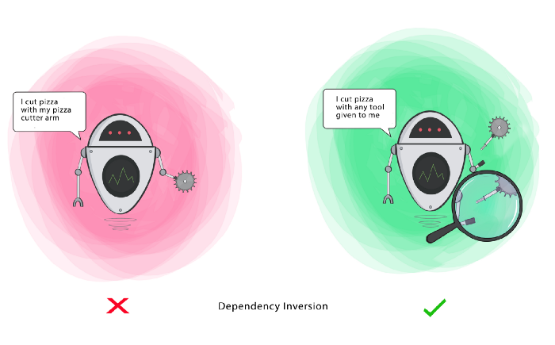
Dependency Inversion Principle
“High level module should not depend upon low level modules , both should depend upon abstractions ”

Slide 15
Design Patterns
DP
✘ Design Pattern is not code. It is in fact an approach or
a model that can be used to solve a problem.
✘ Design Patterns are about design and interaction of
objects and they provide reusable solutions for solving common design problems.
✘ Design pattern consists of various co-operating objects (classes, relationships, etc).

Slide 16
Design Pattern Categories
Object Creation Mechanisms
Creational
Relationships Between Entities
Communication Patterns
Behavioral
Structural

Slide 17

Design Pattern Categories
Creational Design Patterns
Structural Design Patterns
Behavioral Design Patterns
Adapter
Strategy
Singleton
Bridge
State
Prototype
Composite
Template Method
Builder
Decorator
Visitor
Factory Method
Facade
Observer
Abstract Factory
Flyweight
Memento
Proxy
Mediator
Iterator
Interpreter
Command
Chain of Resp.

Slide 18

Creational Design Patterns
Singleton
Singletons are useful in situations where system-wide actions need to be coordinated from a single central place.
Prototype
Builder
Factory Method
Abstract Factory

Slide 19
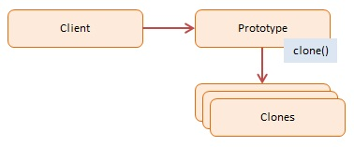
Creational Design Patterns
Singleton
The Prototype Pattern creates new objects, but rather than creating non-initialized objects it returns objects that are initialized with values it copied from a prototype ,The Prototype pattern is also referred to as the Properties pattern.
Prototype
Builder
Factory Method
Abstract Factory

Slide 20
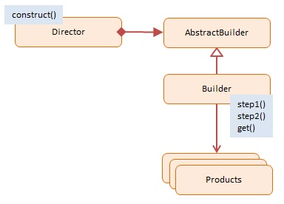
Creational Design Patterns
Singleton
The Builder pattern allows a client to construct a complex object by specifying the type and content only, Construction details are hidden from the client entirely.
Prototype
Builder
Factory Method
Abstract Factory

Slide 21
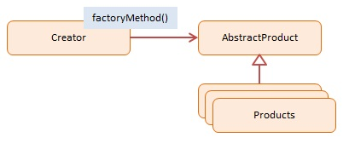
Creational Design Patterns
Singleton
A Factory Method creates new objects as instructed by the client. One way to create objects in JavaScript is by invoking a constructor function with the new operator. There are situations however, where the client does not, or should not, know which one of several candidate objects to instantiate. The Factory Method allows the client to delegate object creation while still retaining control over which type to instantiate.
Prototype
Builder
Factory Method
Abstract Factory

Slide 22
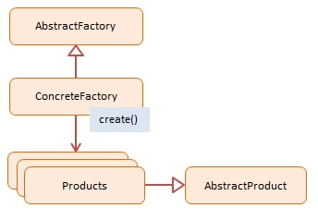
Creational Design Patterns
Singleton
An Abstract Factory creates objects that are related by a common theme. In object-oriented programming a Factory is an object that creates other objects. An Abstract Factory has abstracted out a theme which is shared by the newly created objects.
Prototype
Builder
Factory Method
Abstract Factory

Slide 23

Structural Design Patterns
Proxy
The Proxy pattern provides a surrogate or placeholder object for another object and controls access to this other object.
Decorator
Facade
Adapter
Flyweight
Composite
Bridge

Slide 24
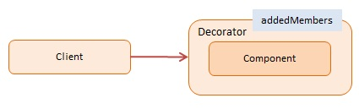
Structural Design Patterns
Proxy
Decorators provide flexibility to statically typed languages by allowing runtime changes as opposed to inheritance which takes place at compile time. JavaScript, however, is a dynamic language and the ability to extend an object at runtime is baked into the language itself.
Decorator
Facade
Adapter
Flyweight
Composite
Bridge

Slide 25
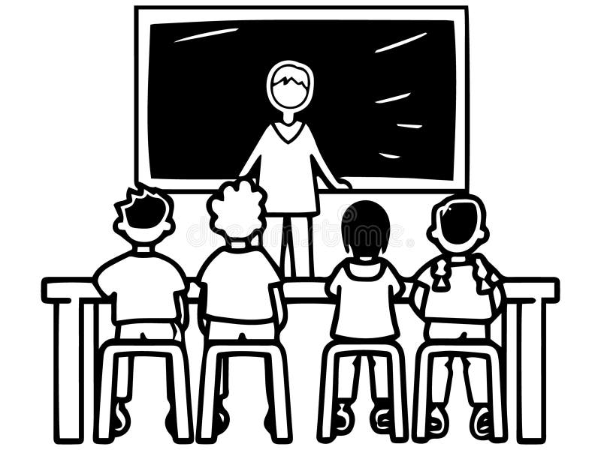



Tasks
1-Create different student types using a Factory. This way, the main code doesn't need to know the details about how to create each type of your students.
2- Using Singleton Design Pattern ,
let's create a counter that will track the number of active instances.
3- Create new Document from existing Document by cloning them ,
each document should have header , footer , pages and text.
4- Create a PizzaBuilder , The definition of pizza is hidden from the customers .

