Slide 1


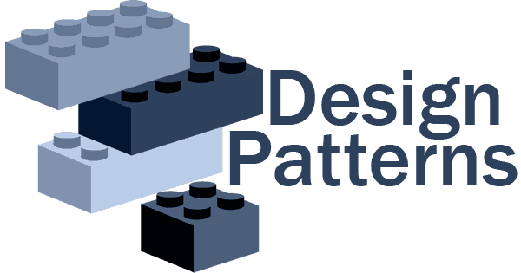

Slides for…
Eng / Ryhab Farouq

Slide 2



OOP Concepts
SOLID Principles
Prerequisites

Slide 3


WHAT IS Object Oriented Programming?
OOP
Is a programming paradigm that relies on the concept of classes and objects, It is used to structure a software program into simple, reusable pieces of code blueprints (usually called classes), which are used to create individual instances of objects.

Slide 4

Inheritance (is-a)
Refers to the capability of creating a new class from an existing class. It is a relationship between classes where one class is a parent (super or base) of another (Child, subclass, derived).
Inheritance Hierarchy
The relationship between super classes and subclasses.
Multi-Level Inheritance
In Multilevel Inheritance a derived class can also inherited by another class.

Slide 5
✘ Virtual Function
A virtual function is a member function that you expect to be redefined in derived classes.
✘ Abstract Method (Pure Virtual Function)
An abstract method is a method that is declared, but contains no implementation, without body, It is needed to be overridden by the subclasses .

Slide 6
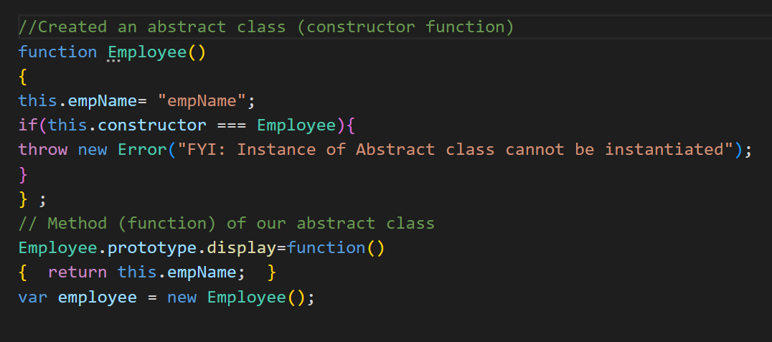
✘ Abstract Class
Abstract classes are distinguished by the fact that you may not directly construct objects from them, An abstract class may have one or more abstract methods, Abstract classes may not be instantiated.
✘ Concrete Class
Any class can be initiating objects directly from it, it is not abstract class.

Slide 7
✘ Interface
capable of describing the wide range of shapes that JavaScript objects can take.

Slide 8


Slide 9
SOLID Principles
The SOLID design principles help us create maintainable, reusable, and flexible software designs.
Each letter in the acronym SOLID stands for a specific principle.
Single responsibility principle
Open–closed principle
Liskov substitution principle
Interface segregation principle
Dependency inversion principle

Slide 10
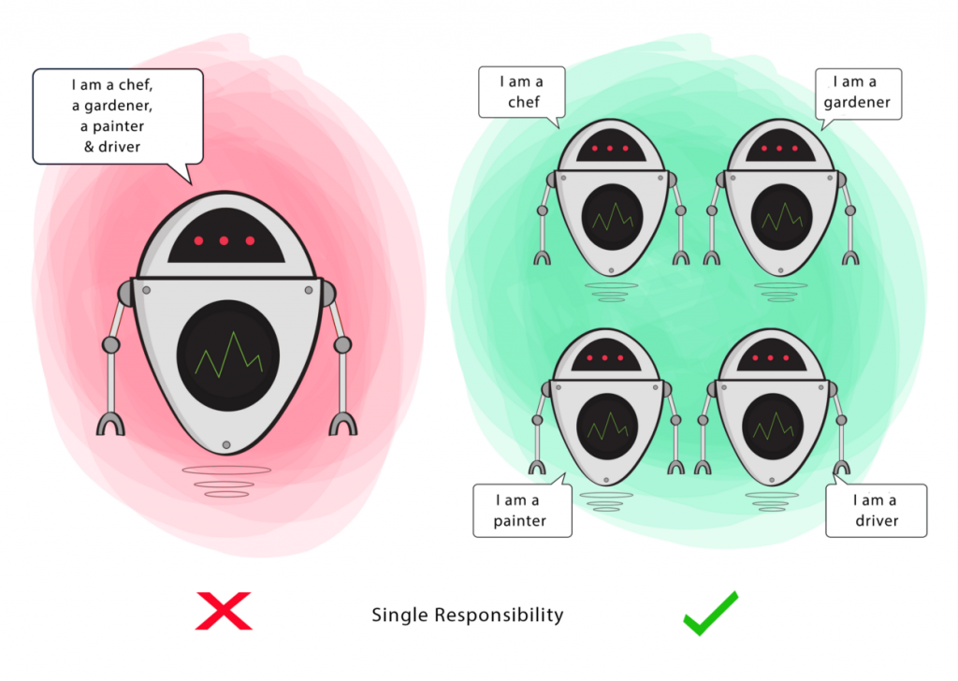
Single Responsibility Principle
“Do one thing and do it well”
A class should have only one reason to change , meaning that a class should have only one job .

Slide 11
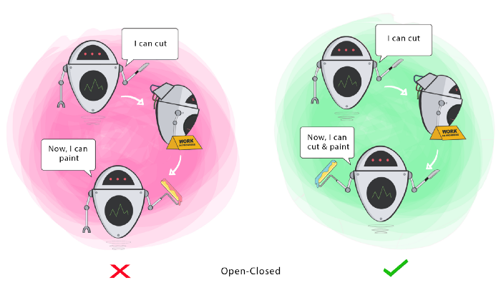
Open/Closed Principle
“Software entities classes , modules , functions should be opened for extension , but closed for modification”
Any new functionality should be done by adding new classes instead of changing existing one .

Slide 12
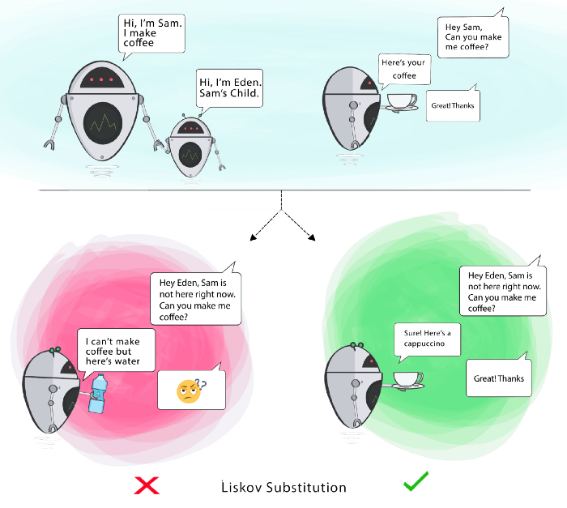
Liskov Substitution Principle
“If you have class B inherits from class A then class A should be replaced by class B without any changes ”

Slide 13
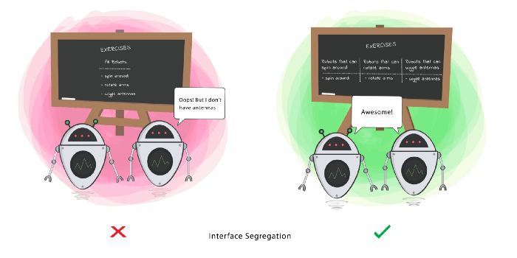
Interface Segregation Principle
“Clients should not be forced to depend on methods they don’t use”
Avoid fat interface

Slide 14
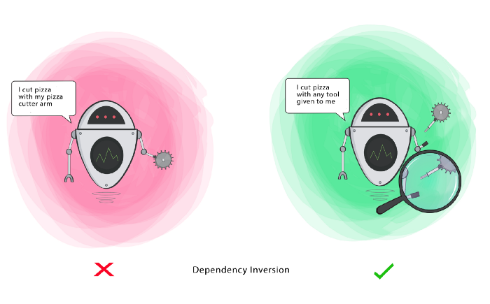
Dependency Inversion Principle
“High level module should not depend upon low level modules , both should depend upon abstractions ”

Slide 15
Design Patterns
DP
✘ Design Pattern is not code. It is in fact an approach or
a model that can be used to solve a problem.
✘ Design Patterns are about design and interaction of
objects and they provide reusable solutions for solving common design problems.
✘ Design pattern consists of various co-operating objects (classes, relationships, etc).

Slide 16
Design Pattern Categories
Object Creation Mechanisms
Creational
Relationships Between Entities
Communication Patterns
Behavioral
Structural

Slide 17

Design Pattern Categories
Creational Design Patterns
Structural Design Patterns
Behavioral Design Patterns
Adapter
Strategy
Singleton
Bridge
State
Prototype
Composite
Template Method
Builder
Decorator
Visitor
Factory Method
Facade
Observer
Abstract Factory
Flyweight
Memento
Proxy
Mediator
Iterator
Interpreter
Command
Chain of Resp.

Slide 18

Structural Design Patterns
Proxy
The Proxy pattern provides a surrogate or placeholder object for another object and controls access to this other object.
Decorator
Facade
Adapter
Flyweight
Composite
Bridge

Slide 19
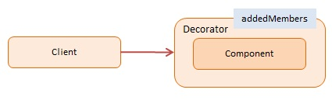
Structural Design Patterns
Proxy
Decorators provide flexibility to statically typed languages by allowing runtime changes as opposed to inheritance which takes place at compile time. JavaScript, however, is a dynamic language and the ability to extend an object at runtime is baked into the language itself.
Decorator
Facade
Adapter
Flyweight
Composite
Bridge

Slide 20
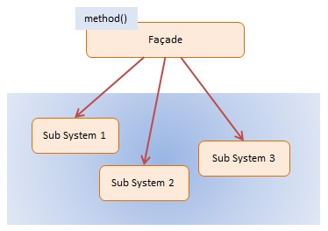
Structural Design Patterns
Proxy
The Façade pattern provides an interface which shields clients from complex functionality in one or more subsystems. It is a simple pattern that may seem trivial but it is powerful and extremely useful. It is often present in systems that are built around a multi-layer architecture.
Decorator
Facade
Adapter
Flyweight
Composite
Bridge

Slide 21

Structural Design Patterns
Proxy
The Adapter pattern translates one interface (an object‘s properties and methods) to another. Adapters allows programming components to work together that otherwise wouldn’t because of mismatched interfaces. The Adapter pattern is also referred to as the Wrapper Pattern.
Decorator
Facade
Adapter
Flyweight
Composite
Bridge

Slide 22
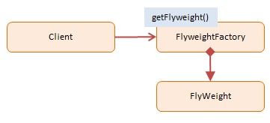
Structural Design Patterns
Proxy
The Flyweight pattern conserves memory by sharing large numbers of fine-grained objects efficiently. Shared flyweight objects are immutable, that is, they cannot be changed as they represent the characteristics that are shared with other objects.
Decorator
Facade
Adapter
Flyweight
Composite
Bridge

Slide 23
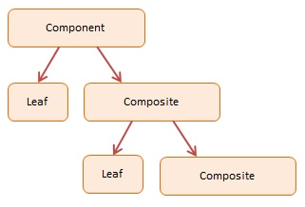
Structural Design Patterns
Proxy
The Composite pattern allows the creation of objects with properties that are primitive items or a collection of objects. Each item in the collection can hold other collections themselves, creating deeply nested structures.
Decorator
Facade
Adapter
Flyweight
Composite
Bridge

Slide 24
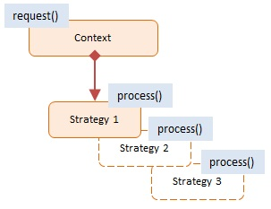
Behavioral Design Patterns
Strategy
The Strategy pattern encapsulates alternative algorithms (or strategies) for a particular task,It allows a method to be swapped out at runtime by any other method (strategy) without the client realizing it, Essentially Strategy is a group of algorithms that are interchangeable.
Strategy
State
State
Template Method
Template Method
Chain of Resp.
Visitor
Observer
Visitor
Memento
Observer
Mediator
Memento
Iterator
Mediator
Interpreter
Iterator
Command
Interpreter
Chain of Resp.
Command

Slide 25
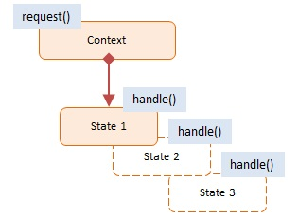
Behavioral Design Patterns
Strategy
The State pattern provides state-specific logic to a limited set of objects in which each object represents a particular state, This is best explained with an example.
State
Template Method
Visitor
Chain of Resp.
Observer
Observer
Visitor
Memento
Visitor
Observer
Mediator
Memento
Memento
Iterator
Mediator
Mediator
Interpreter
Iterator
Iterator
Command
Interpreter
Interpreter
Chain of Resp.
Command
Command

Slide 26
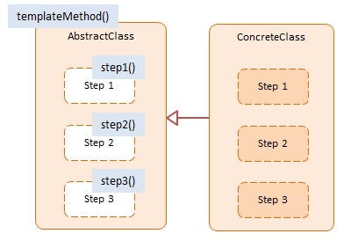
Behavioral Design Patterns
Strategy
The Template Method pattern provides an outline of a series of steps for an algorithm, Objects that implement these steps retain the original structure of the algorithm but have the option to redefine or adjust certain steps, This pattern is designed to offer extensibility to the client developer.
State
Template Method
Chain of Resp.
Observer
Visitor
Visitor
Observer
Memento
Memento
Mediator
Mediator
Iterator
Iterator
Interpreter
Interpreter
Command
Command

Slide 27
Tasks
1- create decorator pattern to make teacher add dynamic property salary ,Nationality , street
2- create proxy design pattern to get countries if cached or not
3- create bridge design pattern where TV and speaker share the same interface of [ increase_volume , decrease_volume and mute ] , two bridge functions supports increase and decrease but one of them support mute also
4- create composite design pattern where box of books which have a number of pages and show the hierarchy
5- Let's say you're trying to build an online store. It will have multiple components and
complex business logic. you will find a tiny segment of an online
store composed together using the Facade design pattern. The various manager and helper
classes are defined first of all.

Slide 28

Tasks
6- Create a ToDo List , and specify a behavior for each State
[STATE_IN_PROGRESS , STATE_READY_FOR_REVIEW , STATE_DONE] .

