Slide 1




Page Classifier
Algorithms
Mechanism
Problems
Introduction

Slide 2
Algorithms
Mechanism
Problems
Introduction

Slide 3
What is Web Crawling?
Web crawler is a program that acts as an automated script which browses through the internet in a systematic way. The web crawler looks at the keywords in the pages, the kind of content each page has and the links, before returning the information to the search engine. This process is known as Web crawling. The page you need is indexed by a software known as web crawler.
Algorithms
Mechanism
Problems
Introduction

Slide 4
What is Web Crawling?
Web crawler is a program that acts as an automated script which browses through the internet in a systematic way. The web crawler looks at the keywords in the pages, the kind of content each page has and the links, before returning the information to the search engine. This process is known as Web crawling. The page you need is indexed by a software known as web crawler.
These web crawlers go by different names, like bots, automatic indexers and robots. Once you type a search query, these crawlers scan all the relevant pages that contain these words and turn it into a huge index.
Algorithms
Mechanism
Problems
Introduction

Slide 5
What is Web Crawling?
Web crawler is a program that acts as an automated script which browses through the internet in a systematic way. The web crawler looks at the keywords in the pages, the kind of content each page has and the links, before returning the information to the search engine. This process is known as Web crawling. The page you need is indexed by a software known as web crawler.
These web crawlers go by different names, like bots, automatic indexers and robots. Once you type a search query, these crawlers scan all the relevant pages that contain these words and turn it into a huge index.
he indexing is done by sorting the pages and looking at the quality of the content and other factors. Google then generates algorithms to get a better view of what you are searching for, and provides a number of features that make your search more effective.
Algorithms
Mechanism
Problems
Introduction

Slide 6
What is Web Crawling?
Web crawler is a program that acts as an automated script which browses through the internet in a systematic way. The web crawler looks at the keywords in the pages, the kind of content each page has and the links, before returning the information to the search engine. This process is known as Web crawling. The page you need is indexed by a software known as web crawler.
These web crawlers go by different names, like bots, automatic indexers and robots. Once you type a search query, these crawlers scan all the relevant pages that contain these words and turn it into a huge index.
he indexing is done by sorting the pages and looking at the quality of the content and other factors. Google then generates algorithms to get a better view of what you are searching for, and provides a number of features that make your search more effective.
One of these factors is common and frequent words.
Algorithms
Mechanism
Problems
Introduction

Slide 7
Algorithms
Mechanism
Problems
Introduction

Slide 8
1
Getting Data
2
Removing Common Words
Algorithms
Mechanism
Problems
Introduction
3
Counting Frequent Words
4
Applying Algorithms To Page

Slide 9
Algorithms
Mechanism
Problems
Introduction

Slide 10
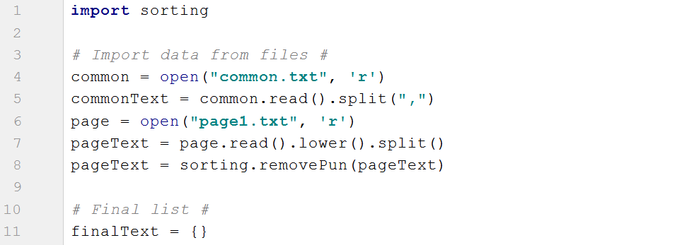
1
Getting Data
Algorithms
Mechanism
Problems
Introduction

Slide 11
1
Getting Data
Algorithms
Mechanism
Problems
Introduction
2
Removing Common Words

Slide 12
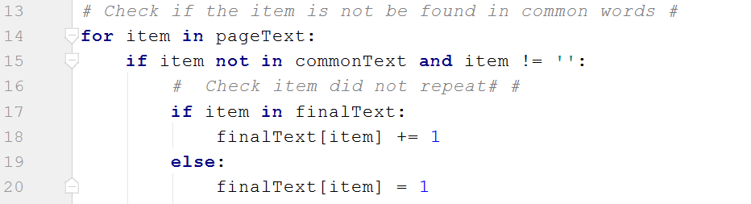
3
Counting Frequent Words
Algorithms
Mechanism
Problems
Introduction

Slide 13
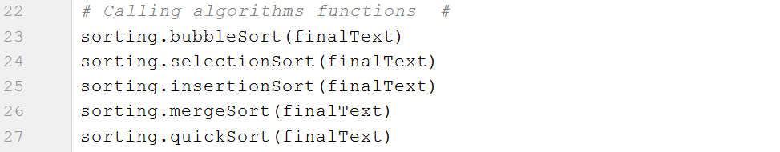
3
Counting Frequent Words
Algorithms
Mechanism
Problems
Introduction
4
Applying Algorithms To Page

Slide 14
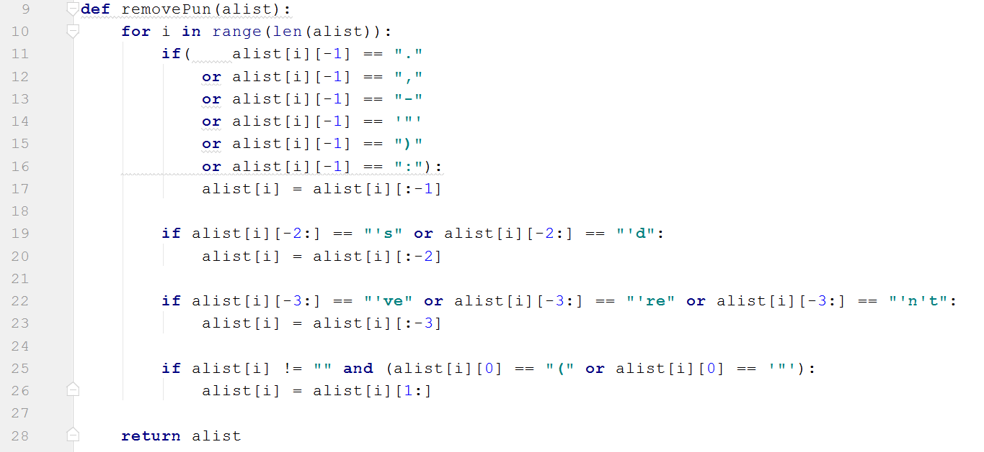
#
Removing Punctuations
Algorithms
Mechanism
Problems
Introduction

Slide 15
Algorithms
Mechanism
Problems
Introduction

Slide 16
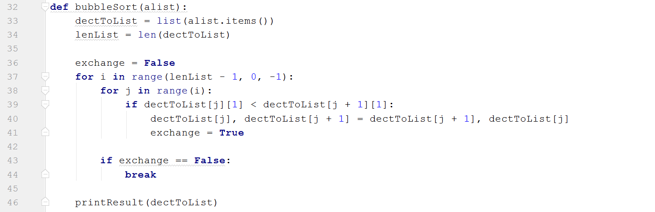
Bubble Sort
Mechanism
Problems
Algorithms
Introduction

Slide 17
Bubble Sort
Algorithms
Mechanism
Problems
Introduction
# alist.items()
Convert dictionary to list of tuples.
Example: if we have a dictionary
A = {“apple”: 2, “panana”: 7, “orange”: 14}
B = A.items()
Now B = { (“apple”, 2), (“panana”, 7), (“orange”, 14) }
Access to key -> print(B[1][0])
Output: panana
Access to value -> print (B[1][1])
Output: 7

Slide 18
Bubble Sort
Algorithms
Mechanism
Problems
Introduction
# dectToList[j], dectToList[j + 1] = dectToList[j + 1], dectToList[j]
After check the value, we need to swap the value and the key but if we swap only the value probably the key will not swap in the current position. So we are swapping the tuple.
Before swapping:
{(“Al-Ahly”, 8), (“Cup”, 9)}
If: 8 < 9
After swapping:
{(“Cup”, 9), (“Al-Ahly”, 8)}

Slide 19
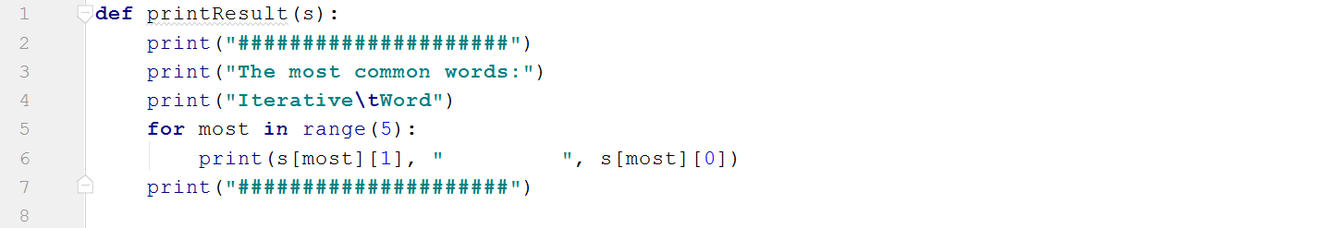
Bubble Sort
Algorithms
Mechanism
Problems
Introduction

Slide 20
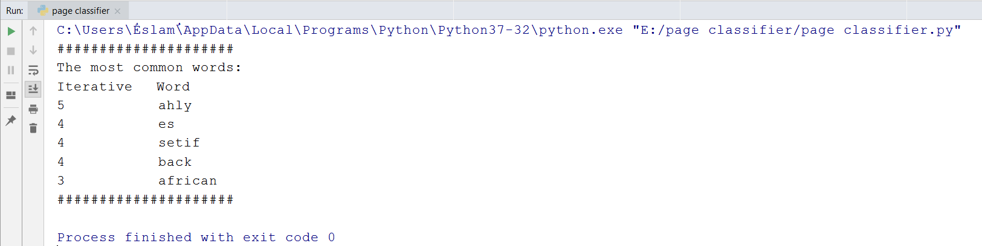
Bubble Sort
Algorithms
Mechanism
Problems
Introduction

Slide 21
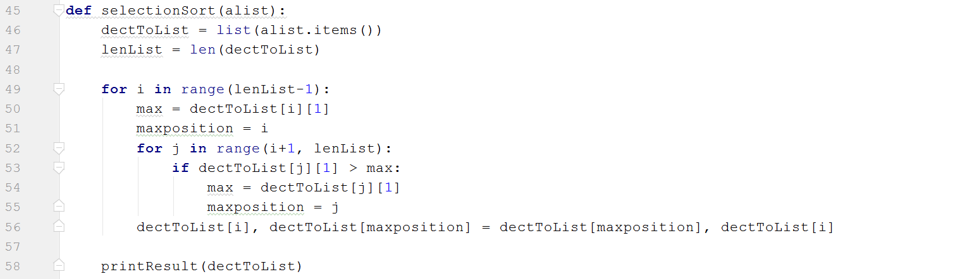
Selection Sort
Algorithms
Mechanism
Problems
Introduction

Slide 22
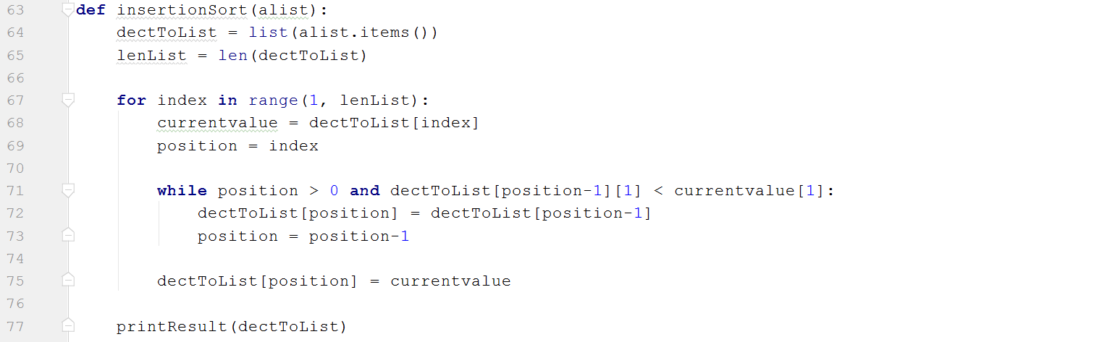
Insertion Sort
Algorithms
Mechanism
Problems
Introduction
# currentvalue = dectToList[index]
We need to compare the current value to the value of (position-1) and if the condition becomes true, change the position of current value and its key.
If became currentvalue = dectToList[index][1]
We can not change the key and ‘int’ object is not subsciptable.

Slide 23
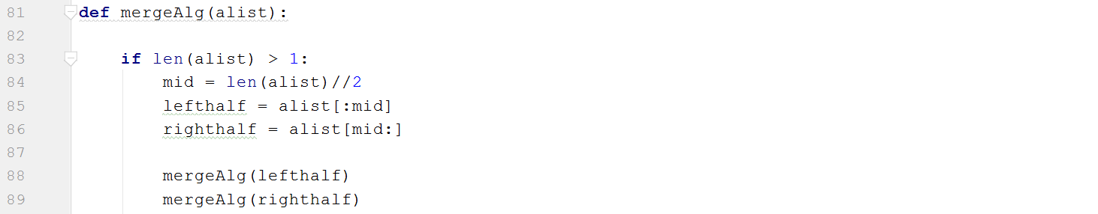
Merge Sort
Algorithms
Mechanism
Problems
Introduction

Slide 24
Merge Sort
Hint
We used two functions in merge sorting as merge divided the list and if we pass the dictionary as a direct parameter, it converts to list but when the function is called itself again the new parameter is not dictionary now, it becomes a list and the list does not take items() attribute.
def mergeAlg(alist):
dectToList = list(alist.items()) # Error:
if len(alist) > 1:
mid = len(alist)//2
lefthalf = alist[:mid]
righthalf = alist[mid:]
mergeAlg(lefthalf) #Error: ‘list’ object has no attribute ‘items’.
mergeAlg(righthalf)
Algorithms
Mechanism
Problems
Introduction

Slide 25
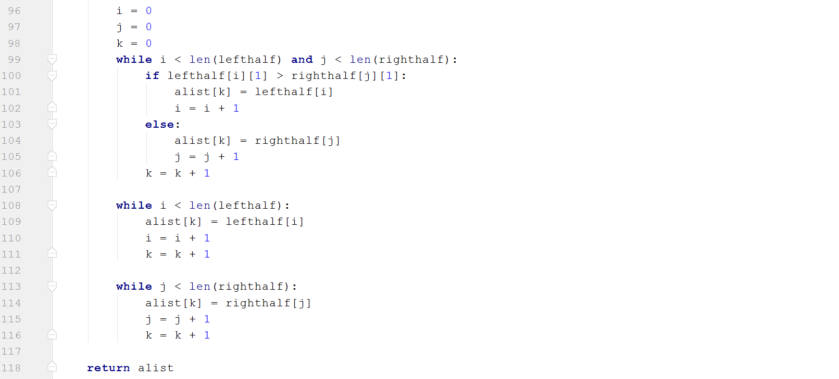
Merge Sort
Algorithms
Mechanism
Problems
Introduction

Slide 26
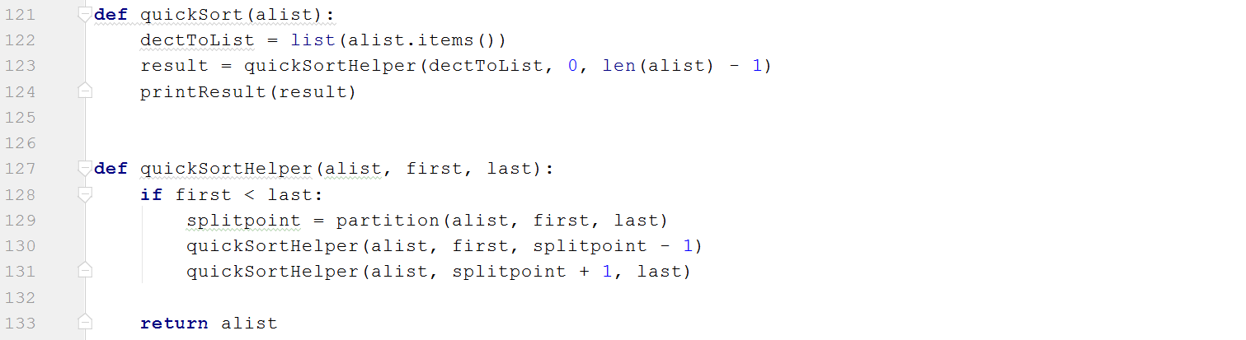
Quick Sort
Algorithms
Mechanism
Problems
Introduction

Slide 27
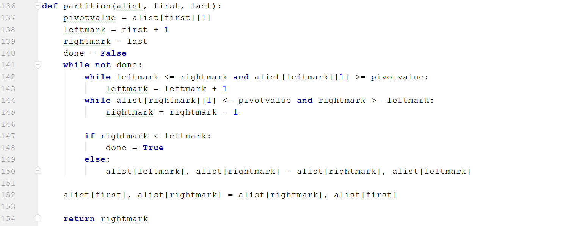
Quick Sort
Algorithms
Mechanism
Problems
Introduction

Slide 28
Algorithms
Mechanism
Problems
Introduction

Slide 29
Thank you for attention
The End
Algorithms
Mechanism
Problems
Introduction

