Slide 1
INTERNSHIP TASKS

Slide 2
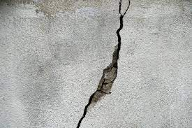
Crack Detection for Buildings
what is building crack?
Engineering structures like concrete surface, beams are often subjected to fatigue stress, cyclic loading, that leads to the cracks that usually initiate at the microscopic level on the structure’s surface.

Slide 3
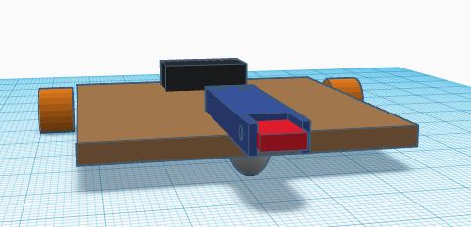
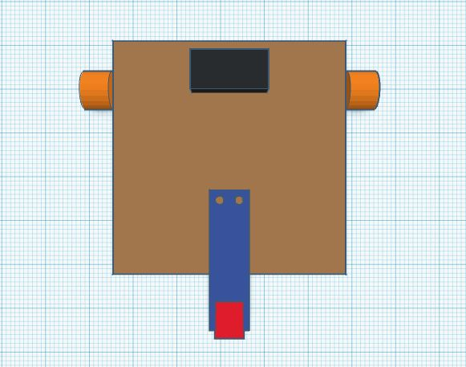
Main Role
Design a simple car to capture photos manually for cracks.
Someone else will make image processing for cracks photos (out of my scope)
Primary Design

Slide 4
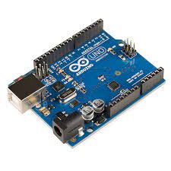
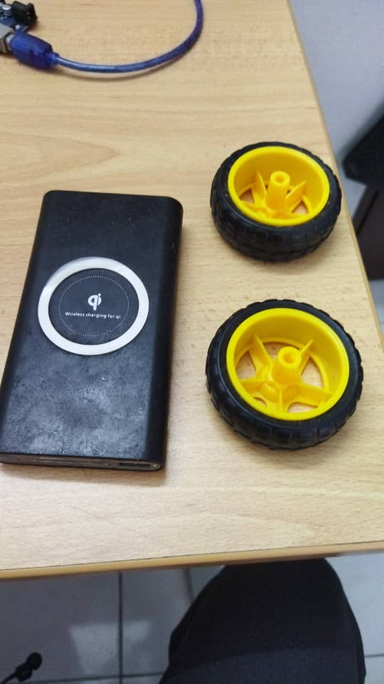
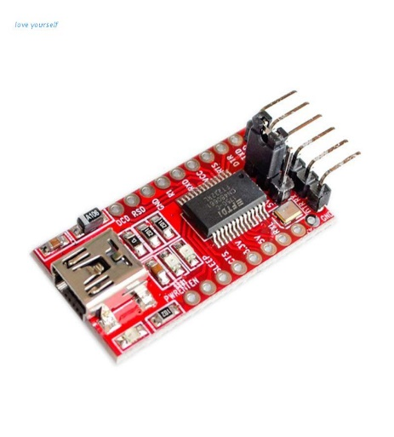
Required Components
Acrylic Base
Wheels and castor wheel
Battery
Arduino UNO (or FT232RL FTDI USB)
Holder for camera
Camera

Slide 5
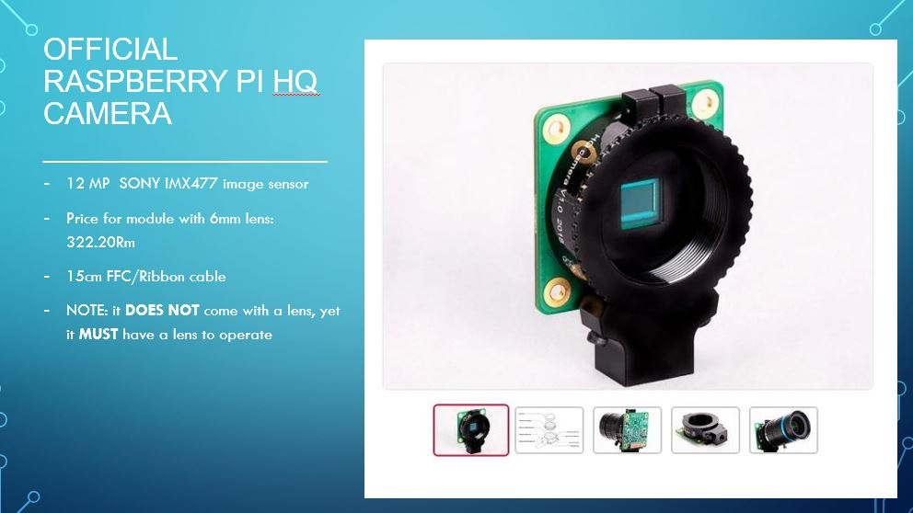

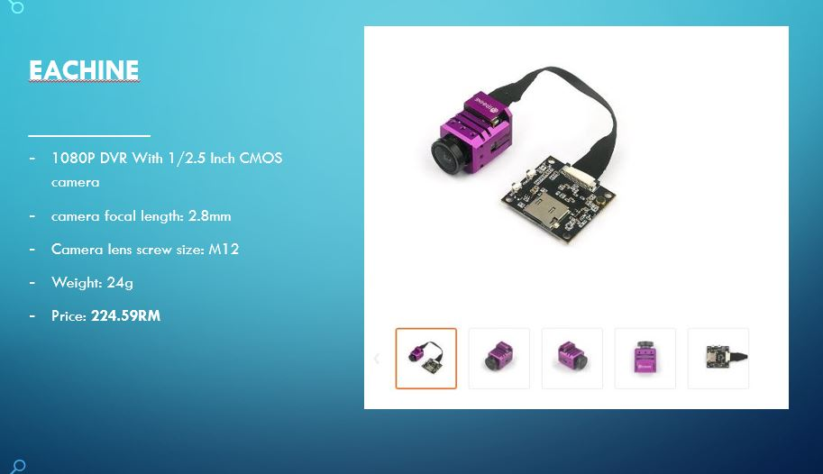

Specify the type of camera

Slide 6
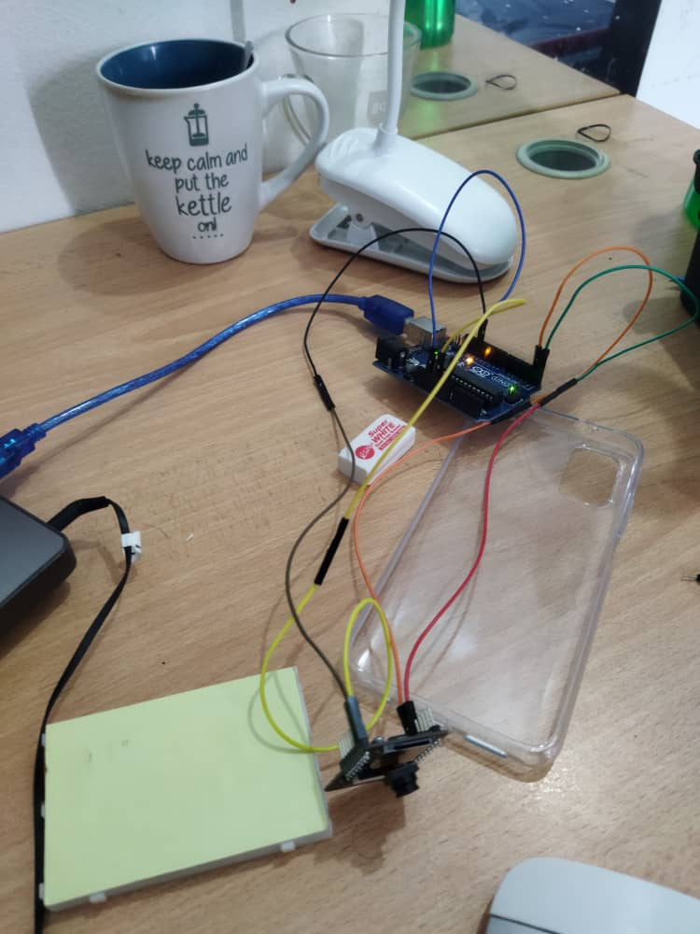
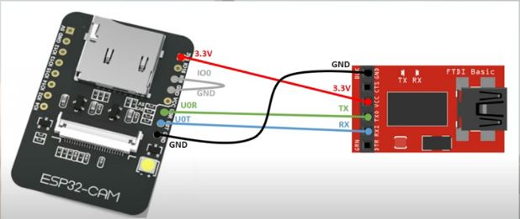
Programming the camera
For low budget we decide to use ESP32 CAM.
Wiring schema

Slide 7
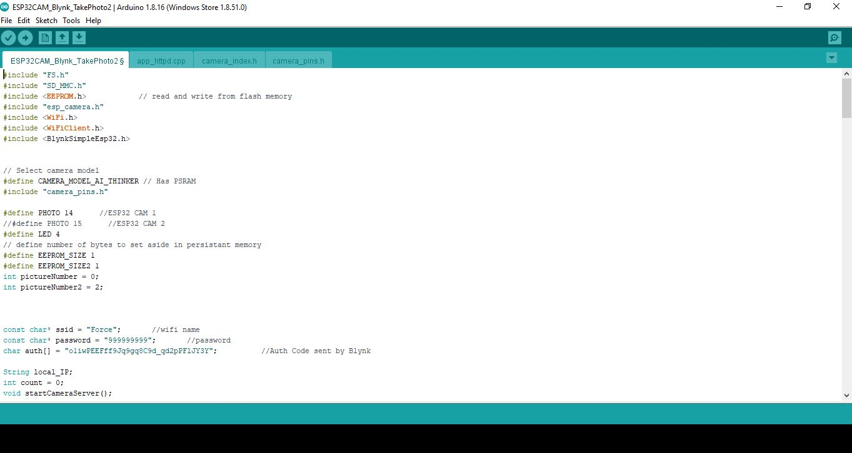
Programming the camera

Slide 8

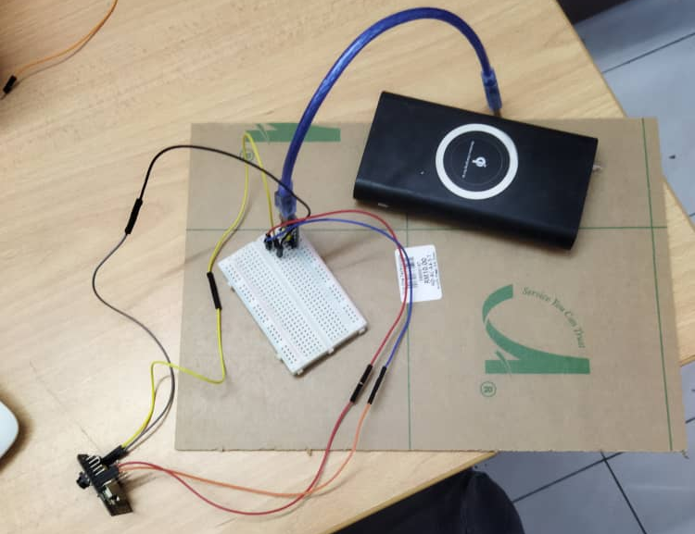
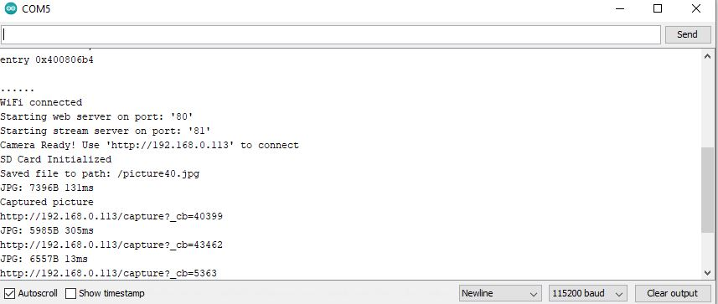
Programming the camera

Slide 9
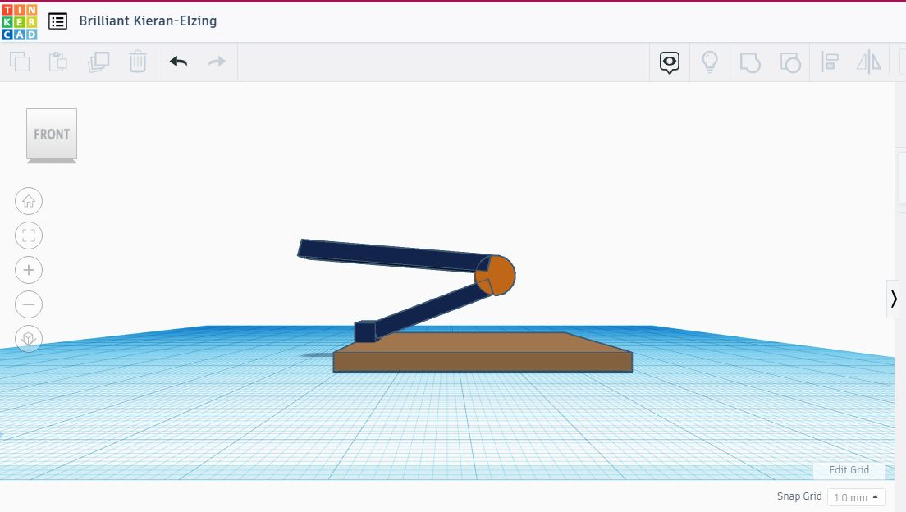
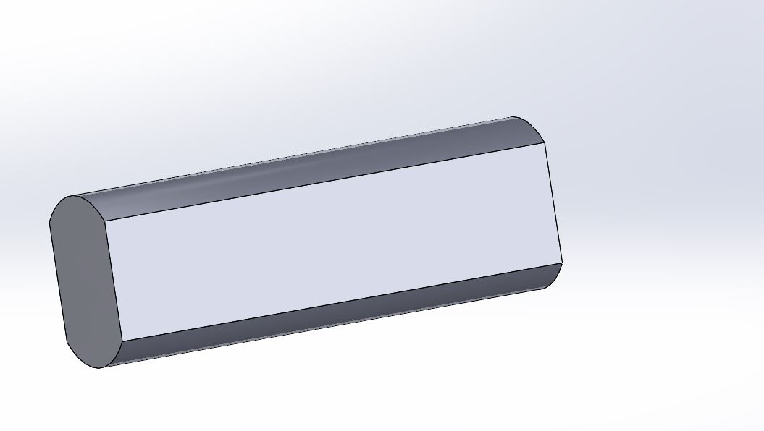
Design the car
Another Design for camera Holder
Wheel bar

Slide 10
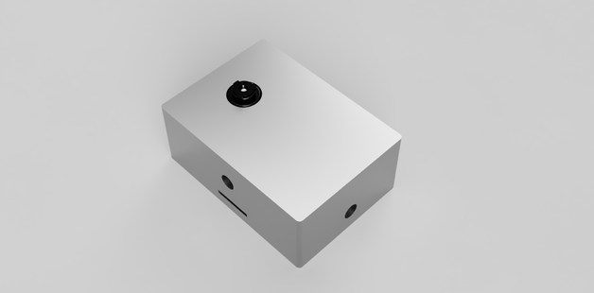
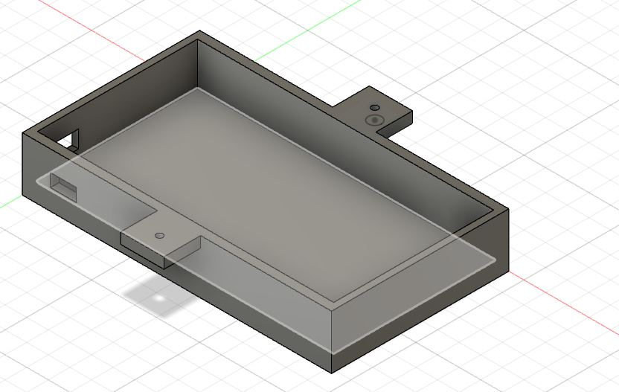
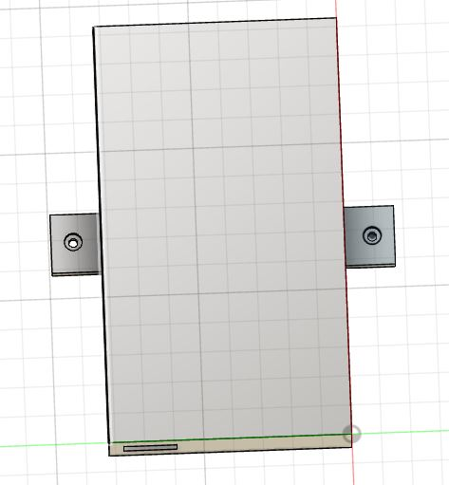
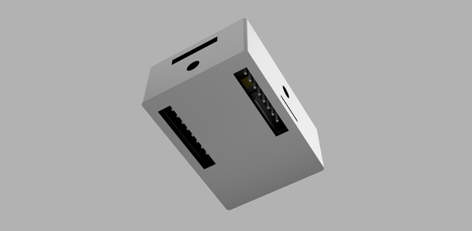
Designing the car
Camera case
Battery cover

Slide 11
THANK YOU

