Slide 1
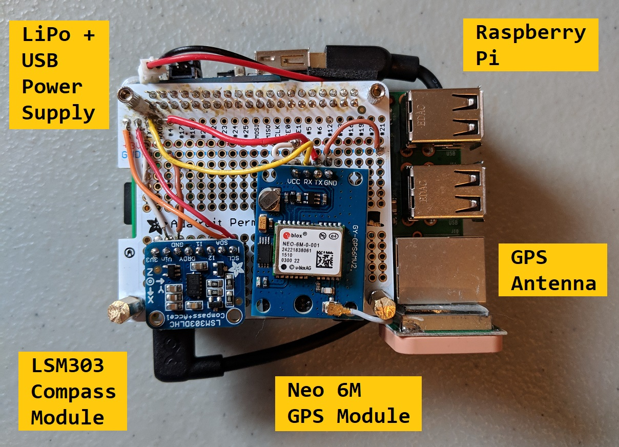
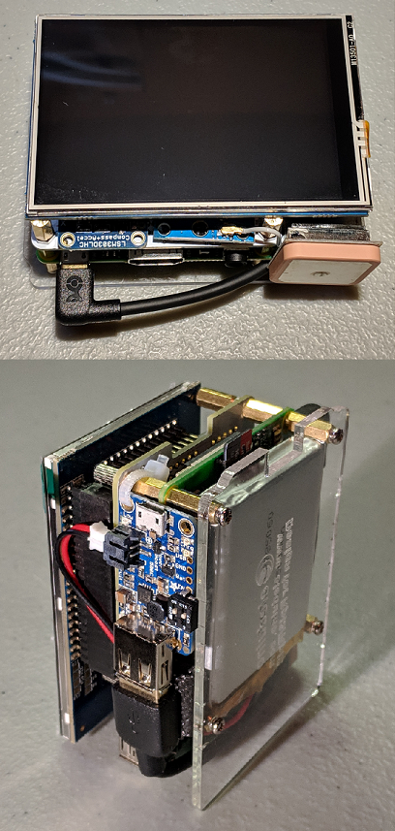
LCD
5V Rechargeable LiPo
Notes:
1. Pictured here is the inside of our device. ....sensors and other components that we are using in our Qibla device..
2. underneath that white protoboard, is a raspberry pi
3. mounted to the side of the device is the GPS antenna (moved antenna, signal was cutting off when mounted on top of ethernet port, screen obstructing signal)
and a usb power supply that is connected to a 5V rechargeable LiPo battery that is mounted on the underside of the device
4. and the top right corner picture is the assembled device with the LCD screen mounted. the LCD screen is used as a visual indicator for the output of our program

Slide 2

Approach Algorithm: Equations
X and Y are for latitude and longitude respectively
Subscripts ‘m’ and ‘u’ are for Mecca and User’s Location respectively
Input is coordinates for current location and Mecca, SA
Output is an angle in degrees to Mecca from True North

Slide 3
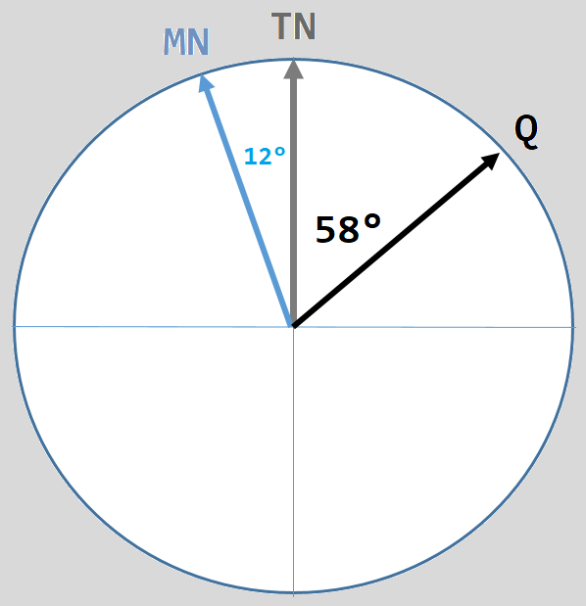
Approach Algorithm: GPS + Compass Relation
Assume True North (TN) to be up
The compass points to Magnetic North (MN)
Adding MD (-12°) to MN, adjusts the compass to point to TN
GPS coordinates and square triangle equation gives the angle for the Qibla (Q) from TN
Then add (Q) angle to TN to get final heading
For Newark, NJ:
MD = -12°
Q = 58° E

Slide 4
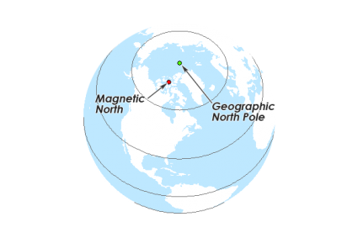
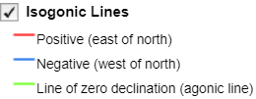
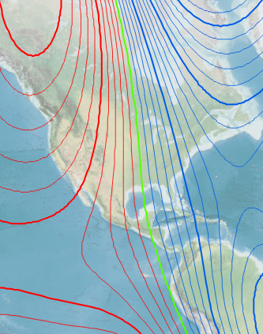
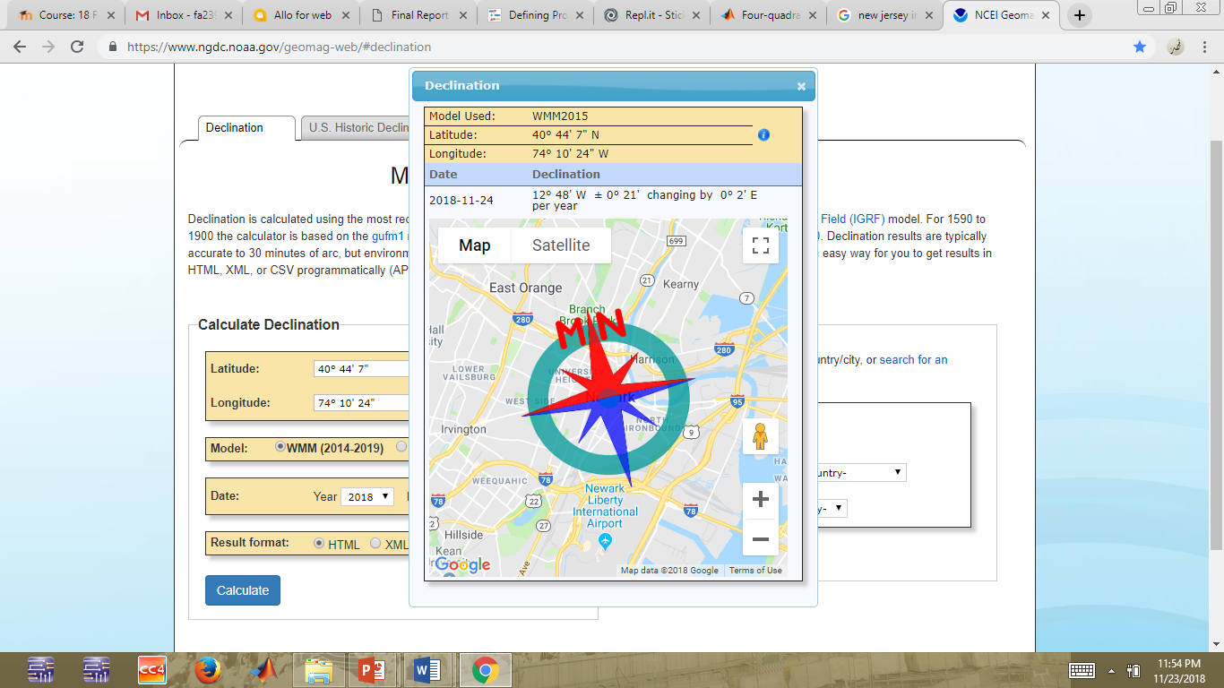
Magnetic Declination
A compass points to Magnetic North
True North is the geographical north pole
MD is the angle difference between Magnetic North(MN) and True North(TN)
When either adding or subtracting MD to MN, TN can be obtained
MD at a given location, changes over time
To determine the proper direction of the Qibla, MD is needed to adjust the compass heading from MN to TN
Notes:
Magnetic declination is an important concept for accurate navigation. A compass will always point along the lines of magnetic force (which converge on what are called the magnetic poles). The angle between the direction of force and the direction of the geographic north pole is called the declination.
As one moves across the surface of the globe, lines of constant magnetic declination are called isogonic lines.
As the earth's magnetic field varies over time, the positions of the north and south magnetic poles gradually change. The magnetic declination at a given location also changes over time.

Slide 5
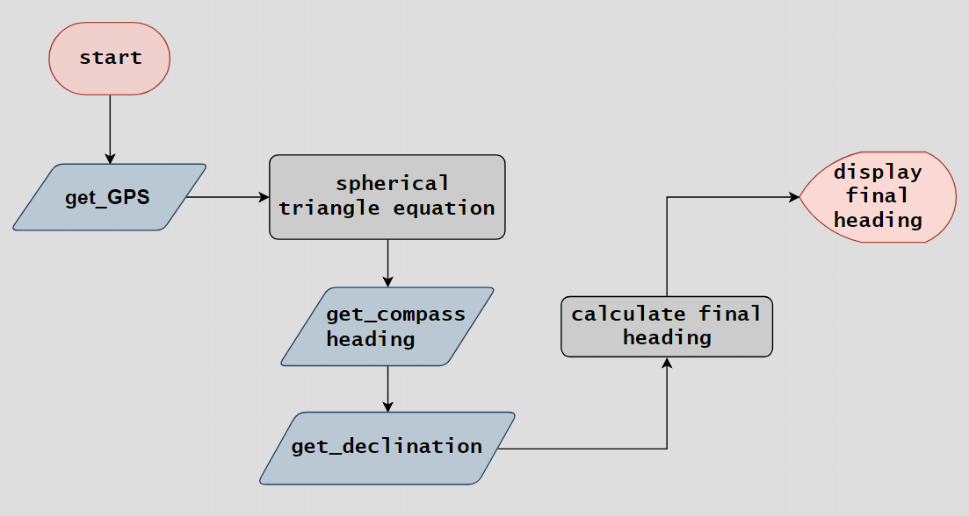
Approach Program Algorithm
Notes:
So when the program starts and the first thing that happens is the
1. GPS searches for a signal. when a signal becomes available the GPS retrieves a string of data and saves it.
--from the string of data, the program extracts lat and long along with their respective directions. these directions determine whether the coordinate will be (+) or (-)...
2. Then the (gps) coordinates are fed into the spherical triangle equation, which will return the direction toward the Qibla in degrees from TN
3. So the next step is to get the compass heading or direction
This is the part where the program sorts out all the raw data that the magnetometer/accelerometer provides. Since we are using the accelerometer as a compass, we are only interested in the X and Y magnetic components
--in our project, the compass is needed to orient the device, but the compass point along the lines of magnetic force, magnetic north, not true north. And we need it to point to true north
4. Next is to find the declination. So in order to get the compass to point to true north, we add or subtract the magnetic declination to the compass heading to adjust it to point from MN to TN
And we do this by running (geomag) a module/script in our program that contains a huge complicated equation that uses lat, long and time as it’s inputs and returns MD for your specific location
#Adapted from the geomagc software and World Magnetic Model of the NOAA# Satellite and Information Service
5. After we get the proper declination, we are able to calculate a final heading.. So we are basically by subtracting a (+) or (-) declination from the heading to obtain a final heading from TN
6 . Lastly we display this final heading on the screen.

Slide 6
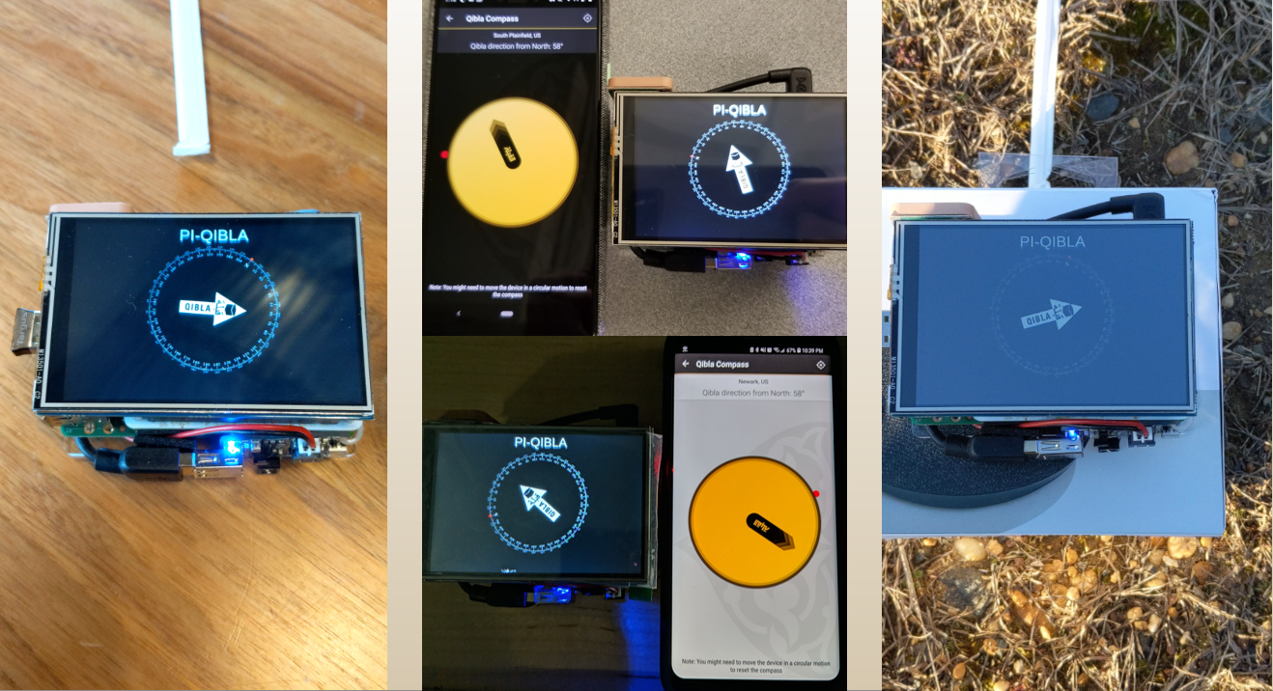
Verification and Validation
Notes:
<videos>

Slide 8
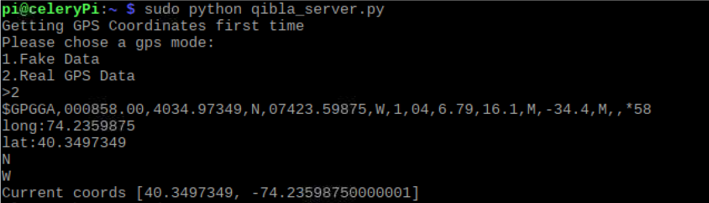
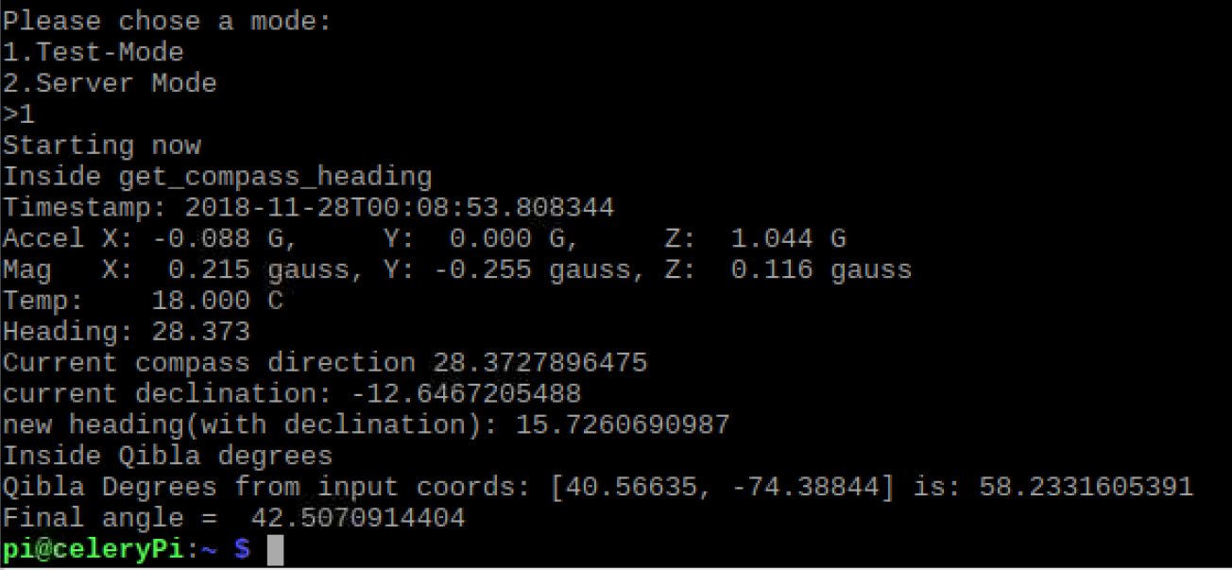
Notes:
Screenshot of the Qibla server
Before running the server, the first task the program looks to complete is to retrieve a string of GPS data
We use ‘1. Fake Data’ (preprogrammed Data) if there is no GPS signal
We use ‘2. Real GPS Data’ if a signal is available
Returned is a raw GPS data string
In ‘1. Test Mode’ the program runs one time
In ‘2. Server Mode’ the program loops forever or until stopped
The image is ‘1. Test Mode’. It returns all the information that the device is producing
When we demonstrate the project, we will chose ‘2. Server Mode’ (this runs locally on the device). In this mode, the program adjusts the compass dial every second.
And lastly, with the ‘Q’ equation, we can calculate the degrees to Mecca, from true north, using the GPS coordinates as the input. Resulting in 58.23 degrees E.
----------------------------------------------------------------
DDMM.MMMMM
Latitude in degrees, minutes, and decimal minutes (you can set the number of decimal places using the JNP command)
K
Latitude indicator; value is N (North latitude) or S (South latitude)
DDDMM.MMMMM
Longitude in degrees, minutes, and decimal minutes (you can set the number of decimal places using the JNP command)
L
Longitude indicator; value is E (East longitude) or W (West longitude)

