Slide 1
Welcome We Are Data Need Analysis

Slide 2
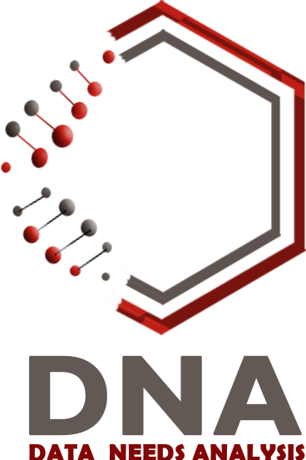

Slide 3
DATA NEED ANALYSIS
Data analytics is the science of extracting patterns, trends, and actionable information from large sets of data. This science can be very helpful to our university
DNA
in the same manner that DNA is an abundant source of data that needs analysis to extract informations hence we named our company data need analysis or shortly DNA
<numéro>

Slide 4
Meet the team
<numéro>

Slide 5

Hello!
I am Toumi abdrahman
Hard-working web developer with a flair for creating elegant solutions in the least amount of time. Developed an ecommerce webapp, customer web portal, documentary launch website, and donations webapp for a local charity.
You can find me at abderrahmanemustapha030898@gmail.com
Project Manager
<numéro>

Slide 6
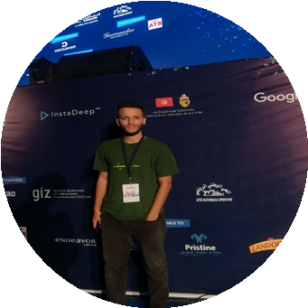
Hello!
I am Kouriba Ali
UX designer & Front end developer created responsive websites from scratch , Designing and maintaining front end for web and mobile applications.
You can find me at
aliloutg@email.com
Ux designer & front end developer
<numéro>

Slide 7

Hello!
I am Yassmine boussafi
I am a beginner software developer seeking knowledge and experience in my field of study
Python, Django and Java as main programming languages, and a strong knowledge in UML based conception .
You can find me at Boussafi.yassmine.1102@gmail.com
Concepteur
<numéro>

Slide 8

Hello!
I am Nachoua Nourhane Hamdani
I am a student in software engineering with a passion for data bases.
Python, Django and Java when coding, and good background in MySQL and PostgreSQL.
You can find me at
nourhanepop14@gmail.com
ANALYST
<numéro>

Slide 9

Hello!
I am LARACHI ABDELHADI
I’m back-end developer , develop, code and test software systems, or applications for software improvements and new products.
Create and develop components applications that deliver value to customers
You can find me at
larachiabdelhadi@gmail.com
DESKTOP DEVELOPER
<numéro>

Slide 10
Introduction
Recently, educational systems are on the one side to
increase the efficiency and quality are encountering the
new difficulties and the requirements of the dynamic
economy and other native or local existing businesses.
This poses the need to establish and institutionalize a
comprehensive systems for supporting decision making
and distributed training
<numéro>

Slide 11
stackHolders
This work is addressed to University Ibn Khaldoun -Computer Science Department-.
Our main goal is trying to collect and analyze the database of our department in order to extract information which will help to improve the university educational level
<numéro>

Slide 12
Planing
<numéro>

Slide 13
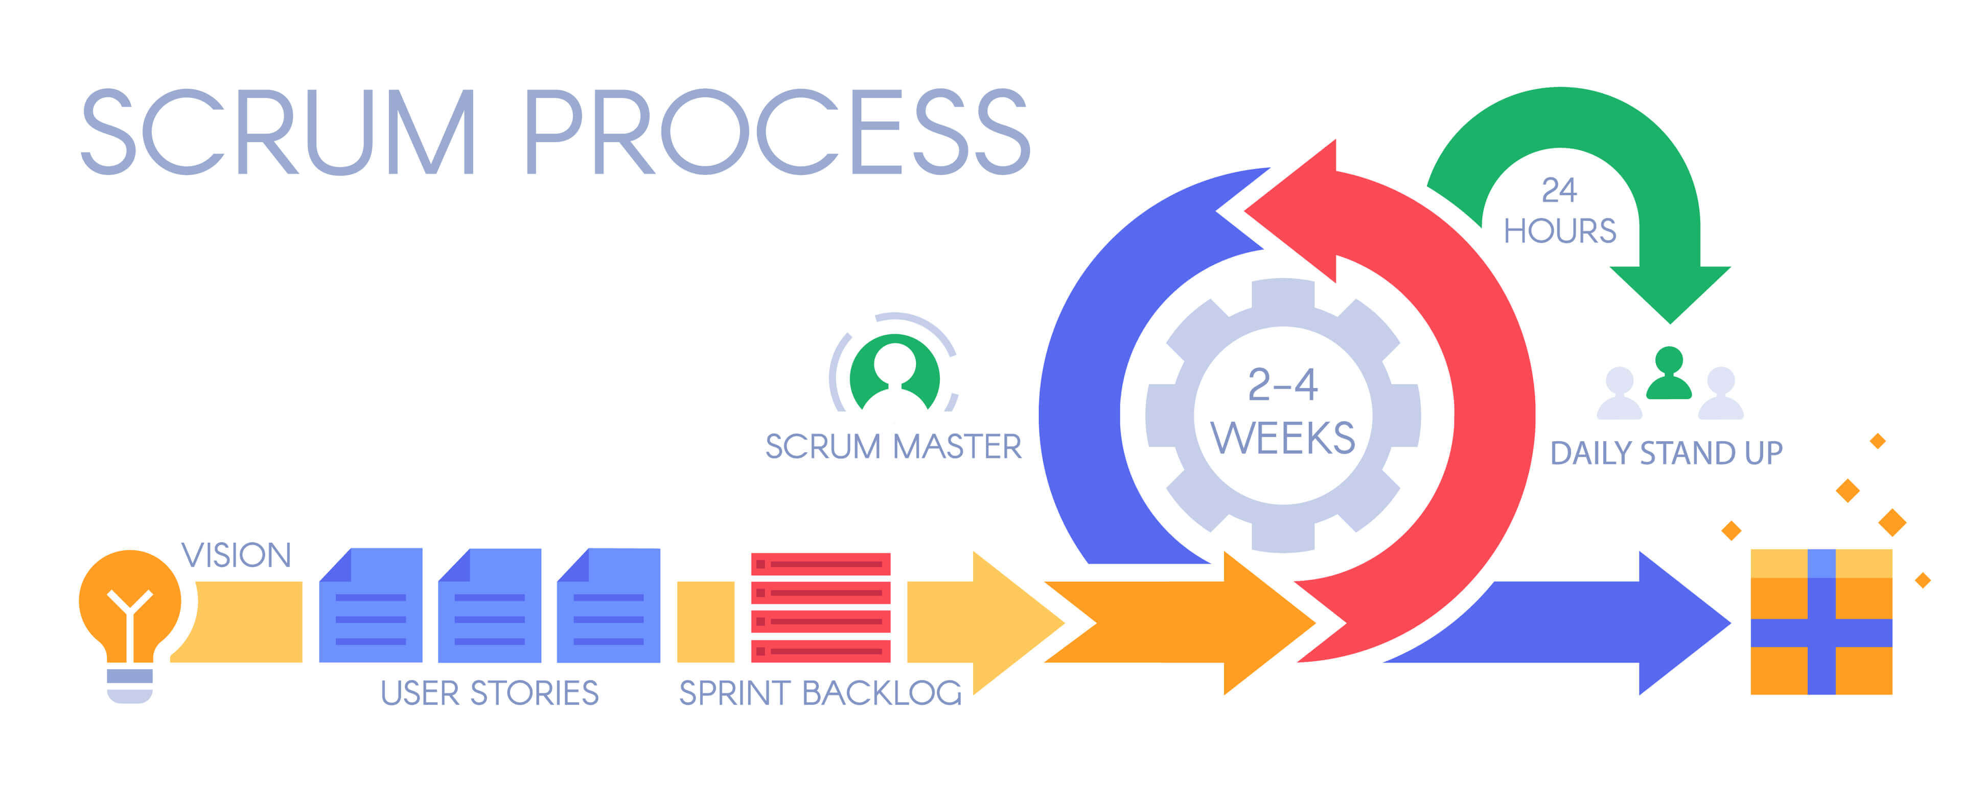
Scrum
<numéro>

Slide 14
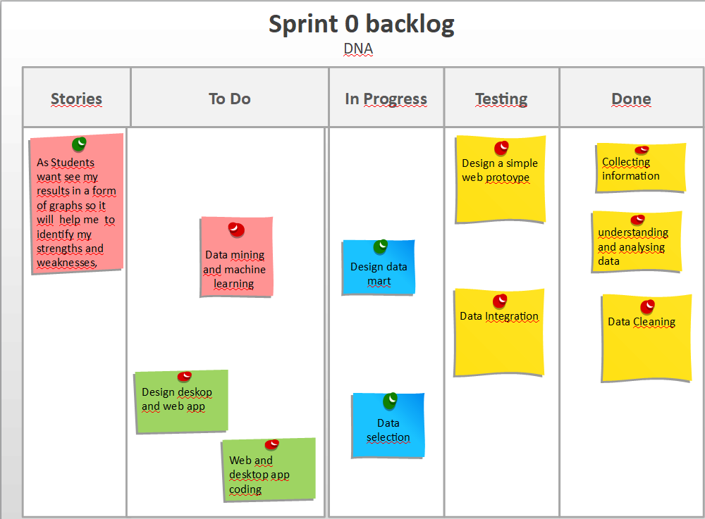
<numéro>

Slide 15
1
Collecte the data
Let’s start with how we collecte data

Slide 16
Pic of data collect
<numéro>

Slide 17
ETL
Extract
is the process of reading data from a database. In this stage, the data is collected, often from multiple and different types of sources..
Transform
is the process of converting the extracted data from its previous form into the form it needs to be in so that it can be placed into another database. Transformation occurs by using rules or lookup tables or by combining the data with other data.
Load
is the process of writing the data into the target database.
<numéro>

Slide 18

Data Integration
Talend
is an open source software integration platform helps you in effortlessly turning this data into business insights.
<numéro>

Slide 19
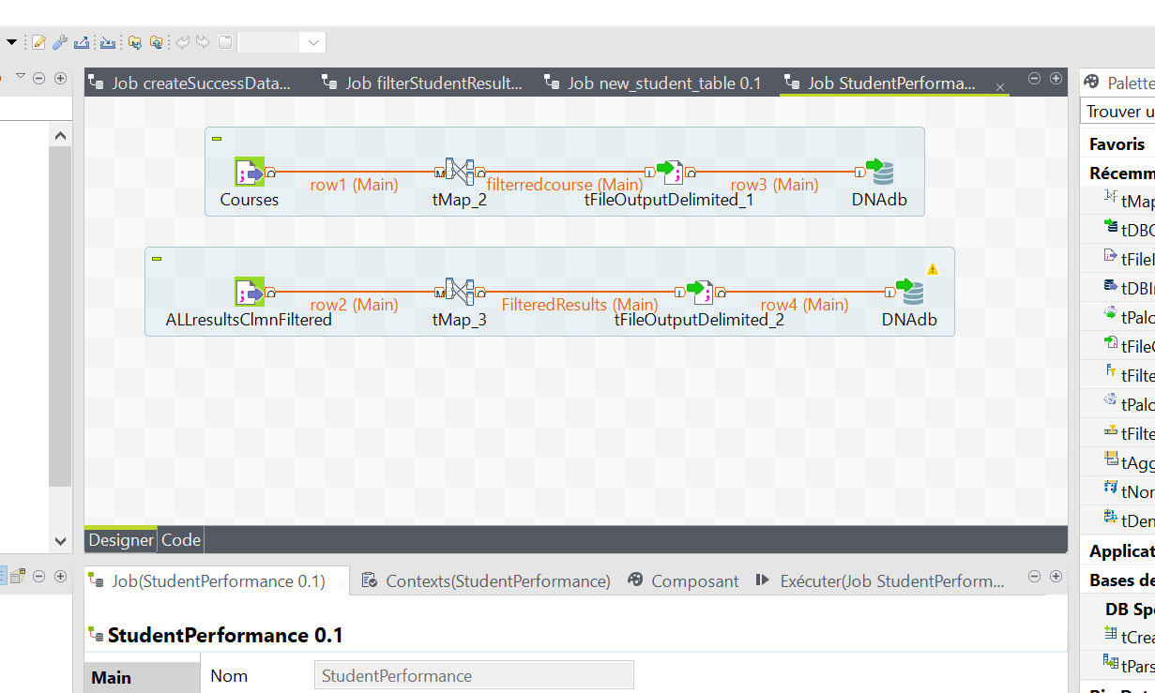
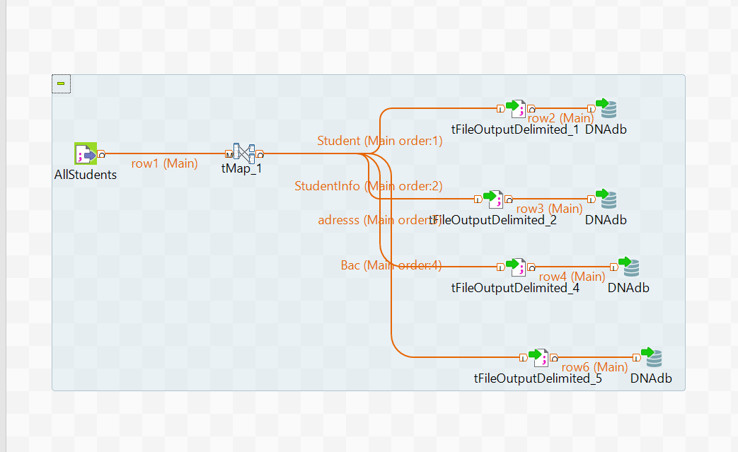
<numéro>

Slide 20
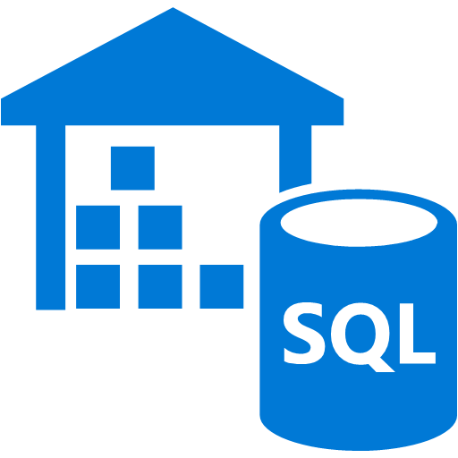
DATA WareHouse
A data warehouse is a system that pulls together data from many different sources within an organization for reporting and analysis. The reports created from complex queries within a data warehouse are used to make business decisions.
<numéro>

Slide 21


Tools
<numéro>

Slide 22
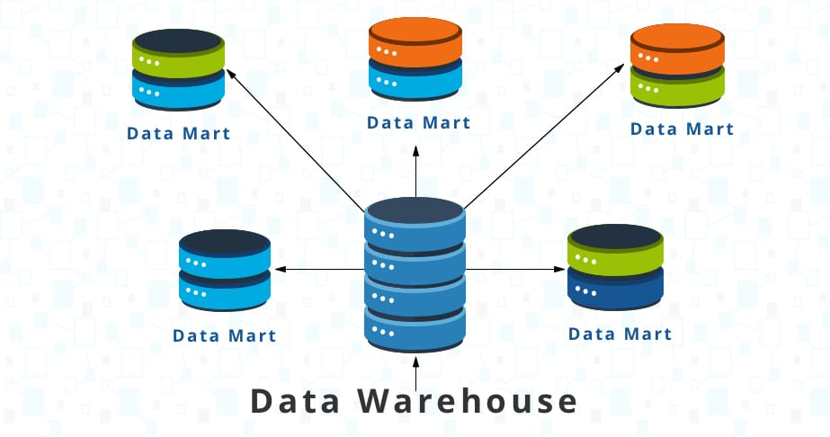
DATA Mart
A data mart is a subset of a data warehouse oriented to a specific business line. Data marts contain repositories of summarized data collected for analysis on a specific section or unit within an organization.
<numéro>

Slide 23
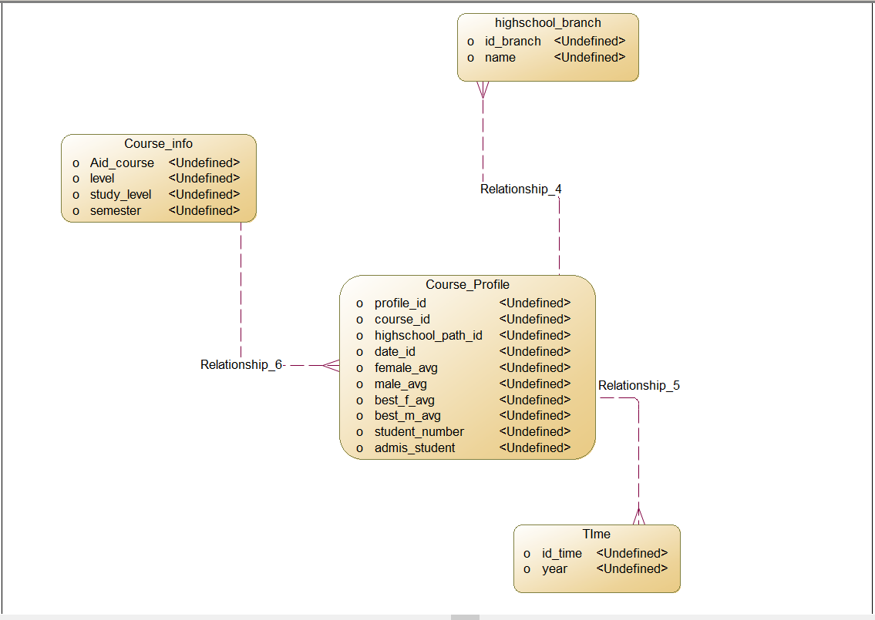
First Data Mart : Course Profile
The success rate of the courses in each year
Dimention :
-Time
-CourseInfo
-HighSchoolBranch
Fact Table:
-CourseProfile
<numéro>

Slide 24
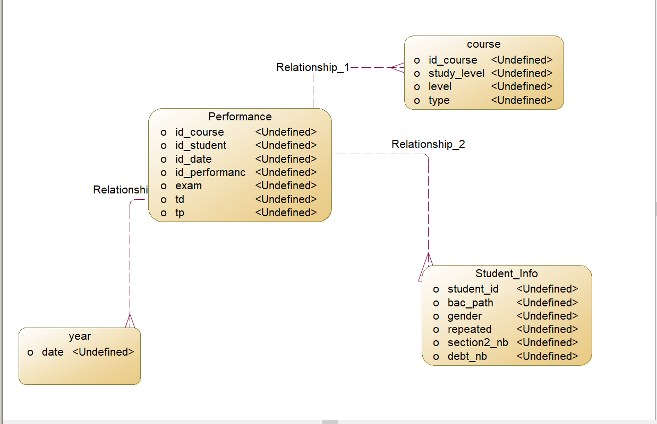
Second Data Mart : Student Performance
monitor the progress and performance of students during all years in the IT department.
the student can see his results and compare them with other student so he can know his weakness.
<numéro>

Slide 25
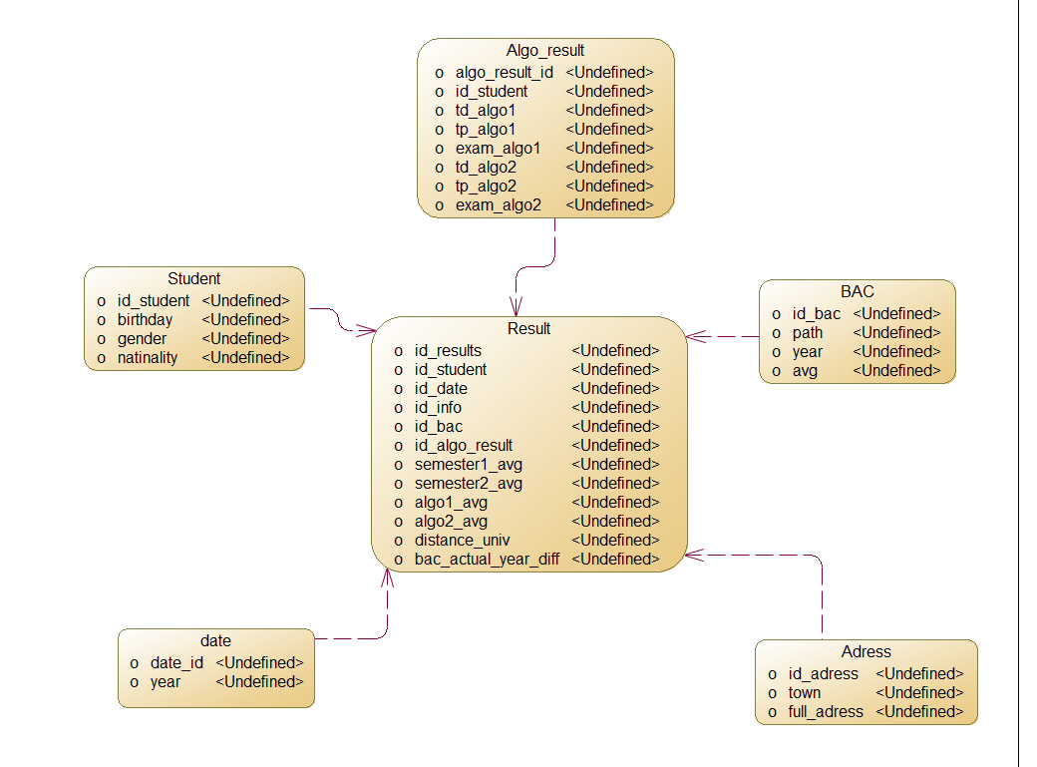
Third Data Mart : Student Success
follow the success of the students will show the student statistics which will also help him to decide if computer science is the right field for him
<numéro>

Slide 26
Data Mining
Data mining is defined as clever techniques that are applied to extract patterns potentially useful.
<numéro>

Slide 27
Machine Learning Algorithms
Classification is the type of Supervised Learning in which labelled data can use, and this data is used to make predictions in a non-continuous form.
SVM
NAÏVE BAYES
K-NEAREST NEIGHBOR
Regression is the type of Supervised Learning in which labelled data used, and this data is used to make predictions in a continuous form.
LINEAR REGRESSION
LOGISTIC REGRESSION
Clustering is the type of Unsupervised Learning in which unlabeled data used, and it is the process of grouping similar entities together, and then the grouped data is used to make clusters.
KMEANS

Slide 28
Problems
<numéro>

Slide 29
Problem 1
predict algo 2 result from algo 1 and bac average usign regression.
Problem 2
find a relation between student (adress, town) and his results.
Problem 5
help student to choose between this three fields GL RT GI.
Problem 3
classify student "admis non admis" by bac info.
Problem 4
Assign appropriate teacher to each groupe of student .
<numéro>

Slide 30







Tools
<numéro>

Slide 31
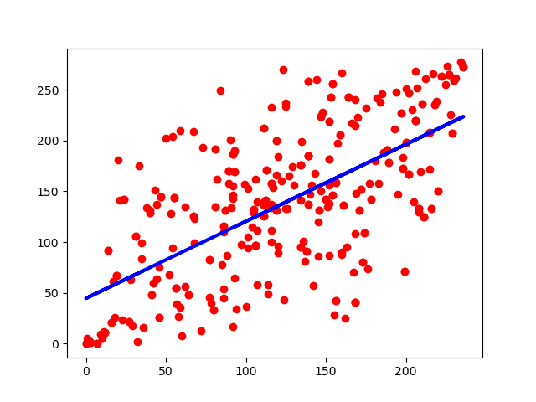
Problem 1 Algorithm (prediction)
Algorithm | R2 Score | Accuracy
Linear Regression | 41% | -
Logistic Regression | 26% | -
Naïve Bayes | - | 99%
<numéro>

Slide 32
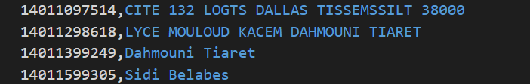
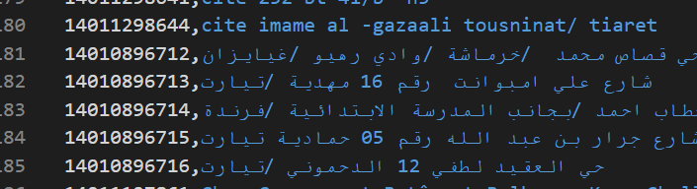
Problem 2
We tried to find a relationship between student address and his result.
But the student address is not formated (has no format)
<numéro>

Slide 33
Problem 3
Algorithm | Accuracy
Ada Boost | 77%
K nearest Neighbor | 75%
Naïve Bayes | 78%
SVM | 77%
classify student "admis non admis" by bac info gender, age, year
<numéro>

Slide 34
Problem 4
We tried to Assign appropriate teacher to each group of student .
But we don’t have enough information about teachers
<numéro>

Slide 35
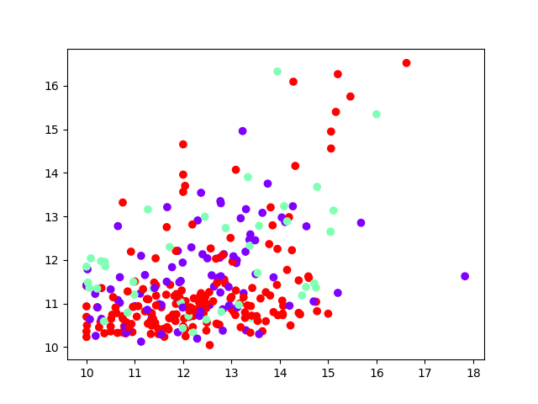
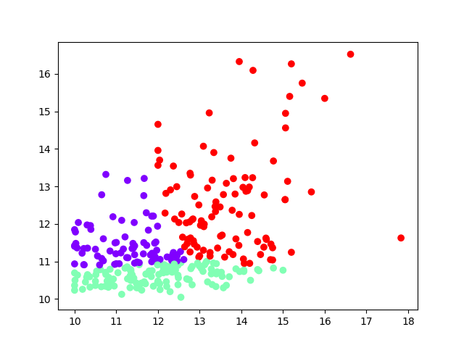
Problem 5
help student to choose between this three fields GL RT GI.
The faculty orientation and the clustering orientation gives us a similarities of 5%.
<numéro>

Slide 36
DNA Web App
<numéro>

Slide 37





Tools
<numéro>

Slide 38
Django API
<numéro>

Slide 39
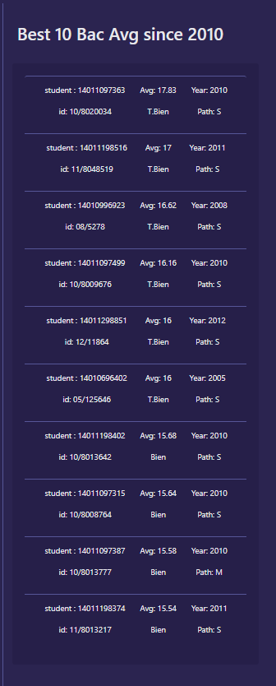
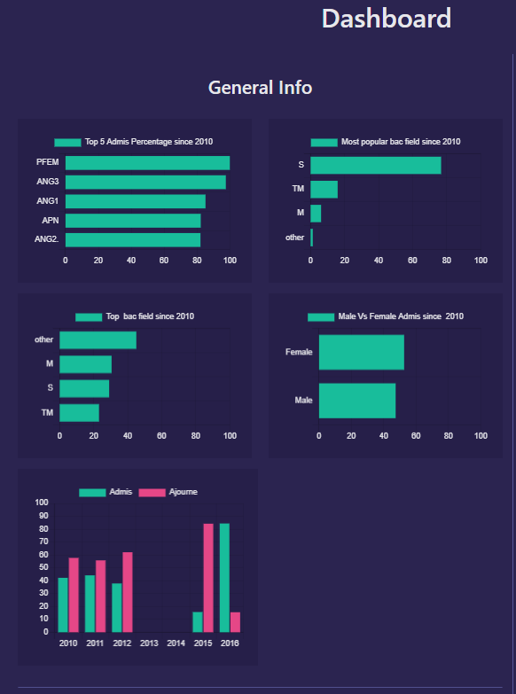
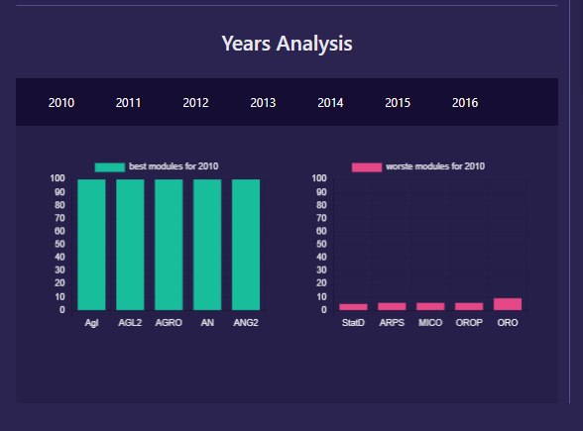
Web App Dashboard
<numéro>

Slide 40
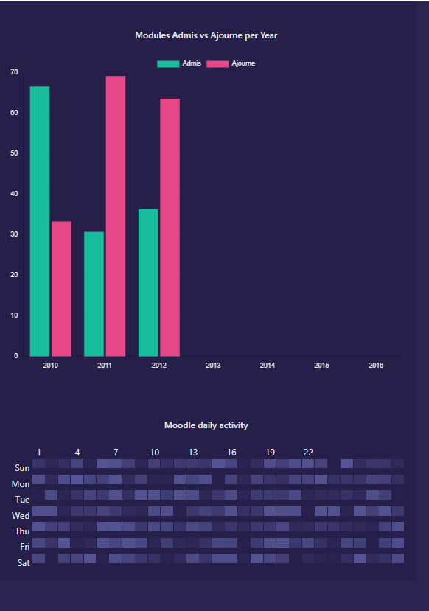
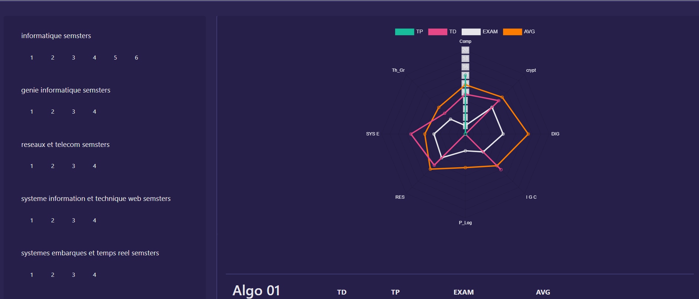
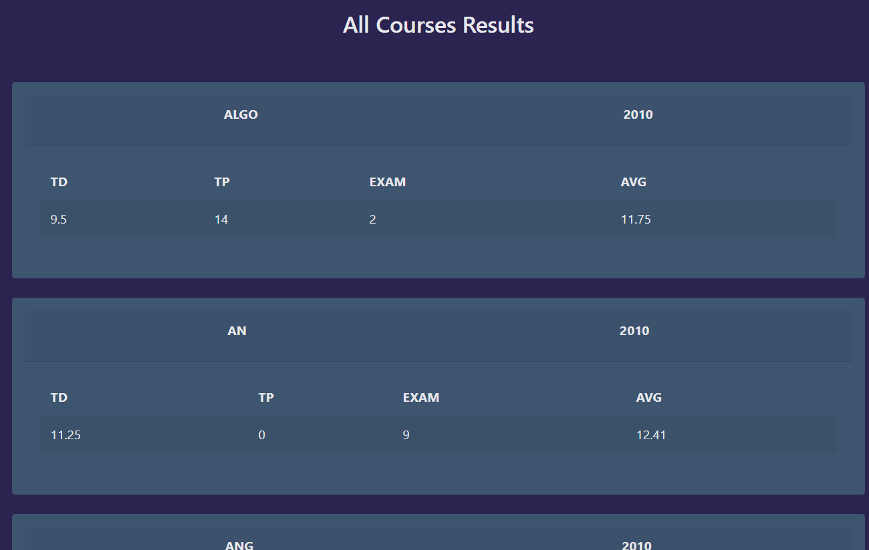
Web App Profile
<numéro>

Slide 41
Thanks!
<numéro>

