Slide 1
SHARIK UIK
For a better university
By toumi mustapha Abderrahmane

Slide 2
Abstract
Our mini project entitled "Sharik" about WEB Programming aims to put civic technology into practice
at Ibn Khaldoun University in Tiaret. to bring out new ideas for practicing environmental protection
relying on digital.

Slide 3
Presentation Road map
more users
Intro
Planing
Tools

Slide 4
“Give me six hours to chop down a tree and I will spend the first four sharpening the axe.“

Slide 5
Planing
User Types
Simple user
Contributor
Maintainers
Admins
Use case diagram
Show what can our users do
Class diagram
Show the relations between users
Events , blogs
Planning may not be the most enjoyable component of managing projects but as they said good
planning saves hours of coding and useless requirements

Slide 6
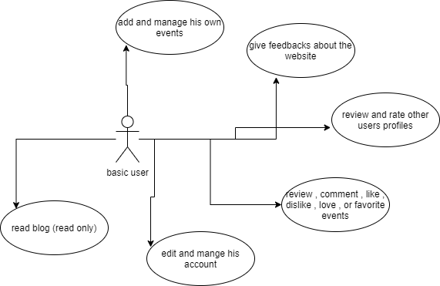
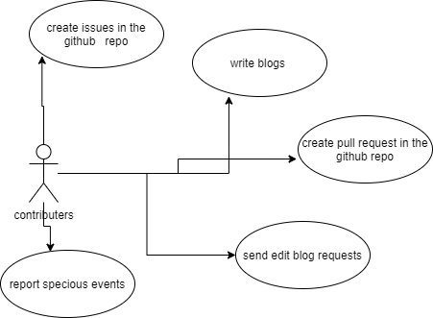
Basic User
Contributers

Slide 7
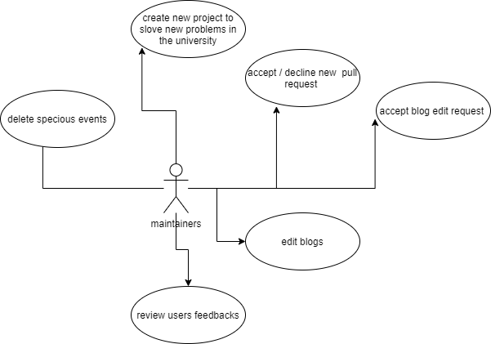
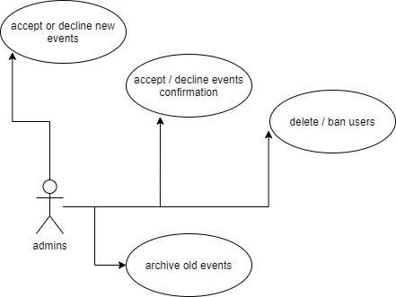
Maintainers
Admin

Slide 8
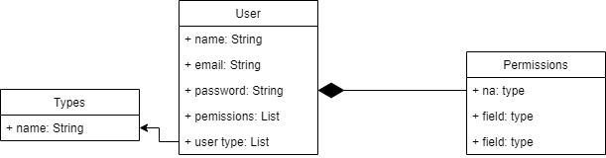
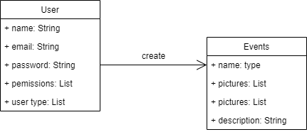
Some Class Diagrams

Slide 9
Github project for project task board

Slide 10
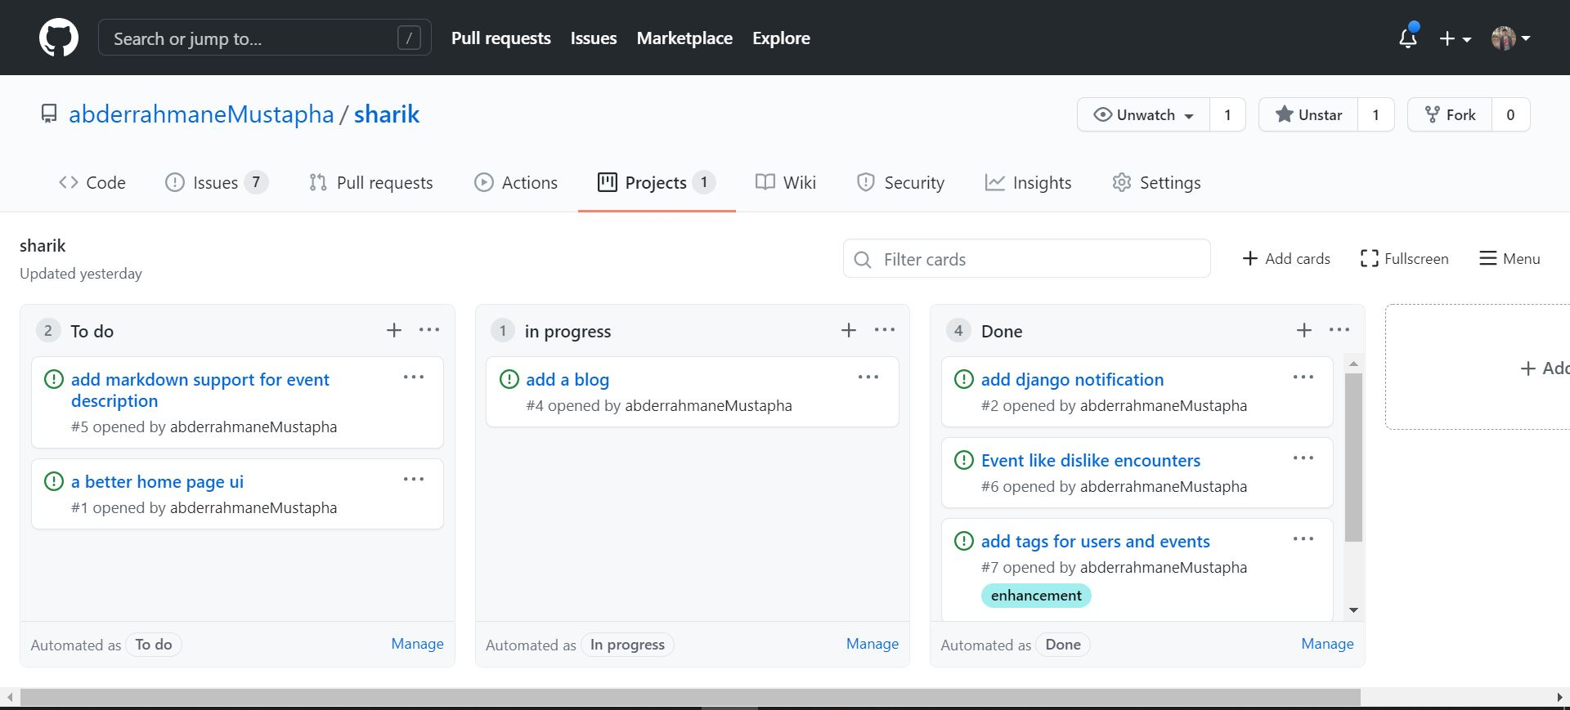

Slide 11
GitKraken Timeline

Slide 12
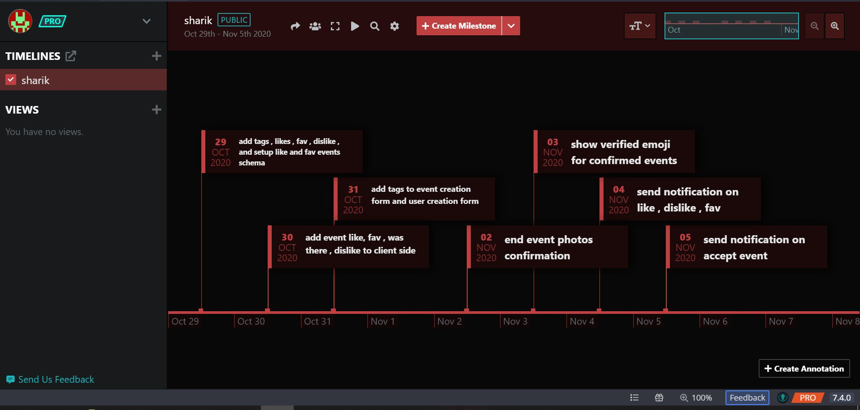

Slide 13
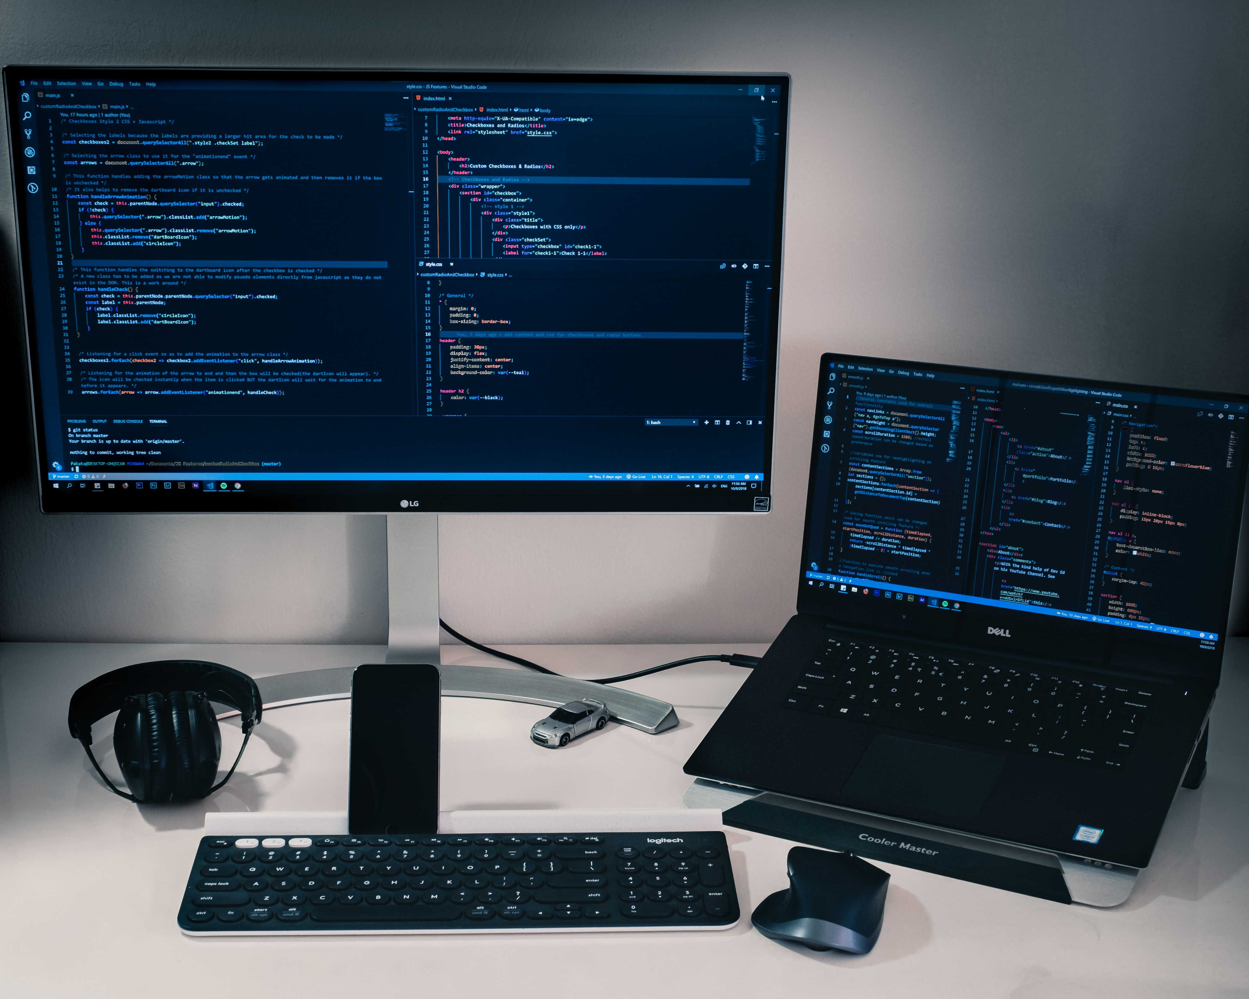

Slide 14





Programming languages

Slide 15



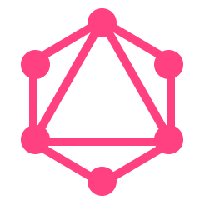



Backend Tools

Slide 16


Frontend Tools

Slide 17

Testing Tools
Django Test Client

Slide 18




Deployment

Slide 19
Keep your users and get more

Slide 20
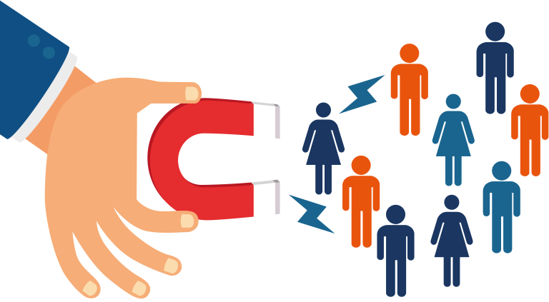

Slide 21


Slide 22
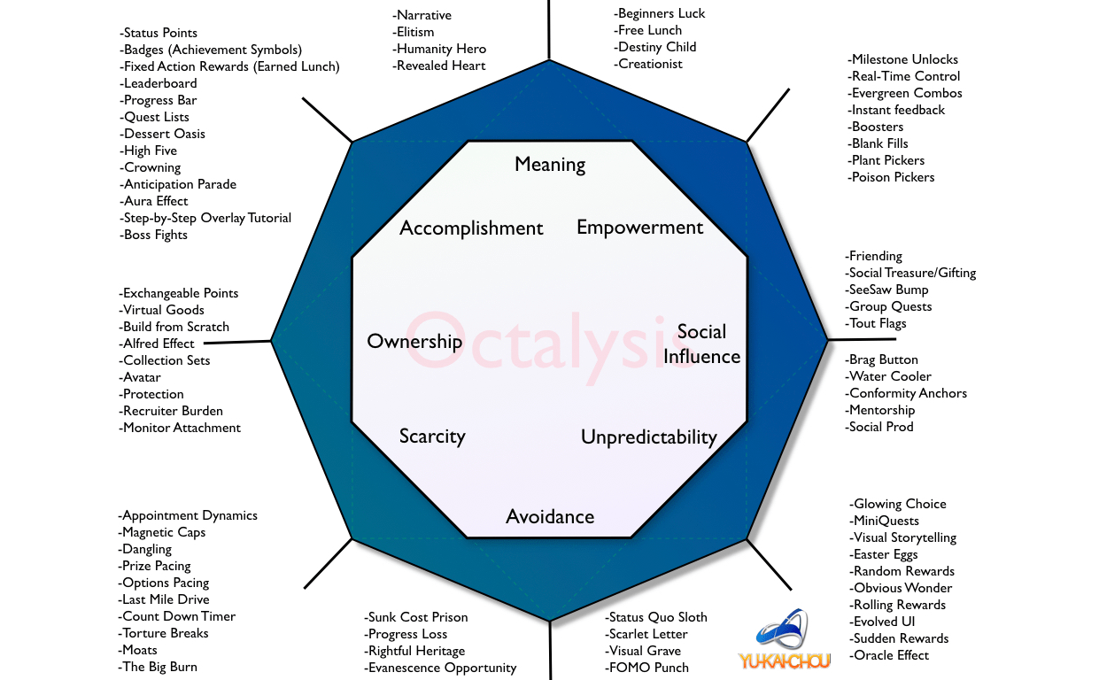

Slide 23
Thanks ….

