Slide 1
TRACK 1
The Laser Grid
Plane Mirrors & Law of Reflection
Mission 1: Redirect the Beam

Slide 2
Mission Context
Mission 1: Redirect the Beam
A laser trips the alarm if broken. You must use two pocket mirrors to bounce the beam into a hidden override sensor — without triggering the alarms.
⚡
🎯
📐
The Problem
The Goal
The Tools
Security laser must be redirected using exactly 2 plane mirrors
Beam must reach the hidden override sensor without any alarm
Two pocket mirrors + the Law of Reflection

Slide 3
Problem 1
M₂
A security laser beam hits mirror M1 at an angle of incidence
i₁ = 30°. Mirror M2 is perpendicular to M1.
r₂=60°
Normal M₂
1
State the Law of Reflection.
i₂=60°
Normal M₁
2
Calculate the angle of reflection r₁ on mirror M₁.
r₁=30°
i₁=30°
3
Determine the incidence angle i₂ on M₂ and the reflection angle r₂.
4
Prove the final ray is parallel to the original but travels in the opposite direction.

Slide 4
1
Law of Reflection
The angle of incidence equals the angle of reflection, both measured from the normal to the reflecting surface.
θᵢ = θᵣ
Incident Ray
Normal
Reflected Ray
θᵢ = angle of incidence (from normal)
θᵢ
θᵣ
θᵣ = angle of reflection (from normal)
Both angles on the same side of the normal
Applies to any flat (plane) mirror surface
θᵢ = θᵣ

Slide 5
1
Law of Reflection
GIVEN
• Incidence angle on M₁: i₁ = 30°
• M₂ is perpendicular to M₁
• Find: r₁, i₂, r₂
Laser
Normal
SOLUTION – M₁
i₁=30°
r₁=30°
Step 1: Apply Law of Reflection
θᵢ = θᵣ → r₁ = i₁ = 30°
Step 2: Angle of reflected beam
Beam travels at 30° from normal of M₁
= 60° from the mirror surface itself
M₁

Slide 6
Calculations
GEOMETRY ANALYSIS
M₂
Since M₁ ⊥ M₂ (perpendicular mirrors):
The normals of M₁ and M₂ are also perpendicular.
In the triangle formed by the:
• normal of M₁
• normal of M₂
• reflected beam from M₁
Sum of angles in triangle = 180°
90° + r₁ + i₂ = 180°
90° + 30° + i₂ = 180°
i₂ = 60°
By Law of Reflection: r₂ = i₂ = 60°
LEGEND
Incident Ray
r₂=60°
Normal M₂
i₂=60°
Normal M₁
Ray on M₁/M₂
Exit Ray
Mirrors (M₁, M₂)
r₁=30°
i₁=30°
Normals (dashed)
M₁

Slide 7
4
Mathematical Proof
Prove: the final exiting ray is parallel to the original but travels in the opposite direction.
Step 1
Step 2
Result
Total deviation at M₁
Angles sum in triangle with Normal:
→ i₁ + r₁ + α = 180°
→ α = 180° − 60° = 120°
Total deviation at M₂
Same logic at right-angle corner:
→ i₂ + r₂ + β = 180°
→ β = 180° − 120° = 60°
Total angular deviation
Total = α + β = 120° + 60° = 180°
→ Final ray is anti-parallel ✓
∴ A corner reflector always returns the beam anti-parallel to the incident ray — regardless of i₁

Slide 8
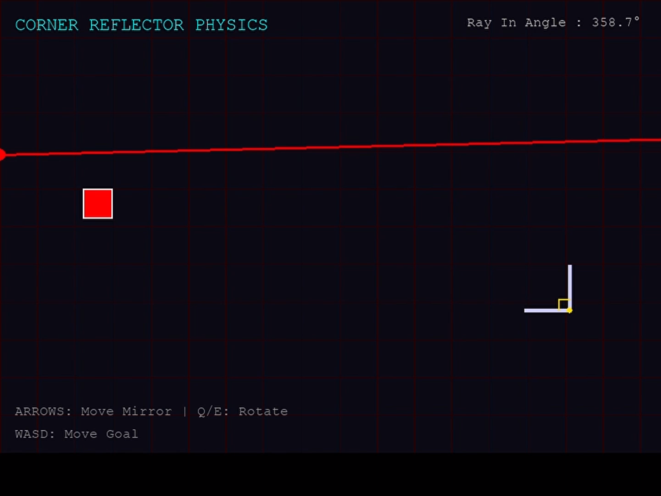
5
Visualisation
Result

Slide 9
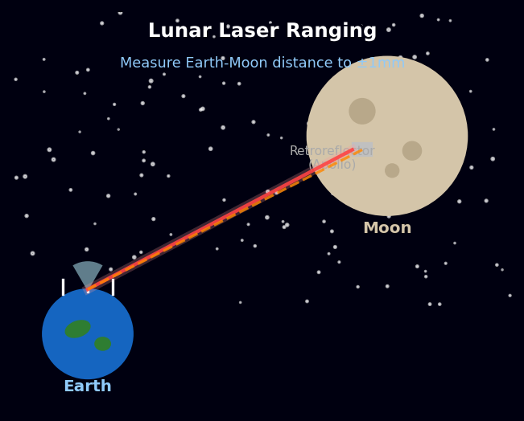
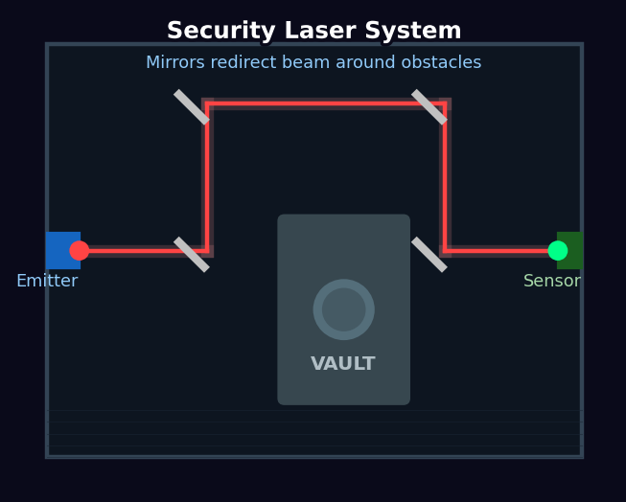
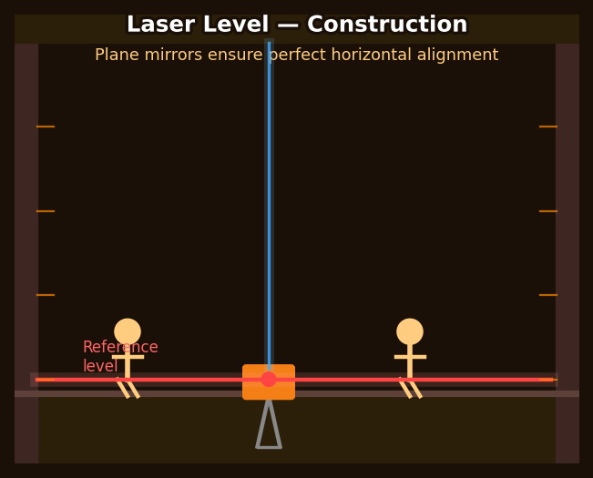
Real World Applications
Where does the Law of Reflection actually matter?
Lunar Laser Ranging
Security Systems
Laser Leveling
🌕 NASA / Astronomy
🔐 Surveillance
🏗️ Construction
Corner reflectors placed on the Moon by Apollo missions bounce laser beams back to Earth — measuring the exact Earth-Moon distance to within 1mm.
Plane mirrors redirect laser beams around obstacles to protect vaults and rooms. If the beam is broken, an alarm is triggered instantly.
Laser levels use plane mirrors to project a perfectly horizontal or vertical reference beam across entire buildings and construction sites.

Slide 10
Summary
Q1
Law of Reflection
Q2
Reflection on M₁
θᵢ = θᵣ
r₁ = 30°
Q3
Reflection on M₂
Q4
Final Proof
i₂ = r₂ = 60°
180° anti-parallel
Corner Reflector → beam always returns anti-parallel · Track 1: The Laser Grid

