Slide 1
Single-eddy-diffusivity closure is the Markovian collapse of a memory kernel
The story in one line
Turbulence models close the small scales with a simple down-gradient rule AND that's convenient, BUT the rule secretly erases the flow's memory, THEREFORE we show it is the memoryless limit of an exact memory kernel — and put the memory back.
Presenter: [your name] · [affiliation] · [ORCID]
code & data: github.com/oss2444/K
Notes:
Open with the punchline: the most common turbulence closure isn't a law, it's the zero-memory limit of something exact — and that's both why it fails and how to fix it. Keep it warm; promise one clean idea, one decisive test.

Slide 2
Think of an echo-cancelling app that erases a room's reverb
A down-gradient closure is like an app that smooths away a room's echo in real time.
It works beautifully — until the echo IS the signal you cared about.
Turbulence has a memory (an echo in time). The standard closure quietly deletes it.
The closure deletes the flow's memory. This talk is about that deleted memory.
Paper 1 · MZ closure repair · github.com/oss2444/K
2
Notes:
Picture an audio 'de-reverb' slider: handy for a phone call, fatal for measuring the room. The question of this talk is: what exactly does the closure delete, and can we put it back? Pause after the analogy and let it land before the formal version.

Slide 3
The standard closure replaces an exact memory integral with a single instant
K-theory is the Markovian-delta projection of an exact, non-local, causal response.
∫ K(t−s)·(s) ds
exact: a memory integral over history
K(0)·(t)
K-theory: only the present instant
memory → 0
the approximation that's usually hidden
Paper 1 · MZ closure repair · github.com/oss2444/K
3
Notes:
Here's the one equation of the talk, in words. The true unresolved force depends on the whole history of the flow through a Mori-Zwanzig memory kernel. Down-gradient K-theory keeps only the present instant — it collapses that kernel to a spike. State it, don't dwell.

Slide 4
How wrong it is, is set by one number — a memory (Deborah) number
De = τ_c / τ_event
memory time ÷ resolved time
error ∝ De^(p+1)
a Chapman–Enskog / Knudsen ladder
De → 0
the only limit where K-theory is exact
Paper 1 · MZ closure repair · github.com/oss2444/K
4
Notes:
The error isn't mysterious; it's governed by a single dimensionless ratio: memory time over the resolved timescale. When that ratio is tiny, K-theory is exact; when it's order one, the closure is wrong by a predictable amount. This converts a vague worry into a number you can check.

Slide 5
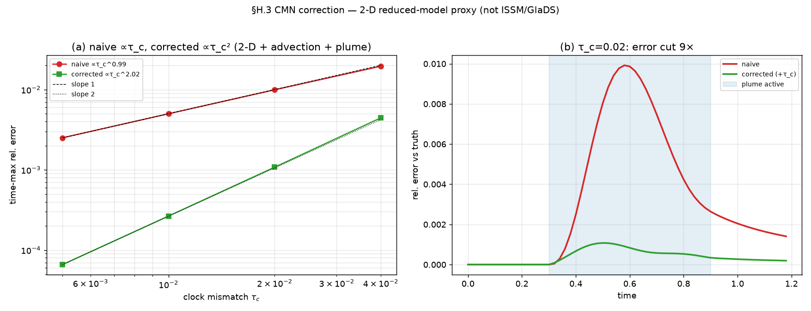
The repair keeps the memory and restores the backscatter the closure threw away
non-local ∫K
memory restored
Re Z < 0
backscatter restored (projected FDT)
∫K can be < 0
net negative eddy viscosity → growth
Kernel-based reduced model (CMN) tracking the full trajectory.
Paper 1 · MZ closure repair · github.com/oss2444/K
5
Notes:
The fix is not a fudge factor. We keep the kernel (a non-local-in-time eddy viscosity) and restore its reactive part through a projected fluctuation-dissipation relation — which brings back backscatter, energy flowing back up to large scales. Net eddy viscosity can even go negative.

Slide 6
The decisive test: the repaired kernel reproduces the exact subgrid force to round-off
5×10⁻¹⁶
MZ projection exact to
7×10⁻¹⁸
kernel = Green's function to
9×10⁻⁸
full trajectory reproduced to
VERIFIED — a-priori against the exact force; certified to round-off, not fit
Paper 1 · MZ closure repair · github.com/oss2444/K
6
Notes:
This is the slide to slow down on. It's an a-priori test against the exact filtered force — not a tuned fit. The projection is exact to 1e-16, the kernel equals the eliminated channel's Green's function to 1e-18, and the reduced model tracks the full trajectory to 1e-8. The memory is necessary to get the interior peak. This is a structural identity, not a calibration.

Slide 7
The memory time is a real, measurable property of the flow — not of the tracer
one τ_c
sets kernel cutoff AND coupling roll-off
scalar-independent
a property of the flow
inverts for V̄
a measurable handle
Paper 1 · MZ closure repair · github.com/oss2444/K
7
Notes:
One last point that makes it useful: the memory clock is the same regardless of which scalar you advect, and it inverts for a mean transport speed. So it's a physical handle, not a bookkeeping device — something you could measure.

Slide 8
What is verified, what is falsified, what is still open
VERIFIED
FALSIFIED
OPEN
• MZ structure of the kernel (round-off)
• Error ∝ De^(p+1) ladder
• Backscatter via projected FDT
• 1-D + 2-D advection / plume proxy
• Down-gradient K-theory as a universal law
• (1+CV²)-type local enhancement
• Full 3-D turbulent ice-flow solver test
• In-situ field calibration of τ_c
Paper 1 · MZ closure repair · github.com/oss2444/K
8
Notes:
Be honest and quick: verified a-priori and in proxies, not yet in a full 3-D solver; that's the next step, not a hidden caveat.

Slide 9
The takeaway: closure failure is a memory problem, and memory is repairable
memory number
tells you WHEN it fails
projected MZ kernel
tells you HOW to fix it
public + reproducible
github.com/oss2444/K
Paper 1 · MZ closure repair · github.com/oss2444/K
9
Notes:
Land the plane. One sentence: when a down-gradient model fails, it's because the memory number isn't small — and we can put the memory (and its backscatter) back, verified. Point them to the public code and the companion relationships NR1, NR13, NR15, NR23.

