Slide 1
A boundary-condition-robust ceiling on turbulent basal melt
The story in one line
We worry turbulence speeds up melt under grounded ice AND it sounds plausible, BUT when we test it the melt is capped by a thin conductive skin, THEREFORE turbulence does not raise the net melt — there is a ceiling.
Presenter: [your name] · [affiliation] · [ORCID]
code & data: github.com/oss2444/K
Notes:
Hook with the stake: basal melt sets how fast ice can ungroundi, and a popular assumption is that turbulence cranks it up. We tested that assumption and it failed — in a useful way.

Slide 2
Think of a wool blanket, not the wind outside it
How fast heat reaches the ice is set by a thin conductive layer right at the interface —
like a wool blanket. You can blow on a blanket as hard as you like;
the blanket, not the wind, sets how fast heat gets through.
If conduction is the bottleneck, stirring the outside barely moves the melt.
Paper 2 · Melt ceiling · github.com/oss2444/K
2
Notes:
Everyone reaches for 'more turbulence = more mixing = more melt'. But if a conductive skin is the bottleneck, stirring the outside barely matters. Hold the blanket image; we'll now show the data agrees with the blanket, not the wind.

Slide 3
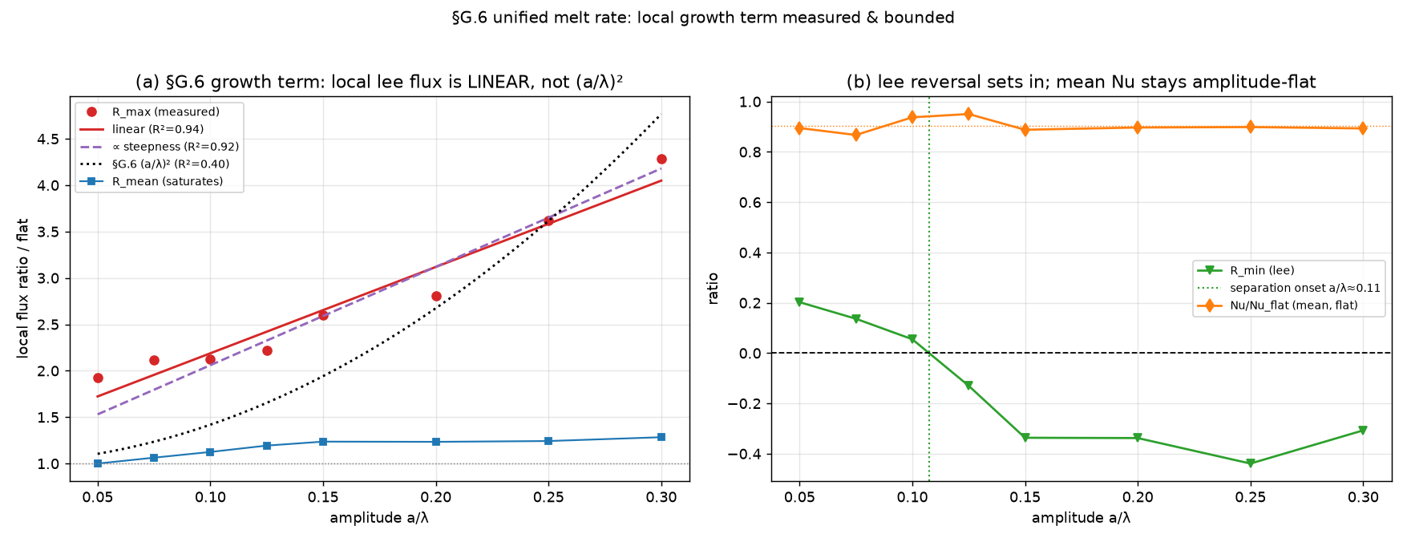
Turning the turbulence off entirely barely changes the melt
flow off ⇒ ~1%
pure conduction reproduces the melt
ceiling
set by the conductive sublayer
not momentum
transport doesn't enhance net melt
Local flux law across the swept control and all closures.
Paper 2 · Melt ceiling · github.com/oss2444/K
3
Notes:
This is the cleanest version of the result. We sweep the solver across closures and boundary conditions, then switch the flow off completely — pure conduction. The melt is reproduced to about one percent. If momentum transport drove melt, that couldn't happen.

Slide 4
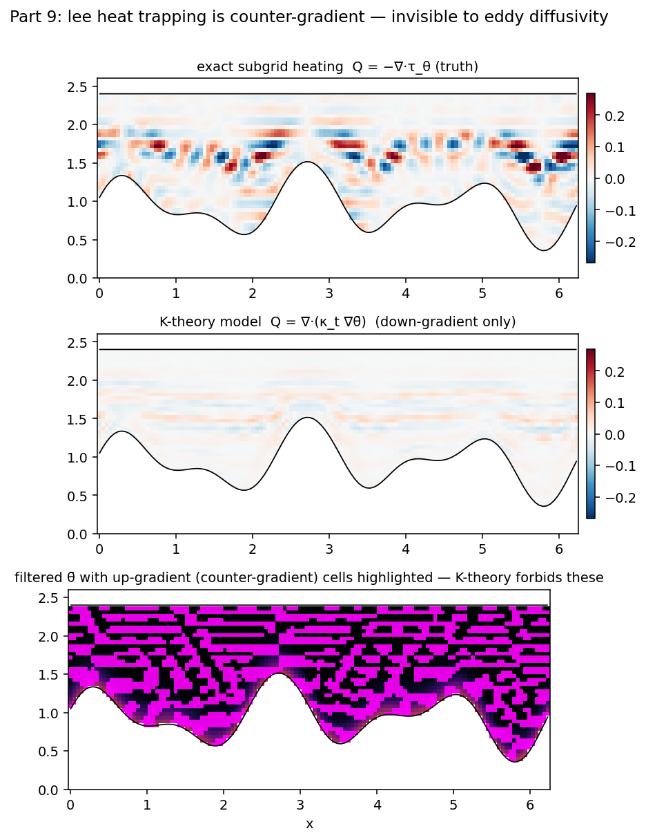
Three plausible turbulent enhancement mechanisms each net to ≈ zero
3 mechanisms
all net to ≈ no gain
(1+CV²)
variance enhancement falsified
area × local flux
mean stays bounded
Subglacial heat-flux field; area-averaged enhancement ≈ 0.
Paper 2 · Melt ceiling · github.com/oss2444/K
4
Notes:
We didn't just assert it — we tried the three ways turbulence could plausibly boost melt. Averaged over the bed, each one cancels: net melt is area times local flux, and the average is bounded. The popular (1+CV²) variance enhancement is actually falsified here.

Slide 5
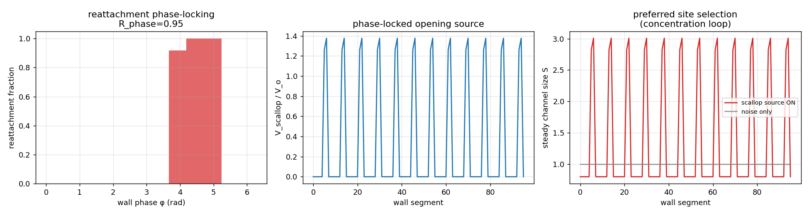
Scallops are a real LOCAL signal — but the basin mean stays under the ceiling
+33% area
local channel growth (calibration-free)
ρL cancels
no free latent-heat knob
mean bounded
still under the ceiling
Scallop → channel feedback geometry.
Paper 2 · Melt ceiling · github.com/oss2444/K
5
Notes:
Be fair to the other side: there IS a positive signal. Scalloped beds grow channels locally, plus thirty-three percent in area, and it's calibration-free — the latent-heat constant cancels. But locally positive and mean-bounded are not the same thing; the average still respects the ceiling.

Slide 6
The ceiling survives the modelling choices a skeptic would attack — same answer
no-slip = slip
trajectories match bit-for-bit
across closures
not one-model luck
BC-robust
the ceiling holds
Boundary-condition robustness (slip gate / wall-flux).
VERIFIED — robust across boundary conditions and closures
Paper 2 · Melt ceiling · github.com/oss2444/K
6
Notes:
This is why it's trustworthy. No-slip versus slip walls reproduce the trajectory bit-for-bit; the result isn't an artifact of one wall model or one closure. Robustness is the headline.

Slide 7
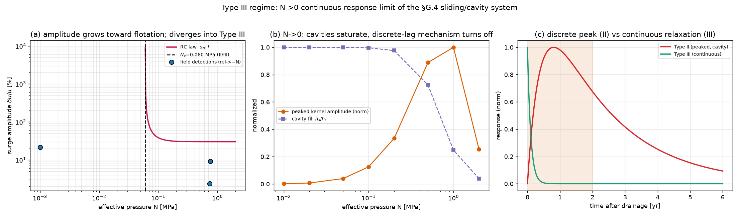
The deliverable is a regime map: where conduction pins melt vs where channels matter
Regime map in the effective-pressure / forcing plane.
Paper 2 · Melt ceiling · github.com/oss2444/K
7
Notes:
End on something usable. We hand modellers a map: most of the grounded cavity sits in the conduction-pinned regime, with channelization mattering only in a corner. That's a drop-in closure for basal-melt parameterizations.

Slide 8
What is verified, what is falsified, what is still open
VERIFIED
FALSIFIED
OPEN
• Conductive-sublayer ceiling (BC-robust)
• Flow-off reproduces melt (~1%)
• Scallop +33% local (calibration-free)
• Regime-map deliverable
• Momentum-transport melt enhancement
• (1+CV²) variance truncation
• Network concentration gain g∈[0.1,0.9]
• Validation at a real cavity
Paper 2 · Melt ceiling · github.com/oss2444/K
8
Notes:
Keep it crisp: the falsified item (turbulent enhancement) is the point of the paper, not an embarrassment. The one open knob is the network gain.

Slide 9
The takeaway: don't budget for turbulent melt enhancement — budget for the ceiling
ceiling, not boost
the modelling takeaway
conduction-set
the mechanism
reproducible
github.com/oss2444/K
Paper 2 · Melt ceiling · github.com/oss2444/K
9
Notes:
Land it: in grounded subglacial cavities, the safe modelling assumption is a conduction-set ceiling, not turbulent enhancement. Connects to NR5. Point to the public code.

