Slide 1
Falsifiable forecasts for subglacial hydrology
The story in one line
Subglacial water drives the ice AND we have predictions, BUT most aren't checkable on real data, THEREFORE we make three and hold each to verify-or-falsify on open Antarctic data — including the one we lost.
Presenter: [your name] · [affiliation] · [ORCID]
code & data: github.com/oss2444/K
Notes:
Open with the stance, not the results: the field is full of plausible stories about water under the ice; we made three concrete predictions and put each on trial against open data. Promise honesty — one is verified twice, one is falsified, one is an honest null.

Slide 2
Three bets on the ice — and we show our hand on every one
We make three predictions about water under the ice, and we test each on open data.
One we verify — twice, on two independent datasets. One we falsify outright.
One comes back an honest null — and we can say exactly why.
A forecast you can't lose isn't a forecast. Here are three we could lose.
Paper 4 · Hydrology forecasts · github.com/oss2444/K
2
Notes:
Most talks show you only the bets they won. The discipline here is that we report all three the same way. That's what makes them forecasts and not stories.

Slide 3
Ocean water should intrude grounded ice exactly where ocean pressure beats the water pressure
A 'door that opens only when the outside pressure wins.'
RTN = (p_ocean − p_atm) / p_w
ocean head vs subglacial water pressure
RTN > 1
ocean can intrude grounded ice
directional
should concentrate at grounding lines
Paper 4 · Hydrology forecasts · github.com/oss2444/K
3
Notes:
Set up bet one simply. Define a dimensionless number, RTN, that compares the ocean's pressure at the bed to the subglacial water pressure. When it exceeds one, the ocean can push in. It's a door that only opens when the outside pressure wins. The prediction is directional: this should cluster at grounding lines.

Slide 4
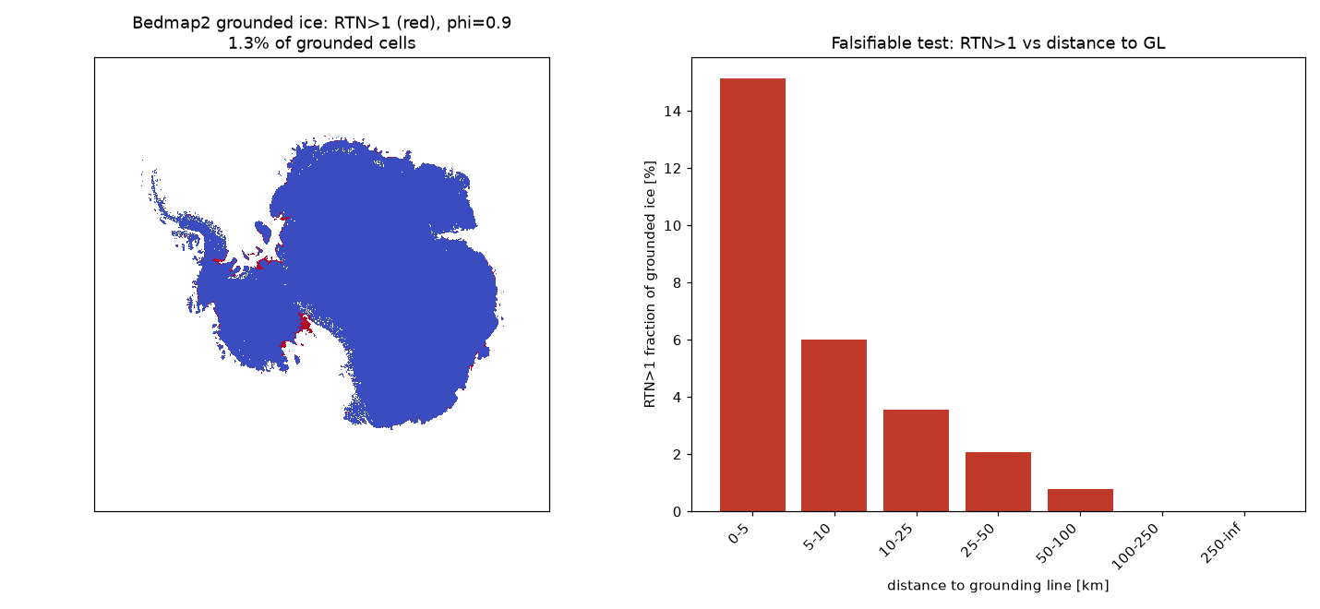
On real Bedmap2 geometry, the intrusion signal piles up at the grounding line
6 km
median dist. to GL (RTN>1)
222 km
median for all other cells
monotonic
decays smoothly inland
RTN>1 concentration vs distance-to-grounding-line (Bedmap2).
Paper 4 · Hydrology forecasts · github.com/oss2444/K
4
Notes:
Bet one, first dataset. On real Antarctic geometry the RTN>1 cells sit a median six kilometres from the grounding line; everything else is two hundred-plus kilometres away. The signal decays monotonically inland. Show the map; let them see the concentration.

Slide 5
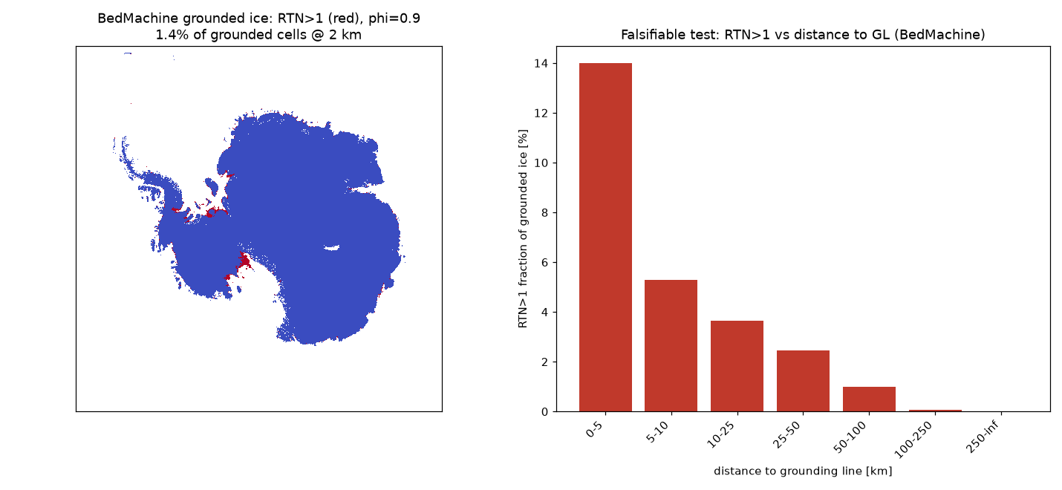
The signal survives an independent dataset — so it isn't an artifact of one map
2.5 / 1.4 / 0.8%
RTN>1 fraction, φ=0.8/0.9/0.95
r = 0.970
BedMachine vs Bedmap2 thickness
10/10
loader tests pass
Independent BedMachine v4 cross-check (decimated to 2 km).
VERIFIED — reproduces on an independent thickness inversion
Paper 4 · Hydrology forecasts · github.com/oss2444/K
5
Notes:
This is the slide that earns trust. We rerun on BedMachine v4 — a completely independent thickness inversion — and get the same decay and the same fractions. The two thickness maps agree at r equals 0.97, and the loader tests pass. One dataset is a claim; two is a result.

Slide 6
Our first guess for surge timing — ice thermal diffusion — is wrong by ~80,000×
τ_ice ≈ 151,000 yr
thermal-diffusion lag on 131 lakes
0.02–2 yr
observed post-drainage lags
~8×10⁴× too slow
a clean, diagnostic falsification
FALSIFIED — thermal sliding-lag kernel, on real geometry
Paper 4 · Hydrology forecasts · github.com/oss2444/K
6
Notes:
Bet two, and we lose it cleanly. The natural hypothesis is that ice-stream surges lag the water forcing by the time heat diffuses through the ice. On 131 real lakes that time is 150,000 years; observed lags are months. It's off by ten thousands. A thick ice slab simply can't feel a fast pulse — and saying so out loud is the point.

Slide 7
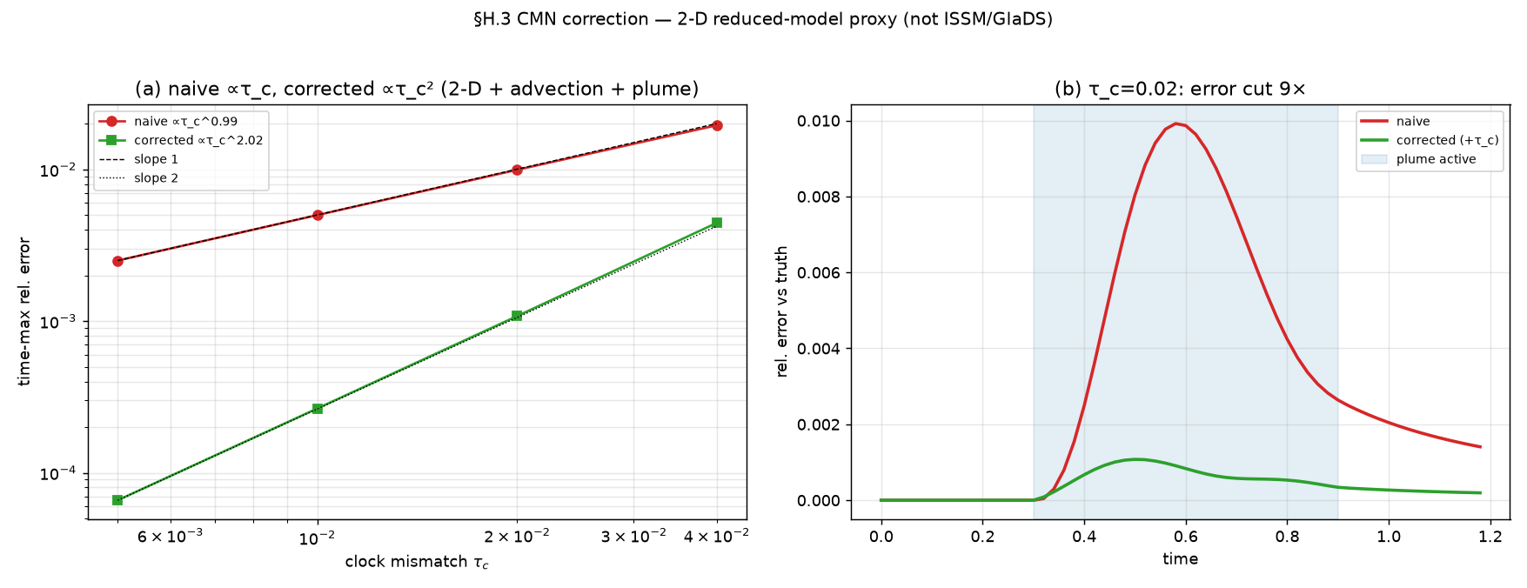
The memory isn't in the ice — it's in the plumbing, and it's an exact memory kernel
hydrology, not ice
where the memory lives
exact MZ kernel
kernel = Green's function
7×10⁻¹⁸
certified to
Reduced cavity↔channel memory model vs full trajectory.
VERIFIED — same MZ structure certified in Paper 1
Paper 4 · Hydrology forecasts · github.com/oss2444/K
7
Notes:
The falsification is productive: it tells us where the memory lives. The cavity-to-channel hydraulic system has a linear response that is an exact Mori-Zwanzig memory kernel — the same structure certified in Paper 1, here to one part in 10^18. So we replaced a wrong clock with a right one.

Slide 8
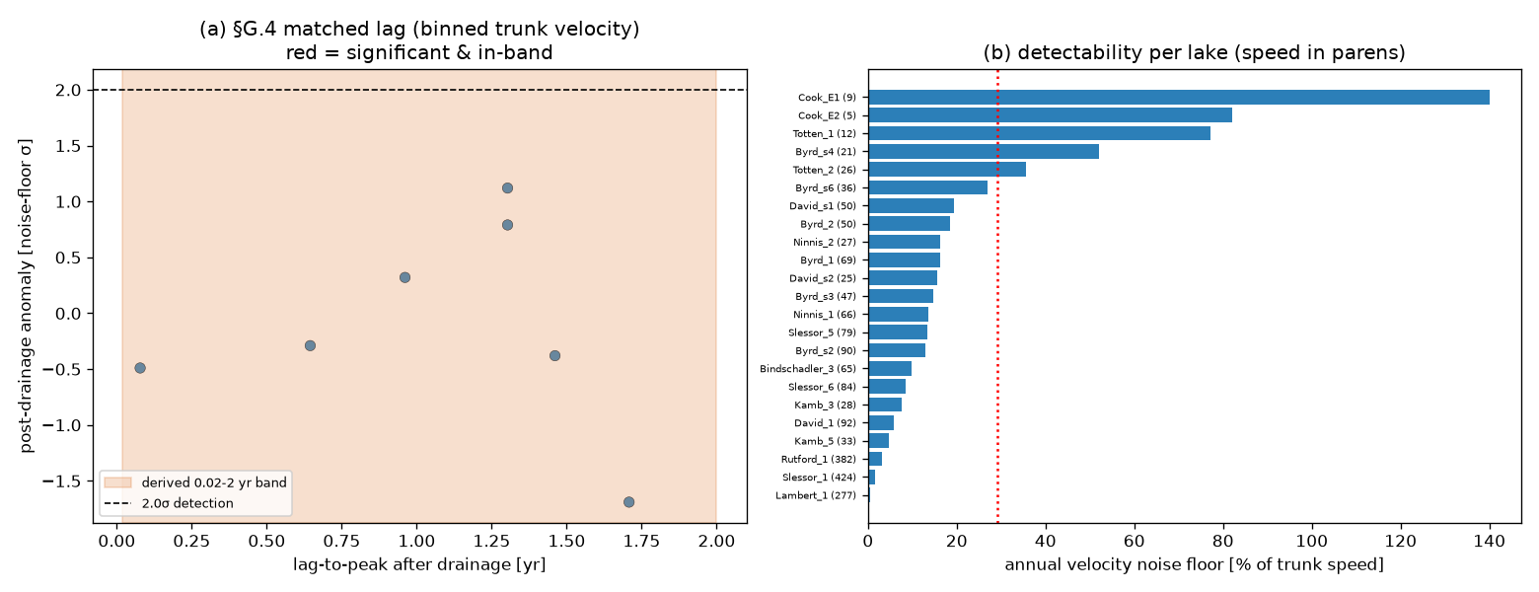
Bet three is an honest null on open data — and we can say exactly why
+0.56σ, 0/5
no significant lag detected
temporal aliasing
sub-annual lag vs quarterly data
fix: sub-annual GPS
the route to a verdict
Matched lake-drainage → velocity lag (CryoSat-2 + ITS_LIVE).
OPEN — unverifiable here for a stated, fixable reason — not a refutation
Paper 4 · Hydrology forecasts · github.com/oss2444/K
8
Notes:
Bet three: test the lag directly on satellite data. We get no significant signal — peak half a sigma, zero of five events. But this isn't a quiet failure: the cause is temporal aliasing, the real lag is sub-annual and the data is quarterly. The fix is named: sub-annual GPS or fast-outlet velocity. An honest null, not a swept-under-the-rug one.

Slide 9
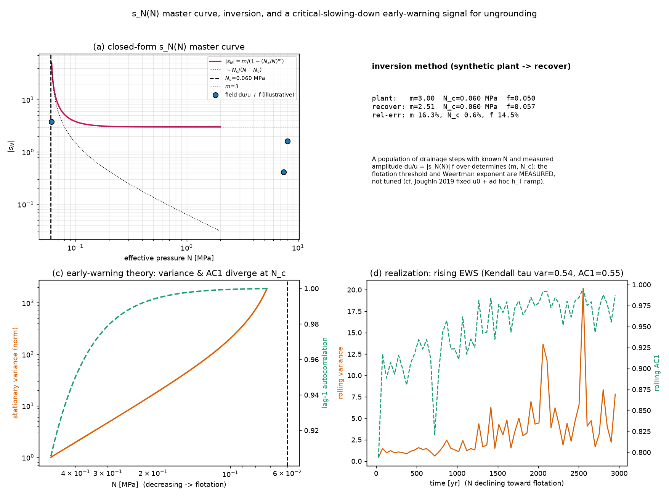
We can read the sliding law off the surface — three independent ways
|s_N| = m/(1−(N_c/N)^m)
closed-form, verified 1.4×10⁻⁴
3 probes
drainage / ocean-thermal / tides
N_c to a few %
+ ungrounding early-warning
s_N(N) master curve and inversion.
Paper 4 · Hydrology forecasts · github.com/oss2444/K
9
Notes:
Now the constructive payoff. There's a closed-form effective-pressure 'master curve' for sliding, verified to 1e-4, that you can probe three independent ways — drainage steps, ocean-thermal gating, and ocean tides — and invert for the flotation threshold to a few percent. It even gives an ungrounding early-warning.

Slide 10
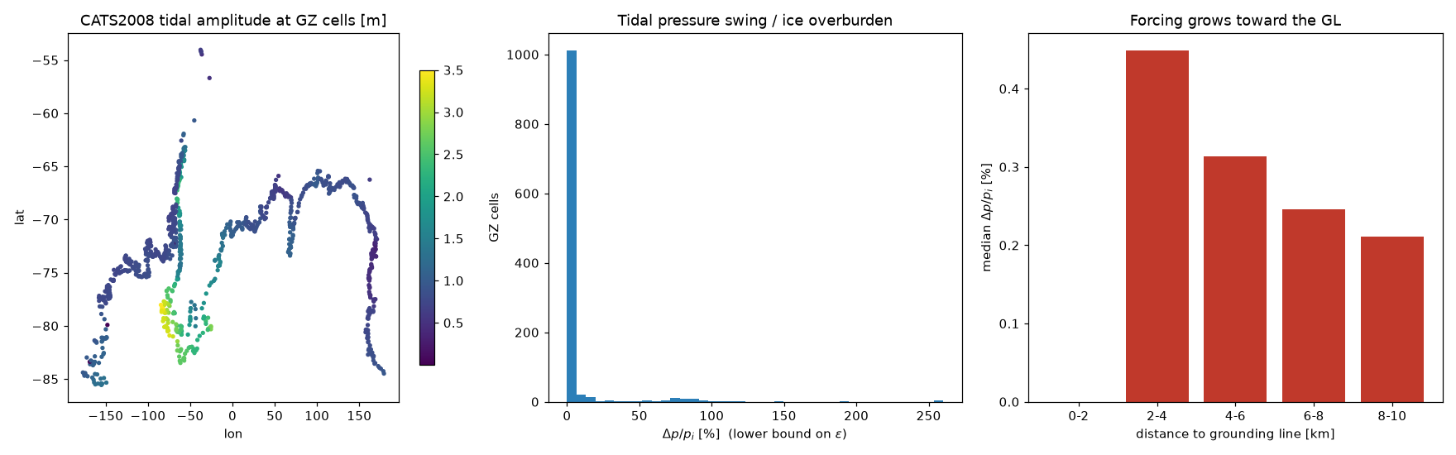
And the tidal forcing it relies on is measured, not assumed
0.30%
median tidal swing / overburden
0.21% → 0.45%
grows toward the grounding line
n = 1108
valid grounding-zone cells
Tidal pressure swing vs distance-to-grounding-line (CATS2008 × BedMachine).
VERIFIED — the forcing magnitude is measured (CATS2008 × BedMachine)
Paper 4 · Hydrology forecasts · github.com/oss2444/K
10
Notes:
Close the loop on a real number. The tidal probe needs a forcing amplitude — and we measure it from the CATS2008 tide model across the BedMachine grounding zone, not assume it. The tidal pressure swing is 0.3% of the ice overburden, growing toward the grounding line. Eleven hundred valid cells.

Slide 11
What is verified, what is falsified, what is still open
VERIFIED
FALSIFIED
OPEN
• RTN GL concentration (Bedmap2 + BedMachine)
• MZ kernel structure (round-off)
• s_N(N) master curve (1.4×10⁻⁴)
• Tidal forcing measured (CATS2008)
• Thermal (τ_ice) sliding-lag kernel
• Surge memory living in ice thermics
• Matched lag (honest null; aliasing)
• Ro thinning vs hydraulic (needs DInSAR)
• Absolute s_N calibration (per-event)
Paper 4 · Hydrology forecasts · github.com/oss2444/K
11
Notes:
Show all three outcomes on one slide — verified, falsified, open — because that even-handedness is the contribution. Don't hide the red column; point at it.

Slide 12
The takeaway: real forecasts you can lose — and a method that pays off when you do
verify / falsify / null
all reported the same way
productive falsification
wrong clock → right clock
public + reproducible
github.com/oss2444/K
Paper 4 · Hydrology forecasts · github.com/oss2444/K
12
Notes:
Land the whole talk: we made three falsifiable forecasts on open data, won one twice, lost one cleanly, and turned an honest null into a concrete next measurement — plus a field-readable sliding law and an ungrounding early-warning. Everything is public and reproducible.

