Slide 1

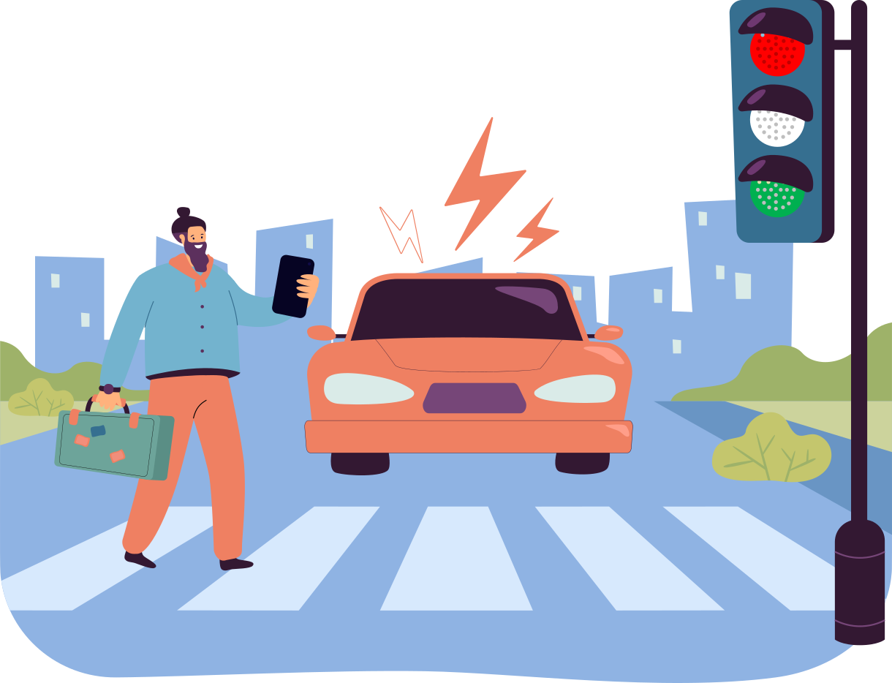

Machine Learning
Table of Contents
01
Using Machine Learning for Pedestrian Detection and Attribute Classification to Improve Road Safety
05
Introduction
Model 2- VAE
02
Project Summary
06
Sample code- VAE
03
Model 1- LSTM
07
Model Comparison
04
Sample Code- LSTM
08
Conclusion and Recommendations
Made by Group 3

Slide 2

Machine Learning
Machine Learning
Table of Contents
Using Machine Learning for Pedestrian Detection and Attribute Classification to Improve Road Safety
01
05
Introduction
Model 2- VAE
02
06
Project Summary
Sample code- VAE
03
07
Model 1- LSTM
Model Comparison
04
08
Sample Code- LSTM
Conclusion and Recommendations

Slide 3
01
Introduction
Why This Project?
Predicting pedestrian motion is essential for traffic safety in cities.`
We use deep learning models to analyze past motion and predict future poses in real-world scenarios.

Slide 4
01
Introduction
Why This Project?
GOAL
Build a deep learning system that predicts the future 3D pose of pedestrians using real-world image sequences.
Predicting pedestrian motion is essential for traffic safety in cities.`
We use deep learning models to analyze past motion and predict future poses in real-world scenarios.

Slide 5




01
Introduction
Why This Project?
GOAL
Build a deep learning system that predicts the future 3D pose of pedestrians using real-world image sequences.
Predicting pedestrian motion is essential for traffic safety in cities.
Predicting pedestrian motion is essential for traffic safety in cities.`
We use deep learning models to analyze past motion and predict future poses in real-world scenarios.
02
Project Summary

Slide 6
01
Introduction
The Project Focuses On
02
GOAL
Build a deep learning system that predicts the future 3D pose of pedestrians using real-world image sequences.
Project Summary

Slide 7
The Project Focuses On
02
Detecting pedestrians in images and videos
Detecting pedestrians in images and videos
Project Summary
Recognizing their visual attributes (e.g., gender, bag).
Recognizing their visual attributes (e.g., gender, bag).
Using real-world datasets from surveillance cameras.
Using real-world datasets from surveillance cameras.

Slide 8
The Project Focuses On
02
03
Predicting future pedestrian poses using deep learning models
Project Summary
Model 1 – LSTM
Analyzing temporal motion data from video sequences
Training models on real-world datasets like 3DPW
Based on public data and models available online

Slide 9


What is LSTM?
Long Short-Term Memory is a model built on a specialized Recurrent Neural Network architecture specifically designed to handle long-term dependencies in sequential data by overcoming the vanishing gradient problem.
Uses memory cells and gates to manage information flow.
03
Model 1 – LSTM
How it Works?
What is YOLOv3?
A fast object detection model that finds people in images or videos in real-time.
What is YOLOv3?
A fast object detection model that finds people in images or videos in real-time.
Function: Detects people in images/videos in real-time.
•⁠ ⁠How it works:
- Splits the image into grids.
- Predicts bounding boxes for people.
•⁠ ⁠Dataset: Public surveillance video (e.g., Milan station).

Slide 10
03
Model 1 – LSTM
Why LSTM?
Pedestrian motion is sequential and time-dependent
LSTM learns movement patterns by remembering previous positions.
Helps predict how a pedestrian’s global position evolves by learning patterns in movement speed and direction.
What is LSTM?
Long Short-Term Memory is a model built on a specialized Recurrent Neural Network architecture specifically designed to handle long-term dependencies in sequential data by overcoming the vanishing gradient problem.
Uses memory cells and gates to manage information flow.

Slide 11
03
How it Works?
Model 1 – LSTM
Why LSTM?
Pedestrian motion is sequential and time-dependent
LSTM learns movement patterns by remembering previous positions.
Helps predict how a pedestrian’s global position evolves by learning patterns in movement speed and direction.
What is LSTM?
Long Short-Term Memory is a model built on a specialized Recurrent Neural Network architecture specifically designed to handle long-term dependencies in sequential data by overcoming the vanishing gradient problem.
Uses memory cells and gates to manage information flow.
Sequential Input
The LSTM model receives pose sequences frame by frame.
Memory Mechanism
At every time step, the LSTM updates its cell state.
Gates that are responsible for Information Flow:
Forget Gate, Input Gate, Output Gate
Output Prediction: The final output at each step is a vector representing the predicted global speed or movement direction, which is then converted into future poses using a speed-to-position conversion function
04
Sample Code – LSTM

Slide 12
03
How it Works?
Model 1 – LSTM
Practical example:
In our project, we used the Global Model (net_g), an LSTM-based model, to predict global motion. The LSTM model receives a sequence of past 3D poses from a pedestrian. The model analyzes how the pedestrian has been moving and predicts how that motion will continue over the next few frames.
Why LSTM?
Pedestrian motion is sequential and time-dependent
LSTM learns movement patterns by remembering previous positions.
Helps predict how a pedestrian’s global position evolves by learning patterns in movement speed and direction.
Sequential Input
The LSTM model receives pose sequences frame by frame.
Memory Mechanism
At every time step, the LSTM updates its cell state.
Gates that are responsible for Information Flow:
Forget Gate, Input Gate, Output Gate
Output Prediction: The final output at each step is a vector representing the predicted global speed or movement direction, which is then converted into future poses using a speed-to-position conversion function
04
Sample Code – LSTM

Slide 13
03
How it Works?
Model 1 – LSTM
Practical example:
In our project, we used the Global Model (net_g), an LSTM-based model, to predict global motion. The LSTM model receives a sequence of past 3D poses from a pedestrian. The model analyzes how the pedestrian has been moving and predicts how that motion will continue over the next few frames.
Sequential Input
The LSTM model receives pose sequences frame by frame.
Memory Mechanism
At every time step, the LSTM updates its cell state.
Gates that are responsible for Information Flow:
Forget Gate, Input Gate, Output Gate
Output Prediction: The final output at each step is a vector representing the predicted global speed or movement direction, which is then converted into future poses using a speed-to-position conversion function
04
Sample Code – YOLOv3

Slide 14
Dataset
Where is your Dataset ?
The 3DPW dataset was chosen because it provides real-world walking scenes and accurate 3D pose annotations, making it ideal for training models to predict human movement. Additionally, the dataset is easier to use compared to others due to its well-organized structure and convenient annotations.
The dataset is structured as JSON files, where each file corresponds to a specific video sequence. Each JSON file contains a list of frames, with each frame representing a human pose. The annotations for each frame include keypoints that represent the 3D coordinates of different body parts (e.g., head, shoulders, hips, knees, etc.). These keypoints are used to train the model to predict future poses based on previous frames.

Slide 15
Folder structure
somof_data_3dpw/: This folder contains the dataset for the 3DPW dataset. It includes video sequences and the corresponding 3D human pose annotations (in JSON format) that will be used for training and testing the models.
train.py: This script is used for training the model on the training dataset. It loads the training data, processes it, and trains the model (using model.py). It also saves the trained model weights for later use.
valid.py: This script is used for validating the model using the validation dataset. During training, it's important to evaluate the model's performance on unseen data to monitor overfitting. This script runs after training to check how well the model generalizes.
test.py: This script is used for testing the model on the test dataset. After training, the model's performance is tested using this dataset to evaluate its real-world application. The script generates predictions and compares them to the ground truth to calculate accuracy and other metrics.
DataLoader.py: This file contains the data loader function for the training and validation datasets. It reads the data from the 3DPW dataset, processes it, and prepares it for input to the neural network. It also handles batching and shuffling of the data to improve training.
DataLoader_test.py: This file contains the data loader function for the test dataset. Like DataLoader.py, it reads the test data, processes it, and prepares it for evaluation. The key difference is that this loader is used exclusively for the test set, which is not used during training.
model.py: This file contains the neural network architecture. It defines the Encoder and Decoder networks, which are used to predict the global and local motion of the human body. It also includes the LSTM and VAE models for predicting future poses from past data.
utils.py: This file contains various helper functions needed throughout the project. These could include data processing functions, metrics calculation, model evaluation utilities, and other functions that are used in different parts of the project.
viz.py: This file is used for visualizing predictions and results. It can display graphs, plots, or visual representations of the predicted poses versus the actual poses. This helps in debugging and assessing the model's performance.

Slide 16

03
Model 1 – LSTM
Practical example:
In our project, we used the Global Model (net_g), an LSTM-based model, to predict global motion. The LSTM model receives a sequence of past 3D poses from a pedestrian. The model analyzes how the pedestrian has been moving and predicts how that motion will continue over the next few frames.
04
Sample Code – LSTM

Slide 17
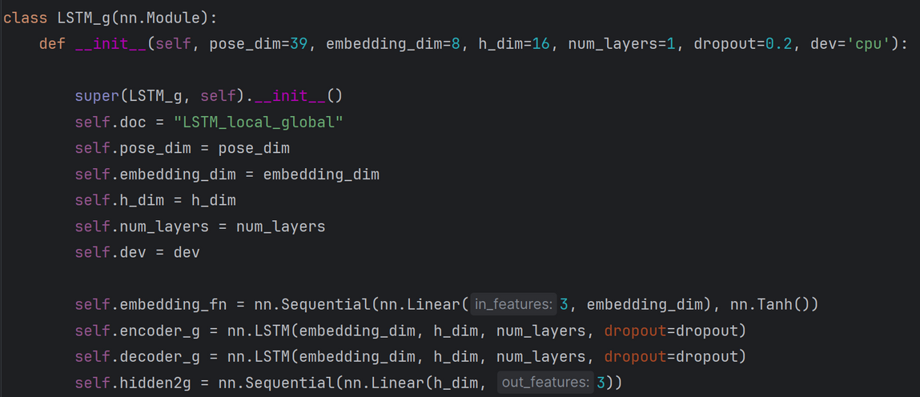
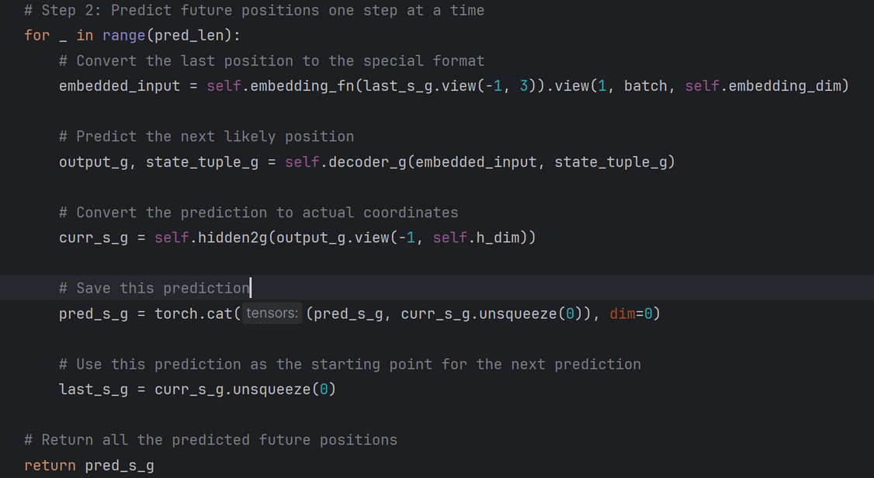
04
Sample Code – LSTM
from model.py
05
Model 2 – VAE

Slide 18
04
Sample Code – YOLOv3
What is VAE?
Variational Autoencoder (VAE) is a generative model based on autoencoders. It encodes data into distributions (mean and variance) in a latent space instead of a single point, enabling diverse and uncertain data generation.
05
Model 2 – VAE
Why VAE for Data Generation?
VAEs excel at encoding high-dimensional data into a lower-dimensional latent space, making them ideal for generating new, realistic data that resembles the training set. This is useful for applications like image synthesis, anomaly detection, and data augmentation.

Slide 19
05
Model 2 – VAE
What is VAE?
Variational Autoencoder (VAE) is a generative model based on autoencoders. It encodes data into distributions (mean and variance) in a latent space instead of a single point, enabling diverse and uncertain data generation.
How It Works:
Sequential Input
Encoding
Sampling Decoding
Loss Function
Practical Example in Our Project:
We use a VAE-based model to generate synthetic data, capturing the data's structure to augment our training set and enhance performance in machine learning tasks.
Why MoveNet?
Real-time performance (30+ FPS).
Two variants:
Lightning: Fast, for mobile and edge devices.
Thunder: More accurate, for precision needs.
Great for recognizing human movement.
Applications in Autonomous Vehicles:
Predicts pedestrian movements by analyzing posture.
Helps differentiate moving people from static obstacles.
Why VAE for Data Generation?
VAEs excel at encoding high-dimensional data into a lower-dimensional latent space, making them ideal for generating new, realistic data that resembles the training set. This is useful for applications like image synthesis, anomaly detection, and data augmentation.

Slide 20
05
Model 2 – VAE
What is VAE?
Variational Autoencoder (VAE) is a generative model based on autoencoders. It encodes data into distributions (mean and variance) in a latent space instead of a single point, enabling diverse and uncertain data generation.
How It Works:
Sequential Input
Encoding
Sampling Decoding
Loss Function
Practical Example in Our Project:
We use a VAE-based model to generate synthetic data, capturing the data's structure to augment our training set and enhance performance in machine learning tasks.
Dataset Used:
normally MoveNet is trained on datasets like COCO Key points.
Why VAE for Data Generation?
VAEs excel at encoding high-dimensional data into a lower-dimensional latent space, making them ideal for generating new, realistic data that resembles the training set. This is useful for applications like image synthesis, anomaly detection, and data augmentation.

Slide 21
How It Works:
Sequential Input
Encoding
Sampling Decoding
Loss Function
Practical Example in Our Project:
We use a VAE-based model to generate synthetic data, capturing the data's structure to augment our training set and enhance performance in machine learning tasks.
06
Sample Code- VAE

Slide 22
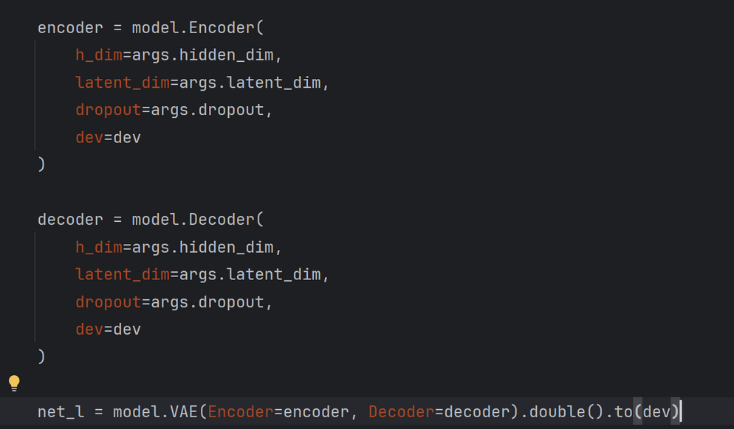
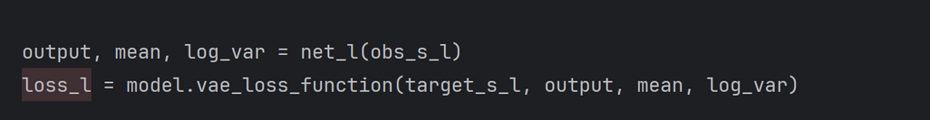
06
Sample Code- VAE
MoveNet output:
Movnet cannot estimate more than 1 objects at once
from train.py
07
Comparison Between Models

Slide 23
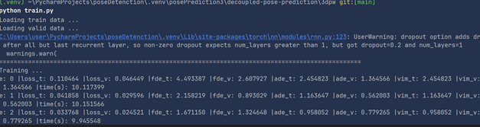
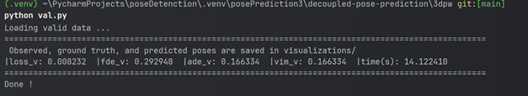
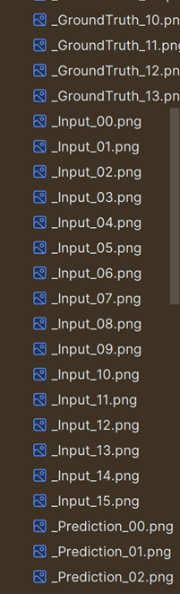
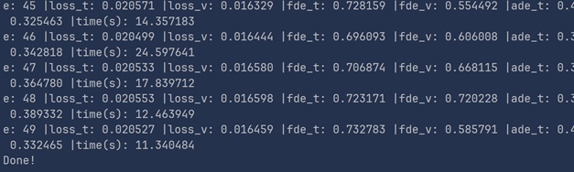
Usage example :

Slide 24
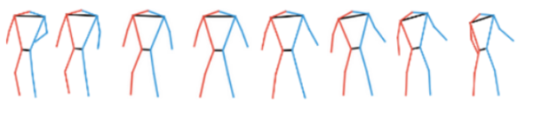
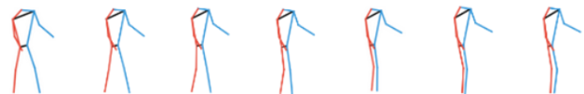
Final output
Image :
Predicted :

Slide 25
06
Sample Code- MoveNet
•⁠ ⁠Example of how a trained CNN can classify a person’s image.
•⁠ ⁠Simulates HP-CNN’s behavior (simplified version).
MoveNet output:
Movnet cannot estimate more than 1 objects at once
07
Comparison Between Models
Model | Purpose | Strength | Limitation
LSTM | predict sequential or time-series data | Captures long-term dependencies in sequence data | Training is slow and struggles with very long sequences
VAE | generate new data samples | Learns latent representations for generative tasks | Generated outputs can be blurry

Slide 26
07
Comparison Between Models
Model | Purpose | Strength | Limitation
LSTM | predict sequential or time-series data | Captures long-term dependencies in sequence data | Training is slow and struggles with very long sequences
VAE | generate new data samples | Learns latent representations for generative tasks | Generated outputs can be blurry
08
Conclusion & Recommendations

Slide 27
Model | Purpose | Strength | Limitation
LSTM | predict sequential or time-series data | Captures long-term dependencies in sequence data | Training is slow and struggles with very long sequences
VAE | generate new data samples | Learns latent representations for generative tasks | Generated outputs can be blurry
07
Comparison Between Models
08
Conclusion & Recommendations
ML models like LSTM and VAE are powerful tools for road safety.
•⁠ ⁠Public datasets (e.g., RAP) make it easier to build and test models.
•⁠ ⁠Simple code implementations show how these systems work in real life.
•⁠ ⁠These models can be used in smart cars, surveillance, and traffic systems.

Slide 28
08
Conclusion & Recommendations
ML models like LSTM and VAE are powerful tools for road safety.
•⁠ ⁠Public datasets (e.g., RAP) make it easier to build and test models.
•⁠ ⁠Simple code implementations show how these systems work in real life.
•⁠ ⁠These models can be used in smart cars, surveillance, and traffic systems.

