Slide 1

INFOLINK
UNIVERSIY COLLEGE HAWASSA CAMPUS
DEPARTMENT OF COMPUTER SCIENCE
“Location Based Drug Store Information System For Yanet Hospital Hawassa”
February 2026
Hawassa, Ethiopia

Slide 2
Group Members ID no
1. Betelhem Tewodros 818625-15
2. Tiblet Guyo 316919-15
3. Tsehay Jima 595442-15
Advisor’s name: Mr. Gizaw Melese

Slide 3
Presentation Content
Introduction
Background of the Study
Statement of the Problem
Objectives of the Project
Scope of the project
Significance of the Project
Methodology
Development Tools
Existing System
Functional requirement
Non- Functional requirement
Analysis Diagrams Design

Slide 4
Introduction
Pharmaceutical services are critical for maintaining public health by ensuring safe, timely, and reliable access to medicines.
In Hawassa City, these services are provided by hospitals and pharmacies, including Yanet Primary Hospital.
Yanet Primary Hospital operates three pharmacy branches that serve a large number of patients every day.
The hospital currently uses an internal pharmacy system mainly for inventory management, such as recording medicines, updating stock levels, and removing expired items.
This system is not accessible to customers.

Slide 5
Background of the Project
Pharmacies and drug stores play a key role in healthcare by ensuring safe and timely access to medicines.
In Yanet Pharmacies and the Yanet Drug Store, medicine ordering and distribution are still handled mainly through manual processes.
Customers must visit pharmacies with paper prescriptions, while pharmacy staff check medicine availability using internal system
When medicines are unavailable, pharmacies contact the drug store using phone calls or paper requests, causing delays and lack of real-time updates.
The absence of a centralized digital system leads to medicine shortages, overstocking, repeated customer visits, and service inefficiencies.

Slide 6
Statement of the Problem
The existing pharmacy system at Yanet Primary Hospital does not provide digital access to services for customers.
Customers must physically visit pharmacy branches to check medicine availability and prices.
There is no online system for remote medicine ordering.
Home delivery services for medicines are not available.
Manual, in-person service processes result in long waiting times and inconvenience.
Pharmacy branches lack an integrated online system to request medicines and track inventory updates from the Yanet Drug Store.
Medicine requests and deliveries between the Yanet Drug Store and other pharmacies are managed manually, without real-time tracking

Slide 7
Objectives of the System
General Objective
To develop a web-based Location-Based Drug Store Information System that improves access to medicines, supports online ordering and delivery, and enhances coordination among Yanet Primary Hospital pharmacies, Yanet Drug Store, and other pharmacies in Hawassa City.
Specific Objectives
Enable online medicine search with price and availability information.
Support electronic prescription submission, verification, and approval.
Provide online medicine ordering and secure payment services.

Slide 8
Improve pharmacy inventory management with real-time stock updates.
Enhance coordination between pharmacies and the Yanet Drug Store for medicine requests and delivery tracking.
Integrate external pharmacies into a standardized digital ordering system.
Reduce customer waiting time and physical queues through online services.
Ensure secure, role-based system access and data protection.
Generate reports on inventory, orders, deliveries, and pharmacy performance for decision-making.

Slide 9
Scope of the Project
Web-based Location-Based Drug Store Information System
Covers Hawassa City only
Supports Yanet pharmacies, Yanet Drug Store, and external pharmacies
Key features:
Online medicine search and price viewing
Prescription upload and medicine ordering
Secure payment and home delivery
Digital inventory and order management
Medicine requests between pharmacies and drug stores
Basic report generation
Limited to web access (mobile apps and nationwide integration excluded)

Slide 10
Significance of the Project
Replaces manual and paper-based processes
Reduces customer physical visits and waiting time
Improves access for elderly and chronically ill patients
Enhances inventory management and coordination
Supports external pharmacies with digital ordering
Improves healthcare service efficiency and customer satisfaction

Slide 11
Project Methodology
Systematic and structured approach
Analysis of existing pharmaceutical services
Identification of user problems and requirements
Design and development of a web-based solution
Focus on efficiency, accessibility, and usability
Data Sources
Primary Data
Collected directly from customers, pharmacy staff, and drug store personnel
Gathered from Yanet Primary Hospital pharmacies and Yanet Drug Store
Provides firsthand information on daily operations and real challenges
Helps identify user needs, medicine availability issues, and service gaps

Slide 12
Secondary Data
Pharmacy records and inventory documents → Used to analyze stock management and medicine availability
Prescription forms and institutional reports → Help understand prescription and reporting processes
Fact-Finding Techniques
Interviews
Conducted with staff and customers
Identified medicine availability problems
Highlighted need for online search, ordering & delivery
Practical Observation
Observed manual prescription handling
Identified delays, errors, and inefficiencies
Confirmed need for digital automation

Slide 13
Development Tools
Technology Area | Tools / Technologies Used
Frontend Technologies | HTML, CSS, JavaScript
Backend Technologies | Node.js, Express.js
Database Management System | MongoDB
Development Environment | Visual Studio Code (VS Code)
Web Browser | Google Chrome
Documentation Tools | Microsoft Word
Payment Tools | Telebirr API,CBE Mobile Banking
Testing Tools | Chrome DevTools, Postman, MongoDB Compass

Slide 14
Existing System
The existing pharmacy service system at Yanet Primary Hospital operates mainly through manual, paper-based, and limited internal digital processes. Inputs such as paper prescriptions, verbal medicine requests, and phone-based communication with the Yanet Drug Store are handled manually. Core processes including prescription verification, medicine availability checking, dispensing, inventory management, and ordering are highly dependent on human effort. Due to the absence of a centralized and integrated system, the process is time-consuming, error-prone, and makes data tracking and retrieval difficult.

Slide 15
Functional requirement
System Requirements
Provide real-time medicine availability across all pharmacies and drug stores
Support fast medicine search with acceptable response time
Allow simultaneous access by multiple users
Ensure secure, role-based login and authentication
Protect system data and user information

Slide 16
Process Requirements
Register and manage pharmacies, drug stores, and user accounts
Add, update, and delete medicine information
Update stock levels automatically after receiving or delivering medicines
Verify, approve, or reject uploaded prescriptions
Enable online medicine ordering based on approved prescriptions
Prevent duplicate orders using the same prescription
Manage order status (pending, approved, dispatched, delivered)
Support medicine requests between pharmacies and the Yanet Drug Store

Slide 17
Input Requirements
Medicine search by name and location
Electronic prescription upload (image or PDF)
Delivery location entry
Online payment information
Output Requirements
Display medicine details, prices, and availability
Show real-time order and delivery status
Generate payment confirmations and receipts
Produce reports for inventory, orders, prescriptions, and deliveries
Export reports in PDF and CSV formats

Slide 18
Non- Functional requirement
Performance
Fast response for core operations (search, order, upload, tracking)
Response time within 50–60 seconds under normal conditions
Support at least 300 concurrent users
Stable performance during peak usage hours
User Interface
User-friendly and intuitive web interface
Accessible on desktop and mobile devices
Simple navigation, clear labels, and instructions
Easy to use for all users, including elderly and non-technical users

Slide 19
Security and Access Control
Secure data transmission for all system activities
Role-based access control for customers, staff, and administrators
Secure storage of passwords and sensitive data using encryption
Protection against unauthorized access or data modification
Backup and Recovery
Regular backup of user data, medicines, prescriptions, orders, and transactions
Protection against data loss due to system failure or human error
Reliable recovery mechanisms to restore data within a reasonable time
Ensures continuous pharmacy and drug store operations

Slide 20
Use Case Model
Actors:
Customer
Pharmacy Staff (Yanet Pharmacies)
External Pharmacy
Yanet Drug Store Staff
Admin

Slide 21
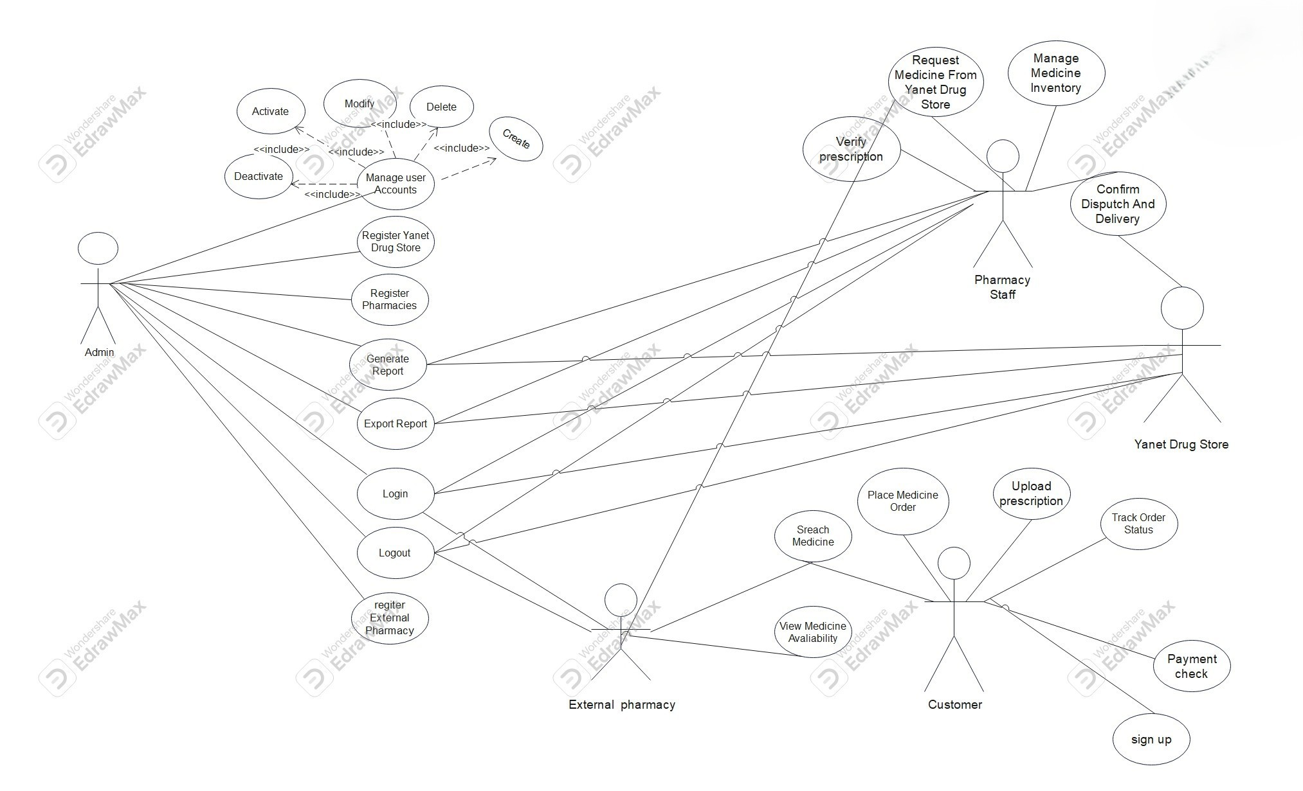

Slide 22
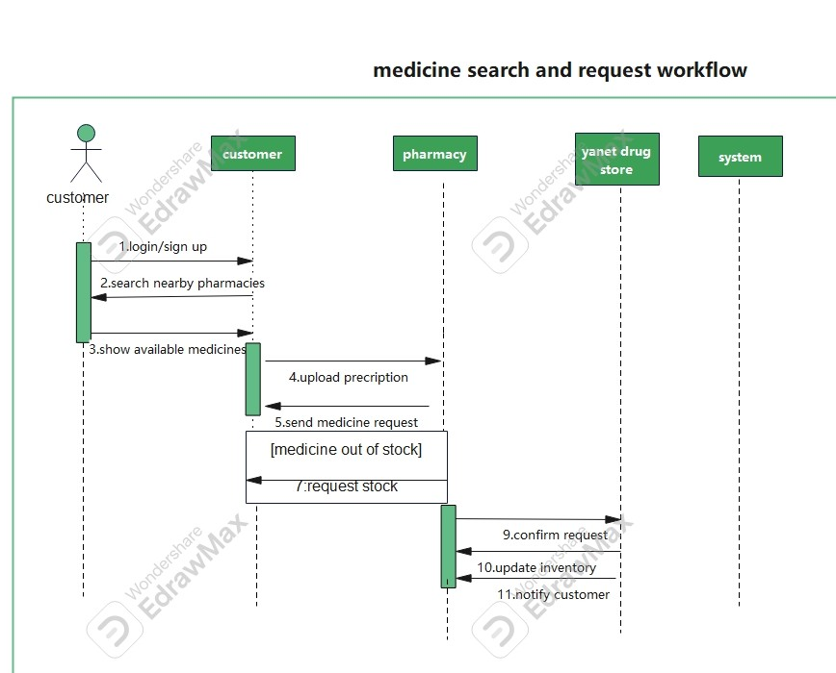

Slide 23
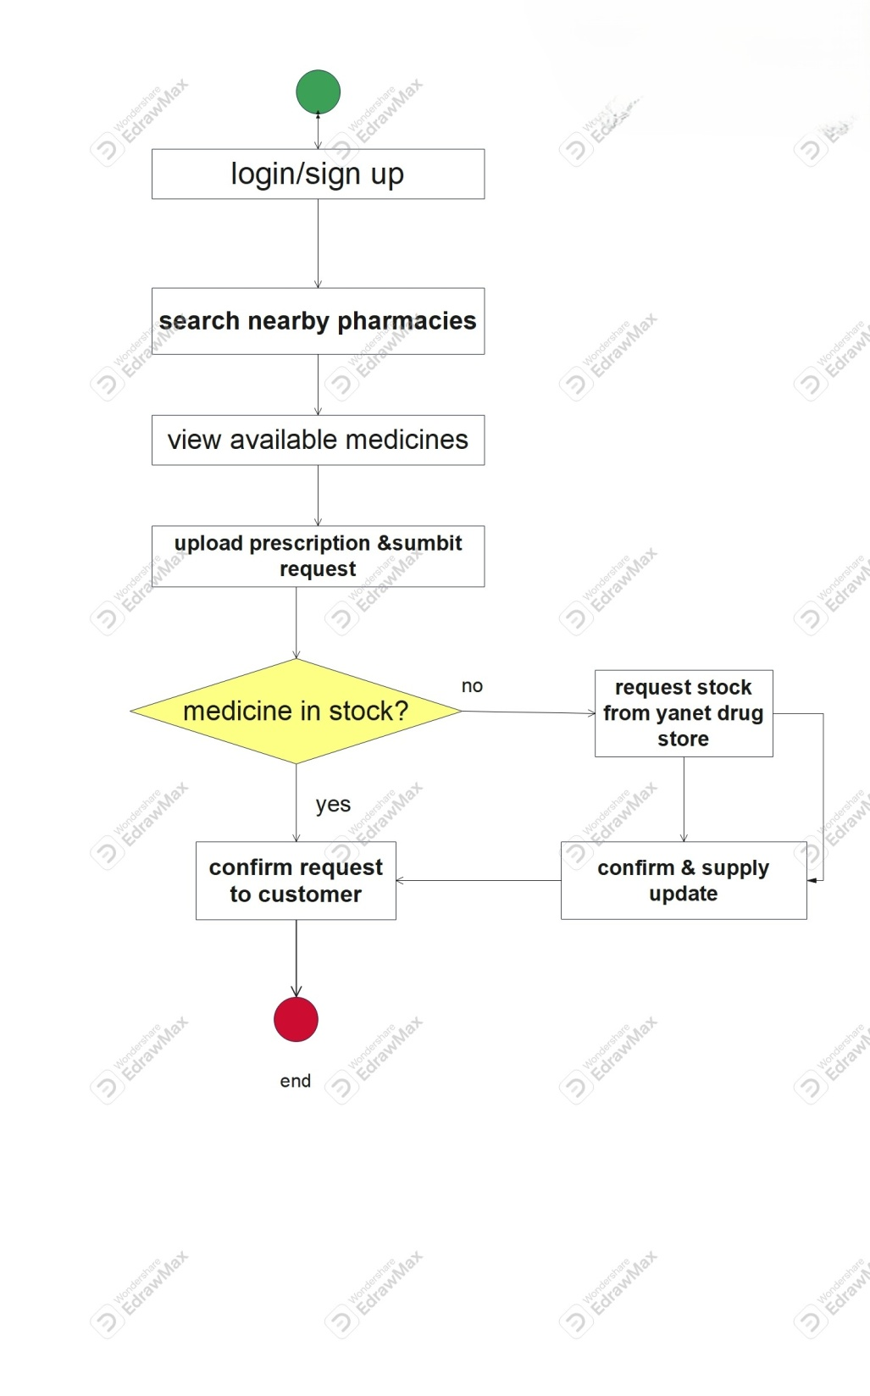
Medicine search and request activity

Slide 24
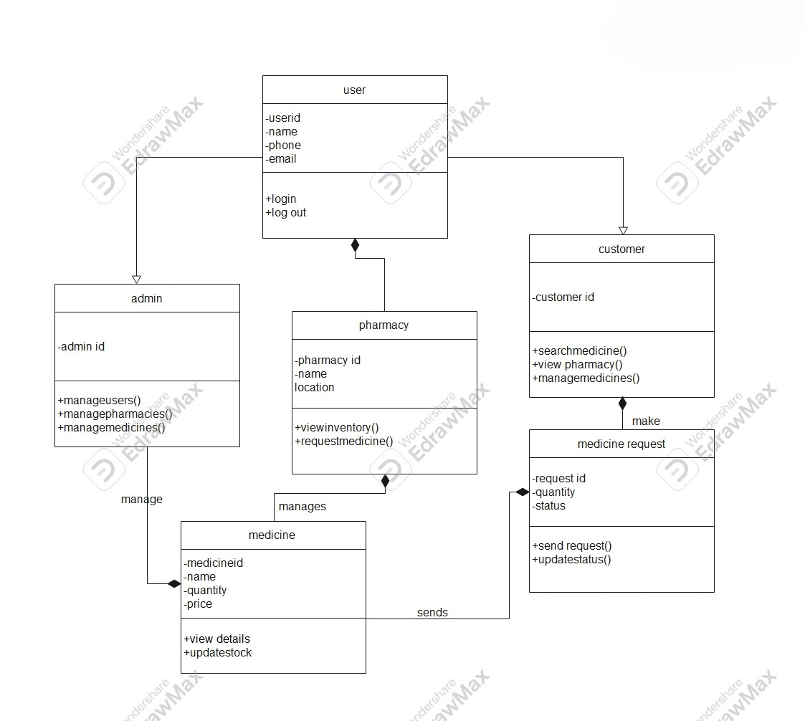

Slide 25


