Slide 1
Rapid Web Application Development With React
Katherine Fogarty and Ryan Stoltz
April 12, 2025

Slide 2
Agenda
About Peraton
Front End Web Dev Intro
Introduction to JS Frameworks
Configuring for React
React Deep Dive
Components
Lifecycle
Syntax
Using external data sources
Demo React App

Slide 3



Peraton at a Glance
Notes:
Peraton is a Next Generation National Security Company with work across multiple different sectors.
Our work has an impact on real people, whether it's protecting the International Space Station from debris or ensuring people across the country have access to Medicare
Some other cool projects around the company includes:
Situational awareness in space
Work on the Nasa Deep Space and Near Space Networks
Managing cyber watch floors and software
Helping protect our borders
And Medicare claims processing

Slide 4

Peraton Culture
Teamwork, innovation, and personal growth​
Focus on innovation and staying current with leading-edge technologies
Team-oriented culture that promotes collaboration and successful outcomes for our customers
Work with highly technical, highly capable developers
College graduates
Grow your career while making an impact on society
Excellent benefits program
Internships & Co-Ops
Work on real customer-facing projects (no “intern projects")
Prepare for your career – we hire about half of the students who intern or co-op with us
Notes:
Highlight internship and coop programs
Speak about your experience as an employee (leadership opportunities, support you've received)

Slide 5


Ways to Engage with Peraton
Stop by our Sponsor table today to meet with a Recruiter
Apply online at https://careers.peraton.com for future opportunities with Peraton
Entry-Level Positions as a Software Engineer, Systems Engineer, Data Scientist, or Cybersecurity Engineer
Internship & Co-Op Opportunities
US citizenship required for all positions
Notes:
You can come work with us on missions that matter by stopping by our sponsor table today!
If Brett is present, ask him to add any comments

Slide 6
Front End Web Dev Intro
Notes:
We'll now go quickly through a frontend web development intro.
If you've taken a web dev class before this might be review for you, but if not we wanted to give you a bit of helpful background.

Slide 7
“Prerequisites”
General knowledge of classic web development languages
HTML
CSS
JS
General familiarity with the command line interface (CLI)
Additional Resources on “Prerequisites” Included at End of Presentation

Slide 8
What makes a website?
Frontend
HTML and CSS code make visual structures on the website
Each structure is called an element
Ex. - text boxes, buttons, images, cards, navigation bar
JS and other code give functionality to the website
Ex. - buttons do something when clicked
Ex. - info from the backend can be pulled and shown
Backend
The data and services that support your website
Could include Python, Java, or other code
Ex. Databases and API calls
Frontend + Backend Work Together to Build a Functional Website
Notes:
Web development is divided into the front end and back end. The front end consists of HTML...
The backend is the data and services...

Slide 9





What is a Framework? What is a Library?
Framework:
A way of structuring your frontend files and code to support a fast and responsive website across multiple pages and complex functionality
Provides tools, libraries, and other resources to speed development
Still uses classic HTML, CSS, and JavaScript
Library
Target specific functionality
Notes:
What is a framework? This is a way of structuring...
Frameworks provide the developer with tools, libraries...
We still use classic HTML, CSS, and JS to create our frontend.
Here are some examples of frameworks commonly used, we have angular …
We also want to note that react isn’t a framework, it’s a library that is used to build react based frameworks like next.js
Transition: All of the frameworks listed here share a common interface that helps make websites built using frameworks efficient, also known as the DOM

Slide 10
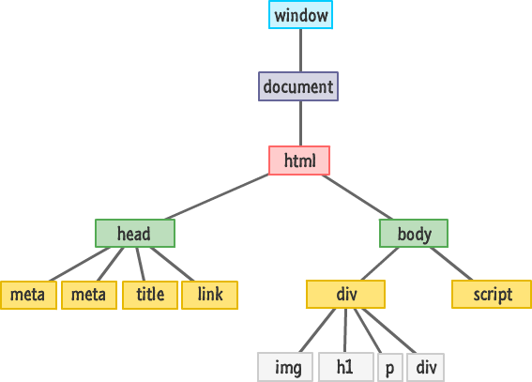
How Can We Visualize + Represent Websites?
Document Object Model (DOM)
Document: contains the entire web page displayed in browser window
A tree representation of all elements on the website page
Helps us:
Visualize the parent-child relationship between elements
Understand how to modify and switch out certain chunks of the page
This is a Way For Humans and Browsers to Represent and Understand the Different Elements in a Web Page
Notes:
The DOM stands for Document Object Model and this is a tree representation...
The DOM helps us...

Slide 11
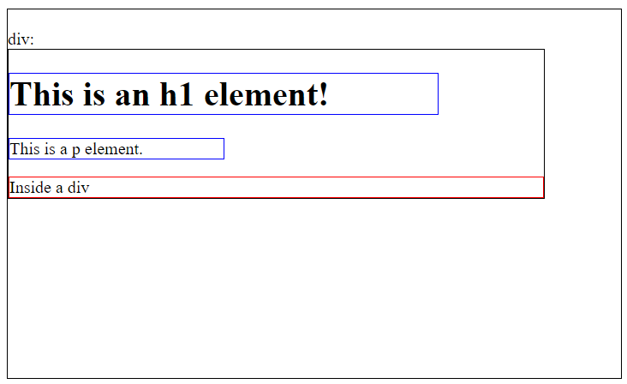
Representing Elements on a Page Using the DOM
<h1> is inside a <div> which is inside the <body> inside the <html> page
Notes:
Here's an example of how the DOM represents elements on a page. The h1 tag is inside ….

Slide 12


How do Frameworks use the DOM?
Real DOM
What we see on our browser screens
Actual DOM in the browser
Virtual DOM
Programming Concept – Copy of real DOM
Changes cause recalculation and comparison between current and prior DOM
Angular manipulates the real DOM – quick
React uses a virtual DOM made with JSX – quicker
Notes:
Frameworks build on this concept of a single page application. Pieces of the …
So websites built off of frameworks are quicker…
Angular manipulates the real DOM which is quick but React uses a virtual DOM made with JSX which is even quicker.
The virtual DOM is a lightweight in-memory representation of the real DOM to optimize rendering and preformance

Slide 13
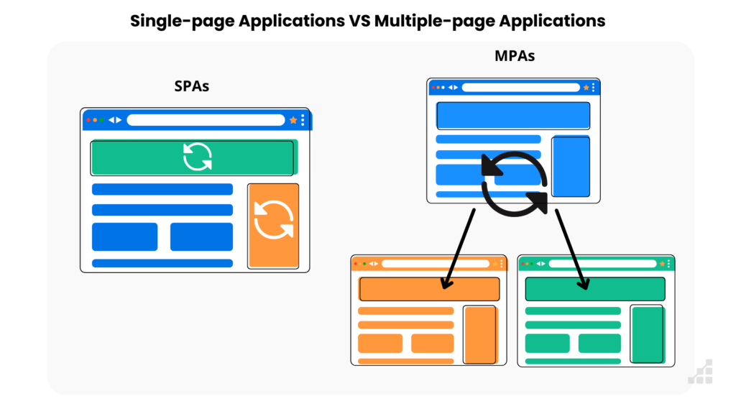
Single-Page Applications vs Multi-Page Applications
Pieces of the DOM are updated and switched out to show different "pages" or information on a single page
Elements that exist across all pages may not have to change
Quicker and more lightweight than traditional websites
New pages are loaded each time a piece of the DOM is updated, updating and/or changing all elements
Slower and more complicated than SPAs
Still used for content-heavy websites
One Approach Isn’t Inherently Better Than the Other!

Slide 14
Introduction to JS Frameworks
Notes:
Next, we’ll learn a bit about JavaScript and some frameworks built by JavaScript.

Slide 15
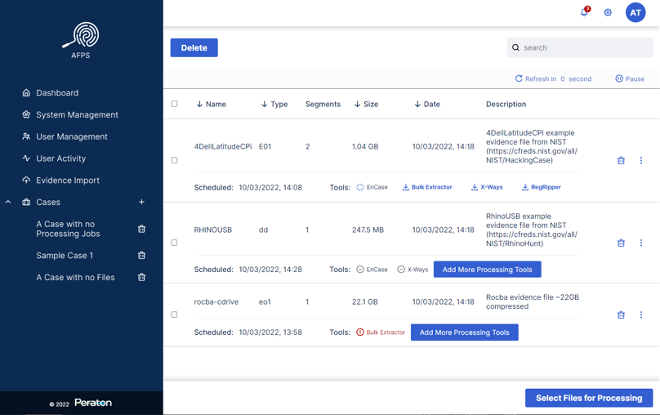
React (ReactJS)
JavaScript library for building user interfaces
Is the foundation for React Native: a framework used for building mobile apps
Developed by Facebook
Allows for a clean and interactive designs that can display changing data
Used to create complex UIs from small, isolated components
Real app developed at Peraton!
Notes:
React is a JavaScript …

Slide 16
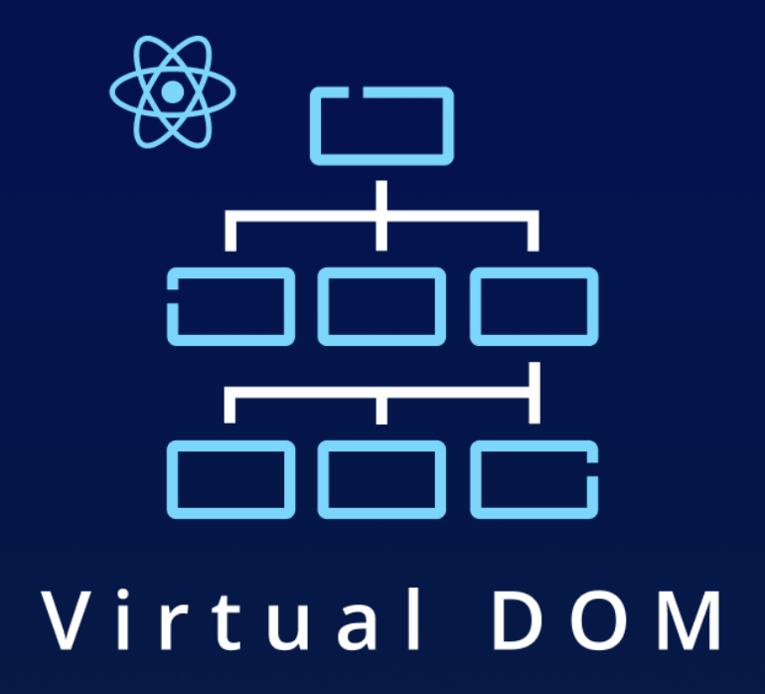
Advantages of React
Open source
Strong community support with many examples and existing components available
Frequently used in industry
Create accessible web app in minutes
Facilitates reusable components
Why does Peraton use React?
Easy to learn
Quickly build high-quality applications
Notes:
One big advantage of react is that its open source …
React also facilitates reusable components which are blocks of code that can …

Slide 17

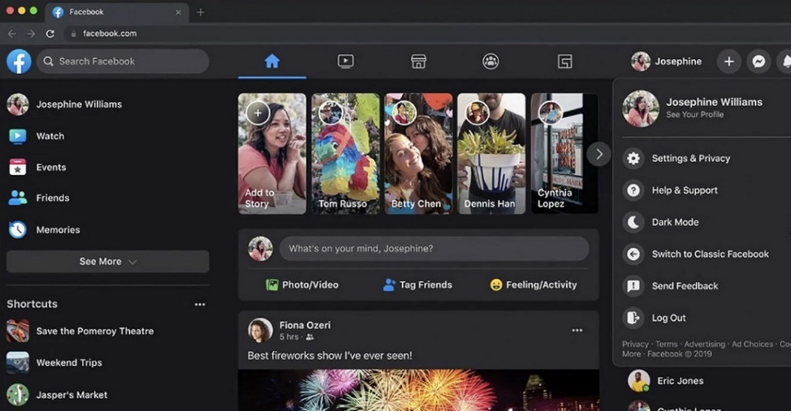
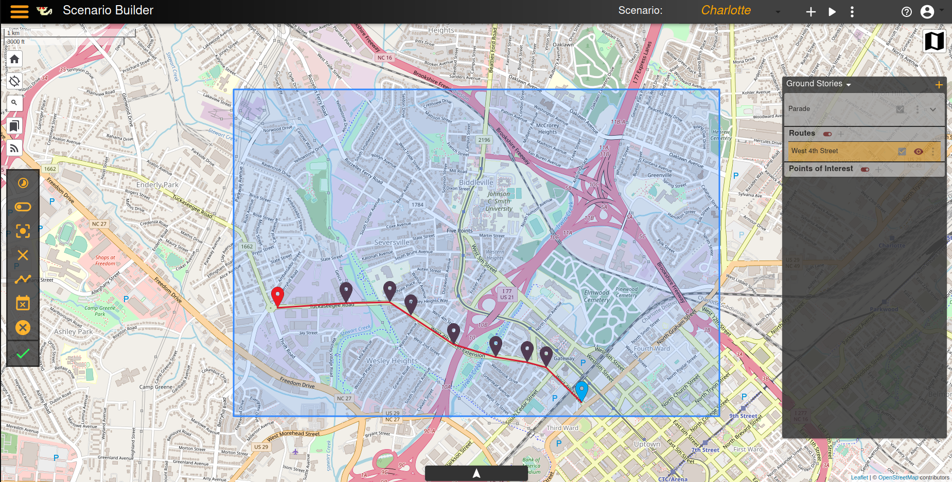
React in the Real World
Netflix
Facebook
Peraton
Peraton

Slide 18
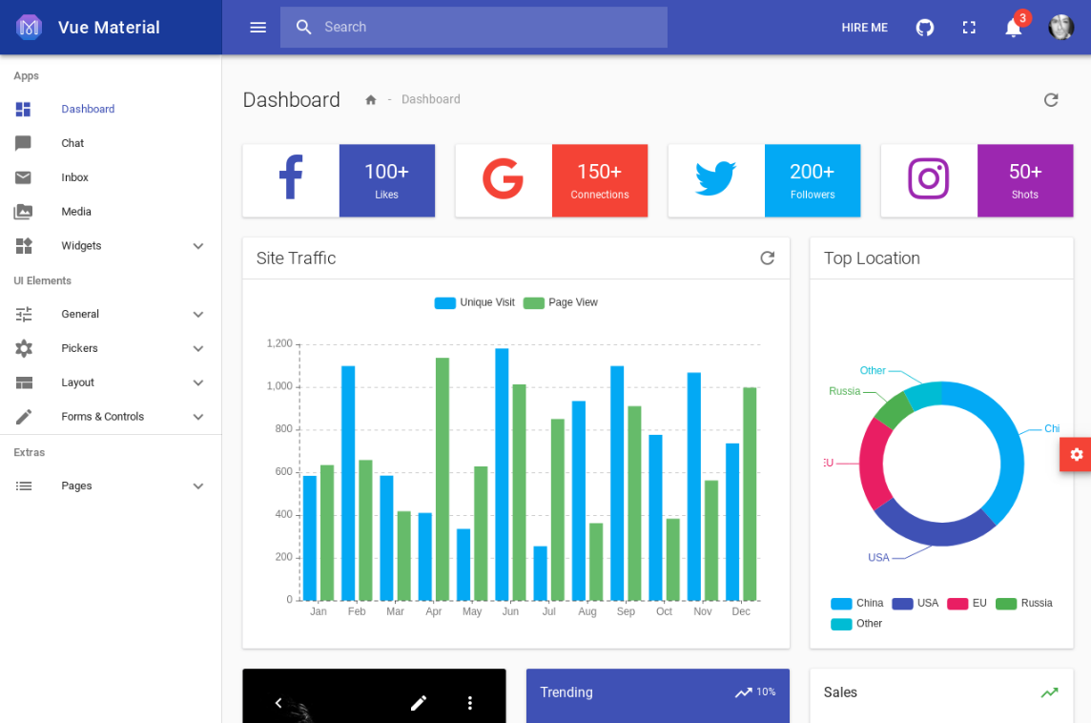
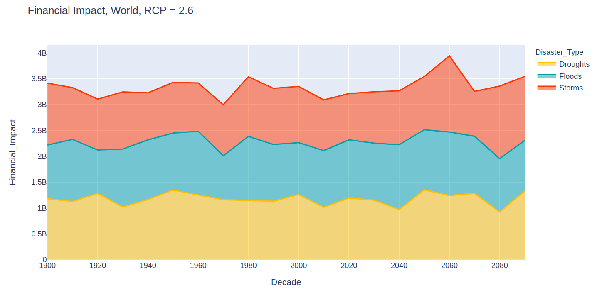
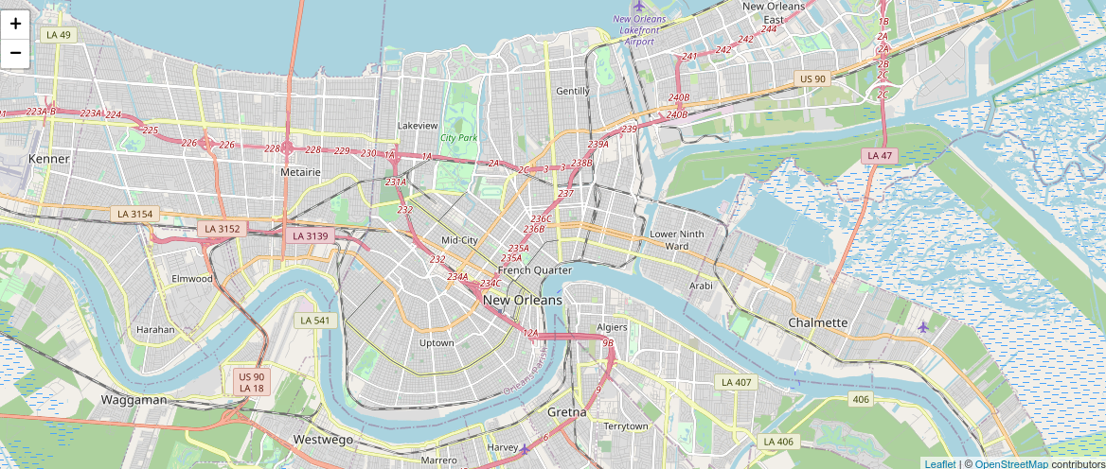
Common Libraries
Material-UI
Material-UI (MUI): This UI component library is available for most front-end frameworks and has ready-to-use components. With out-of-the-box components for input, data visualization, navigation, layouts and more, Material-UI allows developers to rapidly construct professional grade user interfaces.
Plotly: An open-source graphing library that provides easily customizable plots & charts.
LeafletJS: Leaflet is a lightweight open-source JavaScript library that offers a wide variety of map functionality. Esri Leaflet is a plug-in that combines Leaflet's functionality with ArcGIS services and maps.
And Many More!!
Plotly
React Leaflet
Notes:
*Mention what a component library is
JavaScript has many different libraries. We have listed here some common ones that Peraton uses.
Material UI is a …
If you are unfamiliar with ArcGIS, it is a geological information system developed by Esri that offers mapping and analysis solutions for geospatial data.
Transition: There are many other tools and libraries that you can find to suit your specific needs. Next, I’ll hand it off to Daniel to get started on configuring your environment for React development.

Slide 19



React Bootstrap
React-Bootstrap is built for compatibility with an already highly developed UI ecosystem. Out of the box components “just work” with pleasant themes and styles that are easily accessible.
Easy-to-use: it offers numerous templates, themes, and tools to jump-start development.
Web pages are responsive, dynamic, and easily customizable.
The official documentation is thorough, and the support community offers solutions to many common development questions.

Slide 20
Configuring for React
Notes:
Add mini agenda here/transition (why React – our prize category?)

Slide 21


Node and NPM
Node is a platform built on the event-driven JavaScript runtime. It provides a lightweight and efficient I/O model for real-time applications to run.
NPM is NodeJS’s default package manager that provides access to an online database of public and private packages
The command “npm install <package-name>” will pull down and third party libraries for use in your application within seconds.
Node is often paired with React as it bundles React applications, provides a constant server connection, and can handle large quantities of requests using its server load balancer.
Node hosts the server-side code while React generates the client-side code.
With the command “npm start”, Node will locally host your site and any saved code changes will instantly be reflected on the web page.
Notes:
Speak to what a default package manager is

Slide 22
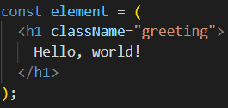

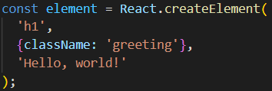
JSX (JavaScript XML) Introduction and Usage
JSX is a syntax extension to JavaScript
UI elements and logic are both specified using JSX
Components and HTML elements are rendered
Allows in-line evaluation of JavaScript expressions using curly braces ‘{ }’
JSX Syntax
Plain JavaScript Syntax
Notes:
Syntax extension means that JSX can be written directly in JavaScript (.js) files, but is transpiled down to plain JavaScript (React.createElement calls) via a library called Babel.
React uses JSX to specify both the view and the logic in a single component.
Curly braces are used for many purposes in JavaScript. In the context of JSX, any expression surrounded by curly braces will be evaluated and the result displayed. If you do not use curly braces around an expression, the plaintext will be displayed verbatim.
JSX is technically optional in React. React functions return React elements and that can be done via JSX or React.createElement(). It is highly recommended to use JSX for convenience and clarity.

Slide 23
React Deep Dive

Slide 24
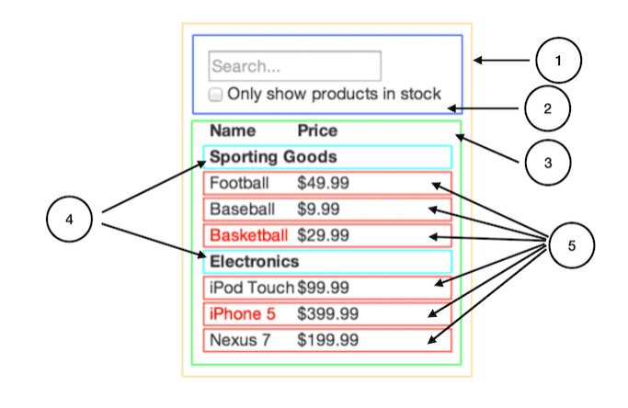
React Components Introduction
Components are...
The Building Blocks of React
Developers can use components from external libraries and build their own
Reusable
Components be used multiple times in the application and can look and behave differently based on props given to the component
Hierarchical
Components can contain other components
Stateful
An internal state object is maintained by the component
#2: check box contains "checked" state
Stateless components also exist
#5: item name and price do not change
Can be “Class” or “Function” type
Components are contained within an ES6 class or a JavaScript function
Notes:
Building blocks: React components contain specify how a part of the UI should look and act.
Reusable: A well-written component is flexible enough to be used multiple times across the application if necessary. Web applications often display similar UI elements across the application, so re-using components prevents code duplication and simplifies the readability and maintainability of the application.
Hierarchical: React elements are specified using JSX (JavaScript XML) which is implicitly hierarchical. Allowing components to render other components also improves reusability. For example, take a webpage that displays a card for each faculty member at a university. You'd build a single component that renders a card UI element showing the faculty member's details (name, department, picture, etc). Then you'd build a separate component that takes in a list of faculty members and renders the card component for each person. You can add sorting/filtering functionality into that component too.
Stateful: Most React components maintain an internal state object that is empty by default. The state object is JSON format, so essentially key/value pairs. When you build a component, you specify the initial state of a component and build logic into the component to update the state in response to certain user actions or other events (e.g. API calls, websocket message received, pub/sub message received, etc). Component state is useful to make components responsive and flexible.
Function components are more common in modern react applications, but you can still use class components. The reason that function components are more popular is that they are generally simpler and less verbose making for better readability and maintainability.

Slide 25
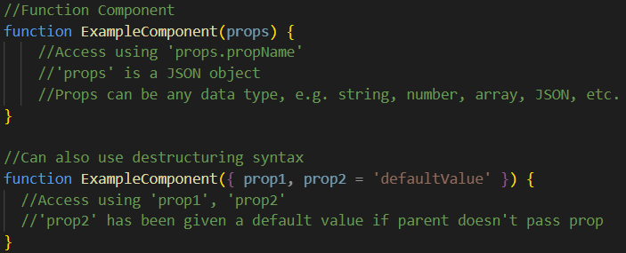
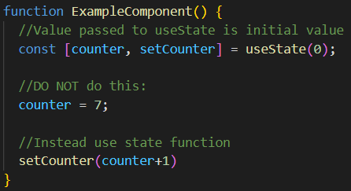
React Components Continued
Components have...
Props
Passed from the parent to the child component
Component cannot change its own props (read-only)
Changing props triggers a re-render
State
Initial state is determined by the component
State object is immutable, instead updated using lifecycle function
Changing state triggers a re-render
Otherwise your UI will not update when variables update
Notes:
Should we move this ahead of the component examples?
Props pass data down from parent to child component
Values passed as props can change, which causes the component to re-render the UI. This way the UI is responsive
State is a JSON object maintained by the component. A component changes its own state which causes the component to re-render.

Slide 26
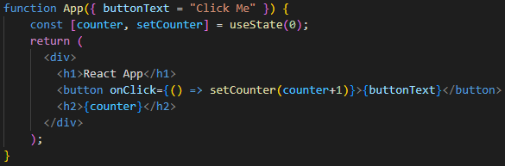
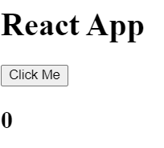
React Functional Component (*Recommended*) Example
JavaScript function named “App”
Receives “props” as a function parameter
Function returns what will be rendered on webpage (JSX)
“useState” used to track variables, any variables you might change in another language
Notes:
At the core, this is a plain JavaScript function called "App" that receives props as parameters to the function. The function returns a React element, which in this case is specified using JSX.
The 'useState' hook makes the component stateful – will talk about the specifics later.
This App function renders the simple UI in the bottom right. When the button is clicked, the counter is incremented.

Slide 27
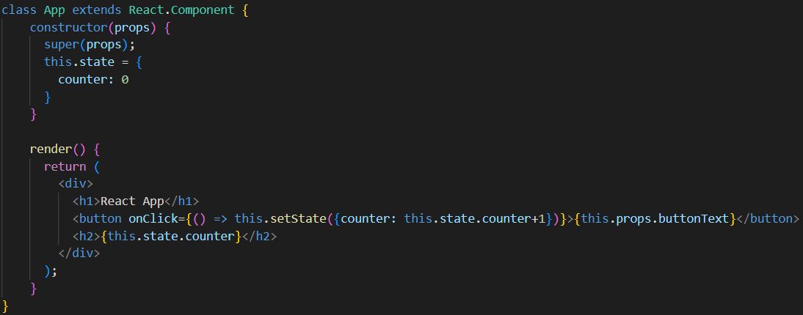
React Class Component Example
Class “App” extends React.Component
Receives “props” as parameter to constructor
Render() function returns what will be rendered on webpage (JSX)
Initial state is specified in constructor
Notes:
This is the equivalent of the function component in the last slide. The UI rendered looks and behaves the same.
Class components use a ES6/JavaScript class extending the "React.Component" class which is imported from the React library.
The props are received via the class constructor.
The render() function returns JSX just like the function component.
The initial state is specified in the constructor rather than via the 'useState' hook since class components don't work with React hooks.

Slide 28
React Lifecycle
The lifecycle of a React component:
Component mount
First render
Setup component (API calls, subscriptions, etc.)
Component updates repeatedly in response to changes to received props or internal state
Responsive and dynamic UI
Updates are asynchronous – scheduled by React
Component unmount
Occurs when component no longer needs to be rendered
Cleanup what was setup on mount (cancel API calls, unsubscribe, etc.)
Component Mount
Component Update
State or
Props change
Component Unmount
Notes:
Component mount means component renders for the first time. The primary lifecycle methods associated with this are ‘componentDidMount’ and ‘useEffect’ (for class and function components respectively). These lifecycle methods are the best place to do “setup” for the component such as calling an API to get data, setting up a websocket, creating a timer, etc.
Component update re-renders the components using the new values from props and/or state. This allows us to build responsive and dynamic components rather than static components. React re-rendering is fast because of something called the “virtual DOM”. Basically, React internally stores an in-memory representation of a webpage that can quickly be updated. However, this is memory-intensive. These updates occur asynchronously and are managed by React. Don’t expect the state to be changed one line after you call setState/useState (it may, but no guarantee).
Component unmount is when the component is no longer rendered. This may happen when the user clicks on a new navigation element on a page (tab, appbar header, etc) or when a user closes a dialog. React lifecycle methods associated with this are ‘componentWillUnmount’ or the ‘useEffect’ callback (class and function components respectively). Things that were setup on mount are cleaned up here. For example, you may cancel pending API requests, disconnect from a websocket, unsubscribe from a service, etc.

Slide 29
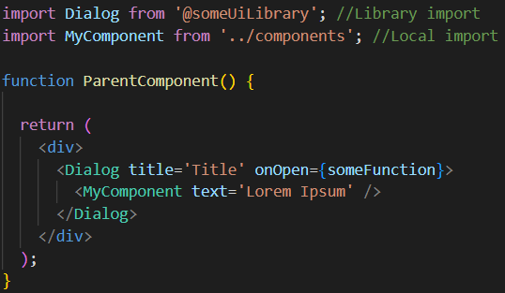
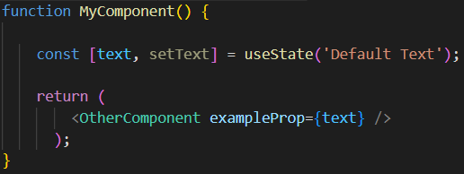
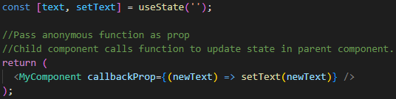
Data Flow Introduction
React data flow is unidirectional
Data is only passed from parent to child component (via props)
Props are received as read-only
Components may pass a value from their own state as a prop
Callback functions may be passed as a prop which allows the child component to call a function within the parent
Passing props through multiple components is called “prop-drilling” and can make the code harder to read and update
Notes:
Data flows by passing props to child components. Component receiving props does not modify their own props and cannot directly pass data back to parent.
Props passed are often from the state of the parent component, but can also be hardcoded.
Any data can be passed as a prop, including a function. Passing a function as a prop allows the child component to call that function from the parent component. This can get messy so try to limit this pattern.

Slide 30
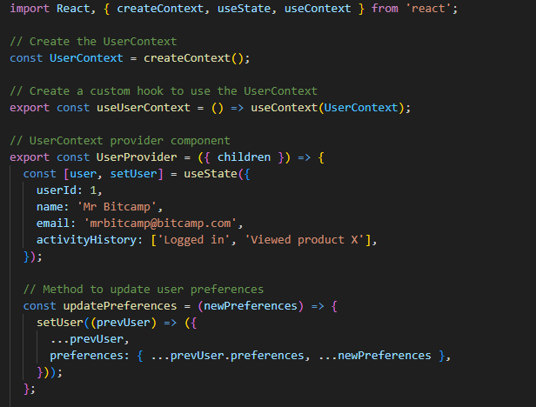
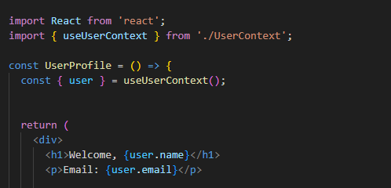
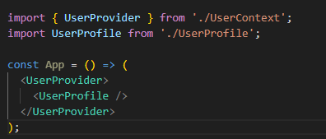
React Context
How Do we solve the issue of prop drilling?
Through Context!
Creates a way for components to share data without having to pass props through each component
Only for specific use cases where you need to access variables and functions frequently across many components (ex: User Authentication)

Slide 31

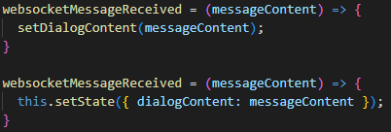
Updating State User interaction events and asynchronous events
Component updates its own state via lifecycle functions
useState – functional components
setState – class components
Events that may update state:
User interactions with browser:
Clicking a button
Typing in form field
Other mouse/keyboard events
Asynchronous events from source setup on component mount
Websocket message received
Response from API request
Notes:
Use state is for functional components
Set state is for class components

Slide 32

React Hooks Introduction and Usage
Hooks are:
JavaScript functions used to add React functionality to a function component
Less verbose compared to equivalent class component functions
Libraries may export Hooks for use in your application
Common React Hooks
useState – gives access to state object and setter
useEffect – triggers on component mount and updates
useContext – used for data stored in parents that can be accessed in children (even if many levels down)
useRef – used for data that stays consistent between renders that doesn’t trigger a re-render
Notes:
Use Context – Avoid prop drilling. Lets data be stored in a parent that can be accessed by any children without having to pass it through intermediate components
Use Ref – Stays consistent between renders (a value you want to track that doesn’t trigger a re-render)

Slide 33
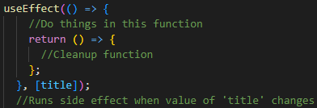
React Hooks useState and useEffect
useState hook
Adds state to function component
Import hook from React library
Initial value ‘MyTitle’ is parameter to function
Function returns state object ‘title’ and function to update state ‘setTitle’
useEffect hook
Performs after effects in response to changes in the component
Import hook from React library
2 parameters:
First parameter is a function to run
Second parameter is array of dependencies
Same functionality as React lifecycle functions from class component (componentDidMount, componentDidUpdate, and componentWillUnmount)

Slide 34
API Calls in React Fetch and Axios
Component Mount (first render)
How do I display data in my web application?
API calls fetch data to display in the web application
REST API ‘GET’ calls return JSON response
When do I make API calls in React?
In the lifecycle method when the component mounts
useEffect hook with empty dependency array for function component
componentDidMount lifecycle function for class component
In response to user events (e.g. user clicks 'refresh' button)
How do I get the data to show up?
Set component's state with data fetched from API call
Component will re-render after state update to display data
What library do I use for making API calls?
Axios library is a 3rd party package that can be installed using npm
Fetch API is part of JavaScript API and is supported by all common browsers
API call in lifecycle function
Set component state with fetched data
Component re-renders showing fetched data

Slide 35
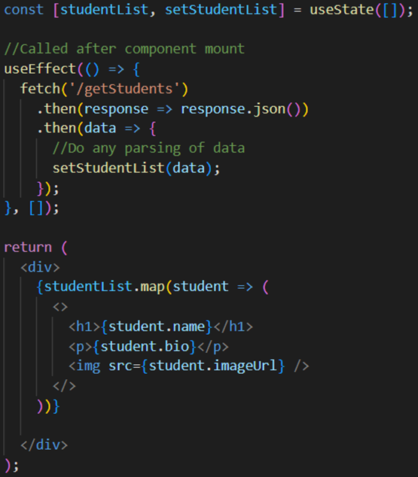
API Calls in React Fetch Example
studentList is a list of students to be displayed in the UI, initially empty
useEffect uses fetch API to make GET call to the /getStudents endpoint
Response to API call is parsed to JSON object and used to set component state
Component view iterates over studentList and displays header, text content, and image for each student

Slide 36

API Calls in React Axios
Axios library is an alternative to the JavaScript Fetch API
Installing Axios
Run 'npm install axios' in project directory
Import Axios library into React component
Use Axios for request
Axios has convenience methods for all REST calls:
axios.get(url[, config])
axios.delete(url[, config])
axios.post(url[, config])
axios.put(url[, config])

Slide 37
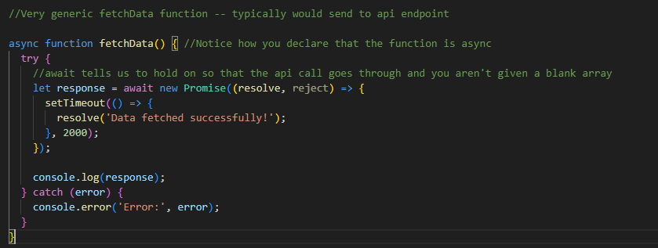
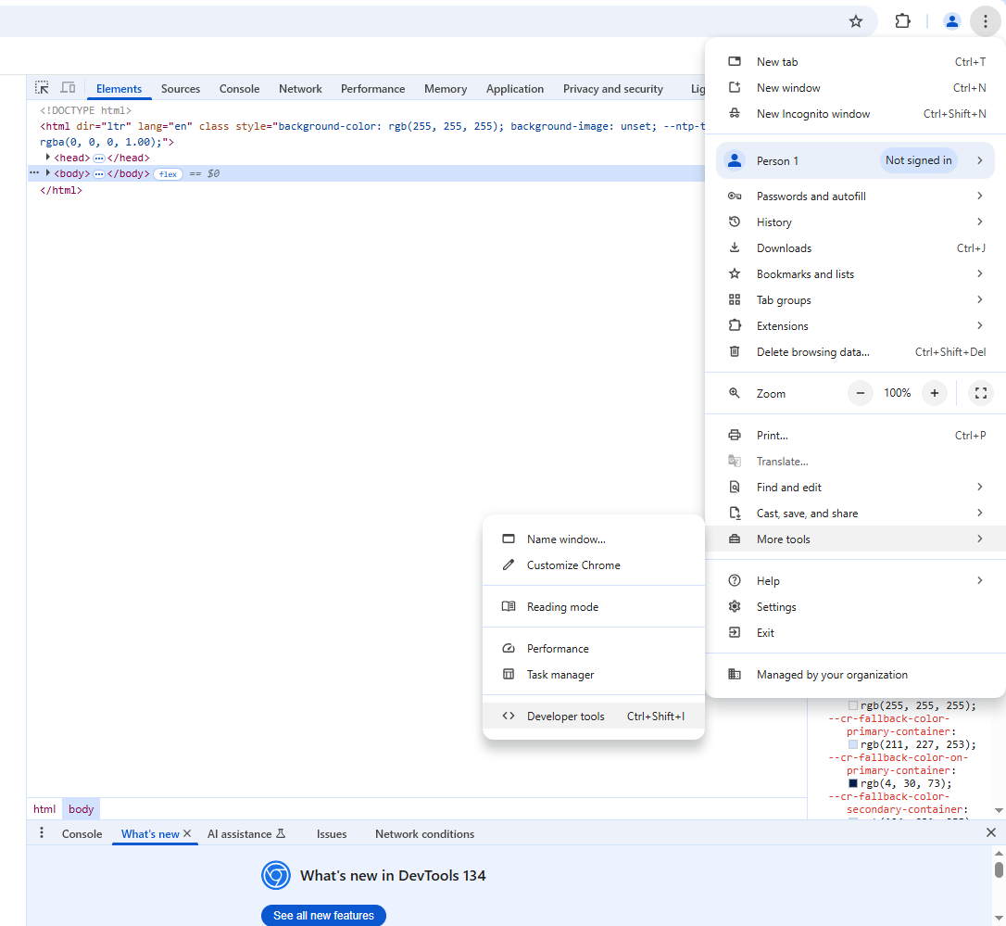
React – Developer Experience
Key notes about React
State updates and data fetching often happen asynchronously, take advantage of async and await
Using devtools is crucial, you can track elements, console.log outputs and check api calls in the network tab
Make use of conditional rendering
{IsLoggedIn && <Homepage/>}
Loginattempts > 3 ? <AccountLocked/> : <Login/>
Learning React?
Never copy and paste code, always write it out
Will help you truly learn the language
Really in-depth course for those super interested ($)
https://www.udemy.com/course/react-the-complete-guide-incl-redux/learn/lecture/39837058?start=600#overview

Slide 38
Thinking in React
Because React uses components, a first step with most projects is to design a logical and reusable component structure:
<div className=“Navbar”>
<NavItem img=url, onClick=handleItemSelect>…
Function MediaPlayer
({mediaUrl,image}){};
Button = ({onClick,children,ClassName})
return(<button…

Slide 39
Getting Started
Notes:
Next, we’ve prepared a getting started guide to help you get started with React development, and as a reminder, these slides will be available after our presentation.

Slide 40
Quick Start
Install Node and NPM
Download | Node.js (nodejs.org)
Build a React App Using Vite (or another build tool and/or framework)
https://react.dev/learn/build-a-react-app-from-scratch
Design basic layout and data flow for your application
Go from UI wireframe to React components: Thinking in React – React (reactjs.org)
Keep best practices in mind as you design
Run local development server
'npm start'
Saving pre-existing files will automatically apply changes to your site
You will need to restart (ctrl+c and re-run 'npm start') to install npm packages or add project files
Refer to these slides and React documentation for examples and help
Hello World – React (reactjs.org)

Slide 41
Resources
Demo Code: https://github.com/lhudsonPeraton/React
Install links
Node/NPM: https://nodejs.org/en/download/
Git: https://git-scm.com/downloads
VSCode IDE: https://code.visualstudio.com/
Documentation:
React: https://reactjs.org/docs/getting-started.html
Material UI (MUI): https://mui.com/material-ui/getting-started/overview/
Axios: https://axios-http.com/docs/intro
Notes:
After this presentation, we’ll demo a quick react application that uses all the features discussed previously.
Transition: If you run into anything you can’t find in the documentation, you can always ask one of us or look online because there is huge community support for React.

Slide 42
Additional Resources
HTML Tutorial: HTML Tutorial (w3schools.com)
CSS Tutorial: CSS Tutorial (w3schools.com)
JS Tutorial: JavaScript Tutorial (w3schools.com)
Unix/Linux Commands: Linux Commands Cheat Sheet | GeeksforGeeks

Slide 43
Demo

Slide 44
Questions?

