Slide 1

Lychee
Learn from YouTube videos like never before with AI.
Ask questions. Get a summary. Quiz yourself.

Slide 2
Problem
Watching online lectures is convenient.
But, makes it hard to engage with the material.
You can’t easily test your knowledge after watching a lecture
You can’t ask clarifying questions
You can’t get a summary for a certain topic

Slide 3
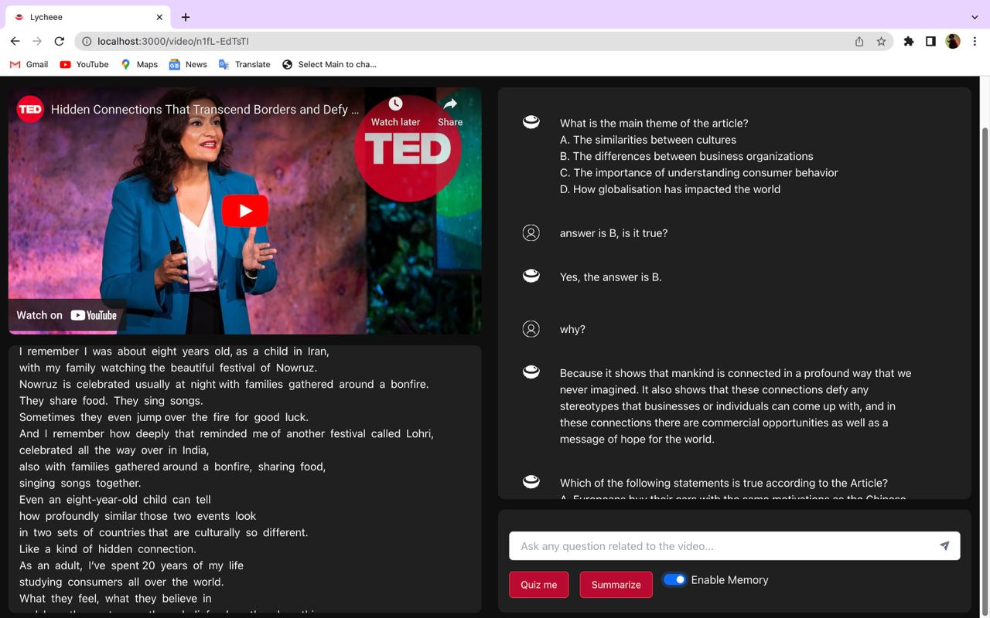
Solution: Lychee
Benefits: Lychee
Answers your question
Tests your understanding
with quizzes
Prepare for exams
Identify areas of weakness
Retain the information better
Reinforce learning
Improve problem-solving skills

Slide 4
Next steps:
Improvement and monetization
Support multiple languages
Provide services in other platforms
Subscription - based online educational platform

Slide 5

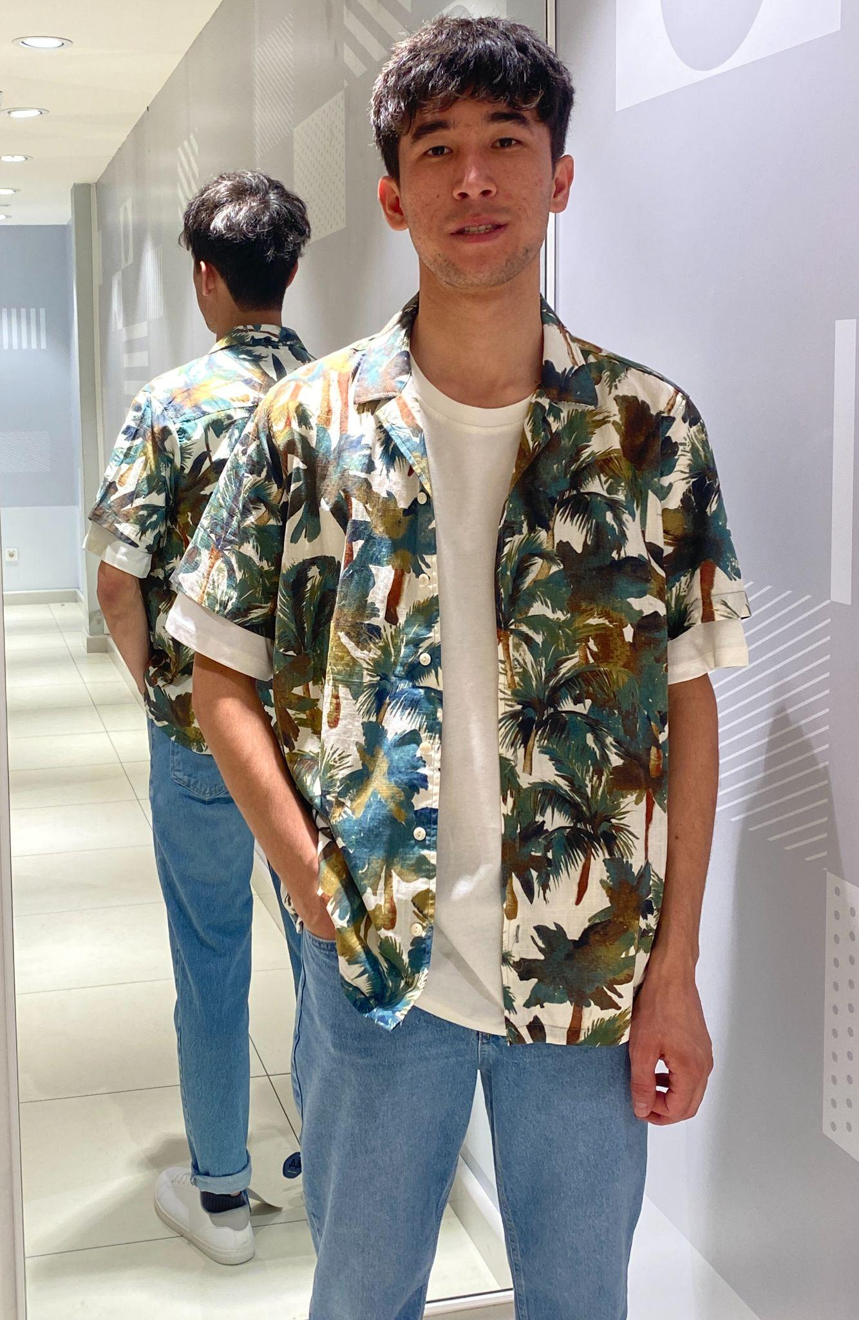

We are product thinkers and builders
Ibrohim Abdivokhidov
Sobir Alimov
PM/Software Engineer
Backend Engineer/UI/UX
Made with ❤️ by NAND

Slide 6
