Slide 1
Who will miss their referral appointment — and what the model can and cannot tell us
Stakeholder presentation of the referral no-show risk model for Jigjiga University Sheikh Hassan Yabare Comprehensive Specialized Hospital (JJUSHYCSH)
Abdi Farah Ahmed · BAN6800 Business Analytics Capstone · Nexford University
Module 5 Assignment — Business Insights Presentation for Stakeholder Decision-Making
October 2026
Objective: explain clearly and neutrally what the Module 4 model found, how it decides, and how fairly it treats patients — so that OPD, hospital leadership and the governance committees can judge it for themselves.
Live dashboard: https://jjushycsh-noshow-dashboard-9nubvdk2zitnkwww33dukn.streamlit.app · Code: https://github.com/abdifaraha570-lgtm/capstoneMolude3
Notes:
Good day. This is the Module 5 presentation for my BAN6800 capstone. It continues the same project as Modules 1-4. My role today is business analyst, not data scientist: I will explain what the model found and how fairly it behaves, without recommending a decision - that belongs to a separate deliverable. The dashboard link is live and shows the same results.

Slide 2
The business problem
From the Module 1 Vision Document and Module 2 Project Overview
Where
JJUSHYCSH is the only tertiary referral hospital for the Somali Region — a catchment of six to seven million, largely rural and pastoralist people, 600 km from Addis Ababa.
What goes wrong
About one in five scheduled appointments is missed in the proxy data. When a referred patient does not come, care is delayed for that patient and a specialist slot that someone else travelled hundreds of kilometres for goes unused.
Why now
OPD staff have no ranked list, so SMS, phone calls and community-health-worker visits cannot be targeted. Reminder capacity is the constraint, not demand.
≥ 15 %
≥ 70 %
fewer no-shows within two quarters of local deployment (Module 1 KPI)
of high-risk no-shows flagged (model KPI, Module 1)
24–72 h
0
before the visit: the window in which a score must arrive to be acted on
patients may be cancelled, overbooked against or deprioritised because of a score
The question for this presentation: can a model tell us, early enough and fairly, which appointments need extra outreach?
Abdi Farah Ahmed · BAN6800 Business Analytics Capstone · Nexford University · Module 5 · Business problem
2
Notes:
The problem is capacity and reach, not demand. The two KPIs come straight from my Module 1 vision document. The last tile is the rule from the Module 1 Ethical AI Charter that governs every slide that follows.

Slide 3
Who this is for, and what they need to decide
Stakeholders from Module 1 and the Module 2 communication plan
Stakeholder | Decision they make | What they need from this presentation
OPD schedulers / referral coordinators | Whom to call, SMS or visit each day | Is the list trustworthy? Why is a patient flagged? How many calls per day?
Department heads | Where to put outreach effort by service | Which patterns drive no-shows; what the flag rate means for staff time
Medical Director / administration | Whether to pilot the tool on local data | Honest performance, limits, and what it would take to go live
HIS / data officer | Data refresh and quality upkeep | What data the model needs and how results are monitored
Hospital Research & Ethics Review Committee | Approval of patient-data use | Privacy safeguards, consent, proxy-data disclosure
AI & Data Governance Committee | Fairness thresholds, change control | Group-level recall gaps, mitigation, oversight hooks
Somali Regional Health Bureau | Oversight (aggregate only) | Aggregate results; no patient-level data
Two audiences in one room: operational users who need clarity, and ethics bodies who need evidence. The deck serves both; the dashboard lets each explore on their own.
Abdi Farah Ahmed · BAN6800 Business Analytics Capstone · Nexford University · Module 5 · Audience
3
Notes:
The last three rows are the ethics and compliance stakeholders from Module 1. The Regional Health Bureau only ever sees aggregates.

Slide 4
What the model is, in plain language
Five modules, one project
Module 1
Module 2
Module 3
Module 4
Module 5
Vision, KPIs, ethical charter
Plan, architecture, fairness criteria
Governed data pipeline, pseudonymised data
Model, explanations, fairness audit
This presentation + live dashboard
Plain-language model explanation
Every scheduled referral or follow-up visit is looked at 24–72 hours before the appointment. The model estimates the chance that the patient will not come, using only facts known at booking time: how far ahead the visit was booked, the patient's own attendance history, age, chronic conditions and welfare enrolment.
It learned these patterns from 77,000 past appointments and was checked on 16,000 appointments it had never seen (16,520 in the test split). It then sorts appointments into Low, Medium and High risk tiers, and each tier maps to an outreach action from Module 1 (SMS → SMS + call → call + community health worker).
The champion is a random forest model. Three algorithms were compared (logistic regression, random forest and gradient-boosted trees); the winner was chosen on a validation set, never on the test set. Every score comes with its reasons, so a coordinator sees why a call is suggested, not just a number.
What it does not use: gender, neighbourhood, whether an SMS was sent, and — after a necessity test — alcohol-use disorder and disability.
Think of it as a triage list for reminders: it ranks appointments by risk and says why, and people decide what to do.
Abdi Farah Ahmed · BAN6800 Business Analytics Capstone · Nexford University · Module 5 · Model
4
Notes:
This is the slide to pause on with non-technical stakeholders. The model is a ranking tool with reasons attached; it is not a verdict on any patient.

Slide 5
Key results
Champion: Random forest · Module 3 test split, 16,520 appointments the model never saw
71%
43%
33%
0.74
of no-shows caught (recall) — target ≥ 70%
of appointments flagged for extra outreach (workload)
of flagged appointments are real no-shows (base rate 20%)
ranking quality (ROC-AUC) vs 0.71 for a simple lead-time rule
What the numbers mean
At the operating threshold the model finds about 71% of the patients who will not come, by flagging roughly 43% of appointments. Most flagged patients would still have attended — that is the price of catching the ones who would not, and the cost of a false flag is one reminder.
A rule a scheduler could apply by hand (flag if days booked ahead >= 5) reaches 72% recall with precision 31%; the model improves ranking quality by +0.032 ROC-AUC and precision by +2.0% points at the same recall target.
All three algorithms landed within a few points of each other, which means the signal is in the data, not in a clever model.
The model meets the 70 % recall target on unseen patients; its gain over a simple rule is real but modest — honesty about that is part of the story.
Abdi Farah Ahmed · BAN6800 Business Analytics Capstone · Nexford University · Module 5 · Results
5
Notes:
Recall is the KPI from Module 1. Precision is low by design: with one no-show in five, catching 70 % means accepting many false flags, each costing one reminder.

Slide 6
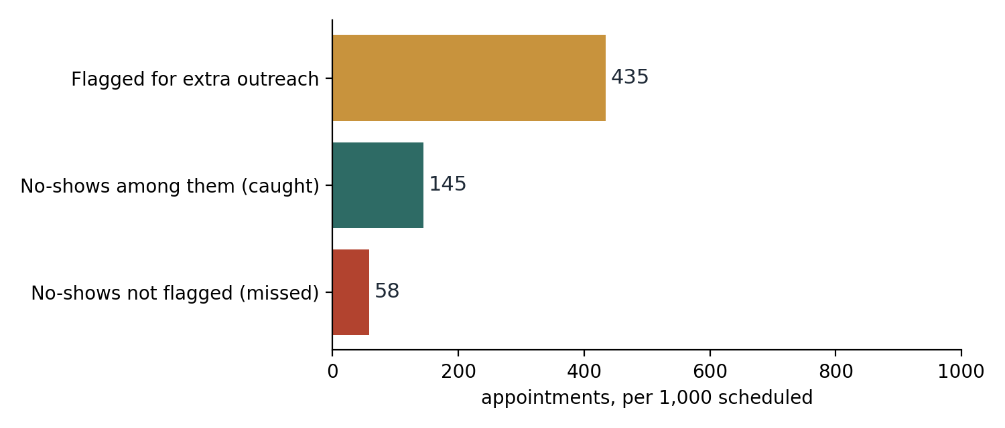
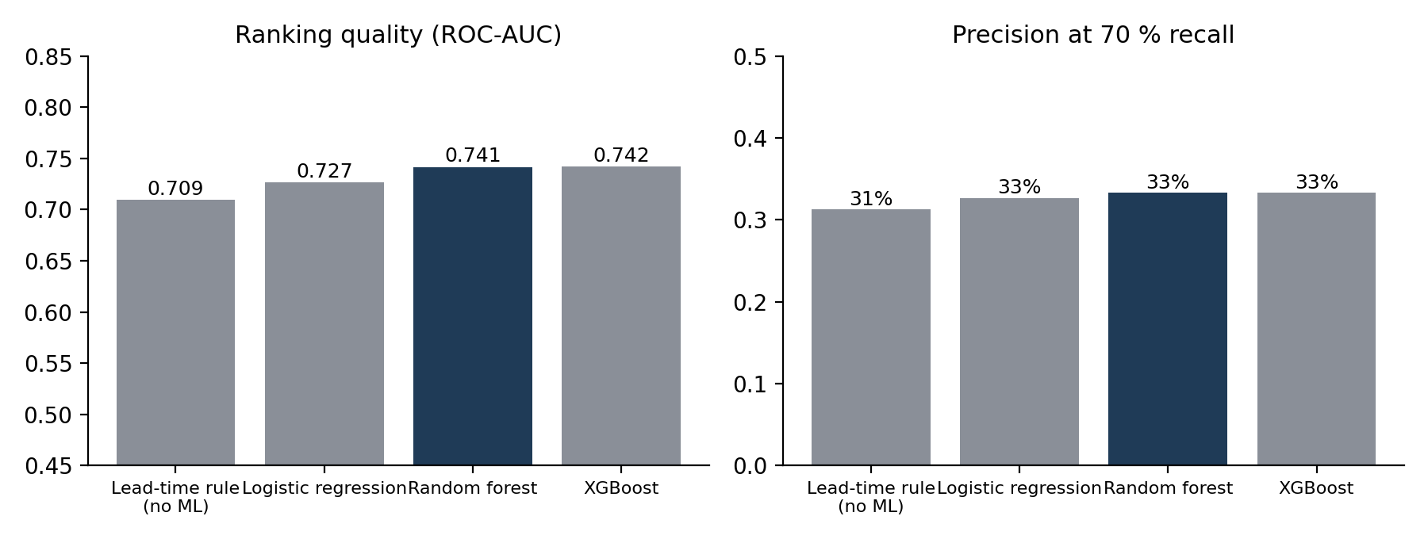
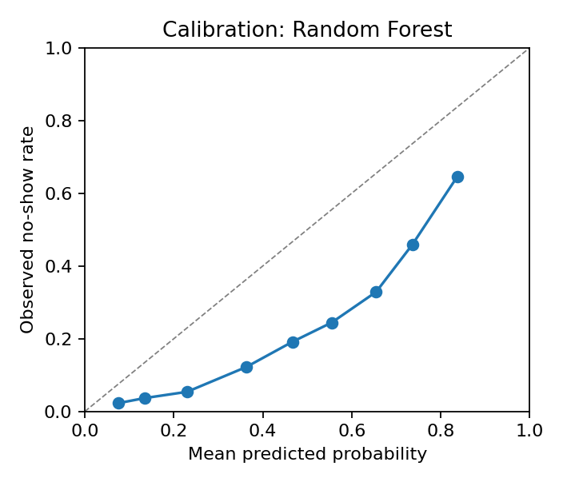
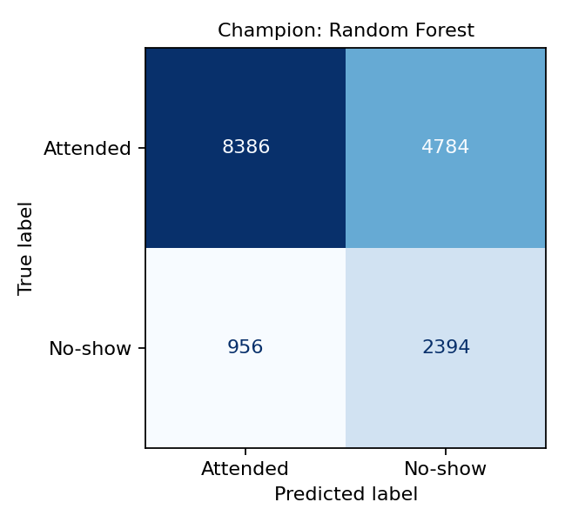
Visual summary of results
Each chart carries one message
Rule vs three models; the champion is highlighted
What 1,000 scheduled appointments look like with the model
Test-split counts at the operating threshold:
caught no-shows 2,394 · missed 956
flagged but attended 4,784 · correctly not flagged 8,386
Calibration: when the model says 40 %, about 40 % of those patients actually miss — so tiers can be read as probabilities.
Per 1,000 appointments: a few hundred calls to reach most of the no-shows. The charts are the evidence; the dashboard lets you move the threshold yourself.
Abdi Farah Ahmed · BAN6800 Business Analytics Capstone · Nexford University · Module 5 · Results
6
Notes:
Left: the workload picture per 1,000 appointments. Right: the model comparison and calibration. The confusion matrix gives the raw counts behind the percentages.

Slide 7
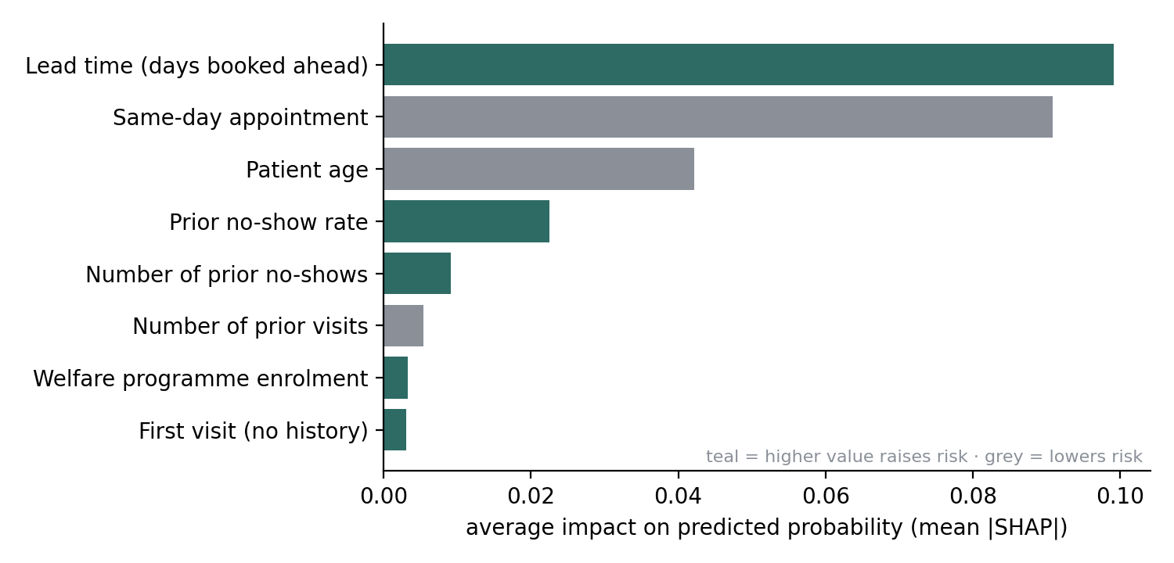
What drives a prediction
SHAP explanations translated into business language (Module 4)
The three strongest drivers: lead time (days booked ahead), same-day appointment, patient age
Days booked ahead — the longer the gap between booking and visit, the more time for travel money, transport or family arrangements to fall through. Same-day bookings are rarely missed.
Attendance history — a patient who has missed before is more likely to miss again. A first visit has no history, so the model leans on the booking pattern.
Age — adolescents and young adults miss more often; older patients with chronic follow-up attend more reliably.
Chronic conditions and welfare enrolment play smaller roles: chronic follow-up creates routine; welfare enrolment signals cost barriers.
What is deliberately absent
Gender, neighbourhood and whether an SMS was sent are not inputs; alcohol-use disorder and disability were tested and dropped because they added nothing (Δ PR-AUC +0.0014, +0.0001).
No-show risk is mostly about the circumstances of the booking, not the diagnosis — which is good news, because booking circumstances can be changed.
Abdi Farah Ahmed · BAN6800 Business Analytics Capstone · Nexford University · Module 5 · Explainability
7
Notes:
SHAP values show how much each factor moves the predicted probability. For OPD staff the message is simple: long lead times and past no-shows are where to look first.

Slide 8
Three appointments, explained
Illustrative cases scored with the serialised Module 4 model; names are invented
Case | Appointment | Predicted risk | Tier | Main reasons (reason codes)
Amina | 27 years old, booked 21 days ahead, 3 earlier visits of which 1 missed, welfare-enrolled | 76% | High | long lead time (raises risk); missed visits before (raises risk)
Hassan | 64 years old with hypertension and diabetes, booked 2 days ahead, 6 earlier visits all attended | 42% | Low | booked close to the visit (lowers risk); chronic follow-up (lowers risk)
Sahra | 16 years old, first visit, booked 35 days ahead | 70% | High | long lead time (raises risk); no attendance history (model relies on booking pattern)
How a coordinator reads this: Amina is High risk (76%) mainly because of long lead time (raises risk) — the Module 1 rule suggests a call 48 h before and, if a slot is free, an earlier appointment. Hassan is Low risk (42%); a standard SMS is enough. The reasons are shown with every score in the API and the dashboard.
A score always arrives with its reasons — a flag is a reason to reach out, never a judgement about the patient.
Abdi Farah Ahmed · BAN6800 Business Analytics Capstone · Nexford University · Module 5 · Explainability
8
Notes:
These three are constructed examples scored with the real model so that the audience sees the logic end to end. The reason codes are the same ones the API returns.

Slide 9
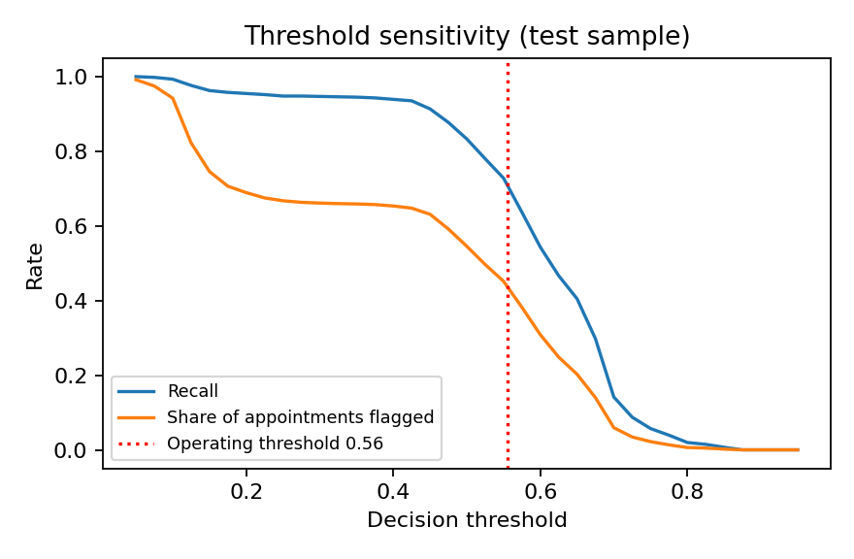
What-if: how changing the inputs changes the outcome
Counterfactuals and threshold sensitivity (Module 4); live version on the dashboard
Age | Booked ahead | Risk | What would need to change | New risk
4 | 31 days | 69% | book 1 days ahead (Thursday) | 55%
45 | 30 days | 63% | book 0 days ahead (Wednesday) | 12%
11 | 4 days | 59% | book 1 days ahead (Tuesday) | 55%
20 | 7 days | 62% | book 1 days ahead (Wednesday) | 55%
0 | 5 days | 58% | book 1 days ahead (Tuesday) | 55%
Only levers the hospital controls were allowed to move (lead time, weekday); age, health and history stayed fixed. For 5 of 5 correctly flagged no-shows, a shorter lead time alone moved the appointment below the High threshold.
Moving the threshold trades reach against workload (red line = current operating point). The model is most sensitive to 'lead_days +3' (24% of High-tier decisions change), least to random data-entry noise.
Lead time is the one lever both the patient and the hospital can change — the what-if page on the dashboard shows this for any appointment.
Abdi Farah Ahmed · BAN6800 Business Analytics Capstone · Nexford University · Module 5 · What-if
9
Notes:
Counterfactuals answer 'what would need to change'. The threshold chart is the capacity dial: leadership can see what a different call volume buys in recall.

Slide 10
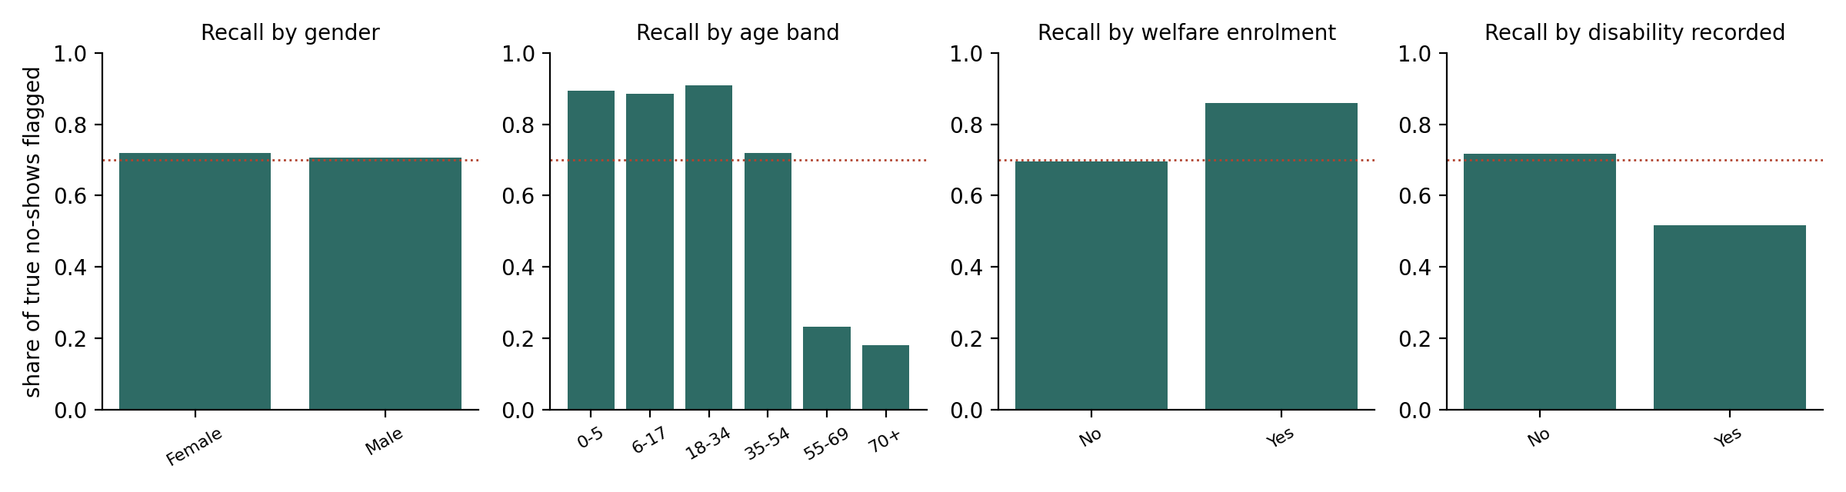
Fairness summary
Does the model find at-risk patients equally in every group? (Module 2 criterion; Module 4 audit)
In plain words
Gender: recall gap between groups 0.01 — within the 0.10 release threshold; flag-rate ratio 0.96.
Age band: recall gap between groups 0.73 — above the 0.10 release threshold; flag-rate ratio 0.16.
Welfare enrolment: recall gap between groups 0.16 — above the 0.10 release threshold; flag-rate ratio 0.76.
Disability recorded: recall gap between groups 0.20 — above the 0.10 release threshold; flag-rate ratio 0.68.
Not every group is served equally: the largest recall gap is on age band (0.73) — next slide shows what was done.
Abdi Farah Ahmed · BAN6800 Business Analytics Capstone · Nexford University · Module 5 · Fairness
10
Notes:
The fairness criterion is equal opportunity: because a flag brings help, what matters is that no-shows are caught equally in every group. Flag-rate differences by age reflect real differences in base rates, not bias. The disability group is small (2 %) so its bars are less precise.

Slide 11
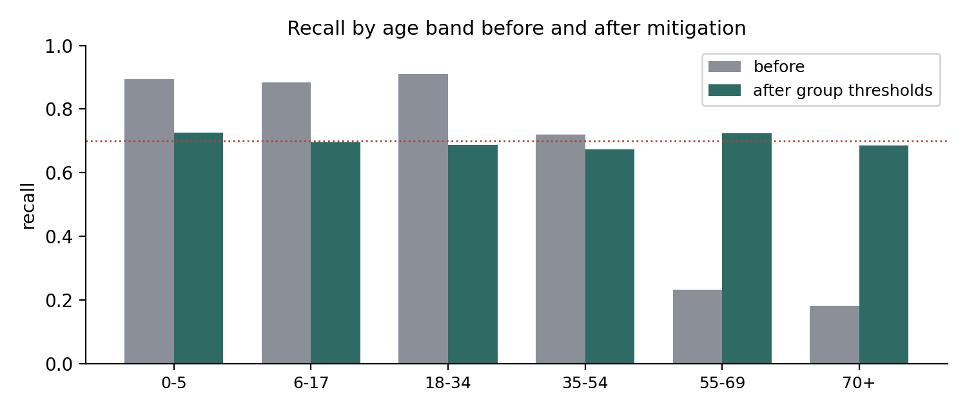
Bias mitigation: what was found and what was done
Module 4, Section 6.5
Found
At one shared threshold, recall differed by 0.73 across age band — above the 0.10 release threshold.
Done
Group-specific thresholds were chosen on the validation split so that every group reaches 70% recall (the equal-opportunity method of Hardt et al., 2016). On the test split the gap fell to 0.05; overall recall 69%, flag rate 44%.
Trade-off
The age band attribute is then used at decision time. That is acceptable only because the decision adds support and never removes it — and it needs approval from the AI & Data Governance Committee before any use.
Cross-check
Fairlearn's ThresholdOptimizer gives a comparable result (details in the Q&A appendix).
Fairness here is an ongoing check, not a one-off result: the audit and the correction run every time the model is retrained.
Abdi Farah Ahmed · BAN6800 Business Analytics Capstone · Nexford University · Module 5 · Fairness
11
Notes:
Mitigation is post-processing: the model is unchanged; only the threshold per group moves. This is the least invasive method and keeps the model auditable.

Slide 12
Model limitations
What this model cannot do — stated before anyone asks
About the data
Trained on a Brazilian public dataset (Hoppen, 2016) as a disclosed proxy — JJUSHYCSH records were not yet available. It is a validated method, not a Jigjiga model.
Six weeks of appointments: no seasons, no rainy-season roads, no pastoral movement.
No distance, transport cost or phone-coverage variables — likely decisive here, absent in the data.
Only ~2 % of records carry a disability flag, so that group's results are imprecise.
About the model
Precision is 33%: most flagged patients would have attended. A flag is a reason to call, not a prediction about a person.
Ranking quality (ROC-AUC 0.74) is modest; the gain over a simple lead-time rule is real but small.
A model trained on one period can drift: the forward-in-time check gave ROC-AUC 0.74 and recall 68% on later appointments — monitoring is not optional.
Scores can be misused to deprioritise patients; the governance policy forbids it and the API states it on every response.
Everything on this slide is in the Model Card. A stakeholder who only reads one page should read that one.
Abdi Farah Ahmed · BAN6800 Business Analytics Capstone · Nexford University · Module 5 · Limitations
12
Notes:
Limitations are presented before implications on purpose. The proxy-data limitation is the most important: nothing here should be read as a measurement of Jigjiga patients.

Slide 13
Transparency and ethics
Built on the Module 1 Ethical AI Charter, the Module 2 privacy plan and the Module 4 Model Card
Transparency statement
The model CAN rank scheduled appointments by likelihood of being missed, 24–72 h ahead, and explain each score with its main reasons.
The model CANNOT say that a given patient will miss, measure Jigjiga patients yet, or see distance, transport or season.
The model MUST NOT be used to cancel, overbook against or deprioritise anyone. Every score is advisory and staff overrides are logged.
Privacy
Pseudonymised keys, k = 20 area grouping, no names or phone numbers, three access tiers (Module 3). Pseudonymised data are still personal data under Proclamation No. 1321/2024.
Oversight
Hospital Research & Ethics Review Committee — approval of any local patient-data use.
AI & Data Governance Committee — fairness thresholds, feature changes, any change in how scores are used.
Honest visuals
Every chart in this deck starts its axis at zero or shows the full 0–1 range, reports the test split only, and shows the baseline next to the model.
Monitoring once live
Monthly recall and per-group recall gap · weekly flag rate vs outreach capacity · monthly input drift · quarterly calibration and override review.
The commitment from Module 1 stands: the score may trigger additional support — never denial, cancellation or lower clinical priority.
Abdi Farah Ahmed · BAN6800 Business Analytics Capstone · Nexford University · Module 5 · Ethics
13
Notes:
This slide is for the ethics committees. It restates the charter, the privacy controls and who decides what.

Slide 14
What the findings mean for JJUSHYCSH
Connecting the results to the Module 1 goals — without prescribing a decision
Reach — Module 1 goal: ≥ 70 % of high-risk no-shows flagged
On unseen appointments the model reaches 71% recall. If JJUSHYCSH's own data behave like the proxy, roughly 72 of the 101 no-shows in a week of 500 referral appointments would be on the outreach list.
Workload — Module 1 constraint: fixed reminder capacity
That reach costs about 217 extra contacts per 500 appointments (43%). The threshold is a dial: the dashboard shows what each level of calls buys in recall.
Where the risk sits — drivers
Long lead times and prior missed visits dominate. Implication: the booking desk, not the clinic, is where most of the risk is created — and where earlier slots or confirmation calls can change it.
Specialist-slot utilisation — Module 1 supporting KPI
Each caught no-show is a slot that can be re-offered; each false flag costs one reminder. The asymmetry is what makes a modest-precision model still worth running.
Fairness as a performance measure — Module 2
Equal reach needs the group-threshold correction for age band; without it, some groups would be under-served.
The findings tie back to each Module 1 goal; whether and how to act on them is a decision for the pilot-readiness gate, not for this presentation.
Abdi Farah Ahmed · BAN6800 Business Analytics Capstone · Nexford University · Module 5 · Implications
14
Notes:
This slide connects results to the KPIs without recommending. The 500-appointment week is an illustration; the real volume comes from the HIS officer.

Slide 15
Possible next steps (for discussion, not a recommendation)
Options the stakeholders may consider; the dashboard and code are available now
Options on the table
Request the anonymised JJUSHYCSH OPD/referral extract through the ethics pathway (Module 2 dependency D-01) and repeat the Module 3–4 validation on local data.
Agree an outreach capacity, then read the threshold off the dashboard rather than fixing it in advance.
Add the local data fields the proxy lacks: distance band, referral source, contact availability.
Decide in the AI & Data Governance Committee whether group-specific thresholds are acceptable.
Pilot in one department with the override log switched on from day one.
Available today
Live dashboard: https://jjushycsh-noshow-dashboard-9nubvdk2zitnkwww33dukn.streamlit.app
overview · results · drivers · what-if scoring · ethical-compliance (fairness) view · limitations
Code and artefacts: https://github.com/abdifaraha570-lgtm/capstoneMolude3
Module 3 pipeline · Module 4 model, API and reports · Module 5 dashboard and this deck
API: POST /predict returns probability, tier, outreach action and reason codes (demo in the appendix).
Q&A appendix follows
Data and split · protocol and hyperparameters · full metrics · fairness definitions · sensitivity and drift · API demo · monitoring · references.
Thank you. Everything shown is reproducible from the repository; the dashboard shows the same numbers live.
Abdi Farah Ahmed · BAN6800 Business Analytics Capstone · Nexford University · Module 5 · Next steps
15
Notes:
These are options, not a recommendation — the brief excludes recommendations from this deliverable. The appendix slides hold the technical detail for questions.

Slide 16
Q&A appendix
Technical backup for questions
A1 Data, pipeline and split
A2 Protocol, hyperparameters and cross-validation
A3 Full performance metrics
A4 Fairness definitions and full metrics
A5 Necessity review, sensitivity analysis and drift check
A6 Architecture and API demonstration
A7 Acceptance criteria and monitoring plan
References (NXU / APA format)
Abdi Farah Ahmed · BAN6800 Business Analytics Capstone · Nexford University · Module 5 · Appendix
16

Slide 17
A1 · Data, pipeline and split
Module 3 hand-over used unchanged
Source: Medical Appointment No Shows (Hoppen, 2016), 110,527 appointments, 14 variables; disclosed proxy for JJUSHYCSH records.
Module 3 pipeline: ingest → raw validation (28 checks) → clean → anonymise (salted SHA-256 keys, k = 20 area grouping, age top-coded at 90) → features → processed validation (23 checks, privacy gate) → publish + bias check + audit log. 110,527 in → 109,899 model-ready rows.
Split: GroupShuffleSplit on patient key, seed 42 — train 76,706 / validation 16,673 / test 16,520; no patient in two sets (asserted in Module 4). No-show rate 20.1% / 20.1% / 20.3%.
Features (12): age, lead_days, prior_visits, prior_no_shows, prior_no_show_rate, chronic_count, scholarship, hypertension, diabetes, same_day, first_visit, appt_weekday.
Excluded: sms_received (intervention leakage), area_code (geography-as-penalty risk), gender (audit only), appt_month (calendar proxy), lead_band (redundant); alcoholism and has_disability dropped by the necessity review.
Data hash 65596f8d2f9e… tagged on every MLflow run (experiment jjushycsh-noshow-m4; registry jjushycsh_noshow_risk v1, alias champion).
Abdi Farah Ahmed · BAN6800 Business Analytics Capstone · Nexford University · Module 5 · Appendix
17

Slide 18
A2 · Protocol, hyperparameters and cross-validation
Model | Best hyperparameters | CV PR-AUC | Val PR-AUC | Val ROC-AUC
Logistic regression | C=0.02162; penalty=l2 | 0.362 ± 0.007 | 0.371 | 0.730
Random forest | n_estimators=200; min_samples_leaf=20; max_features=0.5; max_depth=8 | 0.377 ± 0.003 | 0.383 | 0.739
XGBoost | subsample=1.0; n_estimators=200; min_child_weight=5; max_depth=3; learning_rate=0.05; colsample_bytree=1.0 | 0.378 ± 0.002 | 0.381 | 0.739
Randomized search, 12 candidates per algorithm, 3-fold StratifiedGroupKFold grouped by patient, scoring PR-AUC; class weights for imbalance (no resampling).
Champion chosen on validation PR-AUC. Thresholds set on validation: High = highest threshold reaching 70% recall (0.556); Medium at 90 % recall (0.463).
Every candidate logged as a nested MLflow run; champion registered with alias 'champion' at stage Staging.
Abdi Farah Ahmed · BAN6800 Business Analytics Capstone · Nexford University · Module 5 · Appendix
18

Slide 19
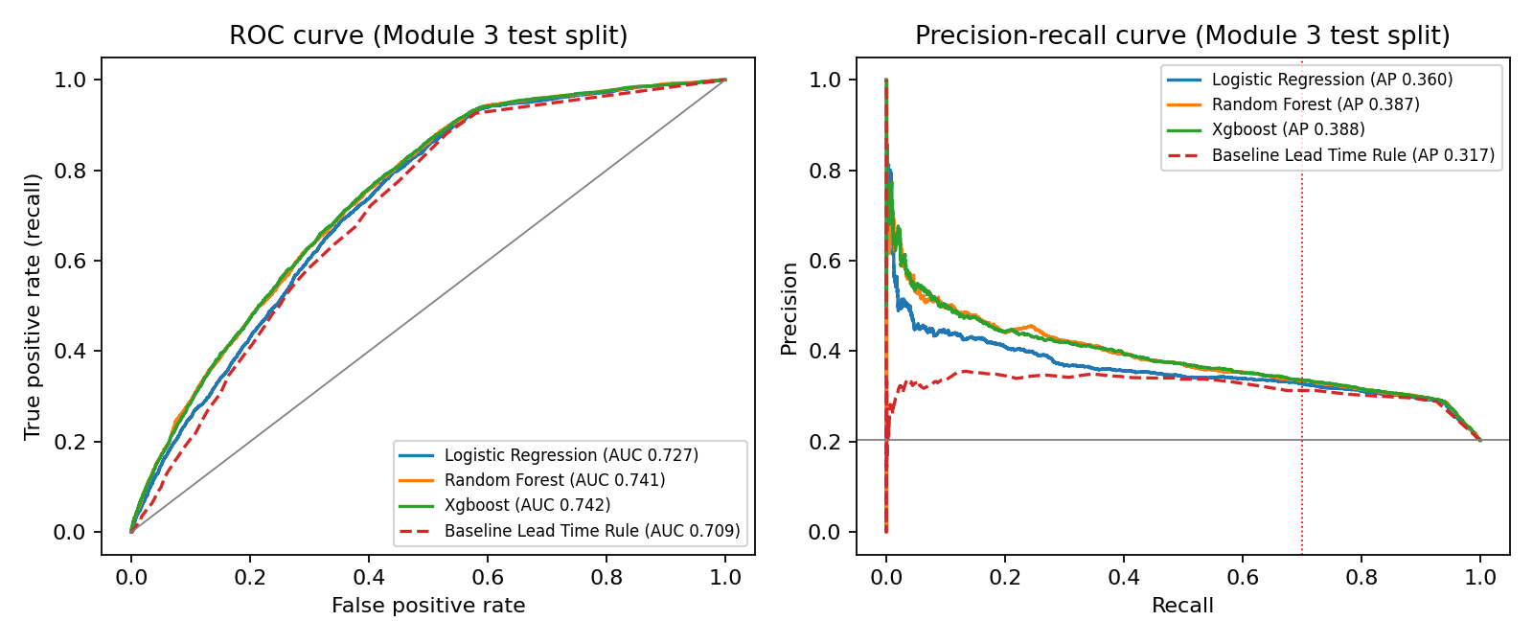
A3 · Full performance metrics (Module 3 test split)
Model | Threshold | Accuracy | Precision | Recall | F1 | ROC-AUC | PR-AUC | Brier | Flag rate | TP / FP / FN / TN
Everyone attends | 0.500 | 0.797 | 0.000 | 0.000 | 0.000 | 0.500 | 0.203 | 0.203 | 0.0% | 0 / 0 / 3,350 / 13,170
Lead-time rule (no ML) | 5.000 | 0.622 | 0.313 | 0.722 | 0.437 | 0.709 | 0.317 | n/a | 46.8% | 2,420 / 5,308 / 930 / 7,862
Logistic regression | 0.558 | 0.646 | 0.327 | 0.705 | 0.447 | 0.727 | 0.360 | 0.213 | 43.8% | 2,363 / 4,867 / 987 / 8,303
Random forest | 0.556 | 0.653 | 0.334 | 0.715 | 0.455 | 0.741 | 0.387 | 0.208 | 43.5% | 2,394 / 4,784 / 956 / 8,386
XGBoost | 0.559 | 0.652 | 0.333 | 0.715 | 0.454 | 0.742 | 0.388 | 0.209 | 43.6% | 2,395 / 4,800 / 955 / 8,370
Abdi Farah Ahmed · BAN6800 Business Analytics Capstone · Nexford University · Module 5 · Appendix
19

Slide 20
A4 · Fairness definitions and full metrics
Module 2 criteria; Fairlearn cross-check in Module 4
Equal opportunity / TPR gap (release threshold ≤ 0.10): difference in recall between best- and worst-served group. Equalized odds adds the false-positive-rate gap. Disparate impact ratio (diagnostic ≥ 0.80): lowest flag rate ÷ highest flag rate. Demographic parity difference: largest minus smallest flag rate. Favourable outcome = being flagged (it triggers support).
Attribute | DP diff | DI ratio | TPR gap | FPR gap | EO diff | TPR gap ≤ 0.10 | DI ≥ 0.80
Gender | 0.017 | 0.960 | 0.012 | 0.017 | 0.017 | yes | yes
Age band | 0.534 | 0.158 | 0.728 | 0.458 | 0.728 | no | no
Welfare enrolment | 0.133 | 0.760 | 0.163 | 0.103 | 0.163 | no | no
Disability recorded | 0.140 | 0.680 | 0.201 | 0.116 | 0.201 | no | no
Mitigation: group-specific thresholds chosen on validation (equal opportunity). Group thresholds: 0-5=0.593, 18-34=0.629, 35-54=0.564, 55-69=0.474, 6-17=0.611, 70+=0.469.
Fairlearn ThresholdOptimizer cross-check: TPR gap 0.059, recall 0.903, flag rate 0.620.
Full per-group tables (n, base rate, flag rate, TPR, FPR, precision) are in the Module 4 Fairness Metrics Report and on the dashboard's ethical-compliance page.
Abdi Farah Ahmed · BAN6800 Business Analytics Capstone · Nexford University · Module 5 · Appendix
20

Slide 21
A5 · Necessity review, sensitivity analysis and drift check
Sensitive flag | CV PR-AUC with | CV PR-AUC without | Δ | Decision
alcoholism | 0.3775 | 0.3761 | +0.0014 | drop as input (audit only)
has_disability | 0.3775 | 0.3774 | +0.0001 | drop as input (audit only)
Scenario | Mean |Δ risk| | High-tier flips | ROC-AUC
unchanged | 0.000 | 0.0% | 0.742
lead_days +3 | 0.154 | 23.5% | 0.659
lead_days -3 (floor 0) | 0.058 | 8.6% | 0.717
lead_days x1.2 | 0.004 | 1.4% | 0.742
age +5 years | 0.016 | 4.6% | 0.740
age -5 years (floor 0) | 0.016 | 4.7% | 0.740
prior no-show rate +0.10 | 0.012 | 1.2% | 0.741
welfare flag flipped | 0.019 | 7.1% | 0.740
Gaussian noise (10% SD) on age and lead time | 0.071 | 10.2% | 0.703
Necessity tolerance: a flag stays an input only if dropping it costs > 0.005 CV PR-AUC. A dropped flag is also removed from chronic_count (data minimisation, Proclamation 1321/2024).
Forward-in-time check: champion configuration refitted on dates before 2016-06-01 (71,023 appointments) and scored on the latest 22,356: ROC-AUC 0.737, PR-AUC 0.356, recall 68.2% at the earlier threshold.
Abdi Farah Ahmed · BAN6800 Business Analytics Capstone · Nexford University · Module 5 · Appendix
21

Slide 22
A6 · Architecture and API demonstration
Module 2 architecture as built in Modules 3–5
Flow
Kaggle proxy (later: HIS/DHIS2 extract, 18:00 daily) → Module 3 pipeline (pandas, validation gates, pseudonymisation, Airflow DAG, Docker) → Module 4 model (scikit-learn / XGBoost, MLflow tracking + registry, SHAP, Fairlearn, DiCE) → FastAPI /predict → Module 5 Streamlit dashboard.
API
POST /predict with age, scheduled_date, appointment_date, flags and attendance history → no_show_probability, risk_tier, recommended_action, reason_codes, thresholds, model, disclaimer.
GET /health → algorithm, creation time, feature list, data hash.
Serving uses the Module 3 feature definitions, so training and serving cannot drift apart.
Run: uvicorn api.main:app → http://127.0.0.1:8000/docs; demo script module5/api_demo.py.
Demo output (module5/api_demo.py)
Amina - 27, booked 21 days ahead, 1 of 3 earlier visits missed, welfare-enrolled: p = 0.7496, tier High — Long lead time between booking and visit: raises risk; Missed appointments in the past: raises risk
Hassan - 64, hypertension + diabetes, booked 2 days ahead, 6 earlier visits all attended: p = 0.4143, tier Low — Booked close to the visit: lowers risk; Chronic follow-up: lowers risk
Sahra - 16, first visit, booked 35 days ahead: p = 0.6919, tier High — Long lead time between booking and visit: raises risk; First visit, no attendance history
Abdi Farah Ahmed · BAN6800 Business Analytics Capstone · Nexford University · Module 5 · Appendix
22

Slide 23
A7 · Acceptance criteria and monitoring plan
Module 4, Section 7
Signal | Acceptance criterion / trigger | Frequency
Recall on no-shows | ≥ 0.70; retrain if < 0.65 | Monthly
Precision / flag rate | Flag rate within outreach capacity; alert if +50 % vs baseline | Weekly
Per-group recall gap (4 attributes) | ≤ 0.10; governance committee review if exceeded | Monthly
Input drift (lead time, age, history) | Population stability index < 0.2 | Monthly
Calibration (Brier score) | Within 10 % of validation value (0.208) | Quarterly
Override log | Staff overrides and reasons reviewed | Quarterly
Module 1 success criteria on the proxy data: recall target met; gain ≥ 0.02 ROC-AUC over the rule baseline met; fairness release threshold met. Status: registered at Staging as a validated method (Module 2 Gate 3 passed on proxy data); Gate 4 requires local data, a repeat of the validation pack and governance sign-off.
Abdi Farah Ahmed · BAN6800 Business Analytics Capstone · Nexford University · Module 5 · Appendix
23

Slide 24
References
NXU (APA 7th) format
Ahmed, A. F. (2026a). Project vision document [Unpublished BAN6800 Module 1 assignment]. Nexford University.
Ahmed, A. F. (2026b). Business analytics project overview report [Unpublished BAN6800 Module 2 assignment]. Nexford University.
Ahmed, A. F. (2026c). Designing a data pipeline for referral no-show analytics [Unpublished BAN6800 Module 3 assignment]. Nexford University.
Ahmed, A. F. (2026d). Predictive model development and validation pack [Unpublished BAN6800 Module 4 assignment]. Nexford University.
CURE Ethiopia. (2023, August 29). New mobile clinic in Jigjiga. https://ethiopia.cure.org/news/new-mobile-clinic-in-jigjiga/
Federal Ministry of Justice, Ethiopia. (2024). Personal Data Protection Proclamation No. 1321/2024.
Hardt, M., Price, E., & Srebro, N. (2016). Equality of opportunity in supervised learning. Advances in Neural Information Processing Systems, 29, 3315–3323.
Hoppen, J. (2016). Medical appointment no shows [Data set]. Kaggle. https://www.kaggle.com/datasets/joniarroba/noshowappointments
Lundberg, S. M., & Lee, S.-I. (2017). A unified approach to interpreting model predictions. Advances in Neural Information Processing Systems, 30, 4765–4774.
Mitchell, M., et al. (2019). Model cards for model reporting. Proceedings of the Conference on Fairness, Accountability, and Transparency, 220–229.
Mothilal, R. K., Sharma, A., & Tan, C. (2020). Explaining machine learning classifiers through diverse counterfactual explanations. FAT* 2020, 607–617.
Weerts, H., Dudík, M., Edgar, R., Jalali, A., Lutz, R., & Madaio, M. (2023). Fairlearn: Assessing and improving fairness of AI systems. Journal of Machine Learning Research, 24(257), 1–8.
Streamlit Inc. (n.d.). Streamlit documentation. https://docs.streamlit.io/
Abdi Farah Ahmed · BAN6800 Business Analytics Capstone · Nexford University · Module 5 · Appendix
24

