Slide 1


Introduction to Banking Management System
This banking management system is designed to streamline and automate the core operations of a financial institution. It provides a comprehensive solution for managing customer accounts, transactions, loans, and other banking services.

Slide 2

Project Overview
1
Enhance Customer Experience
2
Optimize Business Processes
Streamline internal operations and increase productivity through automation and data-driven decision making.
Improve customer satisfaction by offering a user-friendly interface and efficient service delivery.
3
Ensure Regulatory Compliance
Implement robust security measures and adhere to industry regulations to protect customer data and assets.

Slide 3
Key Features
Account Management
Transactions and Payments
Loan Processing
Open, close, and manage customer accounts with ease.
Streamline the loan application, approval, and disbursement process.
Facilitate secure and seamless financial transactions, including deposits, withdrawals, and fund transfers.

Slide 4
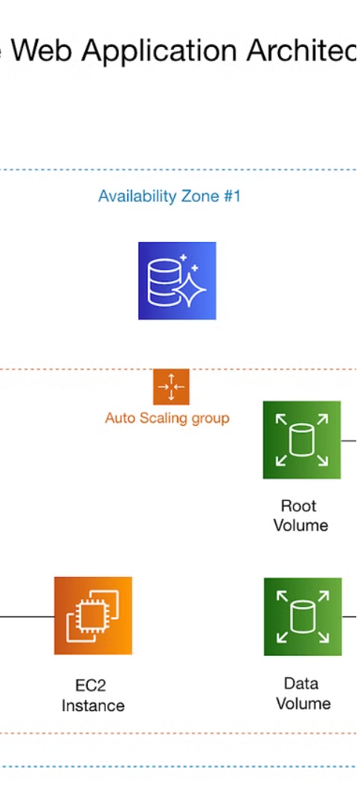
System Architecture
1
Frontend
User-friendly web and mobile interfaces for customers and employees.
2
Backend
Secure and scalable server-side components that handle business logic and data management.
3
Database
Robust and secure database system for storing and managing customer and transaction data.

Slide 5
Database Design
Customer Accounts
Loans
Stores customer information, account details, and transaction history.
Manages loan applications, approvals, and repayment schedules.
Transactions
Security
Records all financial transactions, including deposits, withdrawals, and fund transfers.
Maintains user authentication, authorization, and access control data.

Slide 6




User Interface and Functionality
Account Overview
Transaction Management
Loan Processing
Customer Support
Handle loan applications, approvals, and repayment tracking.
View and manage customer account details and balances.
Initiate and track financial transactions, including deposits, withdrawals, and fund transfers.
Provide personalized customer service and address inquiries and concerns.

Slide 7




Implementation and Deployment
Development
Integration
Deployment
Monitoring
Build and test the system components using agile methodologies.
Seamlessly integrate the frontend, backend, and database systems.
Deploy the system on secure and scalable infrastructure.
Continuously monitor and maintain the system's performance and security.

Slide 8
Conclusion and Future Enhancements
1
Improved Customer Experience
2
Expanded Functionality
Leverage emerging technologies to enhance the user experience and personalize banking services.
Introduce new features such as mobile banking, online lending, and integrated financial planning tools.
3
Enhanced Security
4
Data-driven Insights
Implement advanced security measures, including biometric authentication and blockchain-based transactions.
Utilize data analytics and AI to gain deeper insights and make more informed business decisions.

