Slide 1
Chapter One
Introduction to Emerging Technologies

Slide 2
Activity 1
What is Emerging Technology?
What is Technology?
What is Evolution?

Slide 3
Evolution of Technologies
What is Emerging Technology?
New technology
the continuing development of existing technology .
What is Technology?
Science of the mechanical and industrial arts.
What is Evolution?
The process of developing by gradual changes.

Slide 4
List of some currently available emerged technologies
Artificial Intelligence
Blockchain
Augmented Reality and Virtual Reality
Cloud Computing
Angular and React
DevOps
Internet of Things (IoT)
Intelligent Apps (I-Apps)
Big Data Robotic Processor Automation (RPA)

Slide 5
Introduction to the Industrial Revolution (IR)
A period of major industrialization and innovation (late 1700s and early 1800s. )
IR is Occurred when a society shifts from using tools to make products to use new sources of energy, such as coal, to power machines in factories (started at England).
IR was a time when the manufacturing of goods moved from small shops and homes to large factories .
American IR is the 2nd IR (between 1820&1870).

Slide 6
---continued
The following industrial revolutions fundamentally changed and transfer the world around us into modern society.
The steam engine,
The age of science and mass production, and
The rise of digital technology
Smart and autonomous systems fueled by data and machine learning.

Slide 7
What are the Most Important Inventions of the IR ?
Transportation: The Steam Engine, The Railroad, The Diesel Engine, The Airplane.
Communication: The Telegraph. The Transatlantic Cable. The Phonograph. The Telephone.
Industry: The Cotton Gin. The Sewing Machine. Electric Lights.

Slide 8
The four types of Industries
• The primary industry involves getting raw materials e.g. mining, farming, and fishing.
• The secondary industry involves manufacturing e.g. making cars and steel.
• Tertiary industries provide a service e.g. teaching and nursing.
• The quaternary industry involves research and development industries e.g. IT.

Slide 9
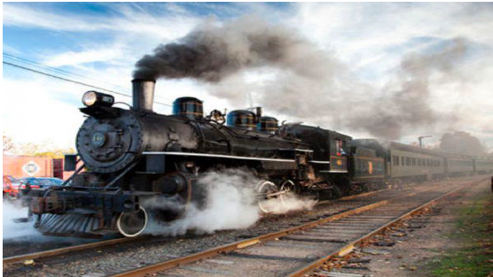
IR 1.0-transition to new manufacturing process
Fig1.Steam Engine
The development of machine tools and the rise of the factory system

Slide 10
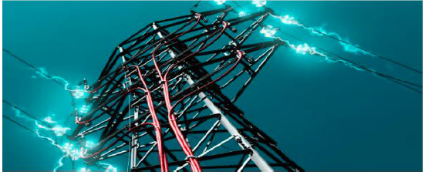
IR 2.0-Technological Revolution
Fig2. Electricity transmission line
New technological systems were introduced, such as electrical power and telephones

Slide 11
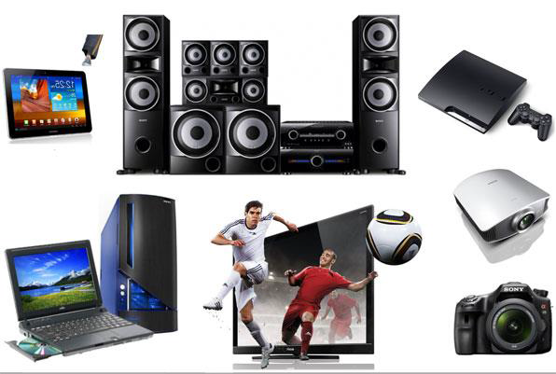
IR 3.0-Digital Revolution
Fig3. High Tech Electronics
Transition from mechanical and analog electronic technology to digital electronics

Slide 12
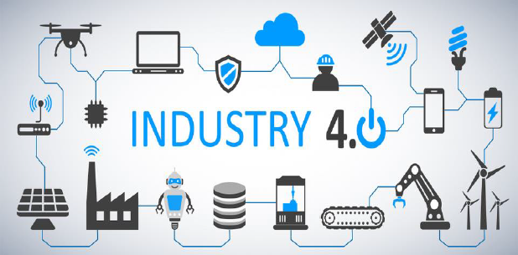
IR 4.0-Robotics and IoT-Cyber physical system
Fig4. Anybody connected device-Eg. Computer Numerical Control (by Instruction)
A cyber-physical system is a mechanism that is controlled or monitored by computer-based algorithms, tightly integrated with the Internet and its users-Eg-AI.

Slide 13
Role of Data for Emerging Technologies
Data is regarded as the new oil and strategic asset since we are living in the age of big data, and
drives or even determines the future of science, technology, the economy, and possibly everything in our world today and tomorrow.
More importantly presents enormous challenges that in turn bring incredible innovation and economic opportunities by understanding, exploring, and utilizing data.

Slide 14
Enabling devices and network (Programmable devices)
In the world of digital electronic systems, there are four basic kinds of devices:
Memory
microprocessors
logic, and
networks.
Memory :stores random information such as the contents of a spreadsheet or database.

Slide 15
… Continued
Microprocessors: execute software instructions to perform a wide variety of tasks such as running a word processing program or video game.
Logic devices: provide specific functions, including device-to-device interfacing, data communication, signal processing, data display, timing and control operations, and almost every other function a system must perform.
Network: is a collection of computers, servers, mainframes, network devices, peripherals, or other devices connected to one another to allow the sharing of data. Eg. Internet

Slide 16
Why is a computer referred to as a programmable device?
Because what makes a computer a computer is that it follows a set of instructions.
Many electronic devices are computers that perform only one operation, but they are still following instructions that reside permanently in the unit.

Slide 17
List of some Programmable devices
Achronix Speedster SPD60
• Actel’s
• Altera Stratix IV GT and Arria II GX
• Atmel’s AT91CAP7L
• Cypress Semiconductor’s programmable system-on-chip (PSoC) family
• Lattice Semiconductor’s ECP3
• Lime Microsystems’ LMS6002
• Silicon Blue Technologies
• Xilinx Virtex 6 and Spartan 6 and Xmos Semiconductor L series

Slide 18
… Continued
A full range of network-related equipment referred to as Service Enabling Devices (SEDs), which can include:
Traditional channel service unit (CSU) and data service unit (DSU)
Modems
Routers
Switches
Conferencing equipment
Network appliances (NIDs and SIDs)
Hosting equipment and servers

Slide 19
Human to Machine Interaction
HMI refers to the communication and interaction between a human and a machine via a user interface.
Nowadays, natural user interfaces such as gestures have gained increasing attention as they allow humans to control machines through natural and intuitive behaviors

Slide 20
What is interaction in human-computer interaction?
HCI is the study of how people interact with computers and to what extent computers are or are not developed for successful interaction with human beings.
As its name implies, HCI consists of three parts: the user, the computer itself, and the ways they work together.

Slide 21
How do users interact with computers?
The user interacts directly with hardware for the human input and output such as displays,
e.g. through a graphical user interface.
The user interacts with the computer over this software interface using the given input and output (I/O) hardware.

Slide 22
How important is human-computer interaction?
The goal of HCI is to improve the interaction between users and computers by making computers more user-friendly and receptive to the user's needs.
The main advantages of HCI are simplicity, ease of deployment & operations and cost savings for smaller set-ups.
They also reduce solution design time and integration complexity.

Slide 23
Disciplines Contributing to (HCI)
Cognitive psychology: Limitations, information processing, performance prediction, cooperative working, and capabilities.
Computer science: Including graphics, technology, prototyping tools, user interface management systems.
Linguistics.
Engineering and design.
Artificial intelligence.
Human factors.

Slide 24
Current and Future Trends in Emerging Technologies
Emerging technology trends:
5G Networks
Artificial Intelligence (AI)
Autonomous Devices
Blockchain
Augmented Analytics
Digital Twins
Enhanced Edge Computing and
Immersive Experiences in Smart Spaces

Slide 25
Chapter One Review Questions
Where did the Industrial Revolution start and why did it begin there?
What does “emerging” mean, emerging technologies and how are they found?
What makes “emerging technologies” happen and what impact will they have on Individuals, Society, and Environment?
Discussed the economic and ideological causes of the American, the French, and the Chinese Revolutions, and to see the larger historical contexts in which these events took place?
Discuss and compare the course of the American, the French, and the Chinese revolutions and analyze the reasons for and significance of the different outcomes of these three revolutions?
Discuss the successes and the shortcomings of the conservative reaction to the French Revolution as seen in the actions of the Congress of Vienna and the Holy Alliance?
How do recent approaches to “embodied interaction” differ from earlier accounts of the role of cognition in human-computer interaction? 8
What is the reason for taking care of design a good computer-human interface?
Discuss the pros and cons of human-computer interaction technology?

Slide 26
Chapter One Review Questions
Thank You !!!

