Slide 1
Chapter Two
Data Science

Slide 2
Activity 2
What is Data Science?
What are Data and Information?
What is Big Data?

Slide 3
An Overview of Data Science
What is Data Science?
Multi disciplinary field that uses scientific methods, processes, algorithms and systems to extract knowledge and insights from structured, semi-structured and unstructured data.
What are Data and Information?
Data: representation of facts, concepts, or instructions in a formalized manner
Information: processed data that decisions are based .

Slide 4
Data Processing Cycle
Figure1: Data Processing Cycle
Examples:
Input: input data is storage on hard disk, flash disk.
Processing: Interest can be calculated on deposit to a bank.
Output: payroll for employees.
INPUT
PROCESSING
OUTPUT

Slide 5
Data Types and their representation
Data types from Computer programming perspective:
Integers(int)- is used to store whole numbers, mathematically known as integers
Booleans(bool)- is used to represent restricted to one of two values: true or false
Characters(char)- is used to store a single character
Floating-point numbers(float)- is used to store real numbers
Alphanumeric strings(string)- used to store a combination of characters and numbers

Slide 6
---continued
A data type makes the values that expression, such as a variable or a function, might take.
Variable: a memory location that can hold values of a specific type.
Function: a group of statements that together performs a task and method or subroutine or procedure.
It defines the operations that can be done on the data, the meaning of the data, and the way values of that type can be stored.

Slide 7
---continued
Data types from Data Analytics perspective:
Structured Data: adheres to a pre-defined data model and is straightforward to analyze. Eg. Excel files and SQL databases.
Semi-Structured Data: contains tags or other markers to separate semantic elements . Eg. JSON and XML .
Unstructured Data: it is information typically text heavy may contains data such as dates, numbers and facts . Eg. Audio, Video files or Non SQL database.

Slide 8
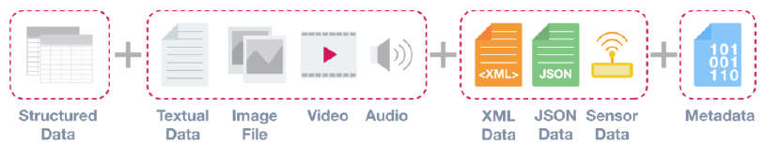
---continued
Figure2 : Data types from a data analytics perspective

Slide 9
Metadata – Data about Data
Metadata is data about data.
It provides additional information about a specific set of data.
In a set of photographs, for example, metadata could describe when and where the photos were taken.
It then provides fields for dates and locations which, by themselves, can be considered structured data.
Because of this reason, metadata is frequently used by Big Data solutions for initial analysis.

Slide 10
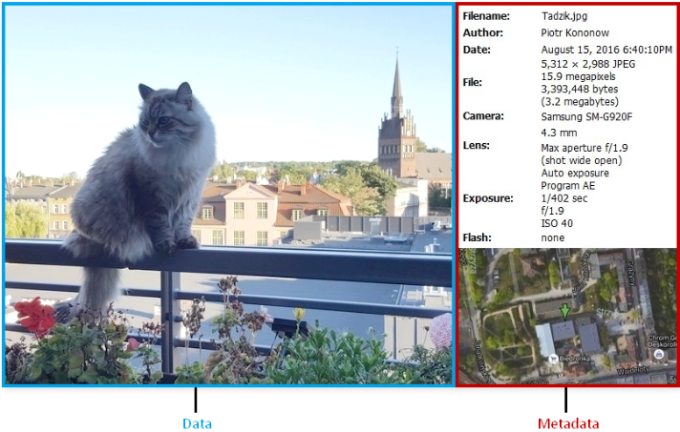
Fig3: Examples of Metadata

Slide 11
Data value Chain
The Data Value Chain is the information flow within a big data system as a series of steps needed to generate value and useful insights from data.
Data Acquisition : the process of gathering, filtering, and cleaning data before it is put in a data warehouse or any other storage solution .
Data Analysis: involves exploring, transforming, and modeling data with the goal of highlighting relevant data, synthesizing and extracting useful hidden information with high potential from a business point of view. Eg. DM,AI-ML

Slide 12
… Continued
Data Curation: categorized in to creation, selection, classification, transformation, validation, and preservation. It is performed by expert curators that are responsible for improving the accessibility and quality of data.
Data Storage: It is the persistence and management of data in a scalable way that satisfies the needs of applications that require fast access to the data. Eg. RDBMS.
Data Usage: It covers the data-driven business activities that need access to data, its analysis, and the tools needed to integrate the data analysis within the business activity.

Slide 13
Basic concepts of big data
What is Big Data ?
is the term for a collection of data sets so large and complex that it becomes difficult to process using on-hand database management tools or traditional data processing applications.
It is a blanket term for the non-traditional strategies and technologies needed to gather, organize, process, and gather insights from large datasets.

Slide 14
Big Data is Characterized by 4V:
Volume: large amounts of data Zeta bytes/Massive datasets
Velocity: Data is live streaming or in motion
Variety: data comes in many different forms from diverse sources
Veracity: can we trust the data? How accurate is it? etc.

Slide 15
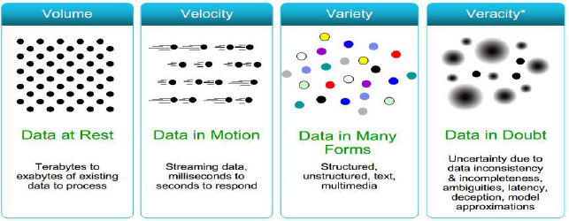
… Continued
Fig4: Characteristics of big data

Slide 16
Clustered Computing and Hadoop Ecosystem
Clustered Computing
Because of the qualities of big data, individual computers are often inadequate for handling the data at most stages.
To better address the high storage and computational needs of big data, computer clusters are a better fit.
Big data clustering software combines the resources of many smaller machines, seeking to provide a number of benefits:

Slide 17
… Continued
Resource Pooling: Combining the available storage space to hold data is a clear benefit, but CPU and memory pooling are also extremely important. Processing large datasets requires large amounts of all three of these resources.
High Availability: Clusters can provide varying levels of fault tolerance and availability guarantees to prevent hardware or software failures from affecting access to data and processing. This becomes increasingly important as we continue to emphasize the importance of real-time analytics.

Slide 18
… Continued
Easy Scalability: Clusters make it easy to scale horizontally by adding additional machines to the group. This means the system can react to changes in resource requirements without expanding the physical resources on a machine.
Cluster membership and resource allocation can be handled by software like Hadoop’s YARN (which stands for Yet Another Resource Negotiator).

Slide 19
… Continued
Hadoop and Its Ecosystem
Hadoop is an open-source framework intended to make interaction with big data easier.
It is a framework that allows for the distributed processing of large datasets across clusters of computers using simple programming models.
It is inspired by a technical document published by Google.

Slide 20
The four key characteristics of Hadoop are:
Economical: Its systems are highly economical as ordinary computers can be used for data processing.
Reliable: It is reliable as it stores copies of the data on different machines and is resistant to hardware failure.
Scalable: It is easily scalable both, horizontally and vertically. A few extra nodes help in scaling up the framework.
Flexible: It is flexible and you can store as much structured and unstructured data as you need to and decide to use them later.

Slide 21
… Continued
Hadoop has an ecosystem that has evolved from its four core components: data management, access, processing, and storage.
It is continuously growing to meet the needs of Big Data.
It comprises the following components and many others:
HDFS: Hadoop Distributed File System
YARN: Yet Another Resource Negotiator
MapReduce: Programming based Data Processing
Spark: In-Memory data processing
PIG, HIVE: Query-based processing of data services

Slide 22
… Continued
HBase: NoSQL Database
Mahout, Spark MLLib: Machine Learning algorithm libraries
Solar, Lucene: Searching and Indexing
Zookeeper: Managing cluster
Oozie: Job Scheduling

Slide 23
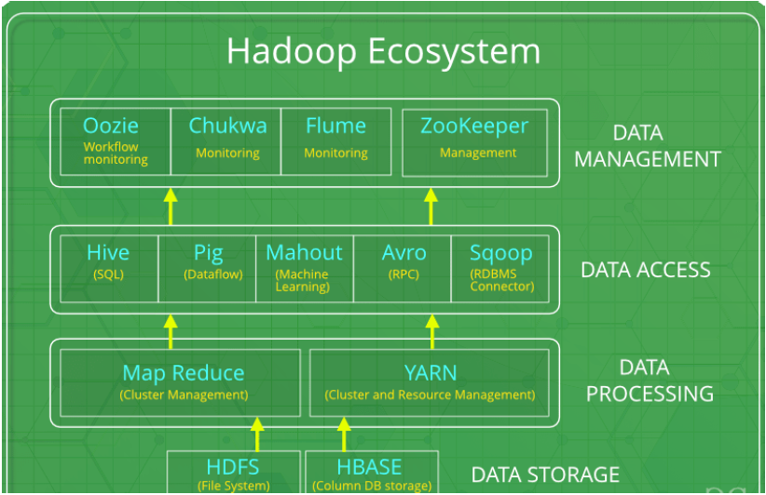
Fig6: Hadoop Ecosystem

Slide 24
Big Data Life Cycle with Hadoop
Ingesting data into the system
The first stage of Big Data processing is Ingest.
The data is ingested or transferred to Hadoop from various sources such as relational databases, systems, or local files.
Sqoop transfers data from RDBMS to HDFS, whereas Flume transfers event data.
Processing the data in storage
The second stage is Processing. In this stage, the data is stored and processed. The data is stored in the distributed file system, HDFS, and the NoSQL distributed data, HBase. Spark and MapReduce perform data processing.

Slide 25
… Continued
Computing and analyzing data
The third stage is to Analyze. Here, the data is analyzed by processing frameworks such as Pig, Hive, and Impala. Pig converts the data using a map and reduce and then analyzes it. Hive is also based on the map and reduce programming and is most suitable for structured data.
Visualizing the results
The fourth stage is Access, which is performed by tools such as Hue and Cloudera Search. In this stage, the analyzed data can be accessed by users.

Slide 26
Chapter Two Review Questions
Define data science; what are the roles of a data scientist?
Discuss data and its types from computer programming and data analytics perspectives?
Discuss a series of steps needed to generate value and useful insights from data?
What is the principal goal of data science?
List out and discuss the characteristics of Big Data?
How we ingest streaming data into Hadoop Cluster?

Slide 27
End
Thank You !!!

