Slide 1
Chapter Three
Artificial Intelligence (AI)

Slide 2
Activity 3.1
What is Artificial?
What is Intelligent?

Slide 3
What is Artificial Intelligence (AI)
Artificial
Defines man-made .
Intelligence
Defines thinking power or the ability to learn or solve problems.
Artificial Intelligence
Means a man-made thinking power.
A branch of computer science by which we can create intelligent machines which can behave like a human, think like humans, and able to make decisions.

Slide 4
Composition of Intelligence
AI exists when a machine can have human based skills such as learning, reasoning, and solving problems with Artificial intelligence you do not need to program a machine to do some work, despite you can create a machine with programmed algorithms which can work with own intelligence. Intelligence is composed of:
Reasoning
Learning
Problem Solving
Perception
Linguistic Intelligence

Slide 5
… Continued
AI is composed of an agent and its environment.
An agent (e.g., human or robot) is anything that can perceive its environment through sensors and acts upon that environment through effectors.
In Classical planning problems, the agent can assume that it is the only system acting in the world, allowing the agent to be certain of the consequences of its actions.
Reasoning: If the agent is not the only actor, then it
requires that the agent can reason under uncertainty.

Slide 6
… Continued
Machine Perception: is the ability to use input from sensors (such as cameras, microphones, sensors, etc.) to deduce aspects of the world. e.g., Computer Vision.
High-profile examples of AI: autonomous vehicles (such as drones and self-driving cars), medical diagnosis, creating art (such as poetry), proving mathematical theorems, playing games (such as Chess or Go), search engines (such as Google search), online assistants (such as Siri), image recognition in photographs, spam filtering, prediction of judicial decisions and targeting online advertisements

Slide 7
… Continued
Artificial Intelligence Vs Machine Learning Vs Deep Learning:
Machine Learning is an advanced form of AI where the machine can learn as it goes rather than having every action programmed by humans and is study of computer algorithms that improve automatically through experience.
Neural Networks are biologically inspired networks that extract features from the data in a hierarchical fashion. The field of neural networks with several hidden layers is called deep learning.

Slide 8
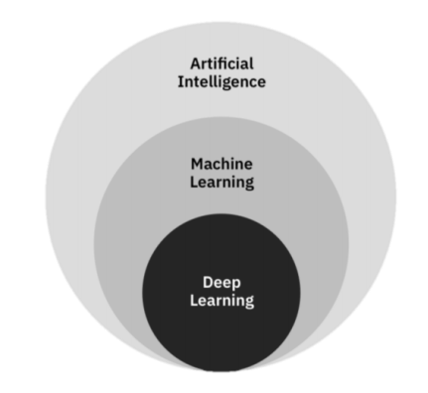
… Continued
Figure 3.1 Artificial Intelligence (AI), Machine Learning (ML) and Deep Learning (DL)

Slide 9
Need for Artificial Intelligence
To create expert systems that exhibit intelligent behavior with the capability to learn, demonstrate, explain and advice its users.
Helping machines find solutions to complex problems like humans do and applying them as algorithms in a computer-friendly manner.

Slide 10
Goals of Artificial Intelligence
Replicate human intelligence
Solve knowledge-intensive tasks
An intelligent connection of perception and action
Building a machine which can perform tasks that requires human intelligence such as:
Proving a theorem
Playing chess
Plan some surgical operation
Driving a car in traffic

Slide 11
…continued
5. Creating some system which can exhibit intelligent behavior, learn new things by itself, demonstrate, explain, and can advise to its user.

Slide 12
What Comprises to AI
AI is not jus Cs even so vast and requires lots of other factors that ca contribute to it.
It requires the following disciplines:
Mathematics
Biology
psychology
Sociology
computer science
Neurons Study and statistics

Slide 13
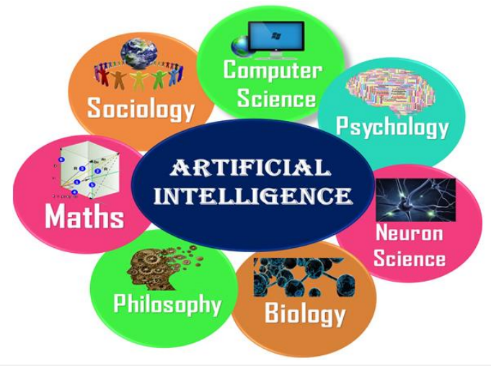
---continued
Figure 3.2 Artificial Intelligence is multidisciplinary

Slide 14
Advantages of Artificial Intelligence
High accuracy with fewer errors
High speed
High reliability
Useful for risky areas
Digital assistant: E-Commerce websites
Useful as public utility: such as a self-driving car which can make our journey safer and hassle-free, facial recognition for security purposes, Natural language processing (for search engines, for spelling checker, for assistant like Siri, for translation like Google translate), etc.

Slide 15
Disadvantages of Artificial Intelligence
High cost
Cannot think out of the box: work only for which they are trained.
No feelings and emotions: only harmful for users if the proper care is not taken.
Increase dependence on machines: humans are losing mental capabilities because of dependency on machines.
No Original Creativity: cannot be creative and imaginative

Slide 16
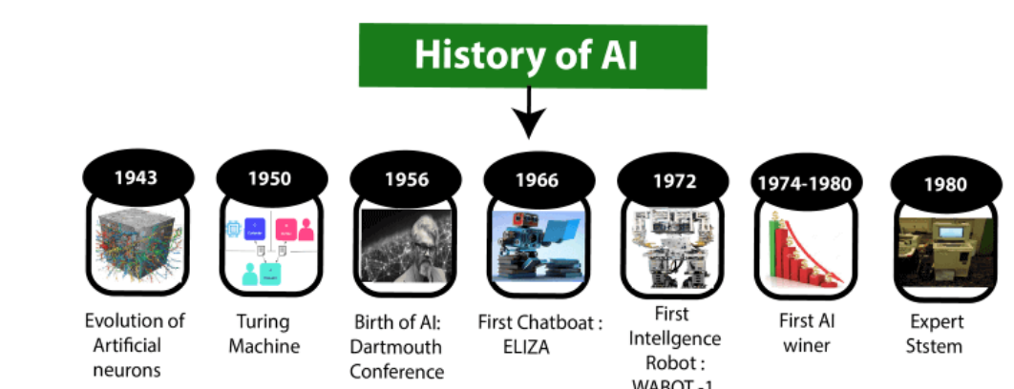
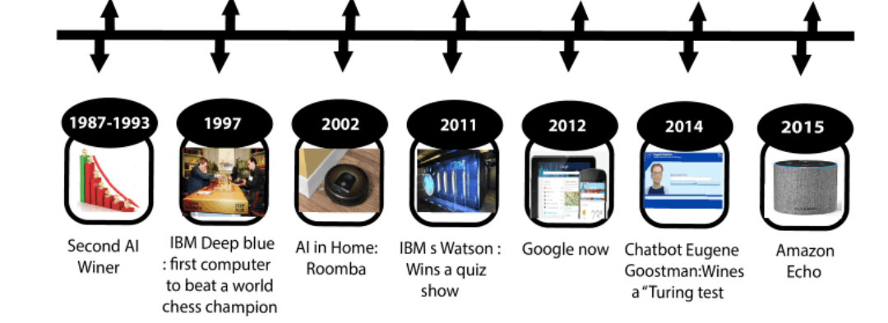
Figure 3.3 History of Artificial Intelligence (AI)

Slide 17
Levels of AI
Stage 1-Rule Based Systems: E.g., Robotic Process Automation and domestic appliances to aircraft autopilots.
Stage 2 – Context Awareness and Retention: are trained on the knowledge and experience of the best human. E.g., chatbots and “roboadvisors
Stage 3 – Domain-Specific Expertise: Builds up expertise in a specific context and Successful use cases have been seen in cancer diagnosis and the well-known Google Deepmind’s AlphaGo.
Stage 4 – Reasoning Machines: They could reason or negotiate with humans and other machines.

Slide 18
…Continued
Stage 5-Self Aware Systems / Artificial General Intelligence (AGI): These systems have human-like intelligence – the most commonly portrayed AI in media
Stage 6 – Artificial Superintelligence (ASI):AI algorithms can outsmart even the most intelligent humans in every domain. Fiction has tackled this idea for a long time, for example in the film Ex Machina or Terminator.
Stage 3 – Singularity and Transcendence: Human augmentation could connect our brains to each other and to a future successor of the current internet, creating a “hive mind” that shares ideas, solves problems .

Slide 19
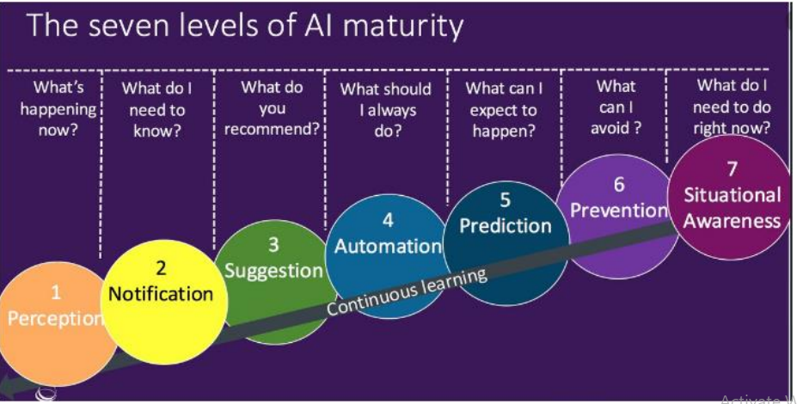
The Seven Levels of AI Maturity
Figure 3.4 The seven layers of AI maturity

Slide 20
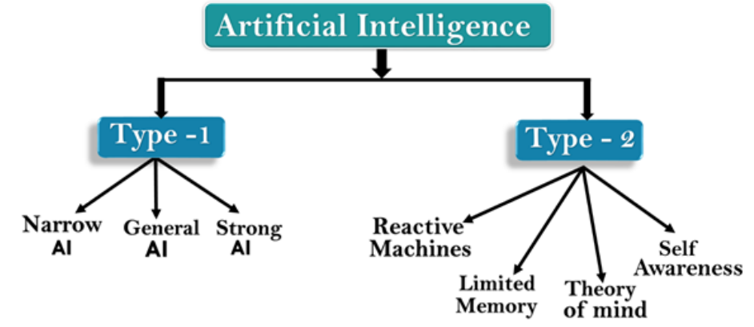
Types of AI
Figure 3.5 types of Artificial Intelligence (AI)

Slide 21
…continued
Based on the Capabilities
Weak AI or Narrow AI: currently available and only trained for one specific tasks. E.g., Apple Siri, IBM’s Watson, Google translate, playing chess, purchasing suggestion on e-commerce sites, self-driving cars, speech recognition, and image recognition.
General AI: perform any intellectual task with efficiency and like a human.
Super AI: machines could surpass human intelligence, and can perform any task better than a human with cognitive properties. E.g., ability to think, to reason, solve the puzzle, make judgments, plan, learn, and communicate on its own are characteristics of strong AI. Super AI is still a hypothetical concept of AI.

Slide 22
…continued
B. Based on the Functionality
Reactive Machines: do not store memories or past experiences for future actions. E.g., IBM's Deep Blue system Google's AlphaGo.
Limited Memory: store past experiences or some data for a short period of time. E.g., Self driving cars.
Theory of Mind: understand human emotions, people, beliefs, and be able to interact socially like humans. This is still not developed, but researchers are making lots of efforts and improvements for developing such AI machines.
Self-Awareness: It is future AI and smarter than the human mind.

Slide 23
How Humans Think
How does a human being think? Intelligence or the cognitive process is composed of three main stages:
Observe and input the information or data in the brain.
Interpret and evaluate the input that is received from the surrounding environment.
Make decisions as a reaction towards what you received as input and interpreted and evaluated.
Note: It is possible to map the human thinking stages to the layers or components of AI systems.

Slide 24
… stages to the layer of AI systems
1st Stage (Sensing layer): humans acquire information from their surrounding environments through human senses, such as sight, hearing, smell, taste, and touch, through human organs, such as eyes, ears, and other sensing organs, for example, the hands.
In AI models, this stage is represented by the sensing layer, which perceives information from the surrounding environment. This information is specific to the AI application.

Slide 25
… continued
For example, there are sensing agents such as voice recognition for sensing voice and visual imaging recognition for sensing images. Thus, these agents or sensors take the role of the hearing and sight senses in humans.
2nd Stage (Interpretation layer): interpreting and evaluating input data.
3rd Stage (Interacting layer): taking action or making decisions. Robotic movement control and speech generation are examples of functions that are implemented in the interacting layer.

Slide 26
Influencers of artificial intelligence
Big data: Structured data versus unstructured data
Advancements in computer processing speed and new chip architectures
Cloud computing and APIs
The emergence of data science

Slide 27
…continued
Big data: refers to huge amounts of data and requires innovative forms of information processing to draw insights, automate processes, and help decision making. Big data can be structured data that corresponds to a formal pattern, such as traditional data sets and databases. It also includes semi-structured and unstructured formats, such as word-processing documents, videos, images, audio, presentations, social media interactions, streams, web pages, and many other kinds of content.

Slide 28
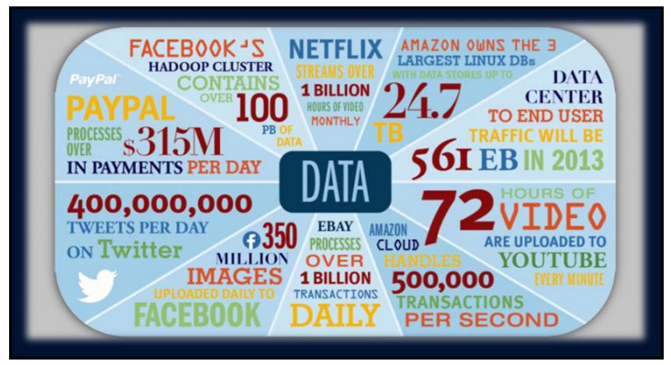
… Continued
Figure 3.6 Current changes in the data landscape

Slide 29
Structured data versus unstructured data
structured data- is information with an organized structure, such as a relational database that is searchable by simple and straightforward search engine algorithms or SQL statements.
Unstructured data -is not contained in a regular database and is growing exponentially, making up most of the data in the world.

Slide 30
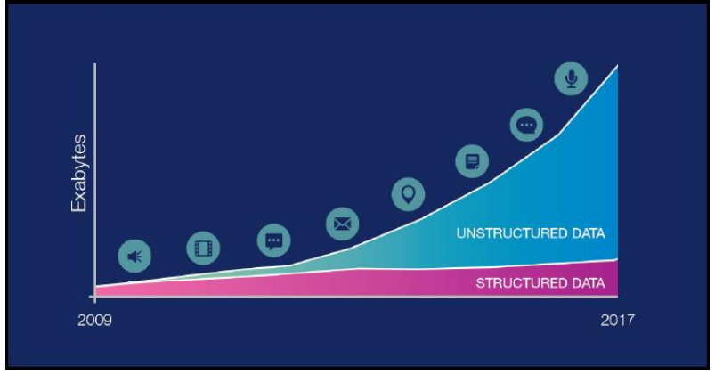
… Continued
Figure 3.7 The comparison between the growth of structured and unstructured data

Slide 31
Advancements in computer processing speed, new chip architectures, and big data file systems.
It enable us to make sense of the information that is generated by big data more quickly.
In the past, statisticians and early data scientists were limited to working with sample data sets.
In recent years, big data and the ability to process a large amount of data at high speeds have enabled researchers and developers to access and work with massive sets of data.
Processing speeds and new computer chip architectures contribute to the rapid evolution of AI applications.
The meaning of big data expanded beyond the volume of data after the release of a paper by Google
on MapReduce and the Google File System (GFS), which evolved into the Apache Hadoop opensource project.

Slide 32
Cloud computing and application programming interfaces
It is a general term that describes the delivery of on-demand services, usually through the internet, on a pay-per-use basis.
In general, application programming interfaces (APIs) expose capabilities and services.
APIs enable software components to communicate with each other easily.
The use of APIs as a method for integration injects a level of flexibility into the application lifecycle by making the task easier to connect and interface with other applications or services.

Slide 33
…continued
All the significant companies in the AI services market deliver their services and tools on the internet through APIs over cloud platforms, for example:
IBM delivers Watson AI services over IBM Cloud.
Amazon AI services are delivered over Amazon Web Services (AWS).
Microsoft AI tools are available over the MS Azure cloud.
Google AI services are available in the Google Cloud Platform.
These services benefit from cloud platform capabilities, such as availability, scalability, accessibility, rapid deployment, flexible billing options, simpler operations, and management.

Slide 34
… Application of AI
AI in Agriculture: soil and crop monitoring, predictive analysis
AI in Health Care: for diagnosis analysis
AI in Education: AI Chatbot can communicate with students as a teaching assistant.
AI in Finance and E-Commerce: Chatbot, adaptive intelligence, algorithm trading.
AI in Gaming, Data Security, Social media, Travel and Transport, Automotive Industry, robotics, and entertainment

Slide 35
AI tools and platforms
AI has developed a large number of tools to solve the most difficult problems in computer science, like:
Search and optimization
Logic
Probabilistic methods for uncertain reasoning
Classifiers and statistical learning methods
Neural networks
Control theory
Languages

Slide 36
…continued
The most common artificial intelligence platforms include Microsoft AZURE Machine Learning, oogle Cloud Prediction API, IBM Watson, TensorFlow, Infosys Nia, Wipro HOLMES, API.AI, Premonition, Rainbird, Ayasdi, MindMeld, and Meya.

Slide 37
Some examples of AI application:
Commuting: Google’s AI-Powered Predictions, Ridesharing Apps Like Uber and Lyft, and Commercial Flights Use an AI Autopilot
Email: Spam filters and smart email categorization
Social Networking: Facebook, Pinterest, Instagram, Snapchat
Online Shopping: Search, Recommendations.
Mobile Use: Voice-To-Text, Smart Personal Assistants, Siri and Google Now, Amazon, Echo

Slide 38
Chapter Three Review Questions
Briefly explain intelligence? What it is composed of?
Define artificial intelligence?
Why we need artificial intelligence?
Write down the driving factors which accelerated the rise of AI?
List down disciplines which artificial intelligence requires?
Write the pros and cons of AI?
Who coined the term AI for the first time?
Who is Alan Turing? What is his contribution to AI?

Slide 39
…continued
9. What are the seven stages of AI? Briefly explain each of them?
10. Based on the level of strength we can classify AI into three, briefly explain each of them?
11. Based on the functionality we can classify AI into four, briefly explain each of them?
12. Briefly explain the mapping of human thinking to artificial intelligence components?
13. Why big data influence the rise of AI?
14. Write down some applications of AI in agriculture, health, education, and business?
15. List down some well-known AI tools and platforms? 16. List down some concrete examples of AI in social media, online shopping, and mobile phone usage?

Slide 40
End
Thank You !!!

