Slide 1
Chapter Four
Internet of Things (IoT)

Slide 2
Activity 4.1
Explain the key features of the IoT?
What is IoT?
What does IoT play in the day-to-day lives of people and in organizations?

Slide 3
What is IoT
IoT is the network of physical objects or ‘things’ embedded with electronics , software, sensors, and network connectivity, which enables these objects to collect and exchange data.
IoT= Services + Data + Networks + Sensors
It is a system of interrelated computing device, mechanical and digital machines, objects, animals or people that are provided with unique identifiers and the ability to transfer data over a network without requiring human-to-human or human-to-computer interaction.

Slide 4
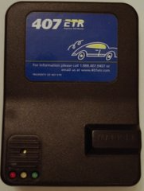
…continued
IoT consists of any device with an on/off switch connected to the Internet.
Medical devices, such as a heart monitor implant or a biochip transponder in a farm animal, can transfer data over a network and are members of the IoT.
IoT applications are found in:
Connected industry, smart-city, smart-home, smart-energy, connected car, smart agriculture, connected building and campus, health care, logistics, among other domains

Slide 5
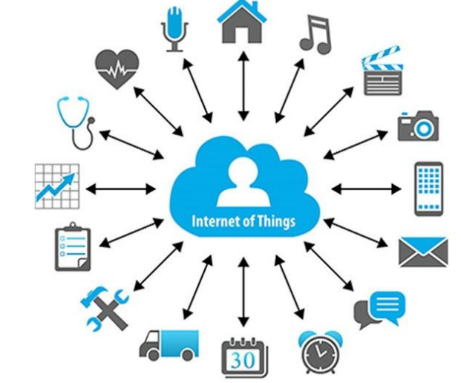
… Continued
Figure 4.1 IoT in Different Domains

Slide 6
History of IoT
Communications were started since 1830s and 1840s by telegraph (the first landline).
The Internet, itself a significant component for IoT, started as part of DARPA(Defense Advanced Research Projects Agency) in 1962 and evolved into ARPANET in 1969.

Slide 7
Advantages of IoT
Improved customer engagement
Technology optimization
Reduced waste
Enhanced data collection

Slide 8
Disadvantages of IoT
As the number of connected devices increases and more information is shared between devices, the potential that a hacker could steal confidential information also increases.
If there’s a bug in the system, it’s likely that every connected device will become corrupted.
Since there’s no international standard of compatibility for IoT, it’s difficult for devices from different manufacturers to communicate with each other.

Slide 9
…continued
Enterprises may eventually have to deal with massive numbers maybe even millions of IoT devices and collecting and managing the data from all those devices will be challenging.

Slide 10
Challenges of IoT
Security-besides of attackers
Privacy-detail of personal data without the user’s participation
Complexity-in terms of design, deployment and maintenance.
Flexibility-conflicting or locking systems.
Compliance-complexity makes the issue of compliance.

Slide 11
How IoT work
An IoT ecosystem consists of web-enabled smart devices that use embedded processors, sensors and communication hardware to collect, send and act on data they acquire from their environments.
IoT devices share the sensor data they collect by connecting to an IoT gateway or another edge device where data is either sent to the cloud to be analyzed or analyzed locally.
The connectivity, networking and communication protocols used with these web-enableddevices largely depend on the specific IoT applications deployed.

Slide 12
Architecture of IoT
Sensing Layer: used to identify any phenomena in the devices’ peripheral and obtain data from the real world.
A sensor hub is a common connection point for multiple sensors that accumulate and forward sensor data to the processing unit of a device.
Actuators can also intervene to change the physical conditions that generate the data.
Motion sensors, environmental sensors and position sensors are categories of sensors in IoT devices.

Slide 13
…continued
2. Network Layer: it acts as a communication channel to transfer data, collected in the sensing layer, to other connected devices.
In IoT devices, the network layer is implemented by using diverse communication technologies (e.g., Wi-Fi, Bluetooth, Zigbee, ZWave, LoRa, cellular network, etc.) to allow data flow between other devices within the same network.

Slide 14
…continued
3. Data Processing Layer: it consists of the main data processing unit of IoT devices.
The data processing layer takes data collected in the sensing layer and analyses the data to make decisions based on the result.
In some IoT devices (e.g., smartwatch, smart home hub, etc.), the data processing layer also saves the result of the previous analysis to improve the user experience.
This layer may share the result of data processing with other connected devices via the network layer.

Slide 15
…continued
4. Application Layer: It implements and presents the results of the data processing layer to accomplish disparate applications of IoT devices.
The application layer is a user-centric layer that executes various tasks for the users.
There exist diverse IoT applications, which include smart transportation, smart home, personal care, healthcare, etc.

Slide 16
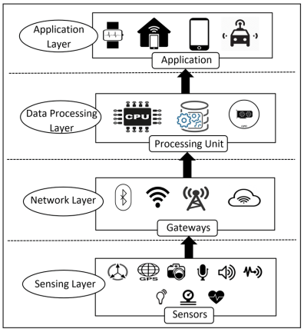
…continued
Figure 4.2 Architecture of IoT

Slide 17
Devices and Networks
Connected devices are part of a scenario in which every device talks to other related devices in an environment to automate home and industrial tasks, and to communicate usable sensor data to users, businesses and other interested parties.
IoT devices are meant to work in concert for people at home, in industry or in the enterprise.
As such, the devices can be categorized into three main groups: consumer, enterprise and industrial.

Slide 18
---continued
Consumer connected devices include smart TVs, smart speakers, toys, wearables, and smart appliances. smart meters, commercial security systems and smart city technologies such as those used to monitor traffic and weather conditions are examples of industrial and enterprise IoT devices.
Other technologies, including smart air conditioning, smart thermostats, smart lighting, and smart security, span home, enterprise, and industrial uses.
In the enterprise, smart sensors located in a conference room can help an employee locate and schedule an available room for a meeting, ensuring the proper room type, size and features are available.

Slide 19
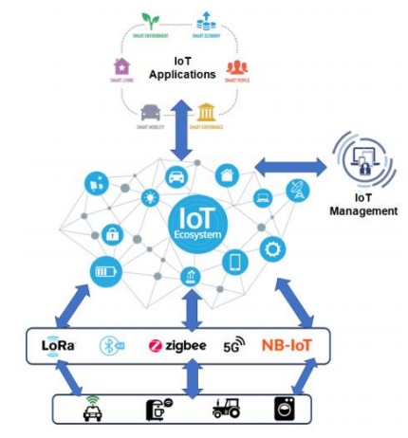
…continued
Figure 4.3 Networked IoT Devices

Slide 20
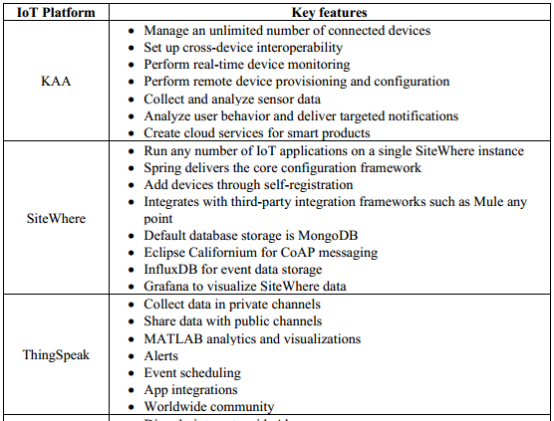
… continued

Slide 21
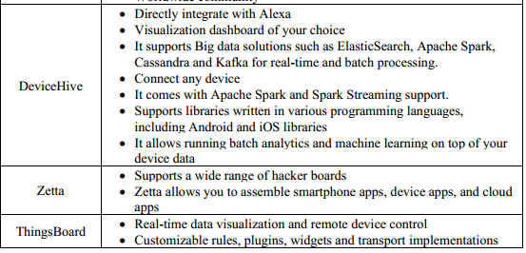

… continued

Slide 22
Applications of IoT
Agriculture
Consumer Use
Health Care
Insurance
Manufacturing
Retail
Transportation
Utilities

Slide 23
IoT Based Smart Home
Remote Control Appliances
Weather
Smart Home Appliances
Safety Monitoring
Intrusion Detection Systems
Energy and Water Use

Slide 24
IoT Based Smart City
Structural Health
Lightning
Safety
Transportation
Smart Parking
Waste Management
Green House
Compost
Animal Farming/Tracking
Offspring Care
Field Monitoring

Slide 25
Chapter Four Review Questions
What are the main parts of the IoT system?
What are the security concerns related to IoT?
Explain IoT Protocol stack?
What is meant by a smart city regarding the IoT?
Give examples of the impact of IoT on our lives?
What influence will the IoT have on monetary growth?
Why will be the IoT successful in the coming years?
What impact will the IoT have on the health care sector?
What are the main social and cultural impacts of IoT?
What the main challenges of an IoT?
What role does the network play in the IoT of everything?
How wireless communication might affect the development and implementations of IoT?

Slide 26
End
Thank You !!!

