Slide 1
Chapter Five
Augmented Reality

Slide 2
Activity 5.1
What do you think about augmented reality?
What are the common features of augmented reality?

Slide 3
Overview of Augmented Reality
The fundamental idea of AR is to combine, or mix, the view of the real environment with additional, virtual content that is presented through computer graphics.
Augmented reality (AR) is a form of emerging technology that allows users to overlay computer generated content in the real world.
AR refers to a live view of a physical real-world environment
whose elements are merged with augmented computer-generated images creating a mixed reality.

Slide 4
…continued
The augmentation is typically done in real-time and in semantic context with environmental elements.
By using the latest AR techniques and technologies, the information about the surrounding real world becomes interactive and digitally usable.
Augmented reality is the integration of digital information with the user's environment in real-time.
Unlike virtual reality, which creates a totally artificial environment, augmented reality uses the existing environment and overlays new information on top of it.

Slide 5
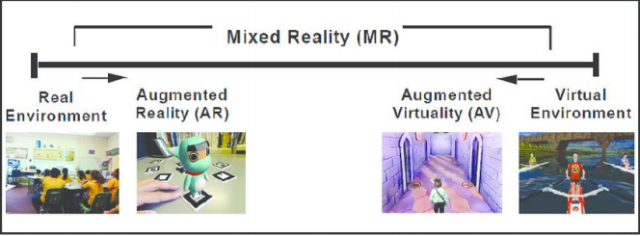
Virtual reality (VR), Augmented Reality (AR) vs Mixed reality (MR)
Figure 5.1 Paul Milgram's Reality-Virtuality (RV) Continuum

Slide 6
Virtual Reality
VR is fully immersive, which tricks your senses into thinking you’re in a different environment or
world apart from the real world.

Slide 7
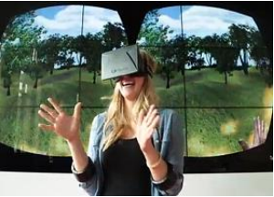
….Continued
Examples of Immersive Technology

Slide 8

Augmented Reality
In augmented reality, users see and interact with the real world while digital content is added to it.
If you own a modern Smartphone, you can easily download an AR app and try this technology.

Slide 9
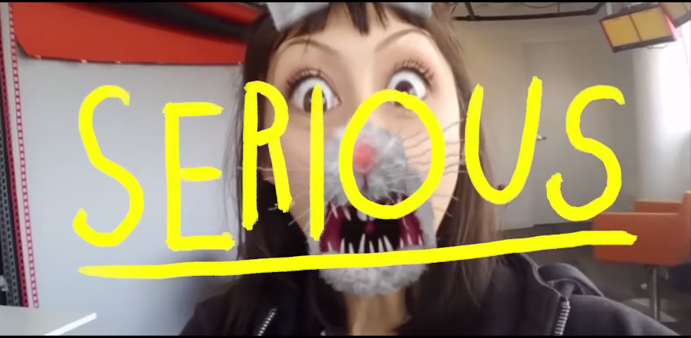
Augmented Reality
In augmented reality, users see and interact with the real world while digital content is added to it.
If you own a modern Smartphone, you can easily download an AR app and try this technology.

Slide 10
Mixed Reality
Mixed Reality (MR), sometimes referred to as hybrid reality, is the merging of real and virtual worlds to produce new environments and visualizations where physical and digital objects co-exist and interact in real-time.
It means placing new imagery within a real space in such a way that the new imagery is able to interact, to an extent, with what is real in the physical world we know.

Slide 11
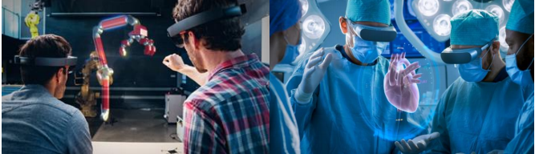
… Continued
Figure 5.5 Mixed Reality in Engineering and Medicine

Slide 12
… Continued
In mixed reality, you interact with and manipulate both physical and virtual items and environments, using next-generation sensing and imaging technologies. MR allows you to see and immerse yourself in the world around you even as you interact with a virtual environment using your own hands—all without ever removing your headset.

Slide 13
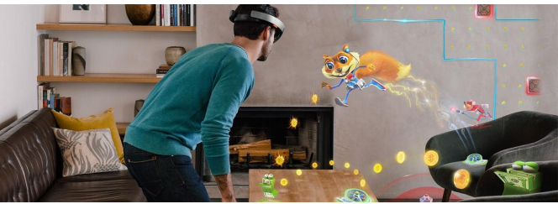
… Continued
Figure 5.6 Mixed Reality in Entertainment

Slide 14
Reading Assignment
The architecture of AR Systems
Applications of AR Systems

Slide 15
Chapter Four Review Questions
Thank You !!!

