Slide 1
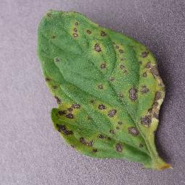


Tomato Leaf Disease Detection using deep learning
DSA 4050_XA- Deep Learning
Abdiqalaq Issack- 671243
USIU-Africa

Slide 2
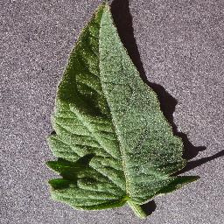

Introduction to Tomato Leaf Disease Detection
01
Tomato crops are affected by diseases such as Early Blight, Late Blight and Leaf Mold, which can reduce crop yield and quality.
This project uses deep learning to automatically identify tomato leaf diseases from images, supporting faster and more consistent detection.

Slide 3
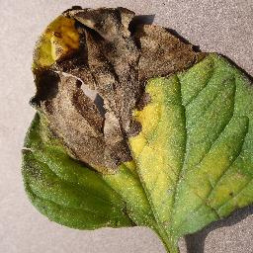

Problem Statement
02
  Tomato leaf diseases can be difficult to identify through visual inspection, especially when different diseases show similar symptoms.
  Manual identification may require agricultural expertise and can be time-consuming.
  This project addresses the problem by developing a deep learning system to automatically classify tomato leaf diseases from images.

Slide 4

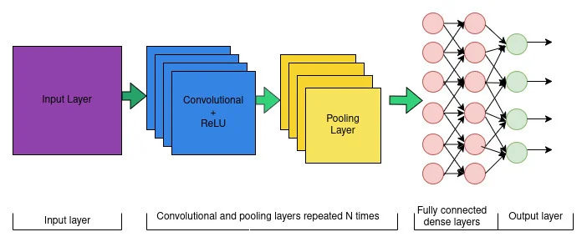
03
Why Deep Learning?
03
• Automatically learns important features from leaf images.
• Detects disease patterns such as spots, discoloration and texture changes.
• CNNs are effective for image classification tasks.
• MobileNetV2 provides an efficient transfer learning approach.
• Reduces dependence on manual feature extraction.

Slide 5
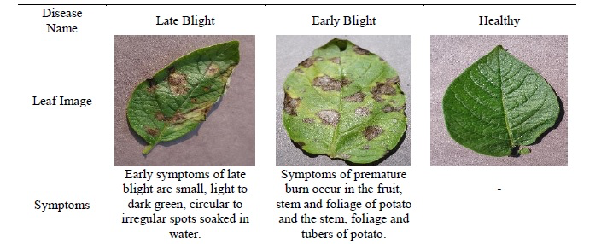

PlantVillage Dataset
04
  Dataset: PlantVillage (Tomato Leaves)
  Total Images: 18,160
  Training: 14,528 images (80%)
  Validation: 1,816 images (10%)
  Testing: 1,816 images (10%)

Slide 6


Tomato Leaf Images
05
Image Processing
Data Preprocessing.
Class Labelling
• Organized tomato leaf images by disease class.
• Split the dataset into training (80%), validation (10%), and testing (10%).
• Resized images for model training.
• Applied model-specific image preprocessing.
• Prepared the data for Custom CNN and MobileNetV2.
Dataset Splitting
Training
80%
Validation
10%
Testing
10%

Slide 7

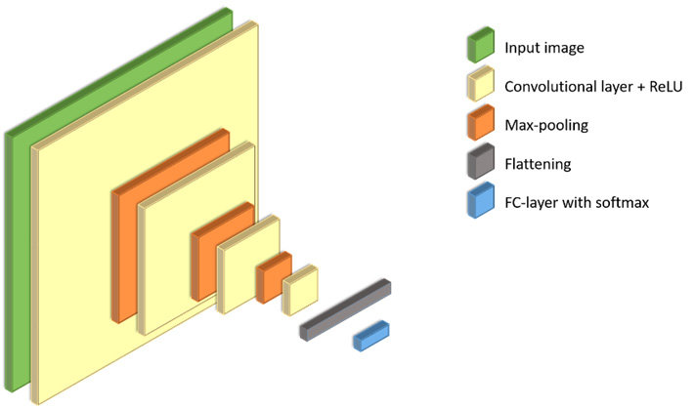
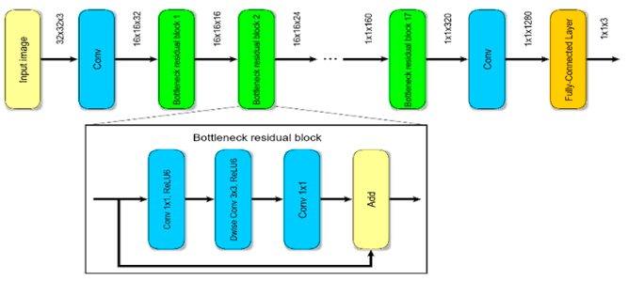

CNN
06
Model Architecture — Custom CNN vs MobileNetV2.
Custom CNN
  Built and trained from scratch.
  Uses convolution and pooling layers.
  Learns disease features from tomato leaf images.
MobileNetV2
  Uses a pretrained neural network.
  Applies transfer learning.
  Designed for efficient image classification.
MobileNetV2

Slide 8
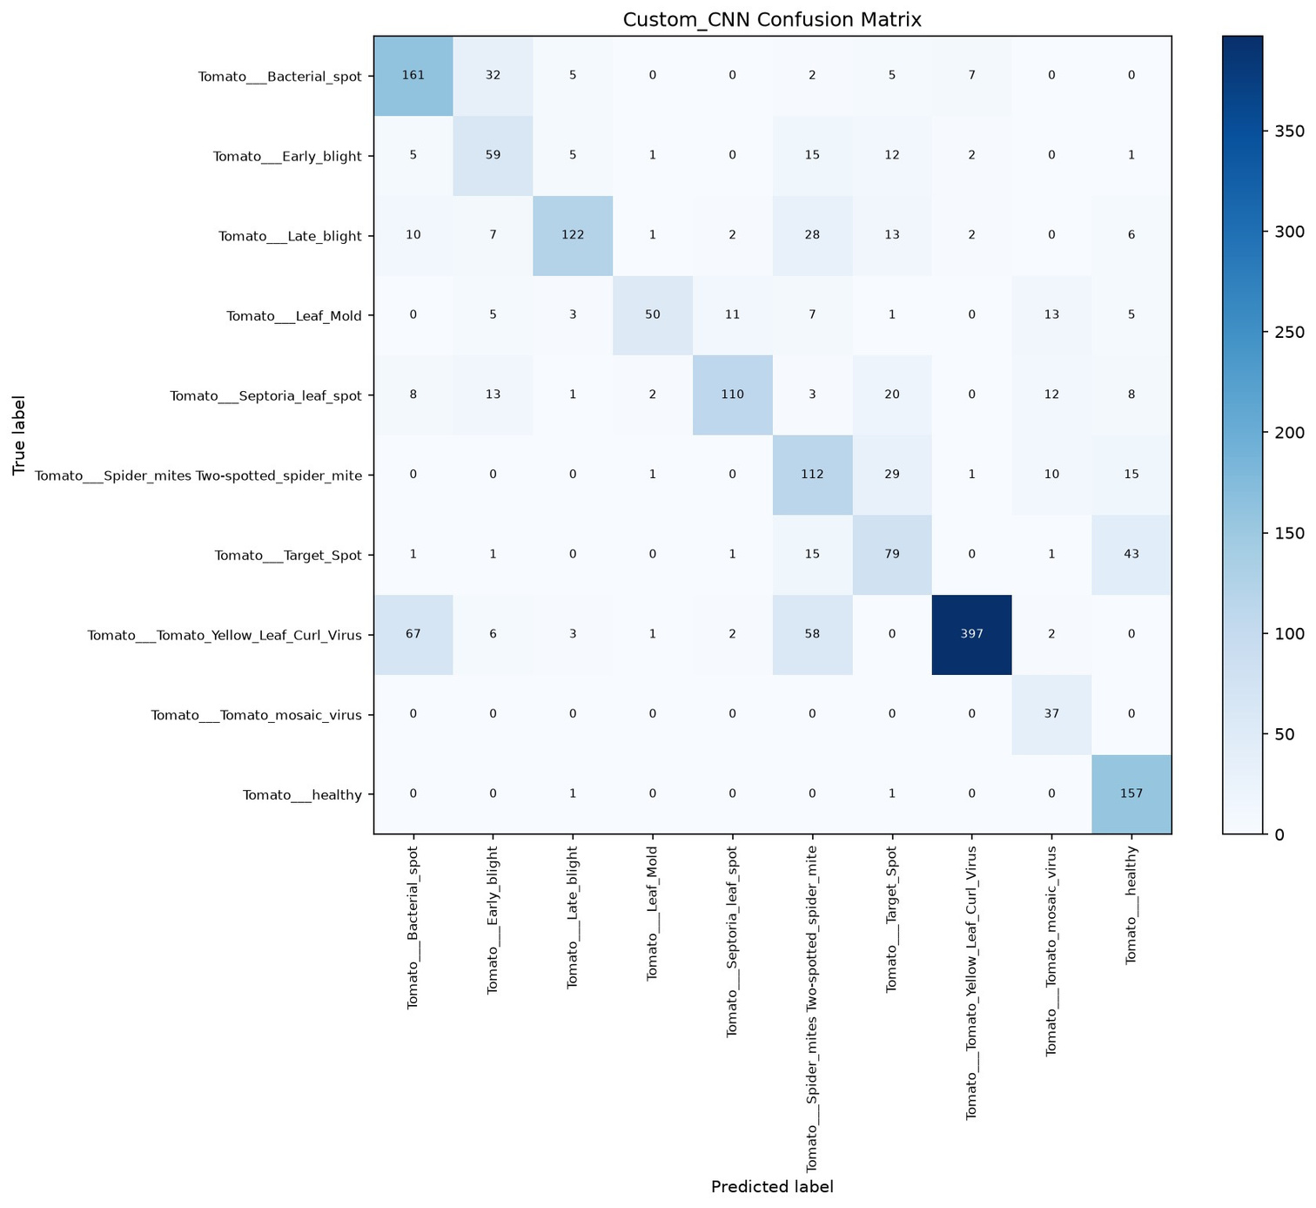
Custom Cnn- Confusion Matrix
07
Model Training and Evaluation.
  Trained Custom CNN and MobileNetV2 models.
  Used training and validation datasets.
  Monitored training and validation accuracy.
  Evaluated performance on unseen test images.
  Compared accuracy, precision, recall and F1-score.
  Generated confusion matrices for both models.

Slide 9
Model Performance Comparison.
08
Metric | Custom CNN | MobileNetV2
Accuracy | 70.70% | 89.65%
Precision | 68.48% | 87.30%
Recall | 70.91% | 88.70%
F1-score | 67.20% | 87.68%
Key Findings
  MobileNetV2 achieved the highest accuracy of 89.65%.
  Custom CNN achieved 70.70% accuracy.
  MobileNetV2 performed better across all evaluation metrics.
  Transfer learning improved classification performance in this experiment.

Slide 10


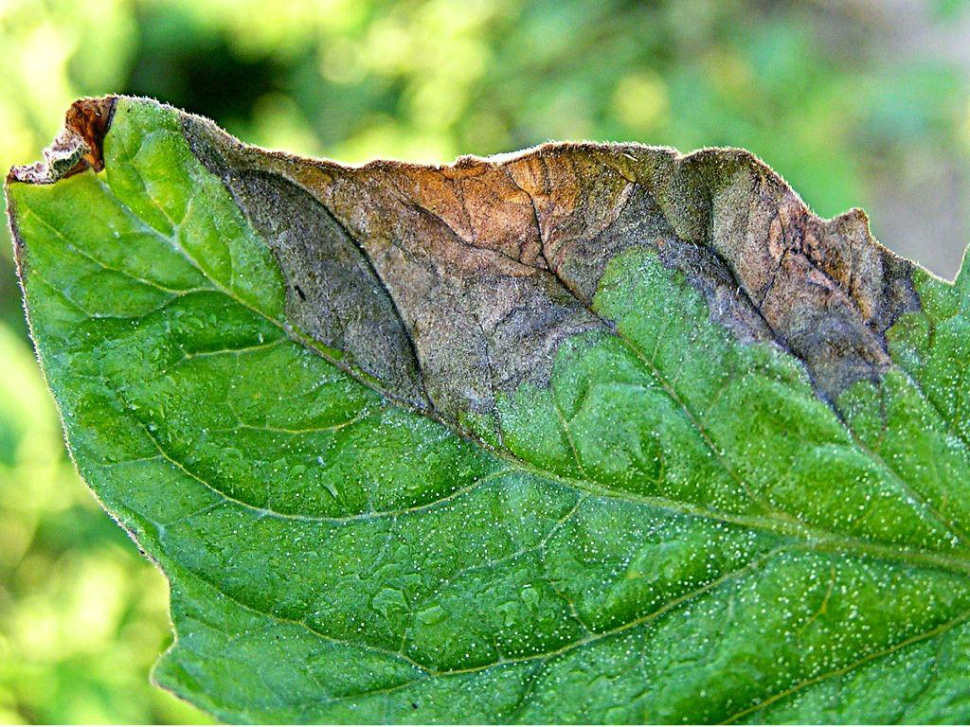

09
Conclusion and Future Improvements
Conclusion
  Developed and evaluated Custom CNN and MobileNetV2.
  MobileNetV2 achieved 89.65% accuracy.
  Custom CNN achieved 70.70% accuracy.
  Transfer learning gave better results.
Future Improvements
  Use more diverse tomato leaf images.
  Improve classification of similar diseases.
  Test on real-world field images.
  Develop a simple disease detection application.

Slide 11



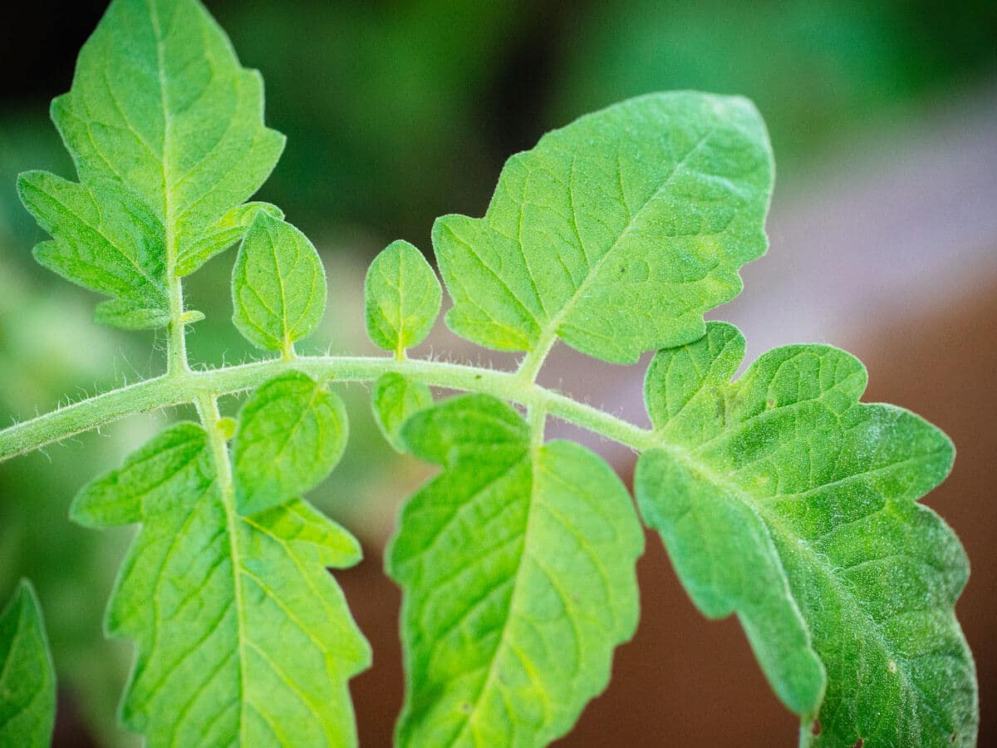
Thank You!
Tomato Leaf Disease Detection
Using Deep Learning
Custom CNN vs MobileNetV2
Questions & Discussion

