Slide 1
Predicting Customer Churn for SyriaTel Using Machine Learning
Binary Classification Model

Slide 2
Business Problem
SyriaTel, like many telecom companies, loses revenue when customers leave unexpectedly.
Understanding customer churn allows the business to take early action.
Churn prediction is a binary classification problem:
Will a customer churn? Yes or No
Goal: Build a predictive model using customer data
Business impact: Reduce revenue loss and increase customer retention

Slide 3
Project Objectives
This project aims to identify customers who are at high risk of leaving SyriaTel.
OBJECTIVES
1. Use customer behavior and demographic data to predict churn
2. Evaluate and compare different models for accuracy and recall
3. Identify key drivers of churn
4. Provide actionable business recommendations
5. Help SyriaTel improve customer retention through data insights

Slide 4
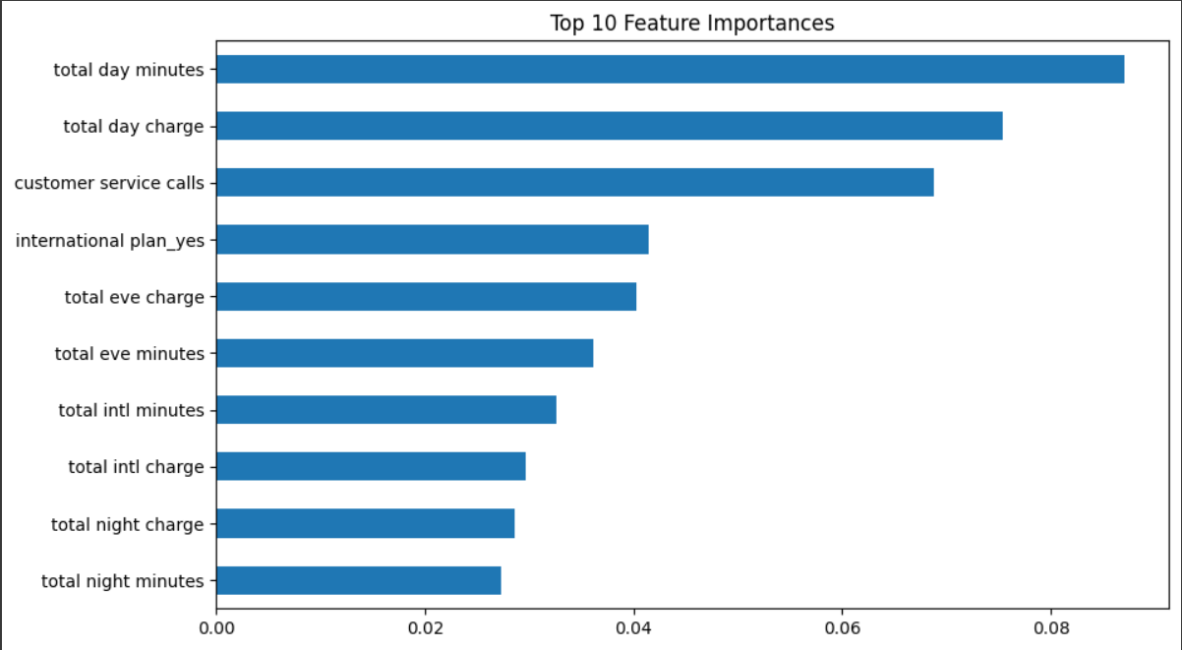
Key Customer Features

Slide 5
Performance in Customer Retention Detection
Model's Performance in Identifying Customer Retention
Random Forest was used to classify customers into churn and non-churn categories.
Recall score was prioritized to catch as many churn cases as possible
Random Forest provided a good balance between precision and recall
It performed better than the baseline Logistic Regression model in identifying customers likely to churn

Slide 6
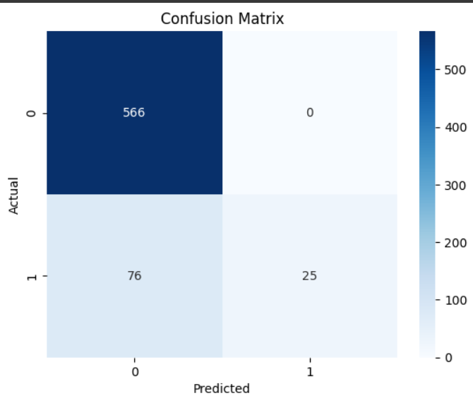
Model Evaluation Metrics

Slide 7
Interpretation of the Matrix
AUC Score (0.943):
The confusion matrix helped us see where the model was making errors:
True Positives (TP): Correctly predicted churns
False Positives (FP): Predicted churn, but customer stayed
True Negatives (TN): Correctly predicted retention
False Negatives (FN): Missed churns (most costly)
Minimizing false negatives is crucial because those are customers we could lose without warning.

Slide 8
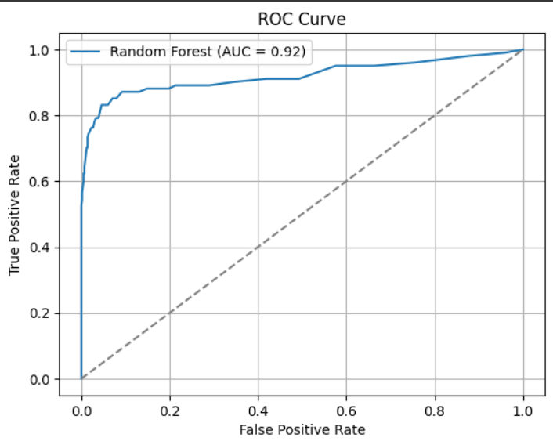
Model Comparison

Slide 9
Interpretation
The Random Forest model showed that:
Customers with month-to-month contracts, high monthly charges, or short tenure were more likely to churn
Customers on longer contracts or with automatic payments were more likely to stay
These insights can guide SyriaTel in identifying at-risk customers early.

Slide 10
Key Insights
Churn is more common among customers with:
Month-to-month contracts
No internet services
High charges and short tenure
Tenure is a strong predictor—longer-tenure customers are more loyal
Contract type and payment method significantly influence retention

Slide 11
Recommendations
To reduce churn and boost retention, SyriaTel should:
Offer loyalty rewards or discounts to long-tenure customers.
Incentivize customers to switch to long-term contracts.
Promote automatic payments to reduce friction.
Launch targeted outreach campaigns to high-risk segments.
Proactive strategies based on model insights can save revenue and increase customers satisfaction.

Slide 12
Thank you
Any questions?

