Slide 1
COTIVITI INTERN ASSESSMENT · TOPIC 2
Agentic AI for Payment Integrity
Why the Auditable Agent Wins
Clinical decision-making and pattern recognition: agentic generative AI for Treatment, Payment, and Operations.
Abdel-Basit Jimoh · Indiana University Bloomington · June 2026
Notes:
Open with the thesis: agentic AI for payment integrity, and my whole argument is that the auditable agent is the one that wins. Keep this to about 20 seconds.

Slide 2
THE PROBLEM
The opportunity hiding in improper payments
$95.5B
$28.83B
Most of it isn't fraud.
It's coding and documentation error: structured, rule-bound work that an agent can actually review at volume.
estimated improper payments across Medicare & Medicaid, FY2025
in Medicare fee-for-service alone
CMS, 2026
CMS, 2026
Why this matters for Cotiviti
Payment integrity is pattern recognition at national scale. A first pass that is faster, steadier, and able to explain itself turns a multi-billion-dollar error rate into something a team can actually work through. That only works if reviewers trust the output, and trust comes from seeing how it got there.
Abdel-Basit Jimoh · Cotiviti Intern Assessment, Topic 2
2
Notes:
Lead with the 95.5 billion. The reframe is the important part: most of that isn't fraud, it's coding and documentation error. That's the structured, rule-bound work an agent can actually review, and it sets up everything after this slide.

Slide 3
THE CONCEPT
Classic methods, plus a new reasoning layer
The familiar toolkit
THE NEW LAYER: AGENTIC GENERATIVE AI
Classification
Goal: review the claim
Sort a claim into a fixed category: clean or improper.
Reason
Act: call a tool
Observe
Prediction
Estimate an unknown value, like what a claim should cost.
Clustering
repeat until confident
Group providers who bill alike, flag the ones who don't.
ReAct in one loop: reason, act, observe, repeat, then return a verdict. Chain-of-thought keeps every step explicit and auditable (Wei 2022; Yao 2023).
Anomaly detection
Watch values over time, catch a sudden billing spike.
Where it sits: across Treatment, Payment, and Operations, Payment is where these methods pay off most clearly and most measurably.
Abdel-Basit Jimoh · Cotiviti Intern Assessment, Topic 2
3
Notes:
The methods on the left are familiar and none of them are unique to healthcare. What's new is the layer on the right: goal, tools, loop, with chain-of-thought and ReAct underneath. Land the point that we're working in Payment, under TPO.

Slide 4
TRENDS
Three shifts converging on payment AI
01
02
03
From answers to agents
RAG keeps models honest
Governance goes operational
The field moved from one-shot generative models to agents that take multi-step action under human oversight. Payers are among the first to put it to work, on claims and prior authorization.
Retrieval-augmented generation pulls the real policy text before the model answers, so the output is grounded in source. It's become the default way to cut hallucination in healthcare LLMs.
Oversight and auditability are turning into design requirements (NIST AI RMF). Newer work tackles “agent sprawl” with identity, kill-switches, and audit logging.
Amugongo et al., 2025
NIST 2023 · Prakash et al., 2026
For a payer, none of this is red tape. It's the part that makes an agent safe enough to actually ship.
Abdel-Basit Jimoh · Cotiviti Intern Assessment, Topic 2
4
Notes:
Three shifts happening at once: models becoming agents, RAG becoming the way you keep them grounded, and governance becoming an actual operations problem. Punchline at the bottom: for a payer this isn't red tape, it's what makes shipping one safe.

Slide 5
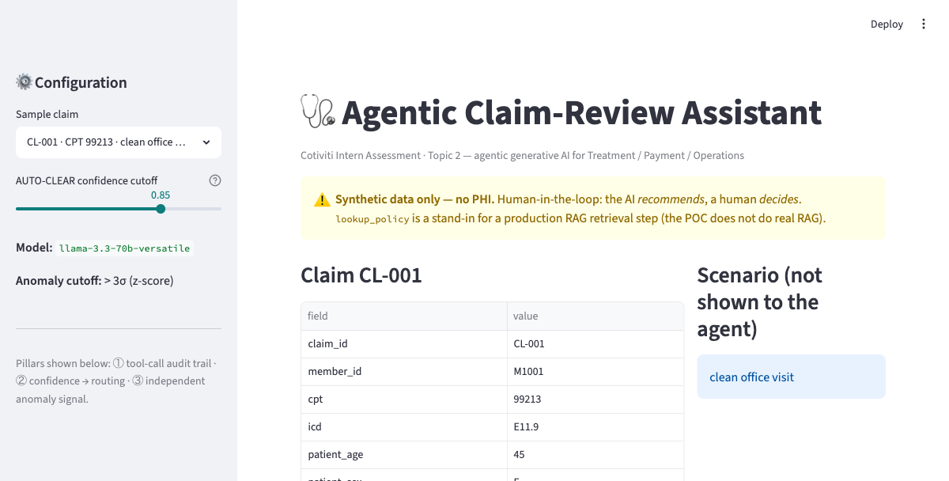
THE POC
Agentic Claim-Review Assistant
The agent takes one synthetic claim, works through the coding and payment rules with three tools, and returns a structured verdict: APPROVE or FLAG, plus a rationale, a confidence score, and a recommendation for the human reviewer.
Streamlit UI: pick a synthetic claim, then hit Review
▼
Agent loop: Groq llama-3.3-70b, native tool-calling, no framework
Picks a tool, reads the result, keeps reasoning until it lands on a verdict.
▼
The running app
lookup_policy()
check_eligibility()
amount_anomaly()
Single-file Streamlit. 100% synthetic data, no PHI. lookup_policy plays the part of a production RAG retrieval step.
coding/payment rules for the CPT
is the member active & covered?
z-score vs. billing history
RAG stand-in
independent signal
▼
Strict JSON verdict
Built from first principles, no LangChain or LlamaIndex.
{ decision, reasons[], confidence, recommended_action }
Abdel-Basit Jimoh · Cotiviti Intern Assessment, Topic 2
5
Notes:
Walk the flow top to bottom: UI, then the agent loop on Groq with native tool-calling and no framework, then the three tools, then the strict JSON verdict. Call out that lookup_policy is the RAG stand-in. The screenshot is there to prove it actually runs.

Slide 6
THE POC IN ACTION
One agent, three routing outcomes
CL-001 · CLEAN OFFICE VISIT
CL-010 · ELEVATED AMOUNT
CL-007 · AMOUNT OUTLIER
Every rule passes and the amount is unremarkable.
Passes every hard rule, but the billed amount is unusual (z ≈ 2.0, just under the 3σ cutoff).
Passes every hard rule, but the independent anomaly check fires anyway.
✓ APPROVE
✓ APPROVE
⚑ FLAG
Confidence 90%
Confidence ~75%
Confidence 90%
AUTO-CLEAR
ROUTE TO HUMAN
ROUTE TO HUMAN
Confidence sits at or above the 85% cutoff, so it clears with no human needed.
Approved, but confidence lands below the cutoff, so the threshold alone sends it to a reviewer.
Amount anomaly z = 5.82 for CPT 27447. A flag always routes to a human, whatever the confidence.
Abdel-Basit Jimoh · Cotiviti Intern Assessment, Topic 2
6
Notes:
This is the routing story in three columns. CL-001 is clean and auto-clears. CL-010 approves but its confidence is under the cutoff, so the threshold alone sends it to a human. That middle one is the slide I'd slow down on. CL-007 passes every hard rule but the independent anomaly fires, so it flags.

Slide 7
DEMO = ARGUMENT
Three design choices, made visible on screen
1
2
3
Auditable by construction
Confidence as a routing threshold
Defense in depth
The tool calls and their results are the reasoning, so the explanation comes for free. It's the record a regulator or an appealing provider would ask for.
The model is calibrated, and only high-confidence approvals clear. Everything else goes to a person. The fix for LLM overconfidence (Tian et al., 2025).
An independent z-score check runs alongside the model, so no verdict ever rests on the language model alone.
In the demo: the audit trail listed under every claim.
In the demo: CL-010 passed the rules but routed on confidence.
In the demo: CL-007 passed every rule; the anomaly caught it.
These aren't claims about the system. They're things you just watched it do.
Abdel-Basit Jimoh · Cotiviti Intern Assessment, Topic 2
7
Notes:
The three design choices are visible on screen, not just claimed: the audit trail falls out of the tool calls, confidence drives routing (that's the Tian fix), and the anomaly check is a second signal that doesn't depend on the model. The histogram puts CL-007 at almost 6 sigma. And I'm honest that lookup_policy stands in for RAG, I don't fake it.

Slide 8
OPPORTUNITIES
A faster, more consistent, explainable first pass
Automation at scale
Classical methods complement
Aligned with Cotiviti's stance
Pull the policy, check eligibility, reason through whether the diagnosis justifies the procedure, return a decision with a rationale and a confidence score. The structured bulk of review.
Clustering and anomaly detection catch providers whose billing breaks from their peers, no labeled data needed. Often the only way a new abuse pattern surfaces (De Meulemeester et al., 2025).
Cotiviti already frames AI as a tool, not a solution: valuable when paired with human expertise and past results to learn from (Arnold & Periyanan, 2025).
This was never about replacing reviewers. It hands them a first pass that's quicker, steadier, and already explained.
Abdel-Basit Jimoh · Cotiviti Intern Assessment, Topic 2
8
Notes:
Three openings: automation across the structured bulk of review, classical methods that catch patterns the agent can't, and the fact that this lines up with Cotiviti's own published stance that AI is a tool paired with human expertise.

Slide 9
THREATS
Every risk has a control built into the design
THE RISK
THE SAFEGUARD
Hallucination
✓
Tool-grounded retrieval plus visible chain-of-thought; the explicit steps catch errors.
91.8% of clinicians have hit one (Kim 2025)
Overconfidence
✓
Confidence is calibrated and used as a routing gate, never trusted at face value.
LLM-as-judge runs hot (Tian 2025)
Bias
✓
A human signs off on every non-cleared claim, with the full trail to inspect.
A model can relearn yesterday's mistakes
Auditability
✓
The reasoning is the record; every decision traces back to the policy it used.
Each call must be justified to regulators
Abdel-Basit Jimoh · Cotiviti Intern Assessment, Topic 2
9
Notes:
Four risks: hallucination, overconfidence, bias, auditability. Don't skip the bottom line, because chain-of-thought actually cut hallucinations in testing. If you can see the reasoning you can check it. The risks are what motivate the design, they don't sink it.

Slide 10
RECOMMENDATION
Make the auditable agent the differentiator
Build agentic claim review as a human-in-the-loop system with a full audit trail, and treat that audit trail as the competitive edge rather than a compliance checkbox.
Defense in depth — each layer is an independent check, with a person at the end:
Agent reasons over the claim, grounded in policy
Audit trail · every step recorded
Confidence gate · low-confidence routes to people
Independent anomaly check · a second signal
Governance · identity, kill switch, logging
Human reviewer makes the final call
A claim decision is only as good as the case behind it. Build the agent that shows its work, and the audit trail becomes the pitch.
Notes:
The recommendation: build it human-in-the-loop with a full audit trail, and sell that audit trail as the edge, not the cost. Run the six points quickly. Close on the line about a decision being only as good as the case behind it.

Slide 11
SOURCES
References
•
Amugongo, L. M., et al. (2025). Retrieval augmented generation for LLMs in healthcare: A systematic review. PLOS Digital Health, 4(6).
•
National Institute of Standards and Technology. (2023). AI Risk Management Framework (AI RMF 1.0), NIST AI 100-1.
•
Arnold, B., & Periyanan, A. (2025). The evolving role of AI in payment integrity [White paper]. AHIP / Cotiviti.
•
Prakash, C., Lind, M., & Sisodia, A. (2026). Agentic AI governance and lifecycle management in healthcare. arXiv:2601.15630.
•
Centers for Medicare & Medicaid Services. (2026). Fiscal year 2025 improper payments fact sheet.
•
Tian, Z., et al. (2025). Overconfidence in LLM-as-a-judge: Diagnosis and confidence-driven solution. arXiv:2508.06225.
•
De Meulemeester, H., et al. (2025). Explainable unsupervised anomaly detection for healthcare insurance data. BMC Med. Informatics & Decision Making, 25(1).
•
Wei, J., et al. (2022). Chain-of-thought prompting elicits reasoning in large language models. NeurIPS, 35.
•
Kim, Y., et al. (2025). Medical hallucinations in foundation models and their impact on healthcare. arXiv:2503.05777.
•
Yao, S., et al. (2023). ReAct: Synergizing reasoning and acting in language models. ICLR.
All POC data is 100% synthetic. No PHI. Repository shared per the assessment instructions.
Notes:
Ten references in APA. Reminder that all the POC data is synthetic and there's no PHI anywhere.

