Slide 1


Team Details
  Team name: Pivot Analytix
  Team leader name: Abdullah Moazzam
  Team members: Saad Wali Muhammad Joiya, Usama Bin Maalik
  Problem Statement: Theme 5 · Future of Work & Enterprise Productivity. Designing a home takes weeks of manual drafting. Checking it against building bylaws is done by hand, by experts in short supply. And most families commit to building from 2D drawings they can’t picture. Naqsha’s AI agents turn a simple conversation into a bylaw-compliant 3D home you can walk through, in minutes. No product does this today. Naqsha is set to transform how architects and residential construction companies work, and how families decide what to build.

Slide 2


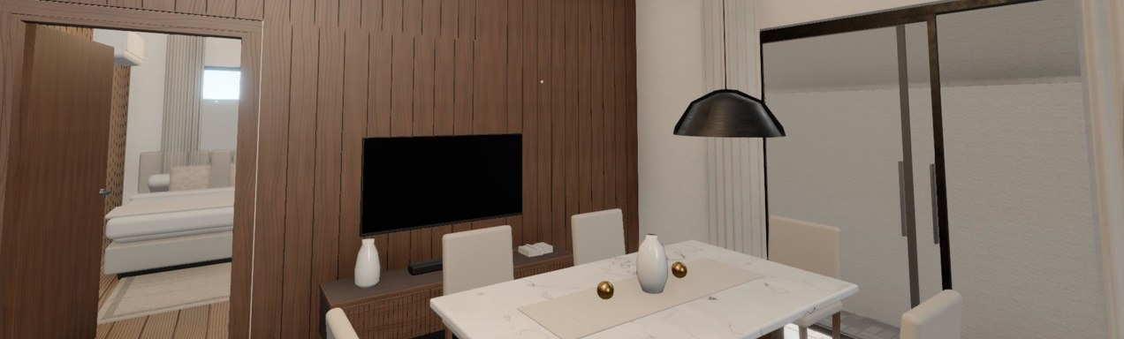
Brief about the idea
Theme 5 · Future of Work & Enterprise Productivity
From a conversation to a bylaw-compliant 3D home you can walk through, in minutes.
No product offers this today: we are redefining how families and architects design a home. Naqsha (نقشہ) is Urdu for “house plan”.
The problem
The solution
Design takes weeks. Every draft and every change is drawn by hand.
Most families never see their home in 3D, let alone walk through it. They commit to building from flat drawings.
Compliance needs scarce experts. They check every bylaw by hand, and mistakes often show up only when the authority refuses the plan.
Feedback is scattered. Owners, family, architects and builders give it in different places, so every round of changes is slow.
Naqsha’s AI agents: an experienced architect you can talk to.
Designs in minutes, by conversation. Describe the plot and the family in plain words. Naqsha drafts the concepts, the floor plans and the full 3D home.
Compliant from the start. Every plan is checked against the local authority’s bylaws, and Naqsha fixes what fails.
Immersive, high-fidelity 3D. Walk through the furnished, finished home, or view it from any angle, by day or night.
Comments that get addressed. Pin a note anywhere as you walk. Naqsha makes the change, or names the rule that stops it.
One project for everyone. Owners, family, architects and builders review and comment together.
Change it by asking. “Make the kitchen bigger” gives you a new, checked version.
Walking through a design in the live app
Prototype: Lahore (LDA) bylaws. Other authorities’ rules load the same way.

Slide 3
Opportunities
Compared with how homes are designed today
How different is it from any of the other existing ideas?
How will it be able to solve the problem?
USP of the proposed solution
No product today takes families and their architects from a conversation to a compliant 3D home they can walk through, comment on and change.
Architect or draftsman: weeks per design, in 2D, with every change redrawn by hand.
3D renders: ordered separately, they take days and are still pictures you can’t walk through.
AI image and floor-plan tools: a picture or a 2D layout, with no bylaw checks, no walkthrough and no shared project.
Weeks of drafting: a complete design in minutes, from one conversation.
Never seen in 3D: every design is a high-fidelity 3D home you can walk through.
Scarce compliance experts: bylaw checks are built in, so the architect stamps a set that is already checked.
Scattered feedback: comments pinned in the model and addressed by the AI architect, one shared project, and changes made by asking.
An experienced architect you can talk to.
AI agents that design the whole home in minutes, check their own work against the bylaws and fix it.
Immersive, high-fidelity 3D, inside and out, in the browser.
Comments pinned where you stand, and addressed for you.
Collaboration and changes in plain language, all in one place.
Rules as data: LDA in the prototype, and any authority’s bylaws can be added.

Slide 4









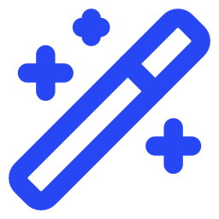



List of features offered by the solution
From your requirements to a complete, high-fidelity, bylaw-compliant
3D walkthrough of your home, in minutes.
Design with an AI architect
Concepts by day and night
Compliant floor plans
Describe your plot, family and wishes in plain words; Naqsha asks only for what’s missing.
Four photoreal exterior options for your plot, each also shown at night.
Every floor is checked against the authority’s bylaws and livable-home rules; Naqsha fixes what fails and reviews its own drawing.
High-fidelity 3D, inside and out
Immersive walkthrough
Night lighting and photoreal renders
Furnished rooms, finished facades, any angle, and cut-away floors.
Walk room to room, jump to any room, and take the stairs up to the roof.
Light the house at night, or turn any view into a photoreal image in seconds.
Comments where you stand
Comments addressed for you
Change it by asking
Pin a note on any wall, window or room as you walk; everyone on the project sees it.
The AI architect makes each change, or names the rule that stops it and offers another way.
Type a request in plain language and get a new, checked version.
Collaborate on one project
Versions and drawings
Bylaws for your area
Owners, family, architects and builders together; client links need no account.
Every version is kept with its changes in feet, plus a 1:100 print set and a compliance report.
LDA in the prototype; other authorities’ rules load as data.
Who it helps
Families see, walk and shape their home before they build.
Architects deliver a checked design in the first meeting.
Construction companies sell and build from designs buyers can walk through.

Slide 5
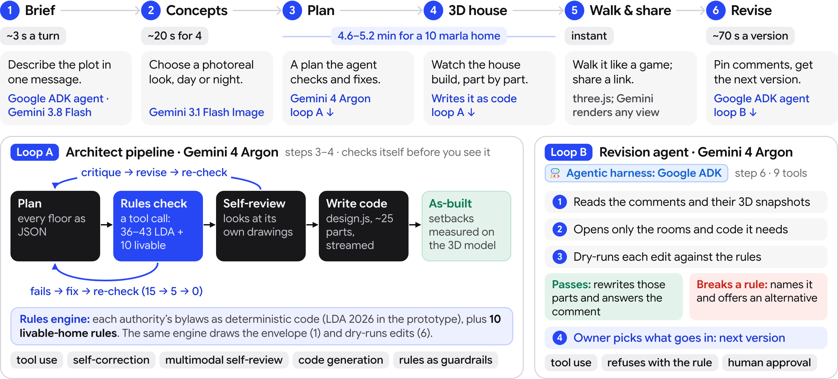
Process flow diagram or Use-case diagram

Slide 6
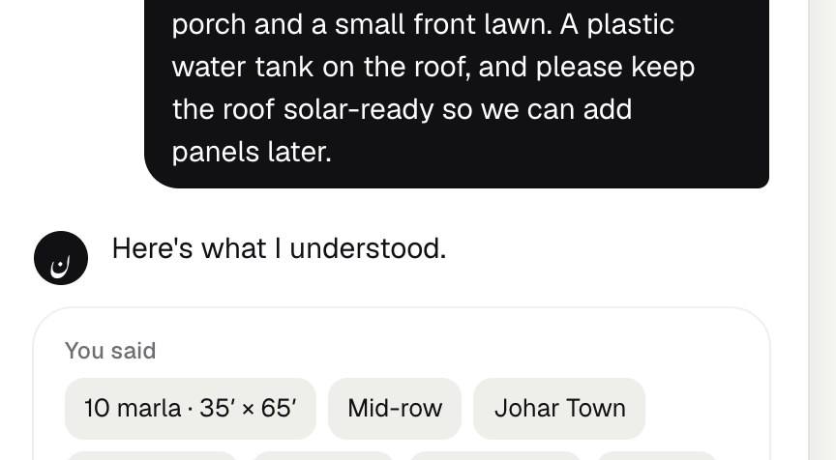
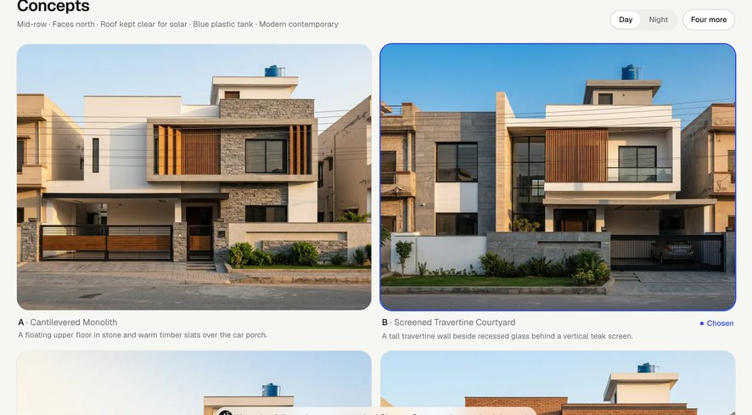
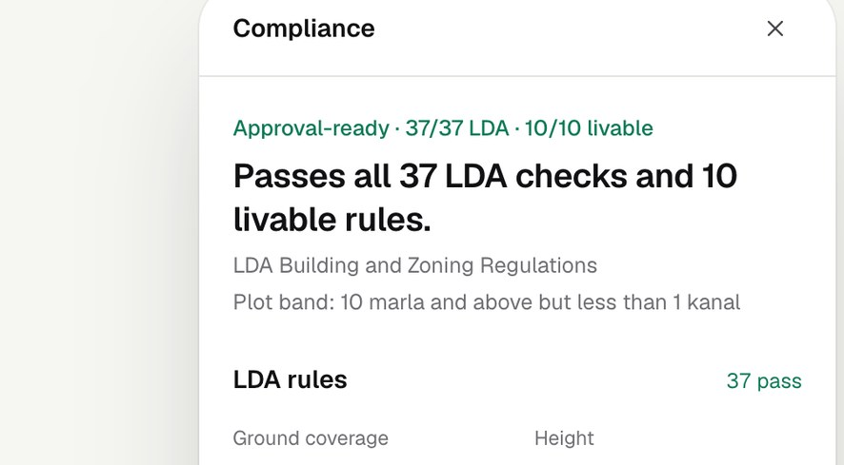
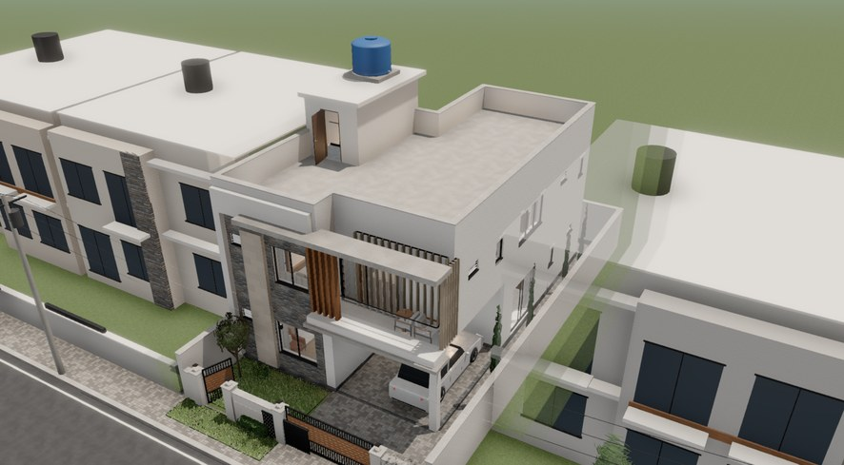
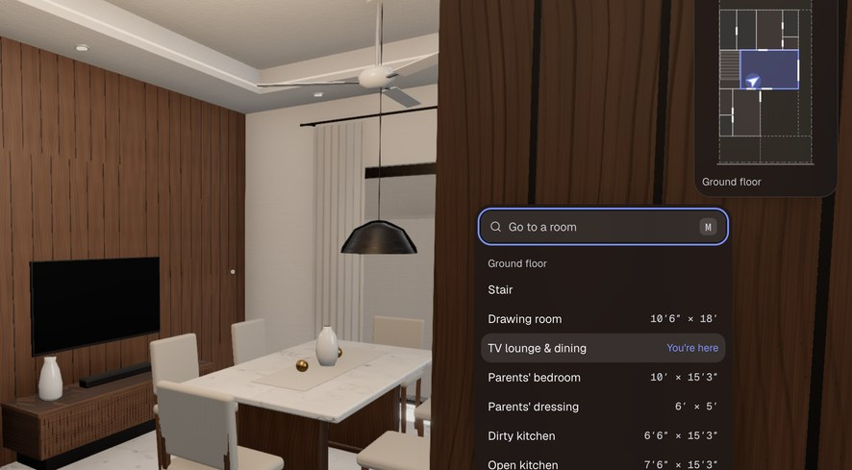
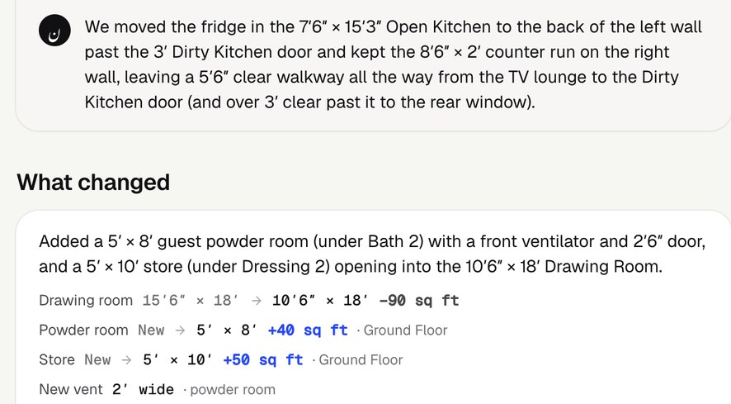
Wireframes/Mock diagrams of the proposed solution (optional)
1
Brief: agent asks what’s missing
2
Concepts: 4 looks, day or night
3
Plan: agent-checked, 37/37 LDA
4
House: coded by Gemini 4 Argon
5
Walk: first person, room finder
6
Revise: agent lists changes in feet
All six are live screens captured from the deployed app on Cloud Run; the crops show the panel each step is about.

Slide 7
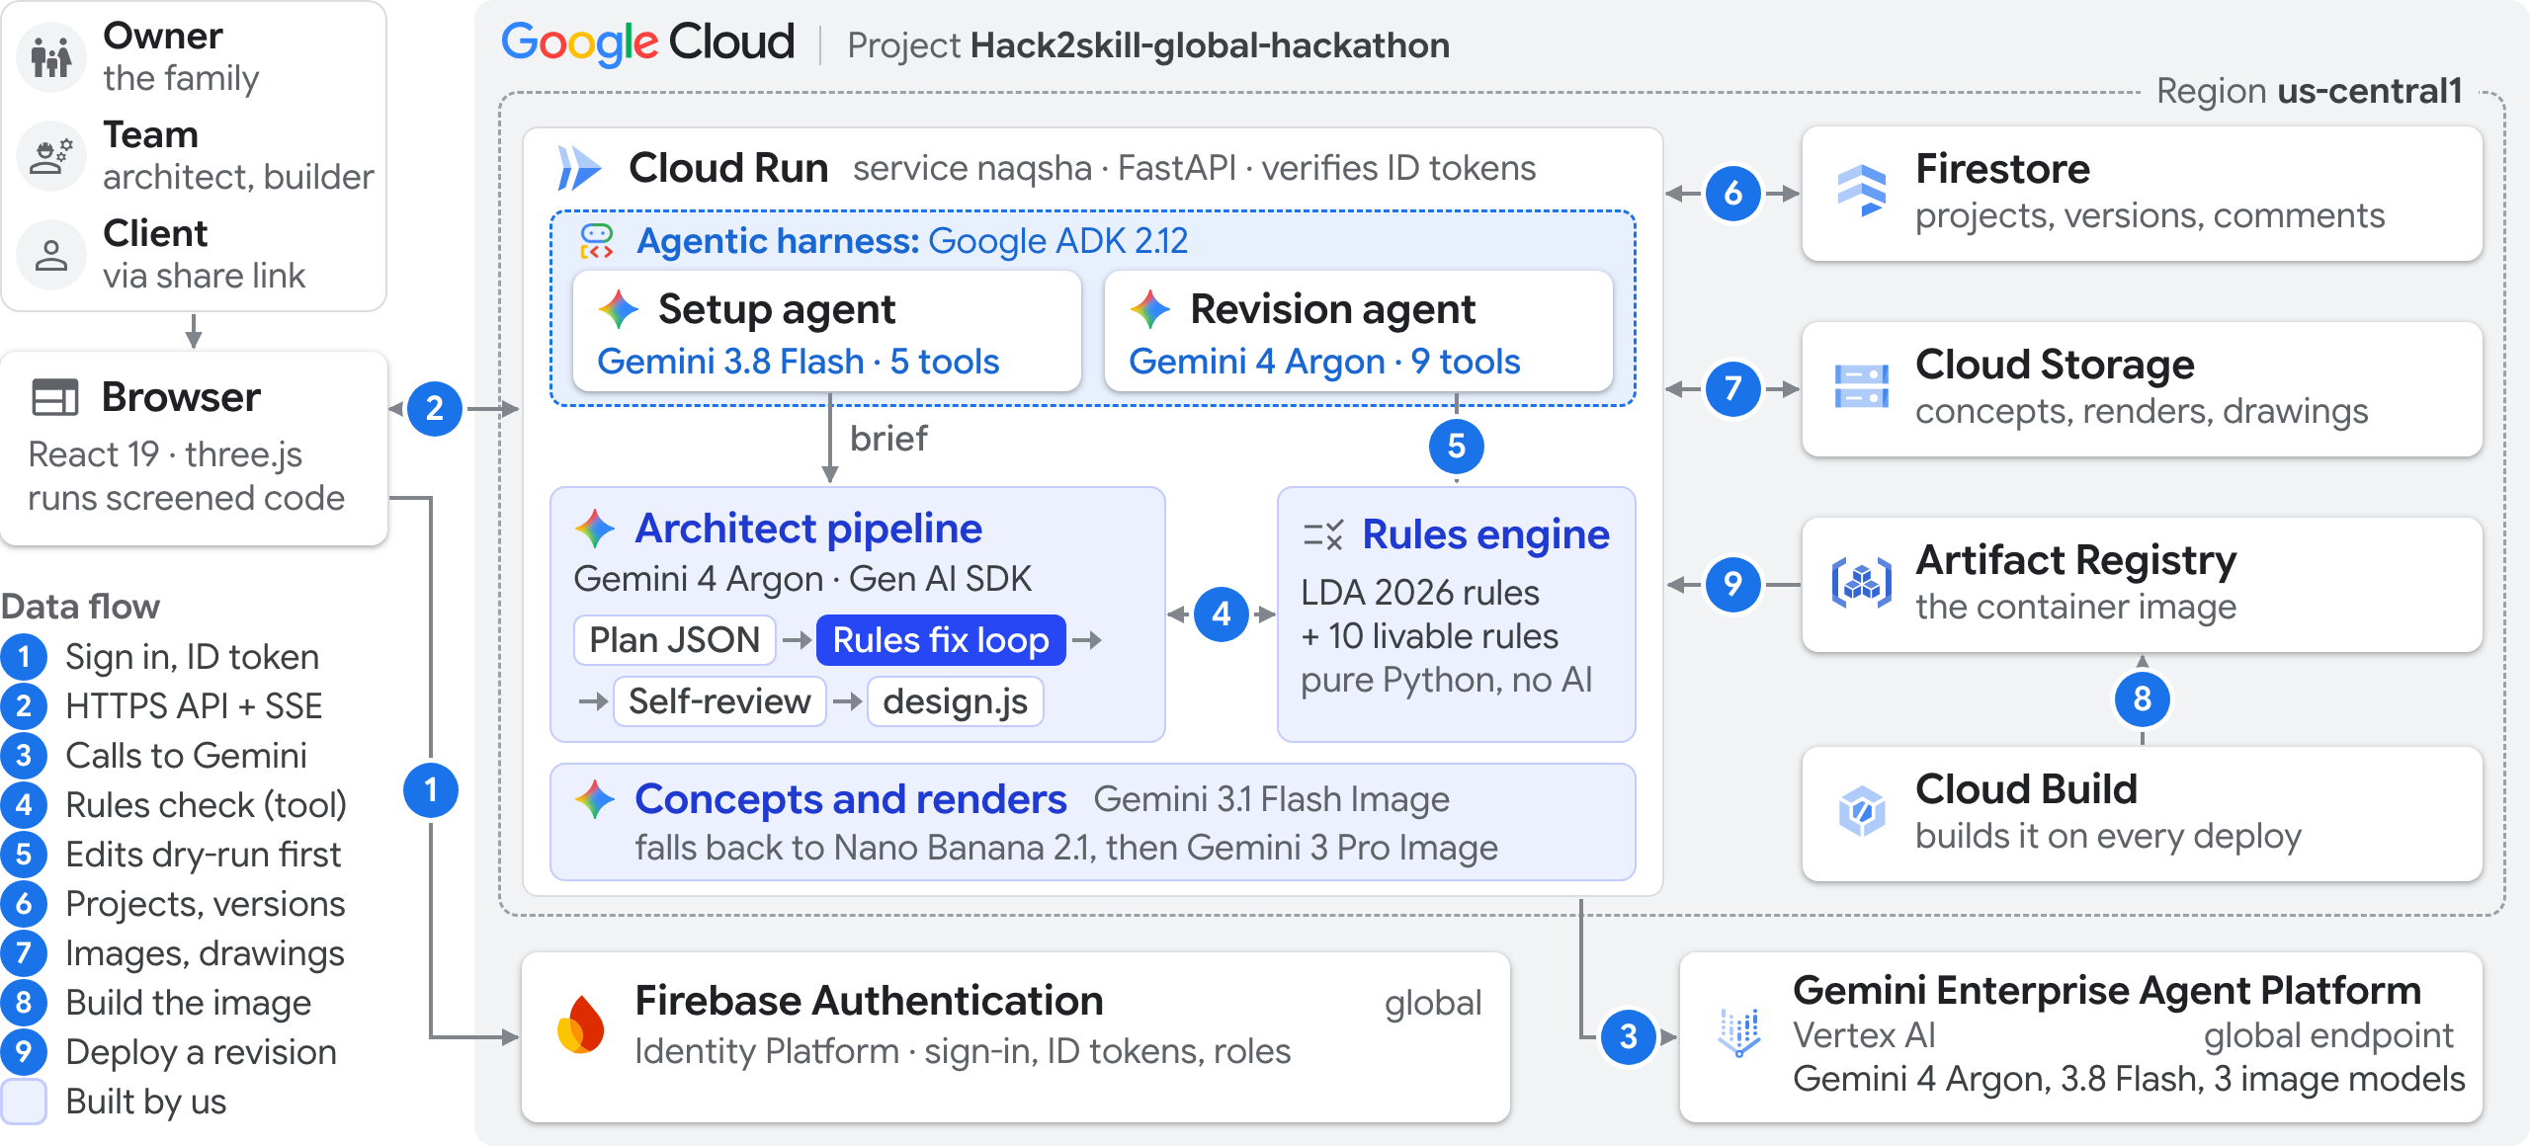
Architecture diagram of the proposed solution
Live on Cloud Run · us-central1

Slide 8







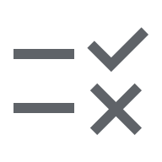














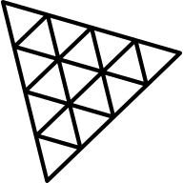










Technologies to be used in the solution
Google platform
Open source
Built by us
Agentic harness: Google ADK 2.12 · 2 agents, 14 tools
Setup agent Gemini 3.8 Flash · 5 tools Revision agent Gemini 4 Argon · 9 tools both run in the Cloud Run service
Vertex AI
Agent Platform
one project
Architect pipeline
Gemini 4 Argon
Gemini 4 Argon plan, 3D code, revise
Cloud Run API, React app, agents
google-genai 2.31 Gen AI SDK
Gemini 3.8 Flash setup agent
Firestore projects, versions
Rules check (tool) LDA + livable rules
Gemini 3.1 Flash Image concepts
Cloud Storage images, drawings
Rules fix loop until every check passes
Nano Banana 2.1 image fallback 1
Firebase Authentication sign-in, roles
Multimodal review its own drawings
Gemini 3 Pro Image image fallback 2
Cloud Build builds each deploy
Resilience 6 tries, 4–60 s backoff
Global endpoint newest models only
Artifact Registry container images
Fixed-step agent loop: ADK not needed.
Backend
api/
Frontend and 3D
web/
Built by us
domain IP
Python 3.13 uv for packages
React 19 TypeScript, Vite
House SDK 44 materials
FastAPI Server-Sent Events
Tailwind CSS 4 app styling
LDA rules as data 2026 regulations
Pydantic API models
three.js r186 WebGL renderer
10 livable rules beyond the bylaws
Pillow plan drawings
react-three-fiber + drei
As-built check setbacks in 3D
pytest 123 tests
three-mesh-bvh walk physics
1:100 print sheets A3, one per floor
Docker one image: web + API
N8AO ambient occlusion
Code screen 21 banned patterns

Slide 9
Estimated implementation cost (optional)
All figures are estimates from list prices
≈ $2.65 of cloud and AI per new home
≈ 55 homes
A 10 marla home, with Gemini 4 Argon at its announced 1 Dec 2026 prices (conservative), about Rs 740. At today’s prices: ≈ $1.60, about Rs 450.
cost the same as one avoided LDA resubmission: the Rs 41,430 scrutiny fee (Rs 15/sq ft × 2,762 sq ft, LDA 2026, Appendix C)
Setup chat, ~6 turns
Gemini 3.8 Flash · ~60k in, 6k out
$0.14
4 concepts + 4 night views
Gemini 3.1 Flash Image · 8 images
Pilot month 1,000 homes + 3,000 revisions
$0.54
Gemini on Agent Platform
~$5,000
Plan, fix loop, self-review
Gemini 4 Argon · ~60k in, 50k out
$1.24
Cloud Run, one warm instance
~$105
Firestore + Cloud Storage
< $50
3D house as code
Gemini 4 Argon · ~25k in, 30k out
$0.70
Total
≈ $5,200
Hosting and storage
Cloud Run ~6 min · Firestore · Storage
Pricing tiers to test prices set in pilots
$0.03
Free one home; samples, no account
Each revision
ADK + Gemini 4 Argon · ~120k in, 15k out · ≈ Rs 220
≈ $0.78
Family per home: revisions, client links, 1:100 set
Professional architects and builders: team seats
Stamping partners PCATP architects; referral fee
Token counts estimated from prompt and output sizes. Rs 280 = US$1.

Slide 10
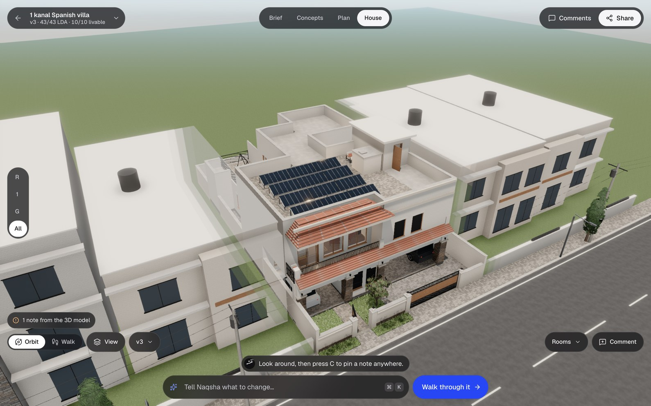
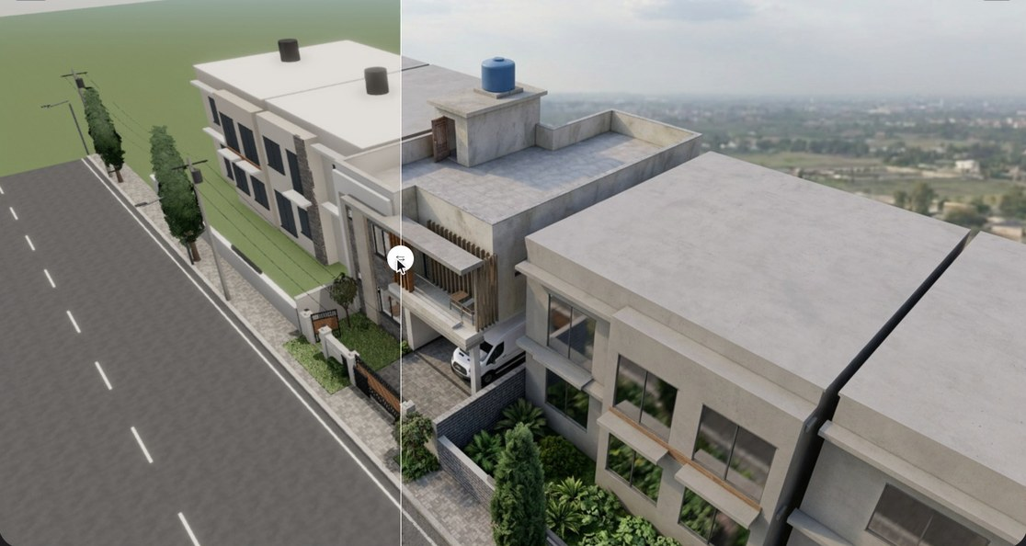
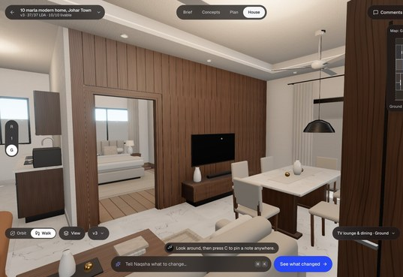
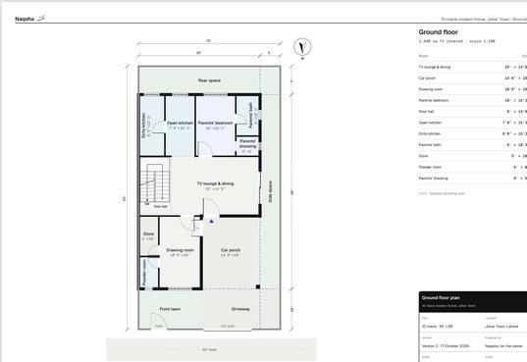
Snapshots of the prototype
All captured from the live service
3D view
Gemini render
Render this view: Gemini turns any 3D view into a photo, same camera, in ~10 s.
The 1 kanal Spanish villa (43/43 LDA · 10/10 livable), written as 3D code by the AI architect (Gemini 4 Argon): tiled roofs, rooftop solar, a two-car porch. Neighbours turn see-through as the camera passes.
Walk mode: TV lounge
1:100 print set

Slide 11
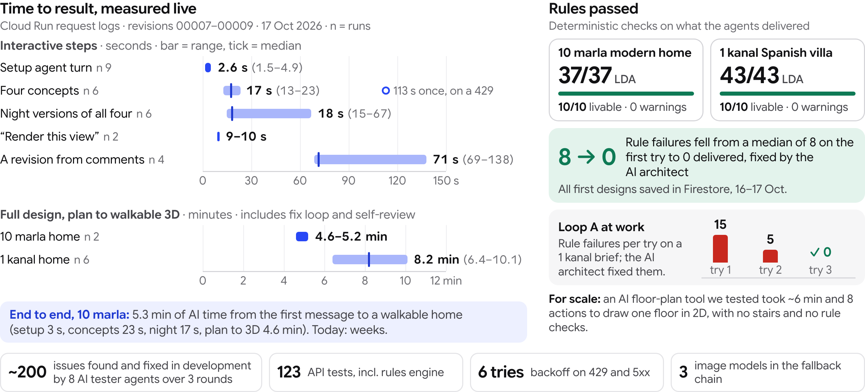
Prototype Performance report/Benchmarking

Slide 12




Additional Details/Future Development (if any)
Next weeks
Scale months
Later ideas
Drag rooms with an instant bylaw re-check
Google sign-in
Generated code in a sandboxed iframe
glTF export, token cost dashboard
Full rule packs for DHA, Bahria, RDA, FDA, MDA and GDA, then authorities beyond Punjab
Pilots with PCATP architects and Lahore builders
Sets ready for online submission, starting with LDA’s
An Urdu interface
Cost and material estimates
Structural and services drafts
Rule packs for cities outside Pakistan
Trust and responsibility
Pre-check only: a PCATP-registered architect (Pakistan Council of Architects and Town Planners) stamps every plan.
Deterministic rules: each authority’s official bylaws, written as code and tested; the prototype uses LDA’s 2026 regulations.
Safe code: Gemini’s design.js is screened for 21 banned patterns (network, eval, DOM, storage) and runs only in the viewer’s browser.
People decide: the owner picks which comments become changes.

Slide 13
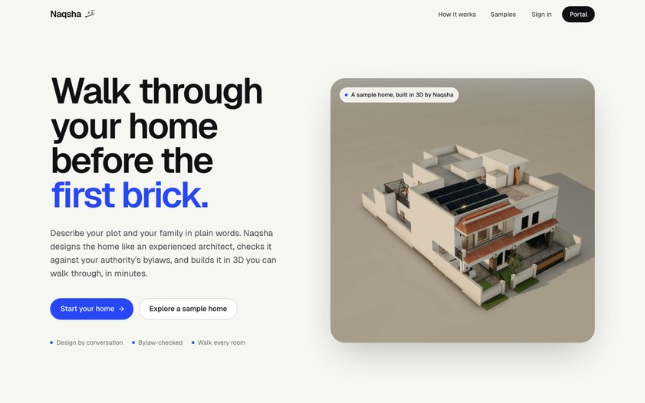

Provide links to your:
GitHub Public Repository
github.com/abdm693/hack2skill-hackathon
Demo Video Link (3:57)
https://drive.google.com/file/d/1xmdn7qxZRsblvwNLezveUji1tdc8WjBB/view?usp=sharing
Final Product Link
naqsha-242926648187.us-central1.run.app
Live app
Try it in a minute: open a sample home, no account.
Scan to open the live app
Cloud Run · us-central1
Repo guide README (run and deploy) · docs/ARCHITECTURE.md · contracts/ (plan schema, House SDK, API) · api/tests (123 tests)
Video a 4-minute walkthrough of the live app.

Slide 14
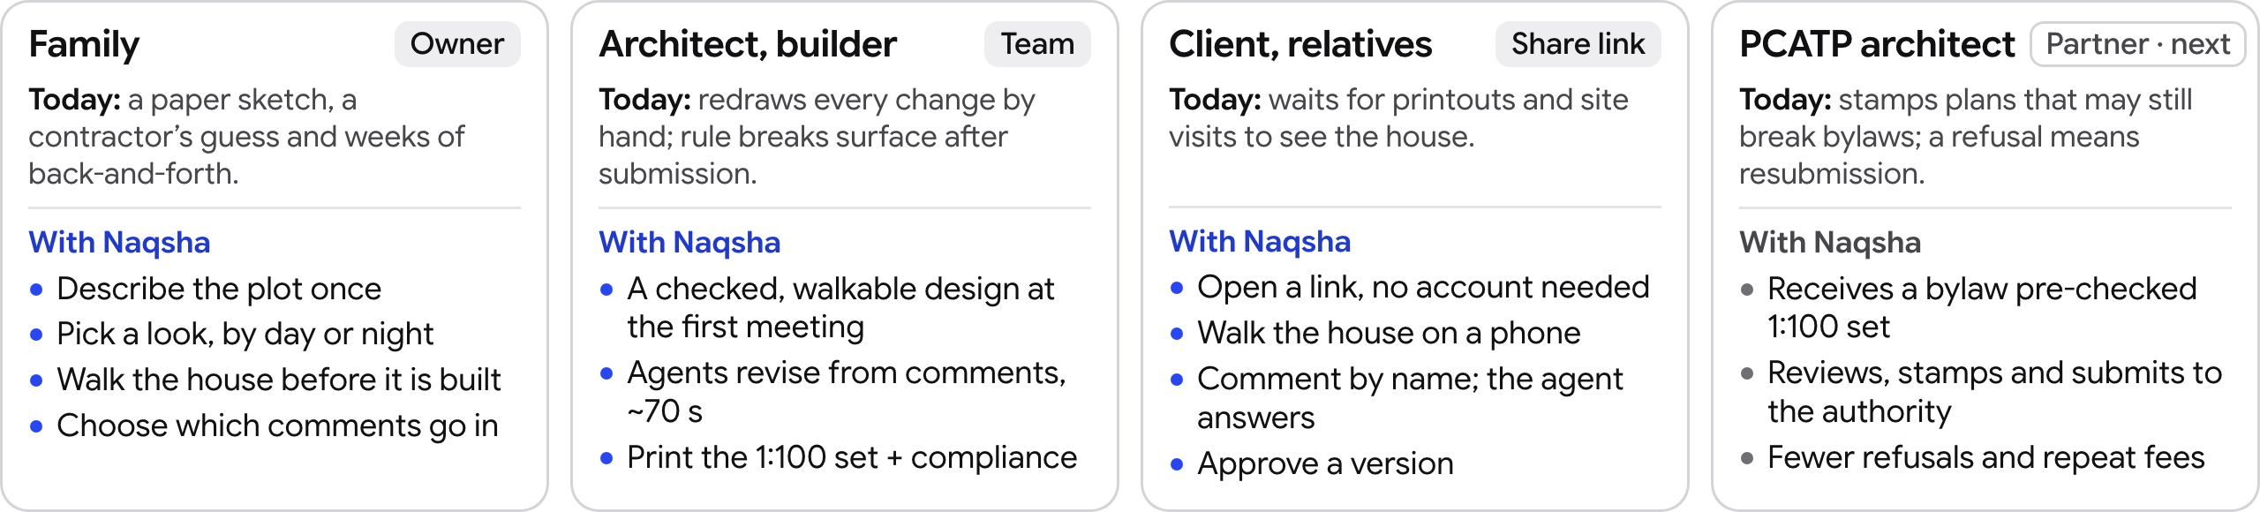
Track and industry impact
Track · Theme 5 · Future of Work & Enterprise Productivity
Future of Work in AEC: weeks of redrawing become one agentic session
Industry · Architecture, Engineering & Construction (AEC) + residential real estate
Pakistan first, then worldwide · Lahore prototype
SPEED
COST TODAY
ITERATION
MARKET
~5–6 min
Rs 41,430
~70 s
≈10 M
of AI time, first message to a walkable, bylaw-checked home
fee paid again when a 10 marla plan is refused in Lahore
median, from comments to a checked version, with reasons
homes short in Pakistan; first city, Lahore, has 13.0 M people
Terms: LDA = Lahore Development Authority · PCATP = Pakistan Council of Architects and Town Planners · 10 marla ≈ 2,250 sq ft (209 m²) · 1 kanal ≈ 4,500 sq ft (418 m²) · Rs 280 ≈ US$1
Sources: fee: LDA Building & Zoning Regulations (09-02-2026), App. C, Rs 15/sq ft × 2,762 sq ft covered · Lahore district: Census 2023 (PBS) · housing shortfall: World Bank estimate

Slide 15

Naqsha نقشہ
Walk through your home before the first brick.
Pivot Analytix · AI Builder Cup 2026
Live app naqsha-242926648187.us-central1.run.app
Code github.com/abdm693/hack2skill-hackathon

