Slide 1

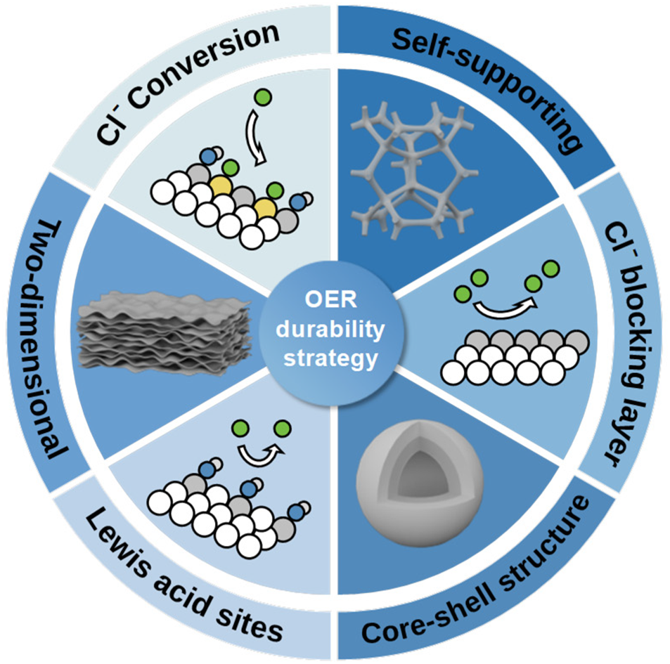
From: Oxygen evolution reaction electrocatalysts for green hydrogen production in seawater: enhancement mechanism in catalytic activity and durability
Green Chem.. 2025;27(43):13607-13631. doi:10.1039/d5gc03577e
Date of Download: 9/12/2026
Copyright © 2026 . All rights reserved.
Notes:
Figure Caption
This study focuses on MSOEs as electrocatalysts for seawater oxygen evolution reaction (OER), summarizes strategies for improving the OER activity and durability, and discusses OER in seawater its improvement strategies based on sustainability.

