Slide 1
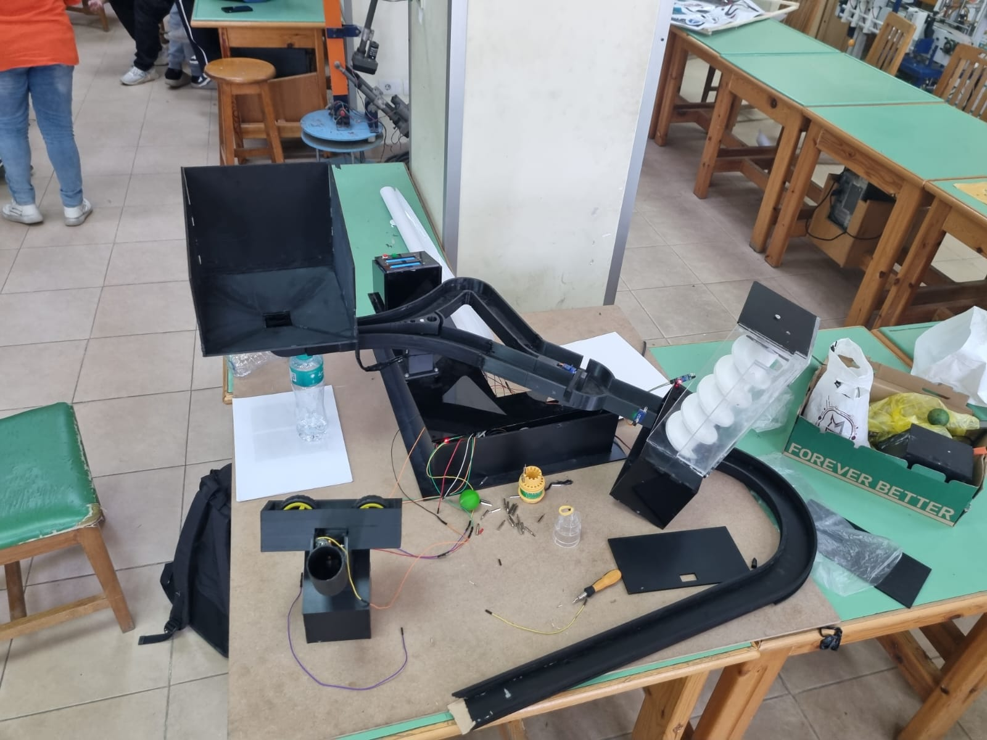


PLANETSORT: ORBITQUEST
Advanced Interactive Mechatronic Product Design System
ARES SECTOR
RED ORBIT
GAEA SECTOR
GREEN ORBIT
Ziad Atef M. Riad
24P0103
Kamal Wahdan
24P0222
Zeyad Amr Nazih
24P0372
Yahya Ashraf
24P0370
Abdoulrahman Adel
24P0098
Ain Shams University · University of East London · Project Defense 2026

Slide 2
PHASE I: VISION
Designing an autonomous, space-themed
planetary sorting and launching system
focused on cognitive development and STEM engagement.
Real project prototype — assembled for defense

Slide 3
User Research & Target Persona
Primary Audience
Core Needs
Children aged 2–10 years. Focused research indicates high engagement for age 8 through visually stimulating mechanical feedback and goal-oriented tasks.
Visual stimulation (moving parts), color recognition, hand-eye coordination, and a safe, intuitive interface for 'closed-loop' play.
2–10
3
100×100
Target Age Range
Core Modules
cm Footprint

Slide 4
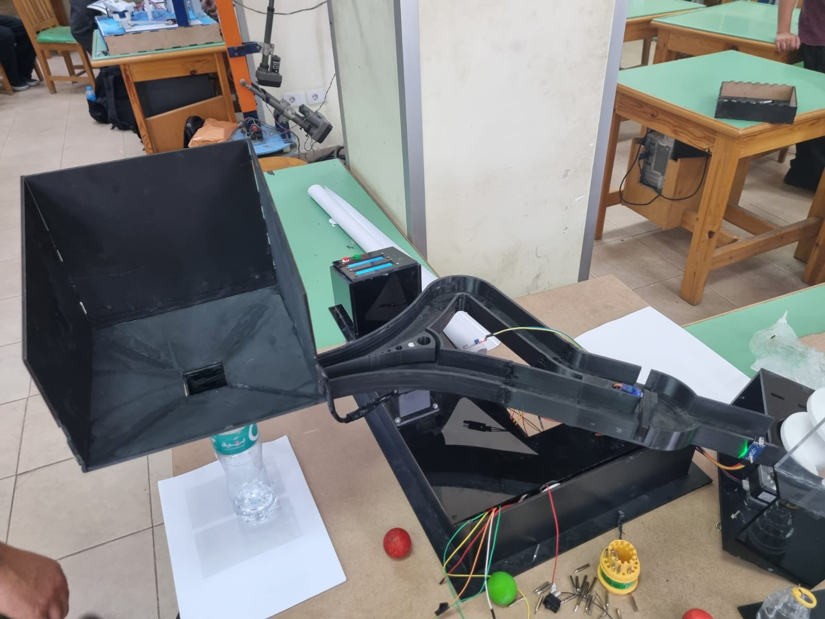
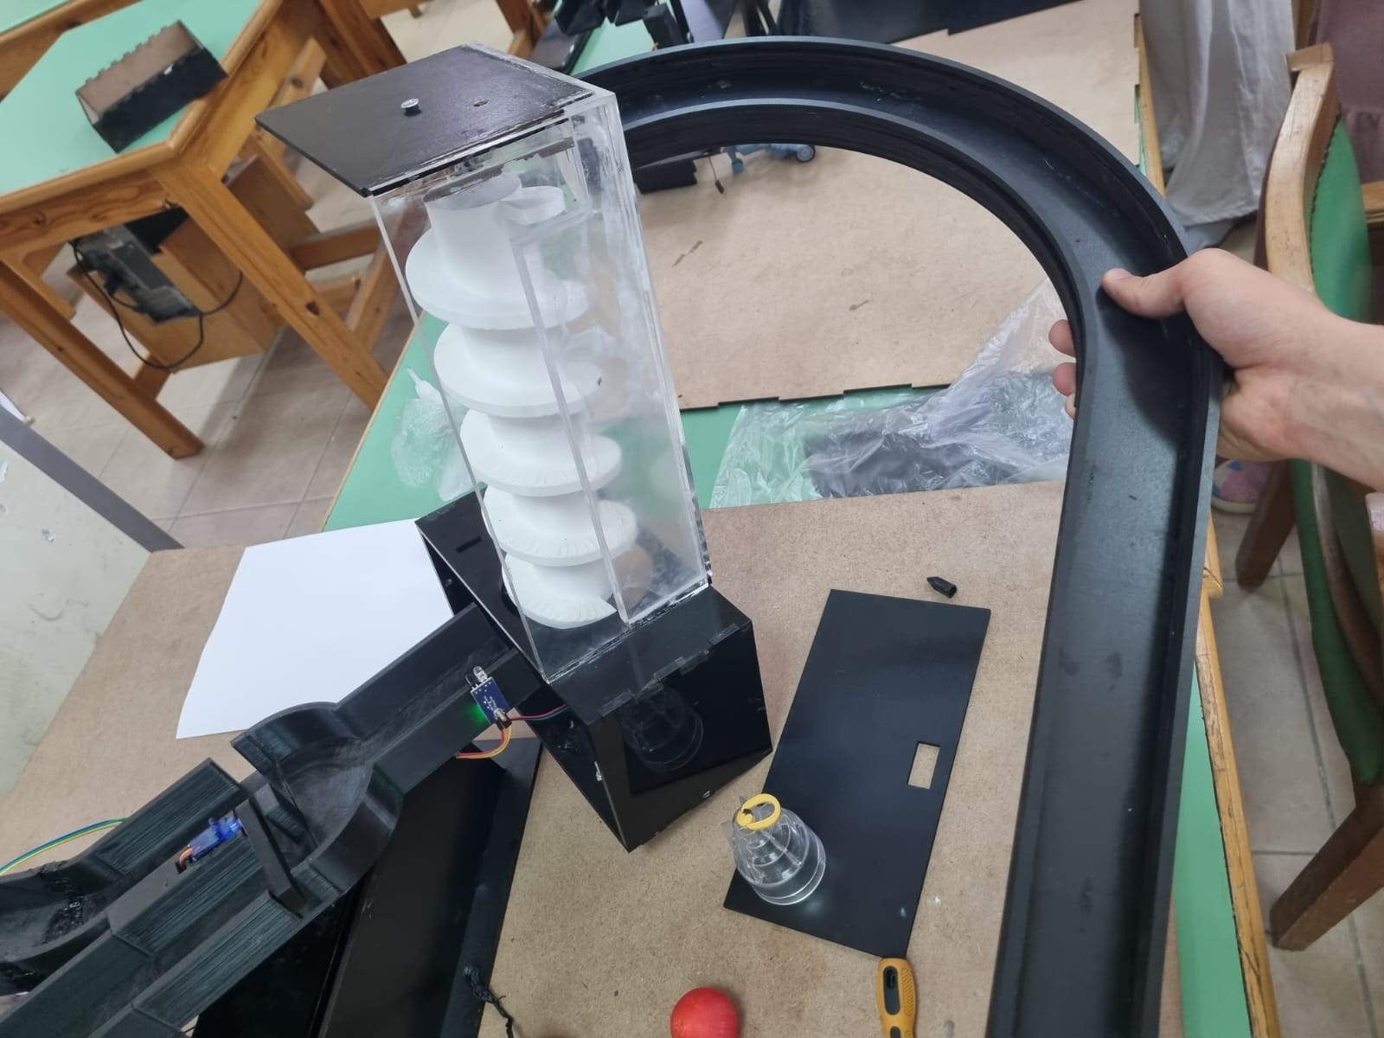
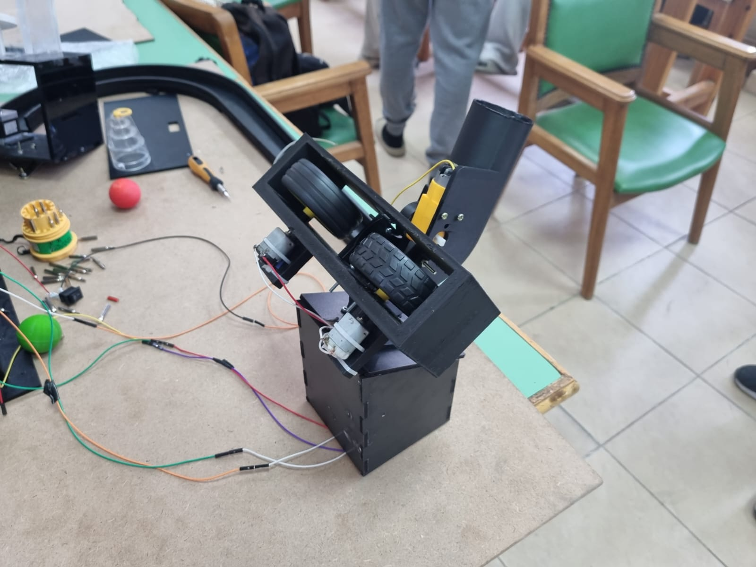
The Design Challenge
Automated Sorting
Vertical Lifting
Orbital Launch
Autonomous color detection and path routing using optical sensing logic.
Continuous vertical transit via an Archimedes spiral mechanism.
High-velocity calibrated projection into a target basketball hoop.

Slide 5
Module I: PlanetScan Sorting
The sorting subsystem identifies planetary marbles by wavelength using the TCS3200 sensor array. Dual SG90 micro-servos actuate high-speed gates to route the spheres.
Real-time RGB frequency analysis
Non-contact optical gating
Dynamic error-correction routing

Slide 6
Module II: Orbital Elevator
Our lifting mechanism utilizes a NEMA 17 stepper motor to drive a 3D-printed helical flight screw within a smooth-walled cylinder.
This module provides precise vertical positioning for the launch bay, ensuring the system is ready for the high-velocity shooting phase.
Motor:
NEMA 17 Stepper
Mechanism:
Archimedes Spiral
Material:
3D-Printed PLA

Slide 7
Module III: Hyperspace Thruster
The shooting module utilizes twin counter-rotating friction wheels driven by high-RPM DC motors. Calibration ensures repeatable orbital injection.
By modulating the PWM duty cycle, we achieve the precise initial velocity required to overcome gravity and reach the target hoop.
4.15 m/s
Calibrated Launch Velocity · β = 30°

Slide 8
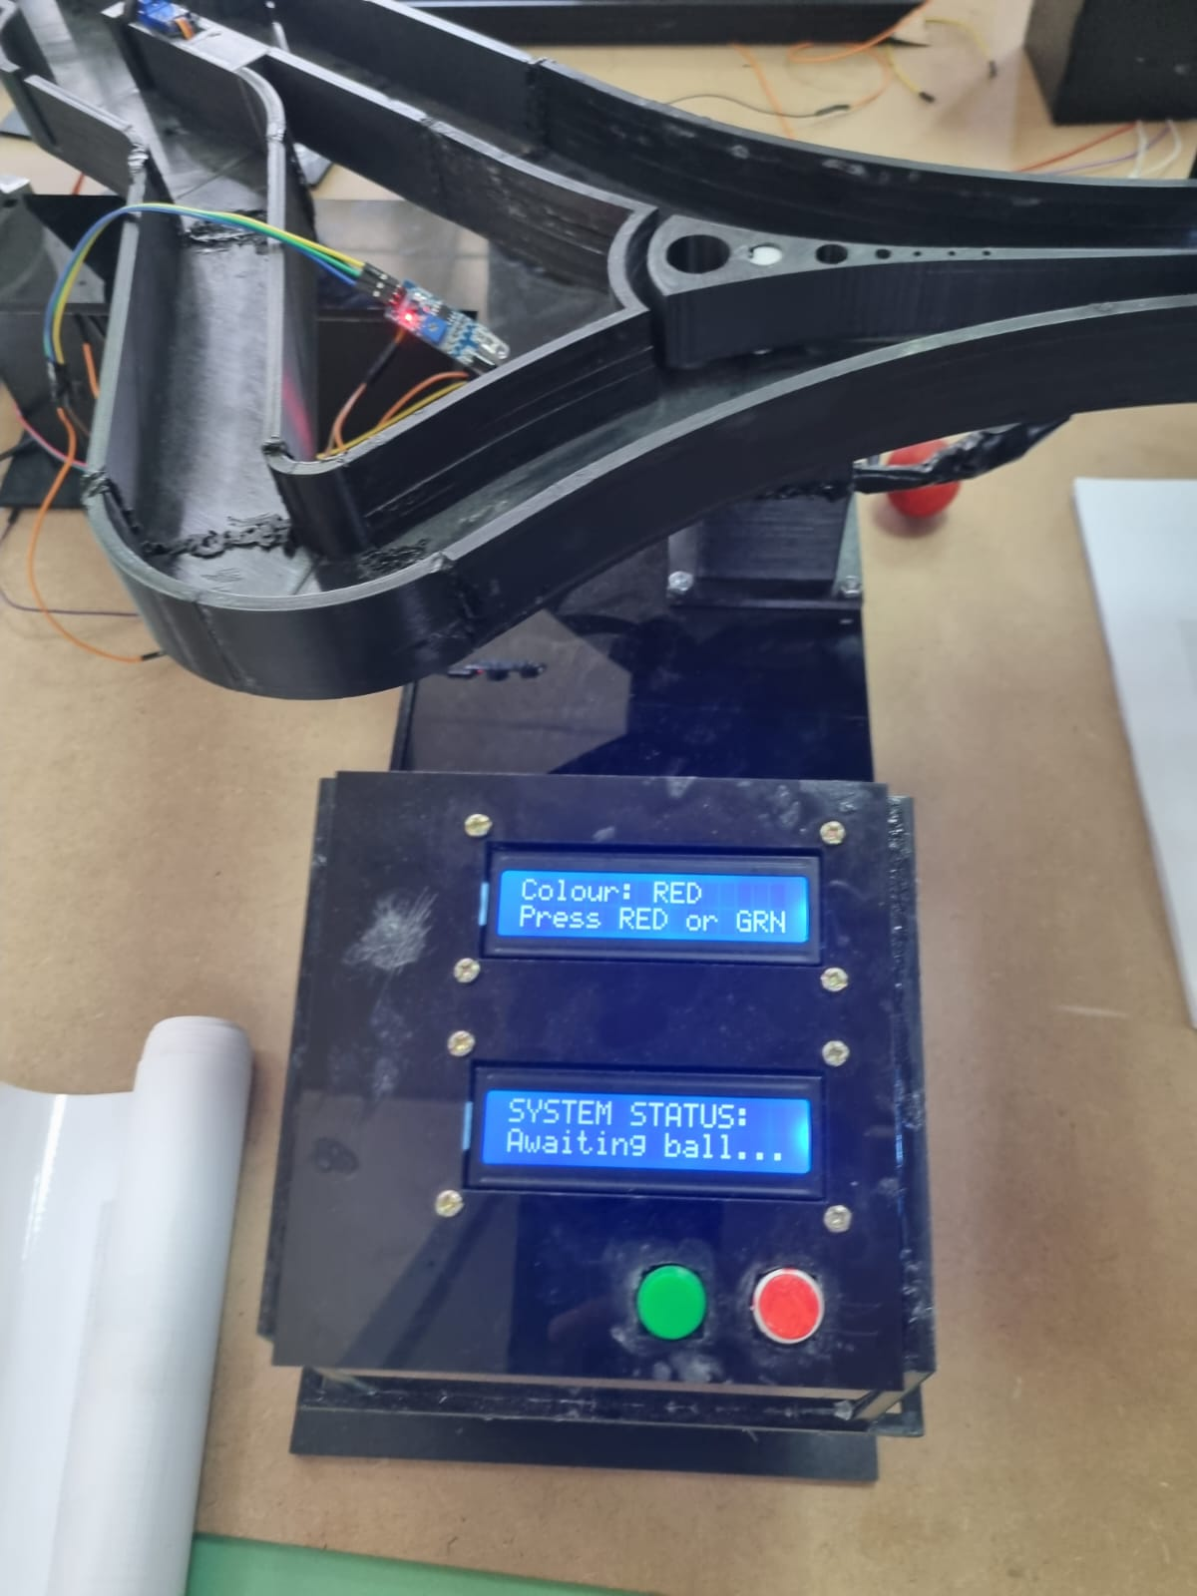
Master-Slave Control Logic
ESP32 Master
Handles high-level tasks: Color sensing, TFT display, Bluetooth telemetry, and ESP-NOW communication with the slave controller.
Arduino Uno Slave
Dedicated to low-level actuation: Precise stepper pulses, DC motor PWM curves, and servo timing isolation.
Communication via ESP-NOW wireless protocol · 2.4 GHz band

Slide 9
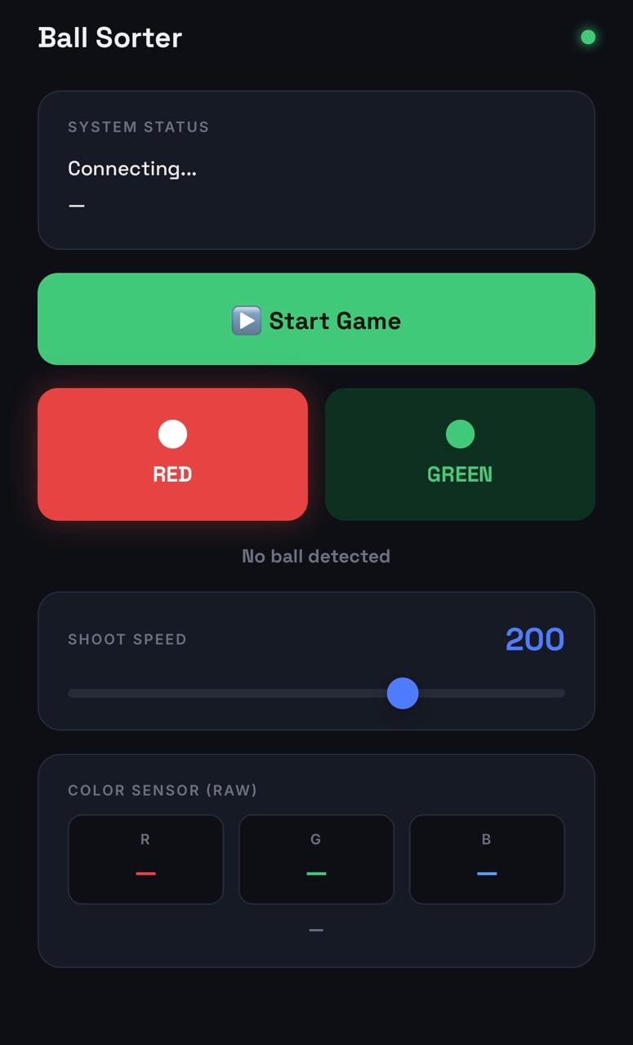
Dual Interfaces: Mission Control
LCD Control Panel
Ball Sorter App
Local onboard display · Colour detection readout
Green & Red button input
Bluetooth remote control · Score tracking
Shoot speed slider · RGB sensor raw data

Slide 10
Engineering Validation
$$v_{o}= \frac{d}{\cos\left(β\right)} × \sqrt{\frac{g}{2\left(d·\tan\left(β\right)− h\right) }}≈ 4.15 m/s$$
Parameter | Value | Validation Status
Initial Velocity (v₀) | 4.15 m/s | Calculated & Tested
Launch Angle (β) | 30° | Fixed Mechanical Constraint
Current Draw (Max) | < 5.0 A | Fused Safety Limit
Motor Safety Factor | > 2.2 | Industry Standard Compliant

Slide 11
Safety & Compliance Protocols
Concealed Architecture
Thermal Safety
All electrical wiring routed through internal structural channels to remain completely hidden and safe.
Onboard resettable 5A PTC fuse safeguards logic and motor rails against stall-current overloads and overheating.
Child-Safe Materials
Hardware Interrupt
Non-toxic PLA and smoothed MDF surfaces eliminate sharp edges and chemical exposure risks.
A physical master-stop button provides immediate electrical isolation of all high-power actuators.
OrbitQuest: Launching Curiosity into STEM · Ain Shams University & University of East London · Project Defense 2026

