Slide 1
Lab 1
Ghada Dahy

Slide 2
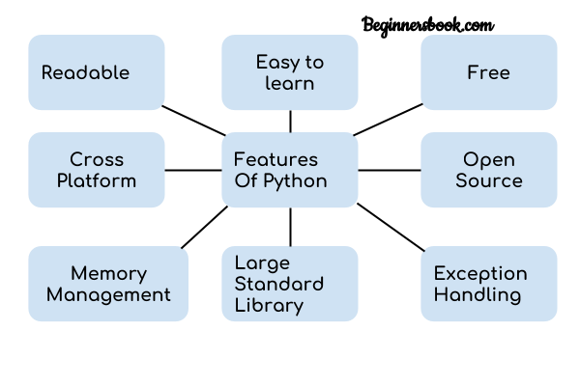
Python
https://beginnersbook.com/2018/01/introduction-to-python-programming/

Slide 3
Python Editor
Download Anaconda python 3.7 https://www.anaconda.com/distribution/#download-section
Use anaconda Navigator to choose your editor:
- We recommend to use Spyder Editor
- Press launch to start writing code

Slide 4
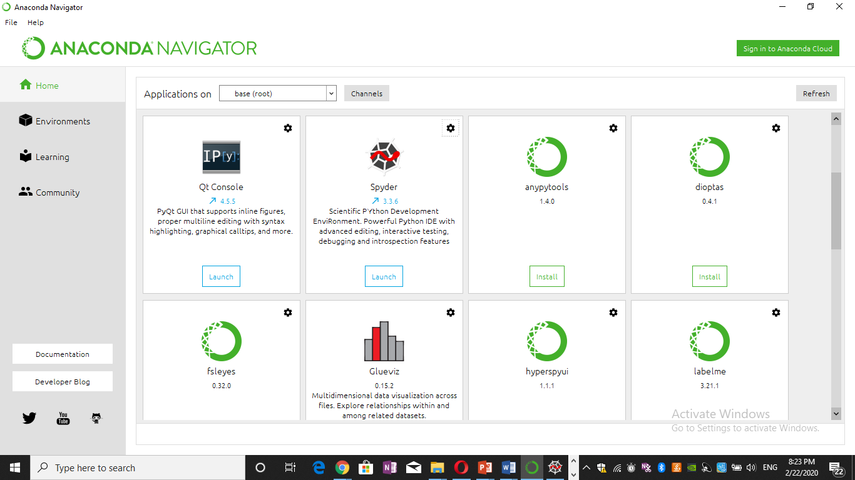

Slide 5
Python Editor
Use anaconda command to install new package online or offline using command
pip install package name
Ex. Download opencv.whl in your local machine
install pckage by using this command::
pip install desktop\opencv_python-4.2.0.32-cp37-cp37m-win_amd64.whl

Slide 6
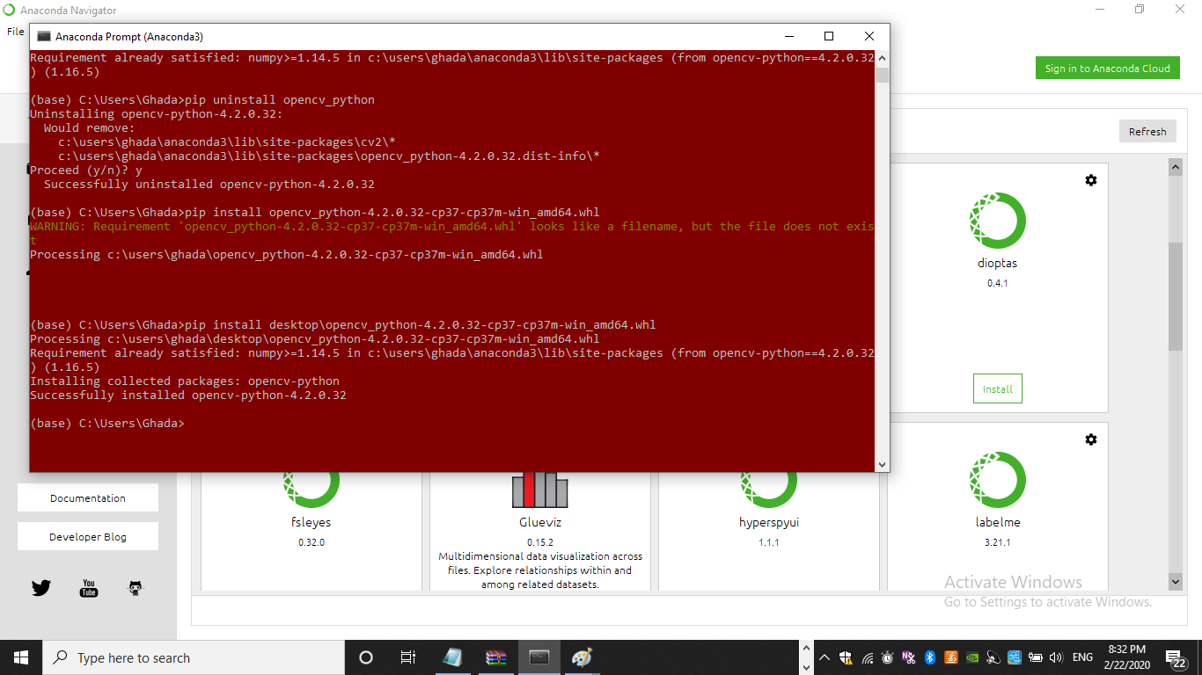

Slide 7
Python[Revision]
Comments:: ‘’’ ‘’’’ #
Week Data type and Case sensitive [Variables]
num = 100
str = "BeginnersBook"
print(num)
print(str)

Slide 8
Python[Revision]
While nm = 10
while num>5:
print(num)
num -= 1
String
us = "This is a String"
s2 = 'This is also a String'
# displaying string s and its type
print(s)
print(type(s))

Slide 9
Python[Revision]
Lists
lis1 = (1, 2, 3, 4, 5)
# prints entire list
print(lis1)
# list of strings
lis2 = ("Apple", "Orange", "Banana")
# loop through tuple elements
for x in lis2:
print (x)

Slide 10
Python[Revision]
dict = {1:"Chaitanya","lastname":"Singh", "age":31}
# prints the value where key value is 1
print(dict[1])
# prints the value where key value is "lastname"
print(dict["lastname"])
# prints the value where key value is "age"
print(dict["age"])

Slide 11
Python[Revision]
Functions
def add(num1, num2):
return num1 + num2
sum1 = add(100, 200)
sum2 = add(8, 9)
print(sum1)
print(sum2)

Slide 12
Python[Revision]
class DemoClass:
# constructor
def __init__(self):
# initializing instance variable
self.num=100
# a method
def read_number(self):
print(self.num)
# creating object of the class. This invokes constructor
obj = DemoClass()
# calling the instance method using the object obj
obj.read_number()

Slide 13
Practice
Create a Class contains:
constructor which takes one input
Function to check if the input is number or Alph

