Slide 1


ITI EXAMINATION SYSTEM
Abdelaziz Ragab Abdelaziz Abdelsalam
Abdelrahman Mohammed Aboulyazeid
Abdelrahman Mohammed Rabie
Mohammed Tarek Mohammed Hassan
Youssef Mohammed Fathy Abdelrahman

Slide 2

Contents
Database Design
Stored Procedures
Data Warehouse
Extraxt Transform Load (ETL) Process
Report And Dashboard
Desktop Application
Application Interface

Slide 3
Project Assumpations
Department means Track and Branch like (power bi Monofia), so we have 20 departments (4 branches and 5 Tracks
Each Instructor teachs only one course
Each Course may be have one or more instructors
Courses Table have 44 Course , 11 public courses(all department)
Each Student have one exam grade and different courses grades

Slide 4

Database Design
Requirements :
Entities
Relationships
The ER-Diagram
Mapping-Diagram

Slide 5
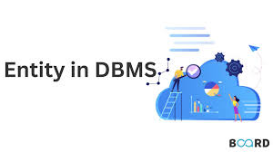
Entities
Departments
Courses
Students
Instructors
Exams
Topics
Questions
Answers

Slide 6

Relationships
Students must belong to one department and many courses.
Students may have one or many exams in many courses and may have many exams in the same. course.
The course must have many questions and may have many topics.
Questions must have answers.
The department must be managed by one instructor.
Instructors must work in one department.
Student must be supervised by one team leader student.

Slide 7
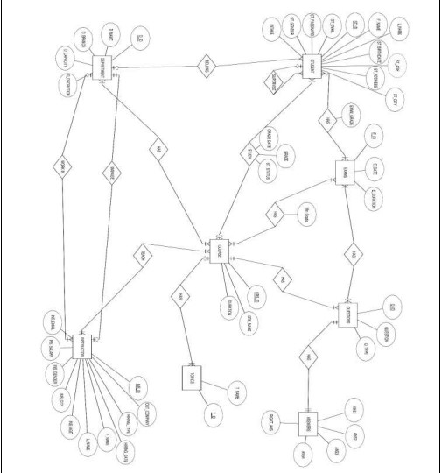
The ER-Diagram

Slide 8
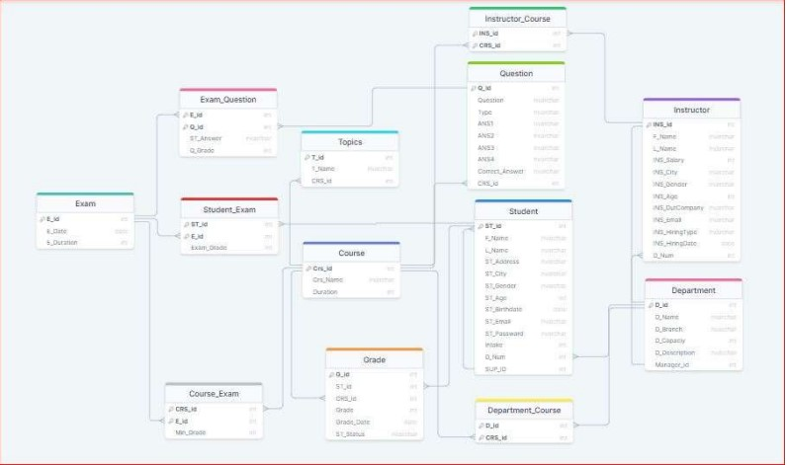
Mapping-Diagram

Slide 9

Data Warehouse Design
Requirements:
Dimensions
Hierarchies
Fact Tables
DWH-Diagram

Slide 10

Dimensions
Department_DIM
Instructor_DIM
Student_DIM
Course_DIM
Exam_DIM
Date_DIM

Slide 11
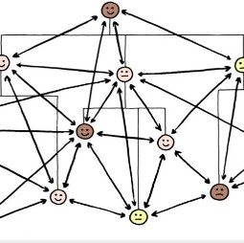
Hierarchies
Instructor_Courses
Department_Courses

Slide 12
Fact Tables
Grade_Fact
Contains Exam_Grade measure and foreign keys from (Department , Student , Course . Exam , Instructor , Date ) Dimensional tables with primary key ( Grade_SK )
Total_Grade_Fact
Contains Grade measure and foreign keys from ( Student , Course , Date ) Dimensional tables with primary key ( Total_Grade_SK )

Slide 13
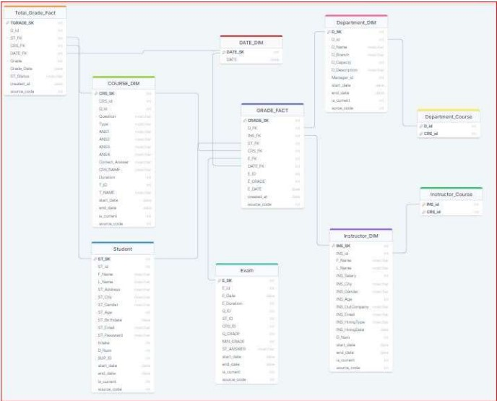
DWH-Diagram(Galaxy Schema)

Slide 14
Extract Transform Load (ETL) Process
Requirements :
Dimensions
Hierarchies
Fact Tables

Slide 15
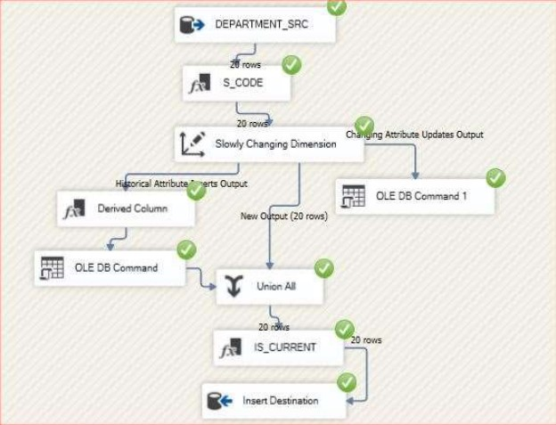
Dimensions
Department_DIM

Slide 16
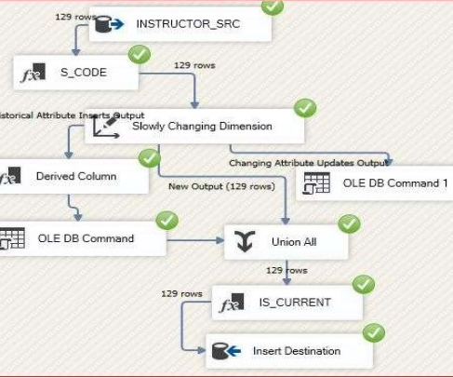
Dimensions
Instructor_DIM

Slide 17
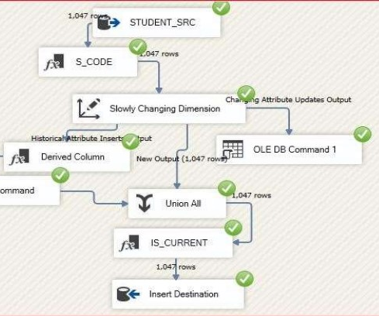
Dimensions
Student_DIM

Slide 18
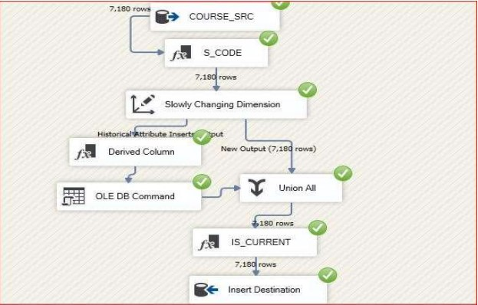
Dimensions
Course_DIM

Slide 19
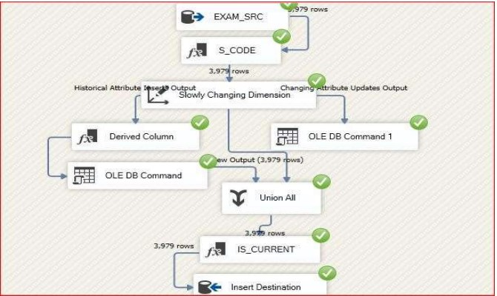
Dimensions
Exam_DIM

Slide 20
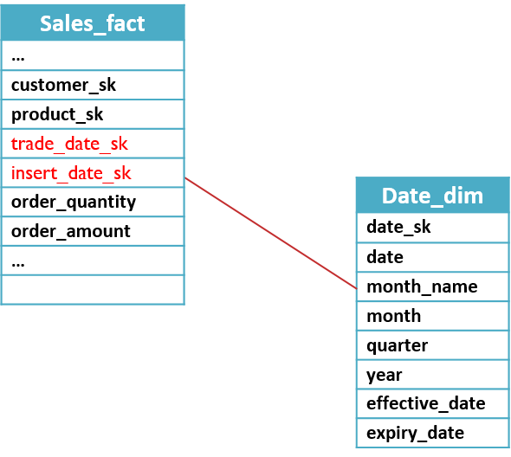
Dimensions
Date_DIM

Slide 21
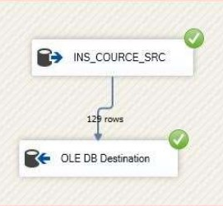
Hierarchies
Instructor_Courses

Slide 22
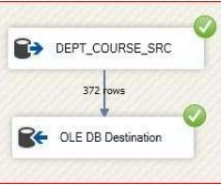
Hierarchies
Department_Courses

Slide 23
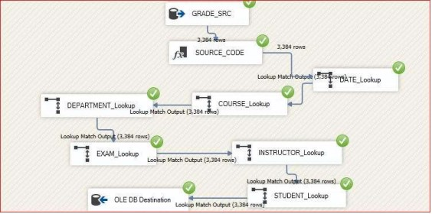
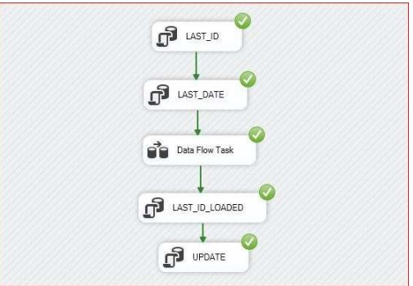
Fact Tables
Grade_Fact

Slide 24
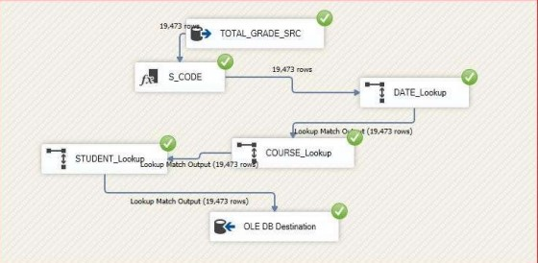
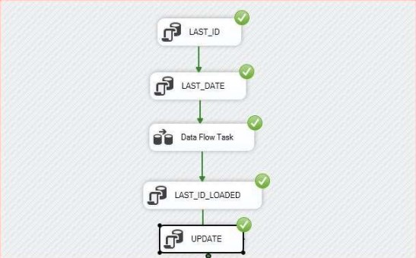
Fact Tables
Total_Grade_Fact

Slide 25

Desktop Application
The Application based on the Database generates an exam with 5 questions and corrects them then shows the exam grade, the student can log in by his email and password then he can insert the course ID on which he has the exam on.
languages :
Python
SQL

Slide 26
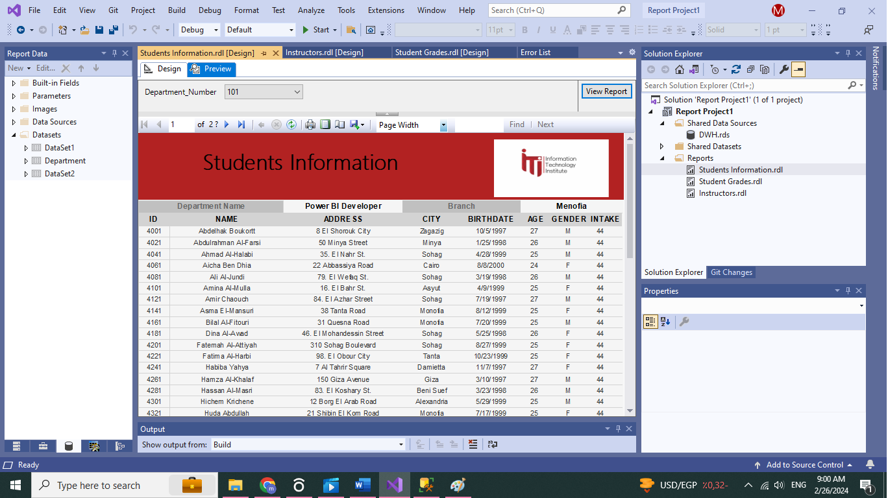
Reports
1
Report that returns the students information according to Department No parameter.

Slide 27
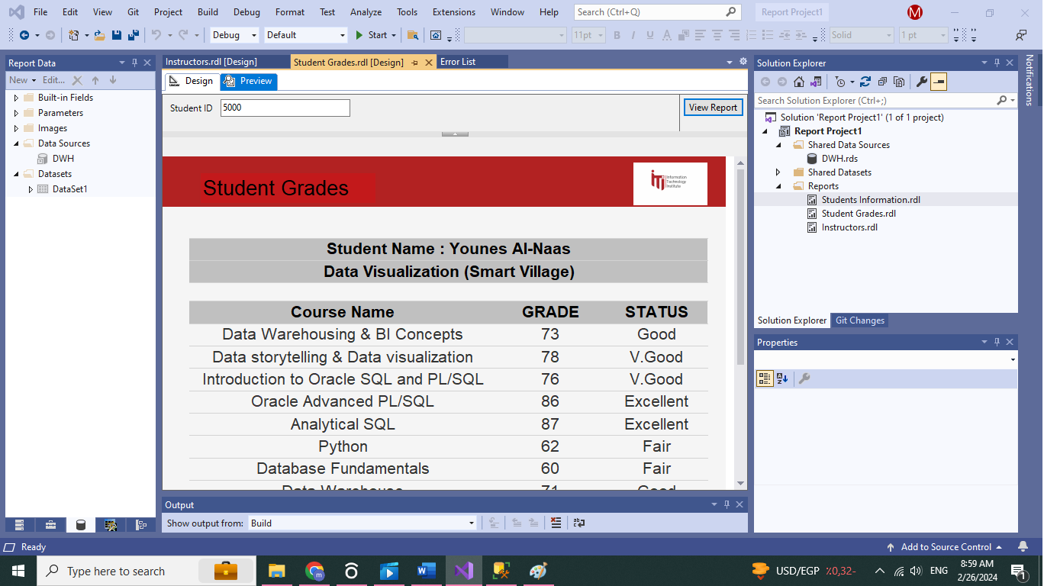
Reports
2
Report that takes the student ID and returns the grades of the student in all courses. .

Slide 28
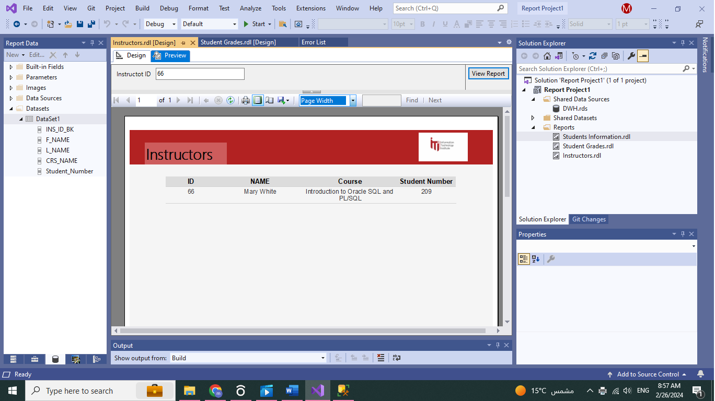
Reports
3
Report that takes the instructor ID and returns the name of the courses that he teaches and the number of student per course.

Slide 29
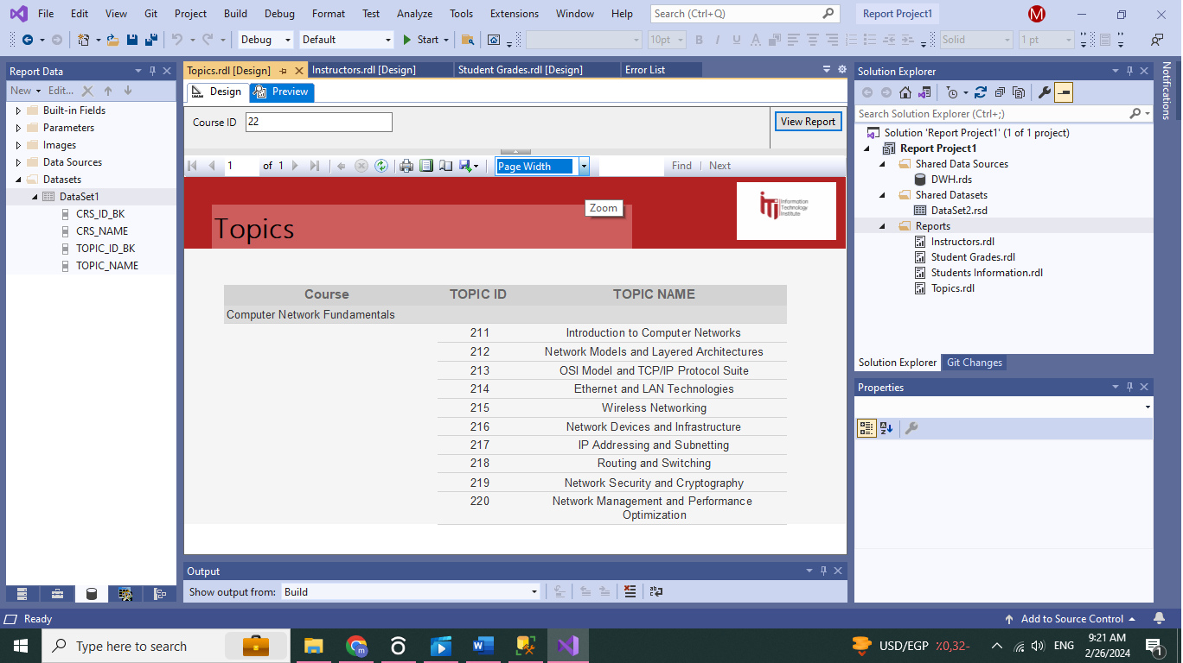
Reports
4
Report that takes course ID and returns its topics

Slide 30
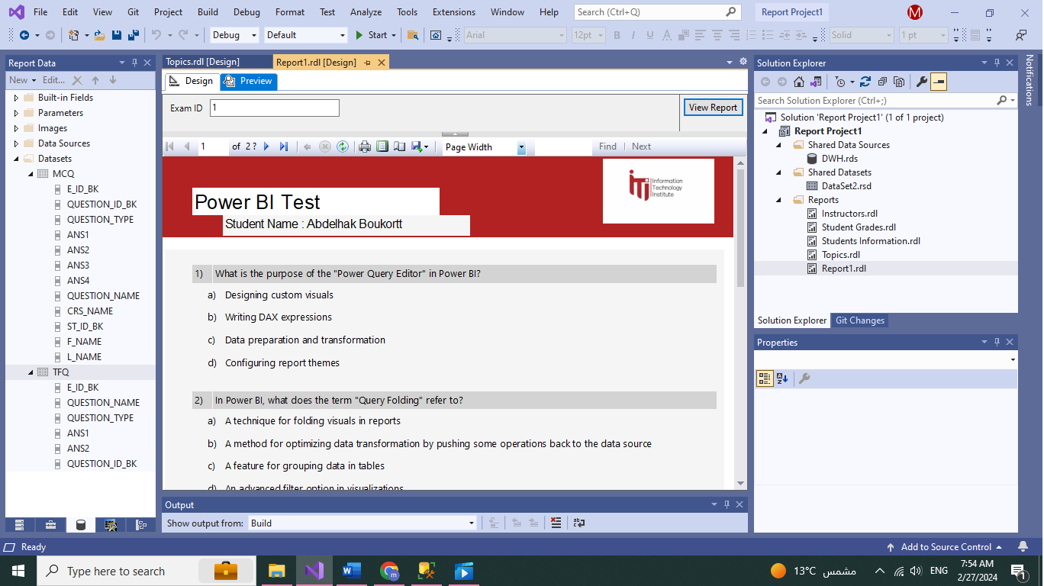
Reports
5
Report that takes exam number and returns the Questions in it and chocies [freeform report]

Slide 31
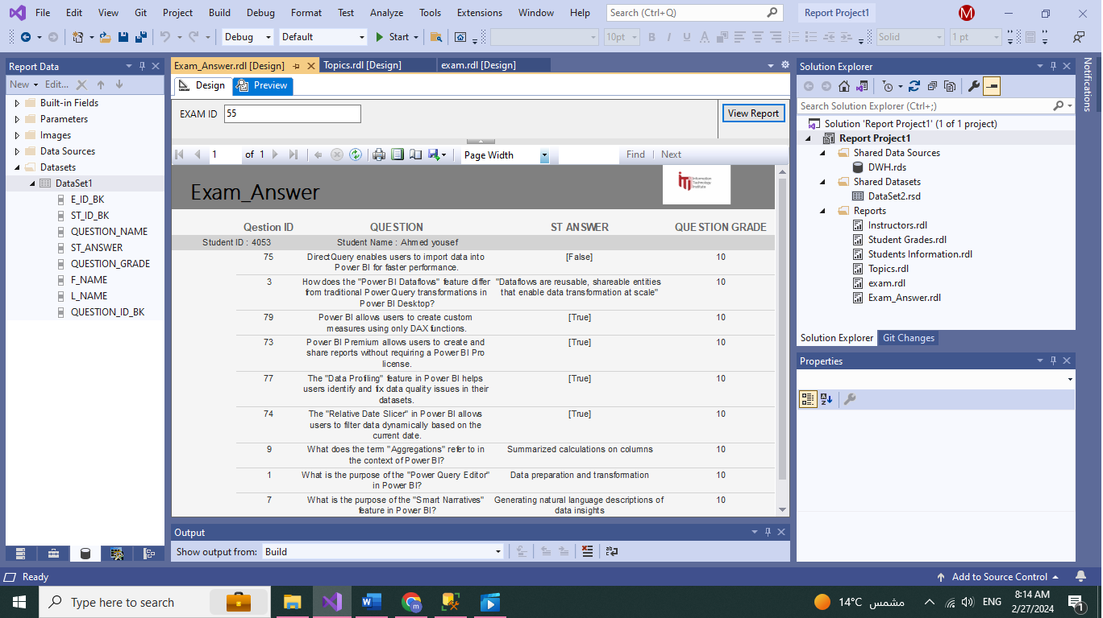
Reports
6
Report that takes exam number and returns the Questions in this exam with the student answers.

Slide 32
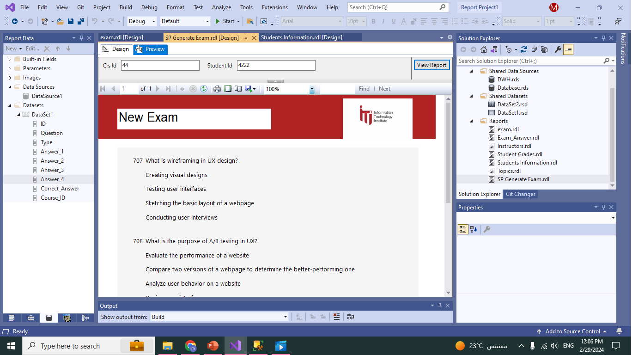
Reports
7
Report that takes exam number and Student number then returns the Questions in this exam with the student answers. (with generate_exam sp)

Slide 33
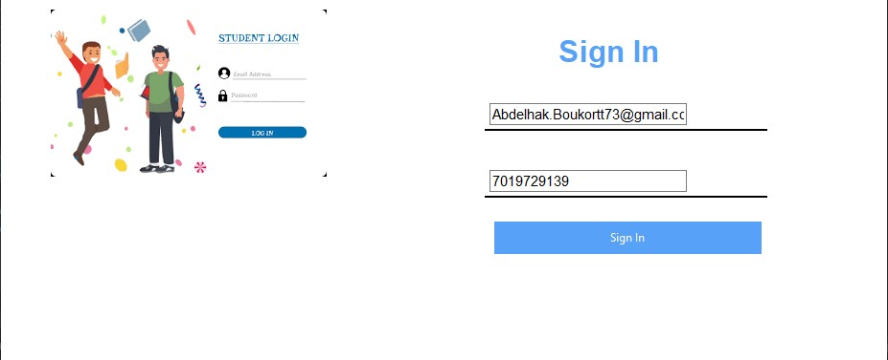
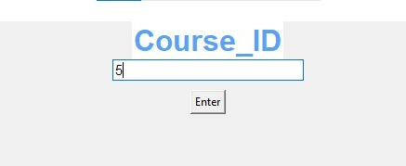
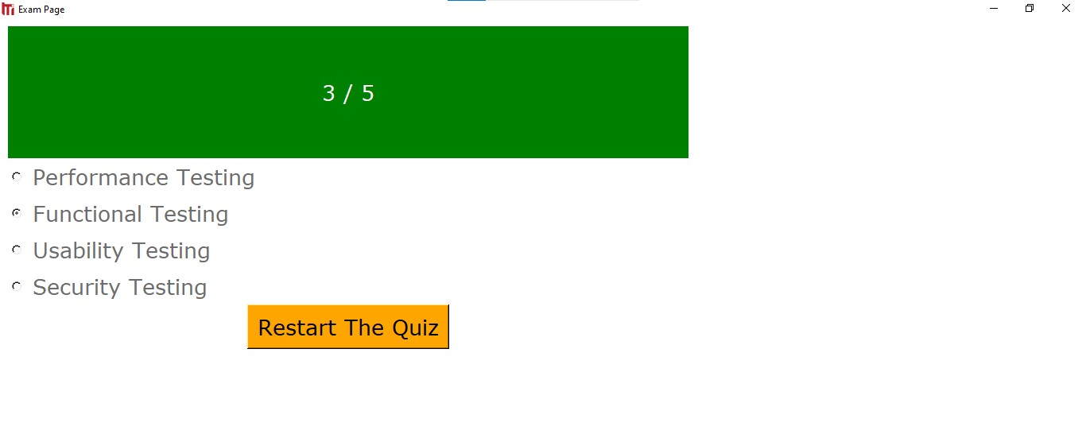
Application Interface

