Slide 1
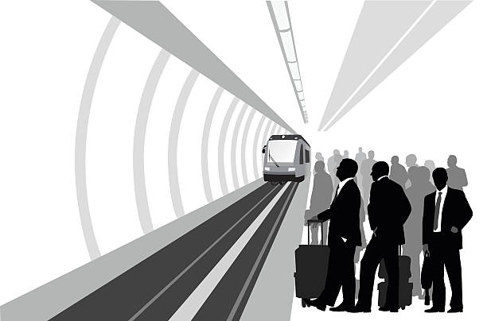
Railway
Reservation
system

Slide 2
Agenda
1
Overview of project
2
Uml tool
3
Component diagram
4
Class,Activity,Use case,sequence diagrams
5
code

Slide 3
system have a form to registration user if not in system or login process then the passengers pick up the source and destination of the trip, if it available the passenger choose train and book the tier whether it first class or second class then the passenger choose payment method whether credit or paypal or mobile wallet and finally ticket will be printed

Slide 4

ArgoUML is an UML diagramming application written in Java and released under the open source Eclipse Public License, it is available on any platform supported by Java SE.
The users of ArgoUML are software designers & architects, software developers, business analysts, systems analysts and other professionals involved in the analysis, design and development of software applications
Argo UML
It uses Open standards: XMI (XML Metadata Interchange (XMI), SVG (Scalable Vector Graphics (SVG), an XML specification and file format for describing two-dimensional vector graphics

Slide 5

ArgoUML was originally developed at UC Irvine by Jason E. Robbins, leading to his Ph.D. It was an open source project hosted by Tigris.org and moved in 2019 to GitHub,The ArgoUML project included more than 19,000 registered users and over 150 developers
In 2003, ArgoUML won the Software Development Magazine's annual Readers' Choice Award in the “Design and Analysis Tools” category.

Slide 6

Forward engineering (code generation supports C++ and C#, Java, PHP, Ruby
and with less mature --modules, Ada, Delphi and SQL).
Reverse engineering / JAR/class file import.
Platform independent – Java 1.5+ and C++.
Click and Go! with Java Web Start (no setup required, starts from your web browser).
XML support.
Export diagrams as GIF, PNG, PS, EPS, PGML and SVG.
Advanced diagram editing and zoom.
OCL support.
All 9 UML 1.4 diagrams are supported.
Available in ten languages: EN, EN-GB, DE, ES, IT, RU, FR, NB, PT, ZH.

Slide 7

No undo feature
ArgoUML does not yet completely implement the UML standard.
Reverse engineering does not provide all code
data types and return value have less option and not customized only support int,bool,string
no navigation with keyboard such as Tab

Slide 8
A component diagram describes the organization and wiring of the physical components in a system.
Component diagrams are often drawn to help model implementation details and double-check that every aspect of the system's required functions is covered by planned development
In the first version of UML, components included in these diagrams were physical: documents, database table, files, and executables, all physical elements with a location.
In the world of UML 2, these components are less physical and more conceptual stand-alone design elements such as a business process that provides or requires interfaces to interact with other constructs in the system
Component Diagram

Slide 9
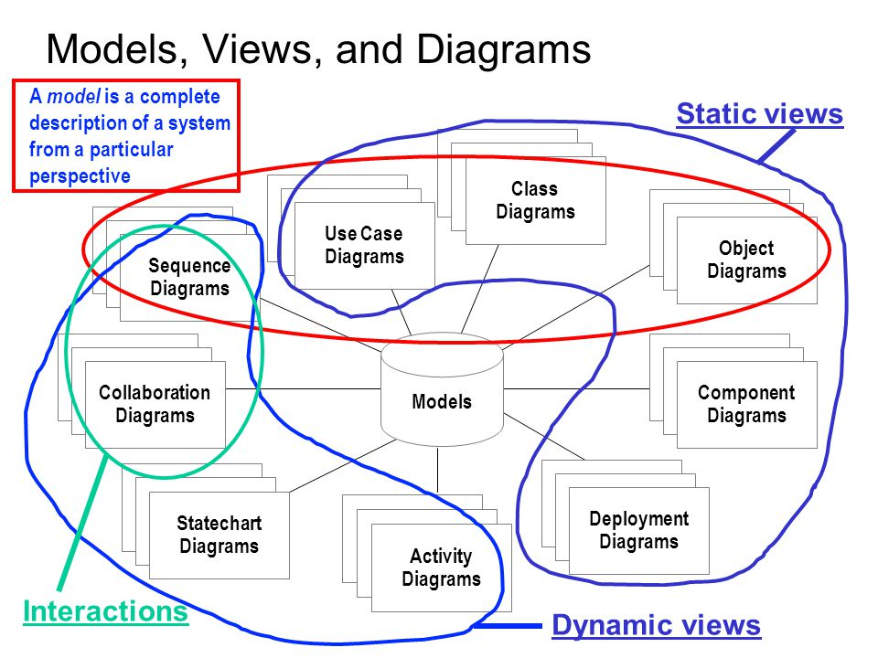

Slide 10

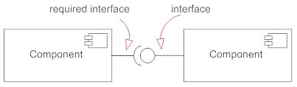
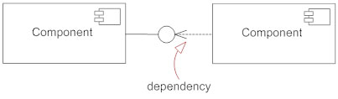
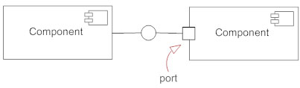
Component
A component is a logical unit block of the system, a slightly higher abstraction than classes.
interface
describes a group of operations used (required) or created (provided) by components
Dependencies
A dependency is a relationship that signifies that a single or a set of model elements requires other model elements for their implementation.
Port
used to help expose required and provided interfaces of a component.

Slide 11
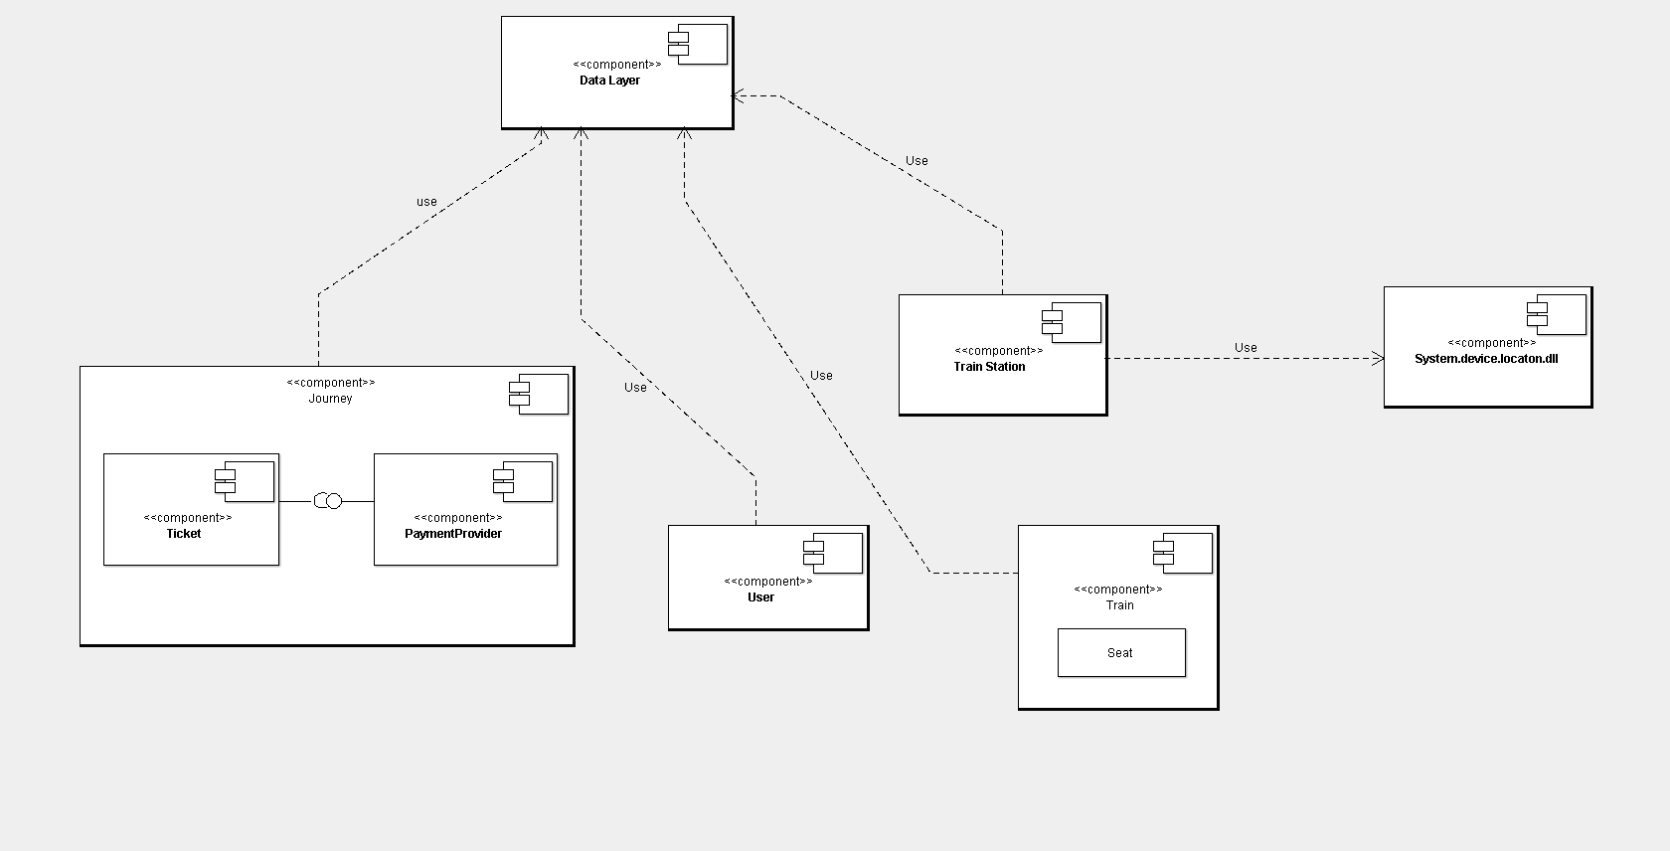

Slide 12

Class Diagram

Slide 13
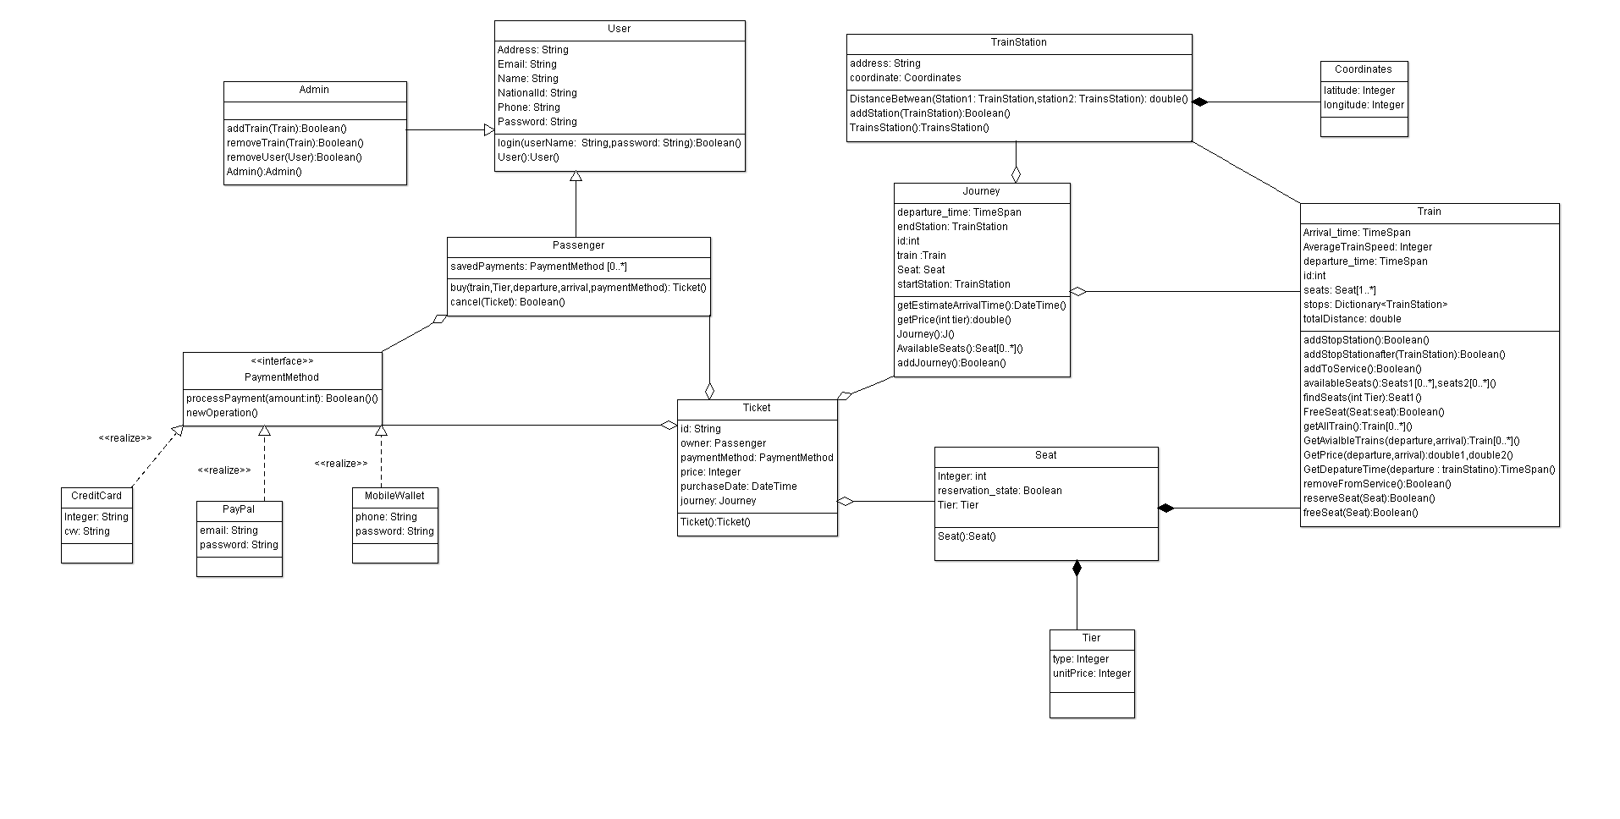

Slide 14
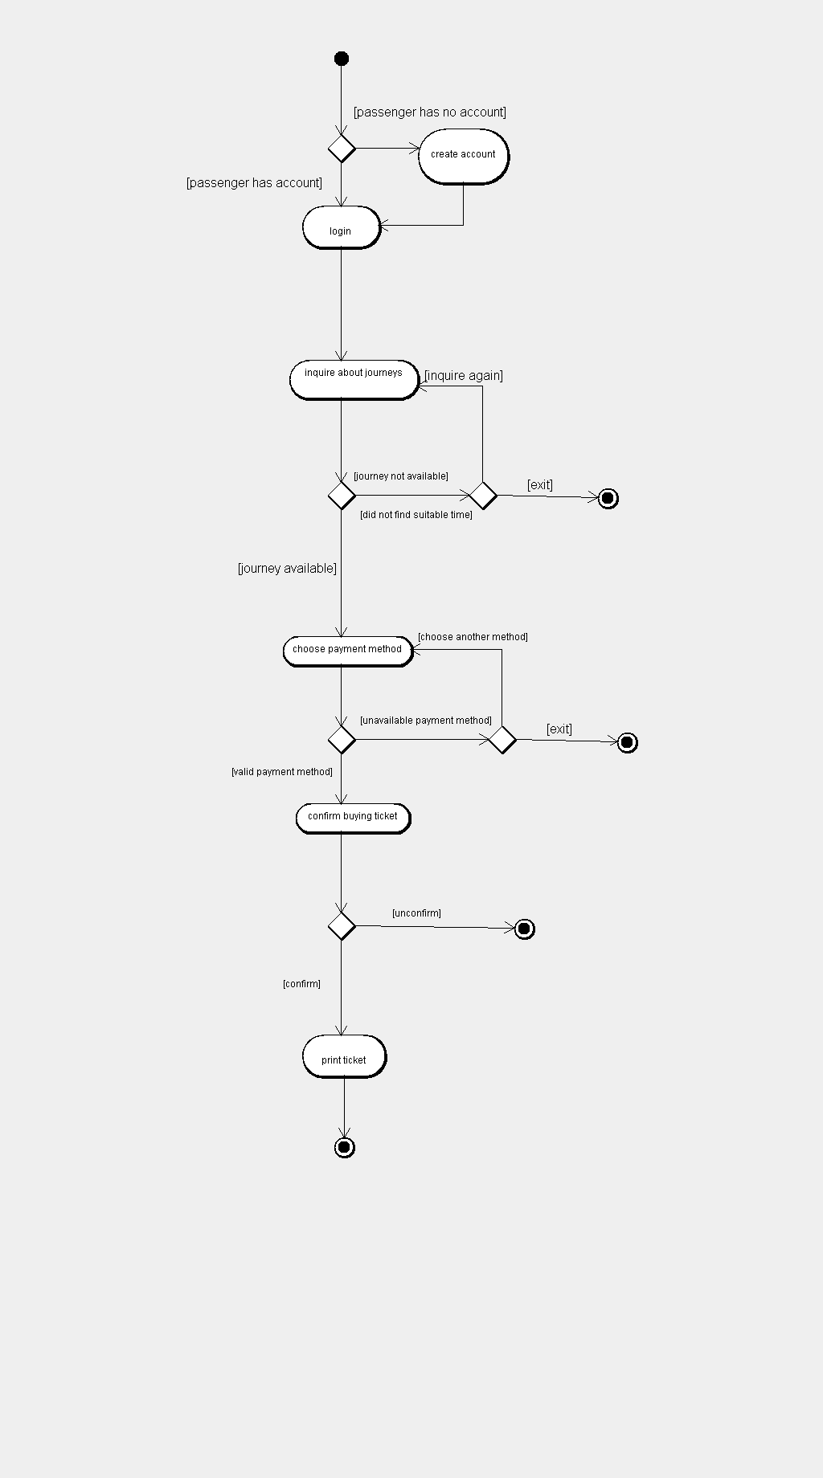
Activity Diagram

Slide 15
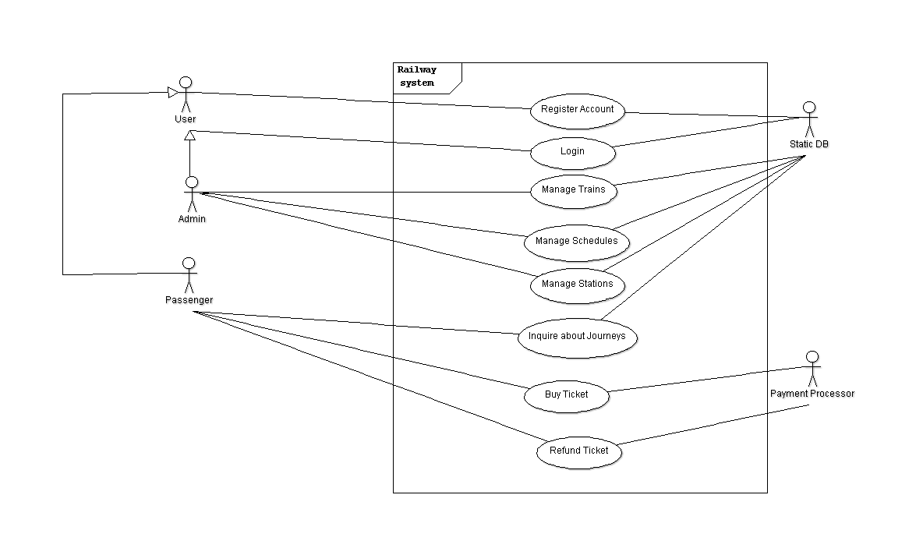
Use case Diagram

Slide 16
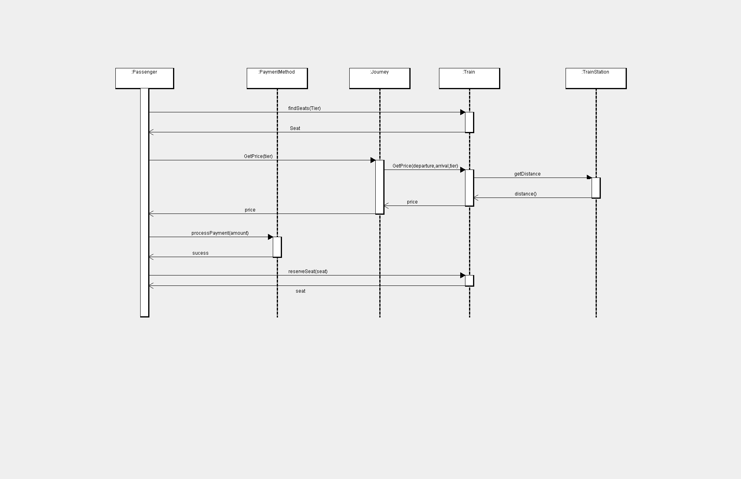
sequence Diagram

