Slide 1
Hardware-aware RIS
beam steering
Scientific validation and CST diagnostics
Abdulrahman
23 October 2026
Notes:
Computational research status report. Actual CST simulations and analytical software tests are distinguished from unresolved paper reproduction. Reference: https://arxiv.org/abs/2508.07098

Slide 2
Research scope and evidence
Analysis | Current status
Reproducible MATLAB array model | 15 tests pass
Actual CST unit-cell diagnostics | 16 completed runs, including backing tests
Paper Figure 2 reproduction | Current model does not establish a match
Four-port impedance extension | Illustrative assumed circuit
Finite-array CST RCS and measurements | Not demonstrated
The array factor isolates reflection-state effects. Full-wave structural scattering remains a separate physical question.
Notes:
Sources: results/validated_v2/tests.json; cst/experiments; results/cst_diagnostics. No hardware measurements or 20x20 full-wave reproduction are claimed.

Slide 3
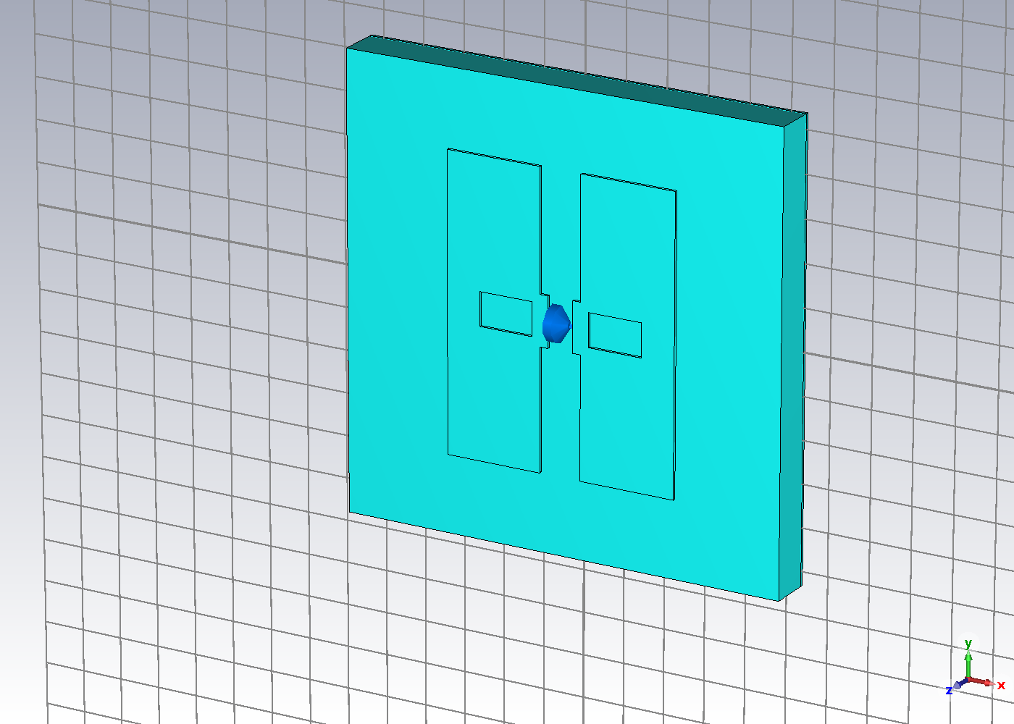
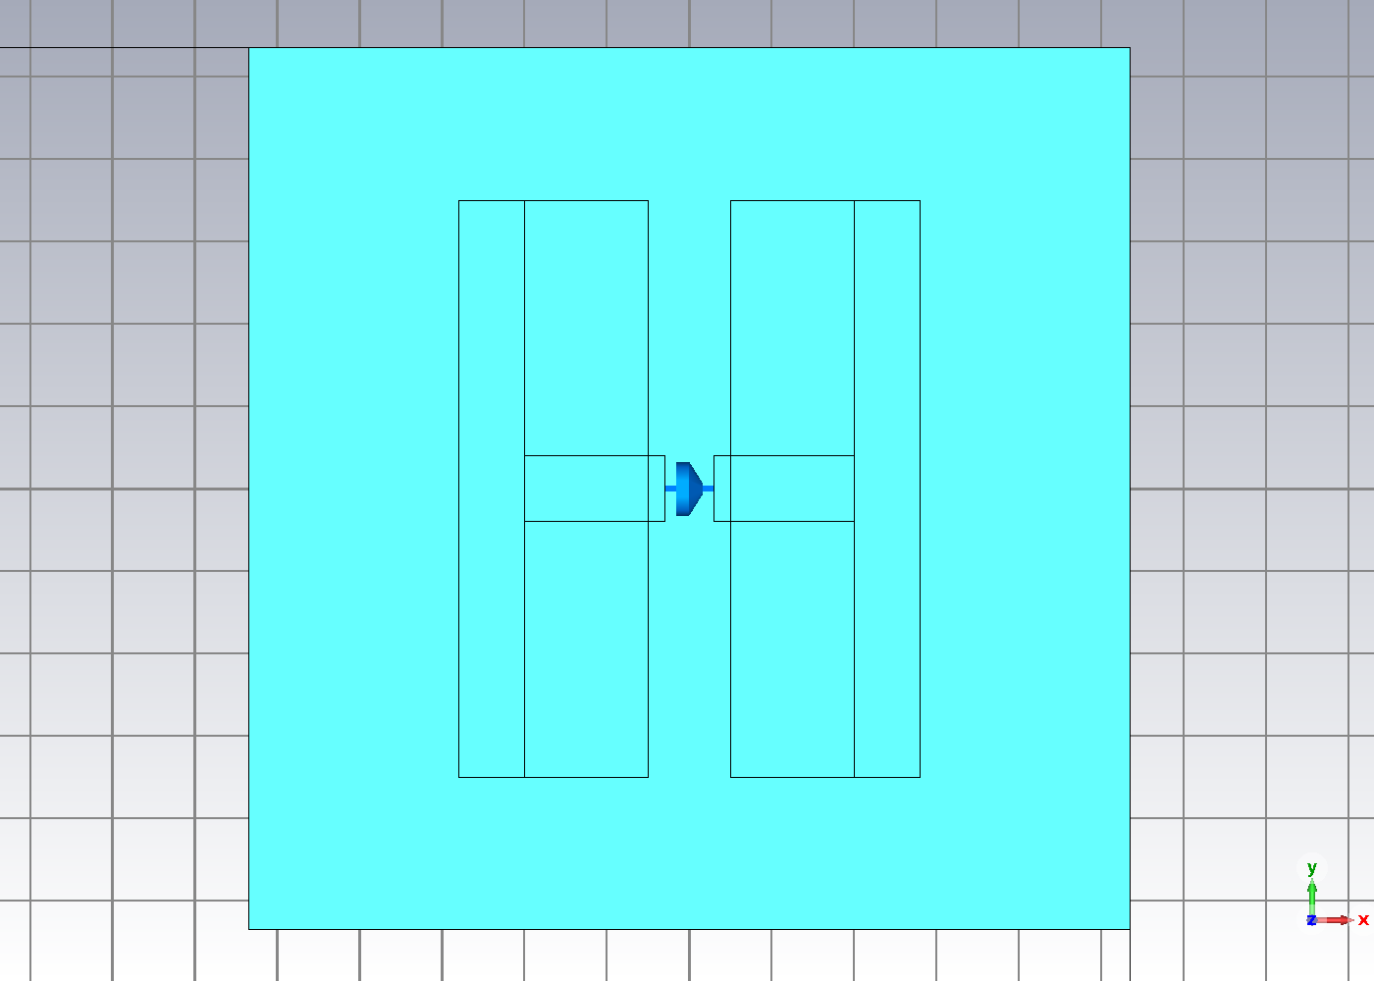
Actual CST geometry views
Connected diagnostic: native perspective
Original topology: native XY view
5.35-mm cell, 0.5-mm substrate, central lumped load and backplane. Added overlaps are diagnostic assumptions.
Notes:
Actual exports: D006 connected perspective and D009 original topology XY view at copper midplane. The two views intentionally show different controlled topologies, clearly captioned. Side-section export fitting remains a display limitation.

Slide 4
Source dimensions and unresolved assumptions
Quantity | Implemented value | Qualification
GL / pitch | 5.35 mm | Periodic square cell
PL / PW | 3.5 / 2.8 mm | Y extent / combined X extent
GW / SW / SL | 0.3 / 2.0 / 0.4 mm | Gap and slot mapping provisional
Substrate | 0.5 mm, eps_r 2.2 | Constant loss tangent 0.0009
Copper | 35 micrometres | Bulk material model warning
Diode and ground | Lumped RLC + backplane | Exact model not calibrated
The original diode lands meet the arms at zero-area XY corners. Controlled tests assess the consequence.
Notes:
Source: supplied paper Fig.1 and Table I. Model evidence: cst/experiments/*/model_history.bas. Detailed mapping and qualifications: docs/CST_PHYSICAL_AUDIT.md.

Slide 5
Open / short sensitivity depends on the mode
26.168 GHz, R = 0.001 versus 1e9 ohm, L = C = 0. Initial meshes. Added connections alone do not recover the published phase separation.
Notes:
Actual results D003-D006. Source: results/cst_diagnostics/open_short_comparison.csv. Mode 1 phase changes 0.001509 / 0.002820 degrees; mode 2 changes 8.456462 / 10.107570 degrees. Polarization and numerical refinement remain separate gates.

Slide 6
Numerical correctness and power checks
15 / 15
CST export checks
MATLAB tests pass
Power-balance residual below 7.3e-7
V - ZI relative residual below 3e-16
These checks do not certify mesh independence
Exact zero-noise difference: 0
Every configuration: 400 complex coefficients
Complex interpolation and passivity screening
Notes:
Test source: results/validated_v2/tests.json. Export checks: results/cst_diagnostics/manifest.json. Eq.1 phase alignment gives magnitude 400 versus 8.051739918 under the printed Eq.6 rule with the same channel definitions. This is a convention inconsistency, not a statement about the authors implementation.

Slide 7
Paper reflection data remain distinct from CST
Figure 2 digitization: about 0.964 at 35 deg and 0.752 at -131 deg at 26.168 GHz. Estimated raster resolution: 0.004 magnitude and 2 deg.
Notes:
Source: supplied Goshu et al. paper Fig.2. Generator tools/digitize_figure2.py records PDF hash and calibration. CSV data/paper_digitized_reference/reflection_states.csv. This is approximate published data, not simulated hardware.

Slide 8
Common normalization exposes binary mirror beams
20 x 20, pitch 5.35 mm, 26.168 GHz. Target polar 25 / azimuth 15 deg. The competing lobe is nearly as strong as the requested beam.
Notes:
Source results/validated_v2/paper_digitized_reference/principal_cut.csv, generated by matlab/ris_array_model.m. Negative signed angle uses opposite azimuth. Power normalization |AF|^2/400^2. No element pattern, coupling, efficiency or RCS.

Slide 9
Target power and strongest lobe
Input / control | Target (dB) | Peak (dB) | Pointing error
ideal continuous | 0.000 | 0.000 | 0.000 deg
ideal binary fixed reference | -3.930 | -3.925 | 0.120 deg
hardware fixed reference | -5.313 | -5.312 | 0.026 deg
hardware optimized reference | -5.302 | -5.300 | 0.073 deg
Strict CST mode 1 | -58.727 | -0.103 | 25.000 deg
Strict CST mode 2 | -27.273 | -0.037 | 25.000 deg
Paper-state patterns retain a competing beam. Both strict CST state pairs favor broadside. Physical model validation remains provisional.
Notes:
Paper approximate data: results/validated_v2/paper_digitized_reference/array_factor_metrics.csv. Actual strict CST data: cst_strict_mode1_provisional and cst_strict_mode2_provisional in the same results version. All power ratios share the ideal coherent reference.

Slide 10
Coupled impedance example
Assumed reciprocal passive circuit. The matched-load term can remain nonzero at zero load reflection coefficient. No physical RIS scattering level follows from this example.
Notes:
Generator matlab/run_impedance_example.m. Eq.7: H=-zRS (ZSS+Zload)^-1 zST, y0=1 and ZRT=0. Positive-definite real part, reciprocal matrix and direct algebraic residual tests. Self 50+j20 ohm; adjacent mutual 5+j12 ohm. These are assumed values, not CST extraction.

Slide 11
Convergence and remaining physical gates
Saved run | Tetrahedra | Passes | Final all-S change
D007_original_ON_refine8 | 35643 | 8 | 0.005665
D008_original_OFF_refine8 | 6232 | 3 | 0.01139
D009_ON_strict | 46198 | 11 | 0.003859
D010_OFF_strict | 47811 | 11 | 0.003836
Both strict runs meet two successive complex changes below 0.005. Derived phase-change bounds stay below 0.224 deg. Eight direct band frequencies use coarse meshes. Ground removal gives 88.70 deg mode-2 separation with strong transmission; neither reproduces the paper.
Notes:
Source results/cst_diagnostics/adaptive_mesh_history.csv and simulation_summary.csv. Solver completion is distinct from project acceptance. The single-frequency result does not establish 24-30 GHz broadband convergence.

Slide 12
Research conclusions and presentation scope
Supported
Unresolved
Reproducible array-factor comparisons
Corrected metrics and uncertainty identity
16 CST load, mesh and backing tests
Faithful broadband paper reproduction
Calibrated exact diode and source geometry
Finite-array RCS and structural scattering
The contribution is a traceable computational investigation with explicit limits on every hardware claim.
Notes:
Suggested CV: Developed and tested a reproducible MATLAB study of nonideal binary RIS states and performed CST 2023 periodic unit-cell load diagnostics, complex S-parameter export and mesh-refinement investigations. No validated physical hardware or full-wave finite-array reproduction claim.

