Slide 1
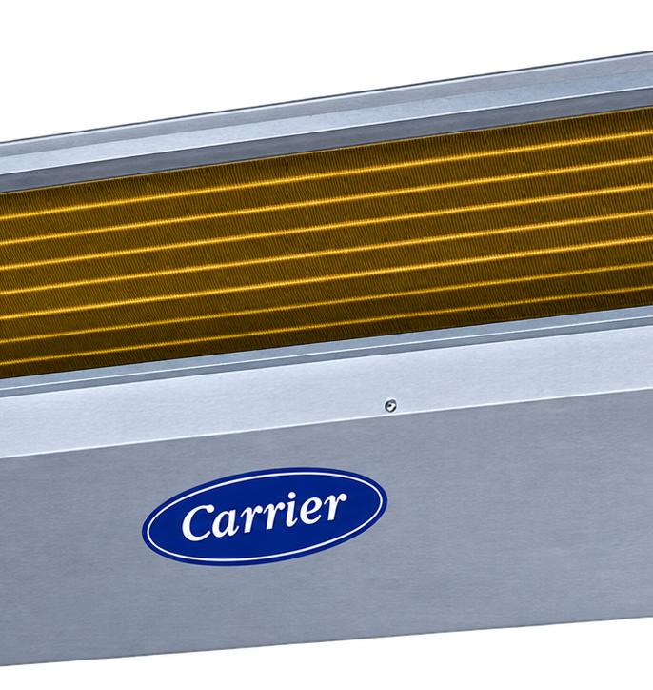
NAELEE
TECH
NEW AIR EGYPT
LUXURY ENGINEERING EXCELLENCE
MEP SOLUTIONS FOR VIP PROJECTS
NAELEE TECH delivers integrated engineering, HVAC, refrigeration, marine climate and luxury design solutions for demanding residential, commercial, industrial and marine environments.
OUR CORE FOCUS
• Luxury Engineering
• Refrigeration Solutions
• HVAC & Air Treatment
• Luxury Interior & Architectural Integration
• Marine Air Conditioning
• MEP Contracting & Construction
NAELEE TECH | NEW AIR EGYPT
01 / 04

Slide 2
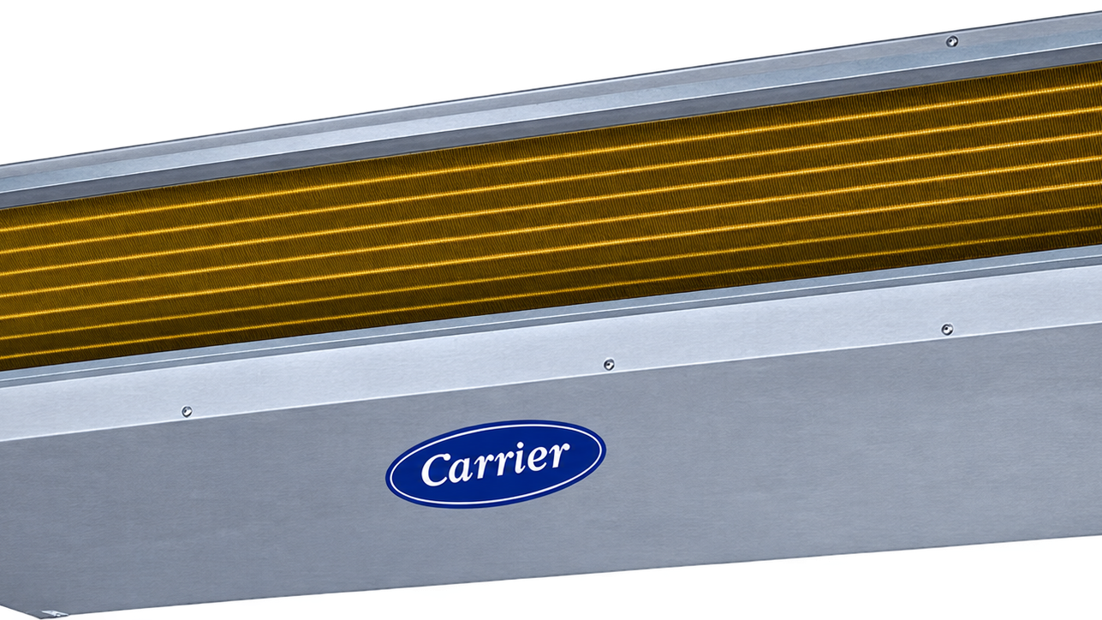
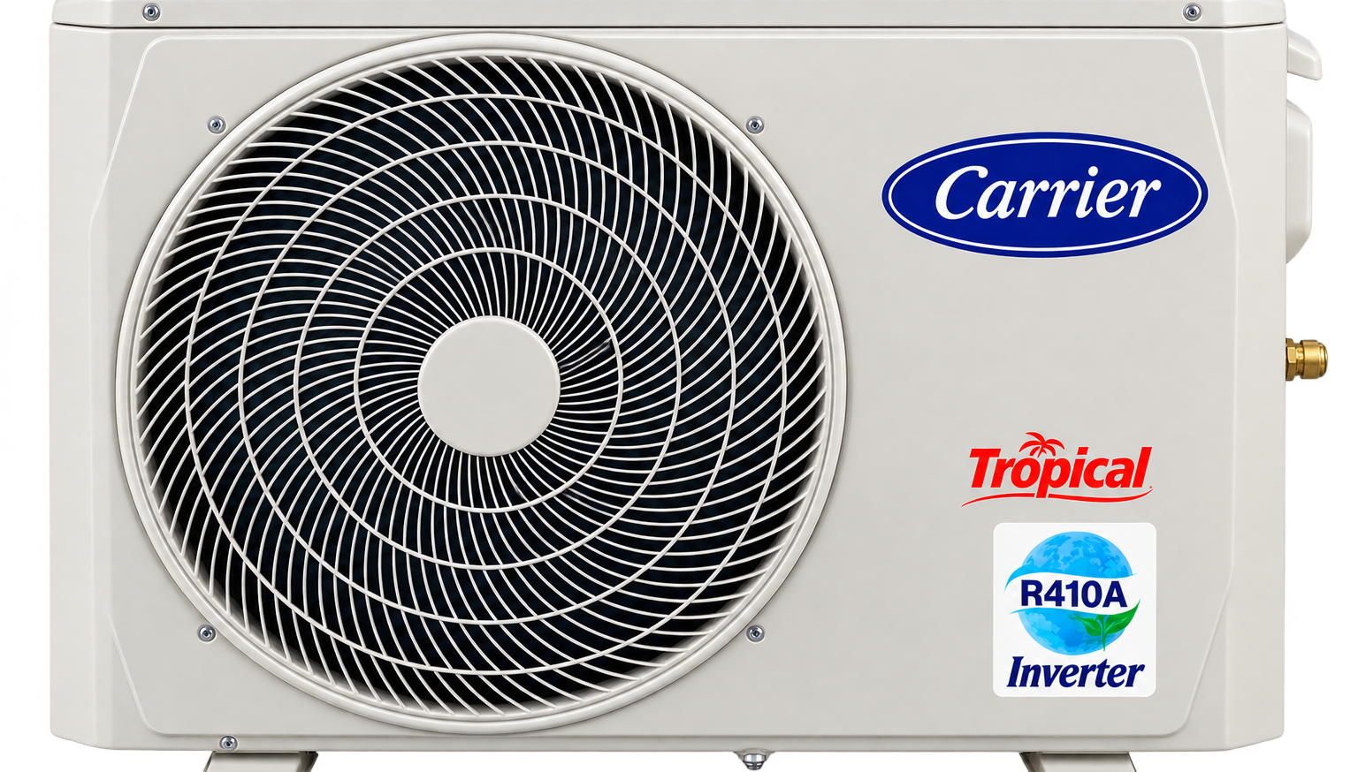
ENGINEERING & LUXURY DESIGN
ENGINEERING AIR TREATMENT
NEW AIR EGYPT
Precision climate engineering for residential, commercial and industrial environments, with system selection based on building use, capacity, comfort requirements and operating conditions.
NEW DESIGN
DESIGN
→
ENGINEERING
→
INSTALLATION
→
TESTING
→
COMMISSIONING
LUXURY NATURE
Luxury Nature combines engineering performance with biophilic design principles, integrating climate systems into architecture rather than treating them as an afterthought.
• Split, concealed and ducted systems for villas and palaces.
• Commercial central AC and ventilation solutions.
• Central AC systems for large facilities.
• Ventilation and fire-fighting integration.
• Industrial HVAC, humidification and air treatment.
• Cold rooms, cooling, freezing and processing.
• Biophilic design
• Luxury interiors
• Architectural integration
• Premium HVAC
• Sustainable luxury
• Quiet and visually integrated systems
NAELEE TECH | NEW AIR EGYPT
02 / 04

Slide 3
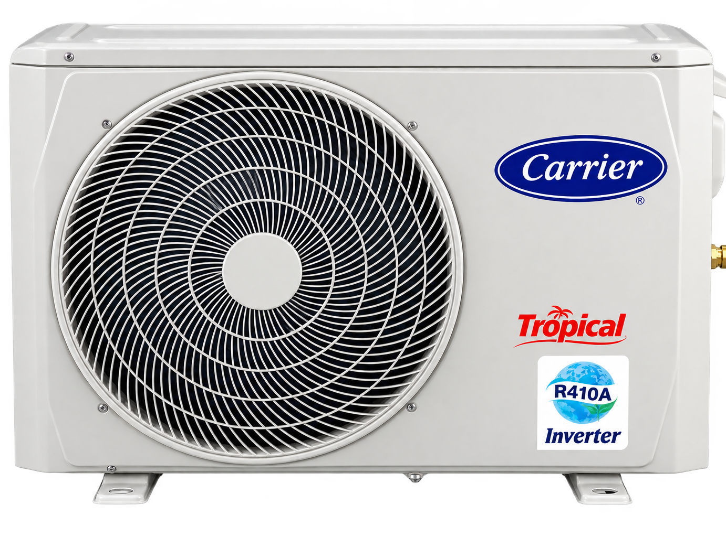
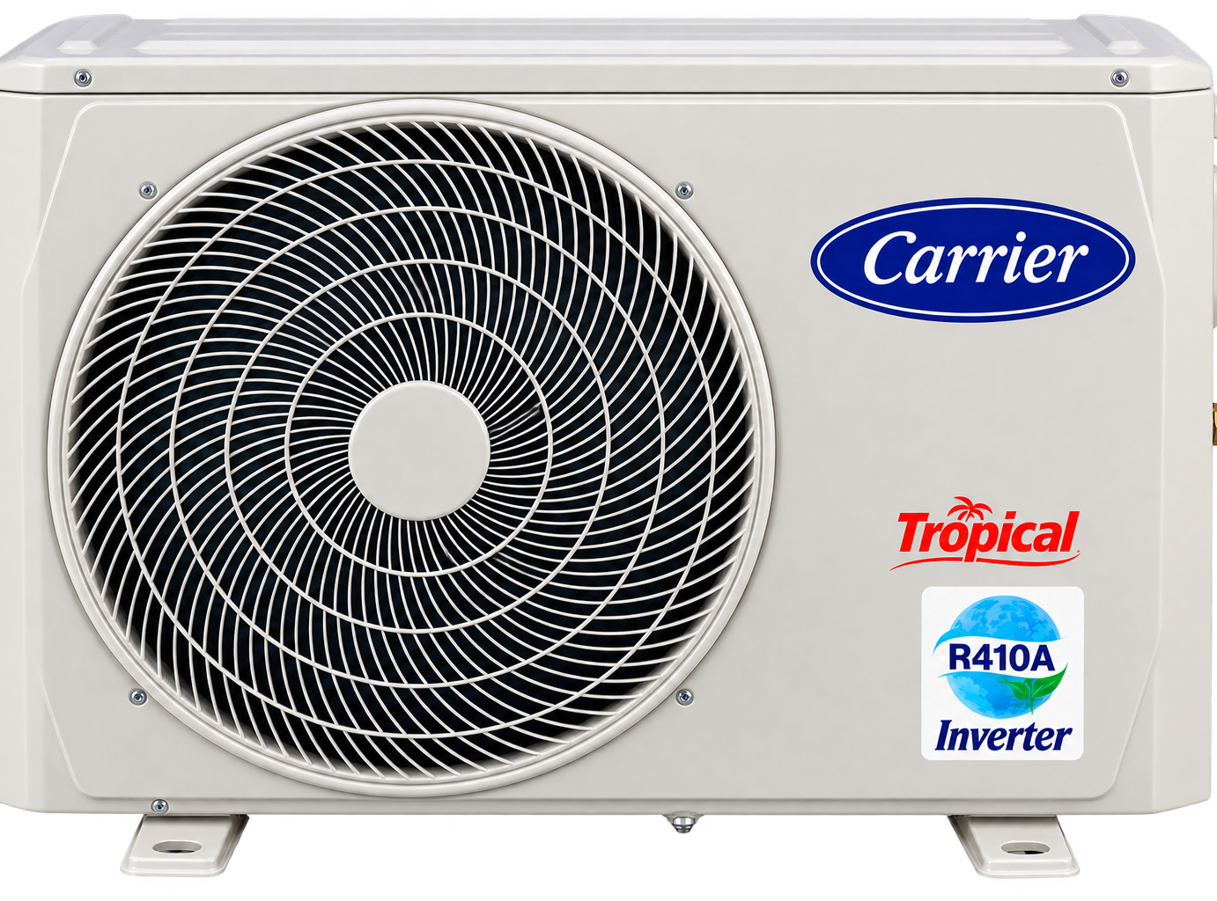
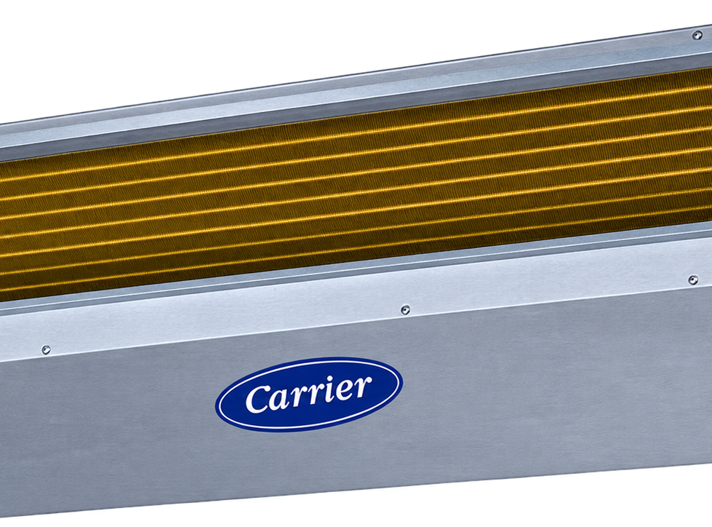
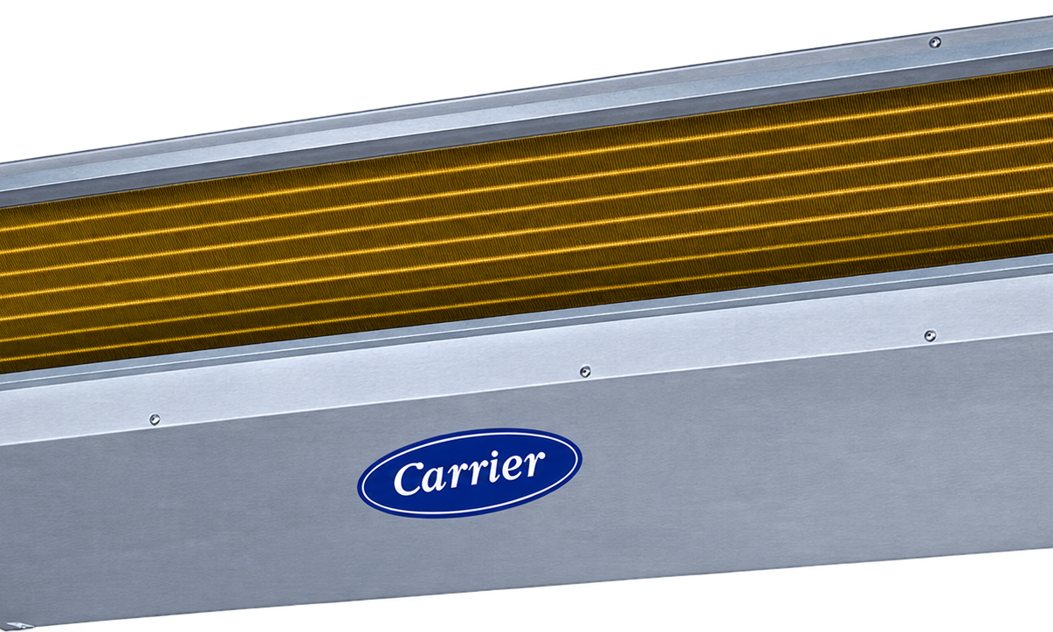
MARINE ENGINEERING & HVAC SOLUTIONS
HVAC & REFRIGERATION
NEW AIR WAVE
PARTS • EQUIPMENT • DIRECT SALES
MARINE AIR CONDITIONING
A product-focused division connecting customers with HVAC equipment and refrigeration components through technical product information, product selection and direct sales support.
Specialized marine climate engineering for environments affected by humidity, salt, vibration, limited space and demanding operating conditions.
HVAC EQUIPMENT
REFRIGERATION
AIR HANDLERS
• Marine AC for boats and fishing vessels.
• Luxury climate control for yachts and superyachts.
• Commercial vessel and offshore HVAC.
• Marine water treatment and fire-fighting.
• Soundproof generator solutions.
COMPRESSORS
VALVES
COILS
EXPANSION DEVICES
SPARE PARTS
INDUSTRIAL COMPONENTS
DISCOVER
COMPARE
SELECT
REQUEST
SUPPORT
NAELEE TECH | NEW AIR EGYPT
03 / 04

Slide 4
WHY NAELEE TECH
ENGINEERING EXCELLENCE. PREMIUM EXECUTION. INTEGRATED SOLUTIONS.
NAELEE TECH brings together engineering, climate technology, luxury design, marine solutions and HVAC products under one integrated professional platform.
OUR SOLUTION ECOSYSTEM
LUXURY DESIGN
MEP ENGINEERING
01 ENGINEERING EXCELLENCE
HVAC
MARINE CLIMATE
EXECUTIVE PORTRAIT
02 INNOVATION
REFRIGERATION
TECHNICAL SUPPORT
03 QUALITY
ENG. ESSAM A.A.A. KAMEL
04 TRUST
FROM CONCEPT TO EXECUTION — ENGINEERED FOR PREMIUM ENVIRONMENTS.
05 SUSTAINABILITY
www.naelee.tech
002-0122-321-8448 • info@naelee.tech
DISCOVER OUR SOLUTIONS | www.naelee.tech
NAELEE TECH | NEW AIR EGYPT
04 / 04

