Slide 1
PLC STUDY
Product Lifecycle Management in Amdocs CatalogONE
From idea to Dynamics 365: a catalog-only PLC that publishes into CRM
Prepared by: [Your name] | October 2026
Notes:
CatalogONE is the PLC. Dynamics 365 stays the CRM. Walk the manager through that split, then the eight stages, then the publish path.

Slide 2
Agenda
01
Why this PLC
02
PLC and TM Forum
Catalog only; CRM stays Dynamics
The industry lifecycle model
03
CatalogONE at a glance
04
Using the system
Modules and data model
Eight stages from idea to launch-ready
05
Publish to Dynamics 365
06
Evidence
How the product reaches the salesperson
Results at real operators
PLC study | Amdocs CatalogONE: from idea to Dynamics 365
2 / 17

Slide 3
Why this PLC: catalog only, CRM stays Dynamics
Catalog, not CRM
One source of truth
A governed journey
CatalogONE owns products, prices, rules and approvals. Dynamics 365 stays the sales, quote and order front end.
Commercial and technical definitions live once. Dynamics, ordering and billing consume them.
Ideation to end-of-life, with workflow, approvals, simulations and versioned change.
Business users configure
Publish, do not re-key
Proven results
Role-based UI, templates and building blocks. No code. No deployment overhead.
Master catalog + Kafka + TMF620 events push Active products into Dynamics.
European operator: 9 months to 1–2 weeks. Sprint / T-Mobile: expected 50% faster TTM.
PLC study | Amdocs CatalogONE: from idea to Dynamics 365
3 / 17
Notes:
Lead with the split the manager cares about: we keep Dynamics.

Slide 4
PLC and the TM Forum standard in brief
TMF620 defines the statuses. CatalogONE PLM runs them. Dynamics only sees Active / Launched.
Conception
approved
Design
approved
Test
approved
Start of
marketing
End of
marketing
In Study
In Design
In Test
Active
Launched
Retired
Idea studied
Being designed
Being tested
Ready, not yet sold
On sale
No new sales
Rejected (test KO)
Inside CatalogONE: defined, approved and tested
Dynamics 365: visible to sales
Amdocs is TM Forum-certified on TMF620. CatalogONE APIs use the TMF data model.
PLC study | Amdocs CatalogONE: from idea to Dynamics 365
4 / 17

Slide 5
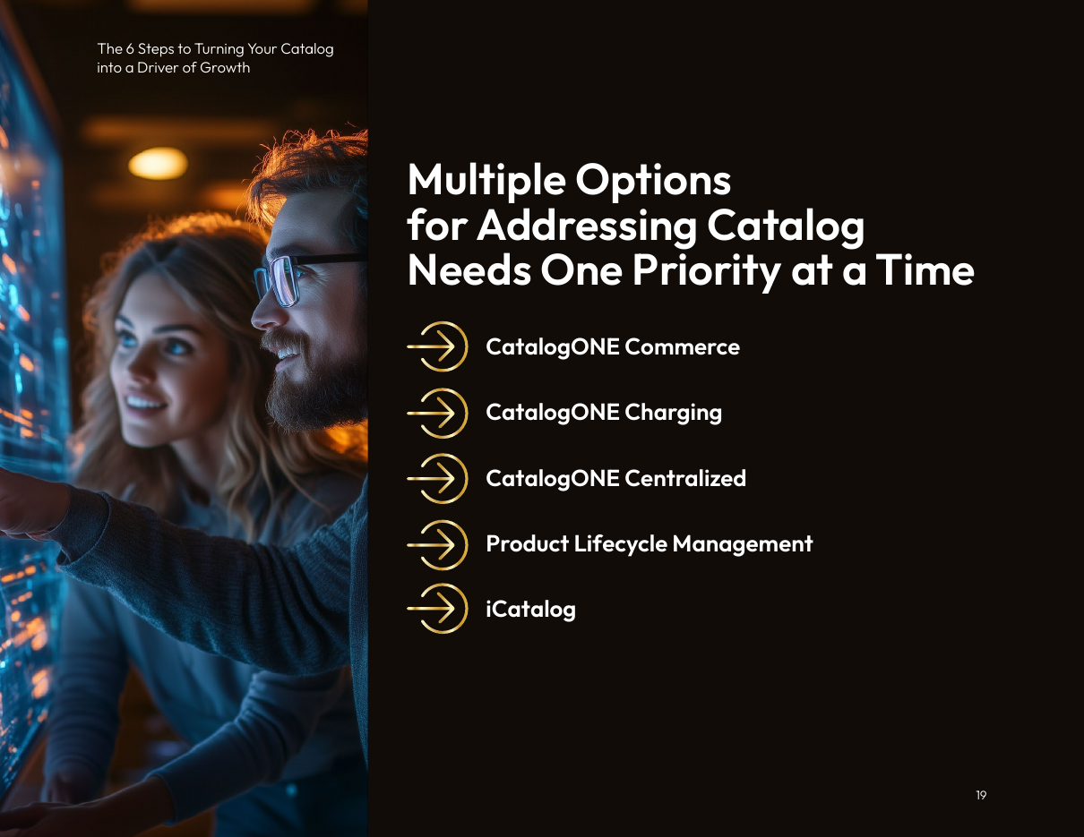
CatalogONE at a glance
Standalone telecom catalog + PLM. Modular. Does not replace Dynamics.
Module | Role
PLM | Ideation to end-of-life; approvals
Commerce | Offers, bundles, channels, segments
Centralized | Master catalog; publish downstream
Service / resource | Technical specs for delivery
Templates | Reusable telco building blocks
Federation | Partner catalogs via TMF APIs
iCatalog | KPI dashboards and recommendations
Charging (optional) | Rated usage — not required here
Source: Amdocs, 6 Steps ebook, p.19
PLC study | Amdocs CatalogONE: from idea to Dynamics 365
5 / 17

Slide 6
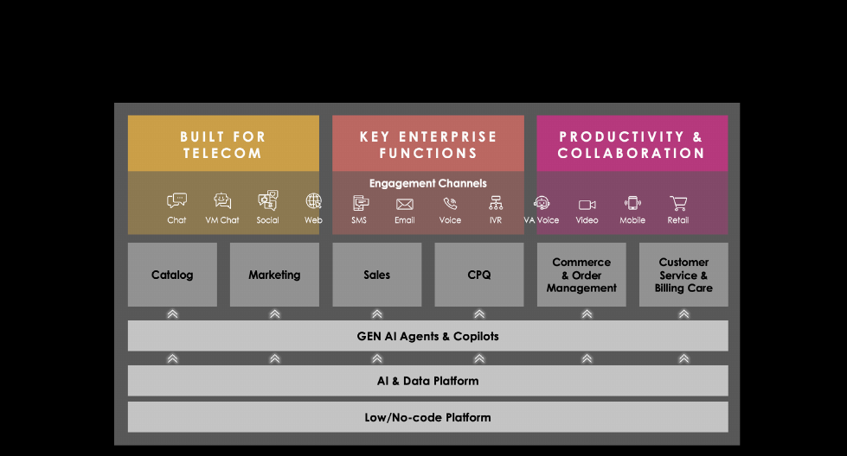
Catalog is a module of its own. Sales is Dynamics 365.
Amdocs–Microsoft Customer Engagement Platform: unified catalog + Dynamics CRM
Catalog (Amdocs)
Product lifecycle, offerings, prices, rules. Source of truth.
Sales (Dynamics 365)
Quotes, orders, account managers. Consumes the catalog.
Why it matters
CRM is not replaced. Approved products are published into it.
Source: Amdocs and Microsoft CEP paper, p.3
PLC study | Amdocs CatalogONE: from idea to Dynamics 365
6 / 17

Slide 7
Core data model, with one running example
TM Forum entities in CatalogONE, illustrated with "Business Internet 100"
Example (illustrative)
Product Specification
What it technically is
Dedicated Internet Access, 100 Mbps
Product Offering
What is sold (single or bundle)
"Business Internet 100" bundle
Product Offering Price
Prices attached to the offer
Monthly fee + installation per site
Channel / segment
Where and to whom it is sold
Enterprise AMs; SME and corporate
Product
What the customer owns after sale
Company X, 3 sites
"Business Internet 100" = 100 Mbps dedicated internet + static IPs + managed router + SLA, on 12 / 24 / 36-month contracts. Unrated enterprise product — Charging catalog is not required.
PLC study | Amdocs CatalogONE: from idea to Dynamics 365
7 / 17

Slide 8
Using the system (1/2): define the product
What the user does, stage by stage (screen names are illustrative)
Stage 1
Ideation & business case
Stage 2
Technical definition
Stage 3
Commercial offer
Stage 4
Pricing
In Study
In Design
In Design
In Design
Owner: Product Manager
Owner: Product Specialist
Owner: Product Manager
Owner: PM + Finance
Register "Business Internet 100 for SMEs"
Attach business case: segment, sites, revenue
Use iCatalog to size demand and cannibalisation
Reuse existing catalog items
Submit for conception approval
Open the service / resource catalog
Set bandwidth, access type, IP block
Add router, IP block, SLA specs
Expose them to the commercial catalog
Start the Commerce offer wizard
Bundle internet + IPs + router + SLA
Add optional add-ons
Place in the Enterprise catalog
Monthly fee and installation per site
Prices by contract term (12 / 24 / 36)
Multi-site discount, validity dates
Charging catalog is optional here
PLC study | Amdocs CatalogONE: from idea to Dynamics 365
8 / 17
Notes:
Evidence: role-based UI; Commerce wizard; iCatalog for ideation.

Slide 9
Using the system (2/2): control and release it
Rules, approvals, versions and testing decide when a product is ready
Stage 5
Rules & eligibility
Stage 6
Approval gates
Stage 7
Versioning
Stage 8
Testing & readiness
In Design
In Design to In Test
Any status
In Test to Active
Owner: Product Manager
Owner: Approvers
Owner: PM / Catalog admin
Owner: Test team / IT
Market: fibre-covered areas
Channel: enterprise account managers
Segment: SME, corporate
Constraints (backup link only on 24/36 months)
PM submits in PLM
Marketing, Finance, Legal, IT review
Approve or reject with comments
All approved: status moves to In Test
Never edit a launched product directly
Create a new version instead
New version re-runs approval and test
Auto-release publishes the new version
Release to sandbox
Test quotes and orders
Pass: Active, ready for Dynamics
Fail: Rejected or new version
PLC study | Amdocs CatalogONE: from idea to Dynamics 365
9 / 17

Slide 10
Approval gates: nothing reaches Dynamics by accident
Each status change is a decision, recorded with who approved it and why
Gate 1
Conception approved
Gate 2
Design approved
Gate 3
Test approved
Gate 4
Start of marketing
In Study to In Design
In Design to In Test
In Test to Active
Active to Launched
Question: Is the idea worth designing?
Approvers: Product Manager, Marketing, Finance
Question: Are offer, price, rules and terms right?
Approvers: Marketing, Finance, Legal / Regulatory, IT
Question: Does it work end to end?
Approvers: Test team, IT
Question: Go on sale on the planned date
Approvers: Product Manager
Gates and statuses: TMF620. CatalogONE PLM supplies workflow, approvals and notifications (KT: business users manage the offering lifecycle).
PLC study | Amdocs CatalogONE: from idea to Dynamics 365
10 / 17

Slide 11
Dynamics consumes the approved product. It never re-creates it.
CatalogONE is the source of truth. Dynamics 365 is the sales channel.
What gets published
CatalogONE
Commerce + PLM
Only Active products are published
Offering and bundle structure
Dynamics 365
Sales
Quote, order and contract use the catalog definition
Prices, discounts, contract terms
Eligibility: channel, segment, market
Dependencies and constraints
Validity dates (start / end of sale)
Status and version
Amdocs–Microsoft CEP: "unified Catalog, CPQ, Commerce and Order Management" plus "Dynamics 365 modules focused on sales, marketing, and customer service". CatalogONE Centralized publishes to consuming applications.
PLC study | Amdocs CatalogONE: from idea to Dynamics 365
11 / 17

Slide 12
How the hand-over works
Master-catalog publish + Kafka events + TM Forum Open APIs
Mechanism | Direction | What it does
CatalogONE Centralized | Catalog to Dynamics | Author once; publish offerings, prices, rules
Kafka distribution | Catalog to Dynamics | Sync approved versions in minutes, not weeks
TMF620 Product Catalog | Catalog to Dynamics | Read catalogs, offerings, prices, specifications
TMF620 events | Catalog to Dynamics | Notify on create / change / status change
TMF679 Qualification | Dynamics to catalog | "Can this customer get this offer here?"
TMF622 Product Ordering | Dynamics to order mgmt | Order carries offering ID and version
Product becomes Active
Kafka / TMF event
Dynamics reads TMF620
AM quotes in Sales
Order stores offer version
PLC study | Amdocs CatalogONE: from idea to Dynamics 365
12 / 17

Slide 13
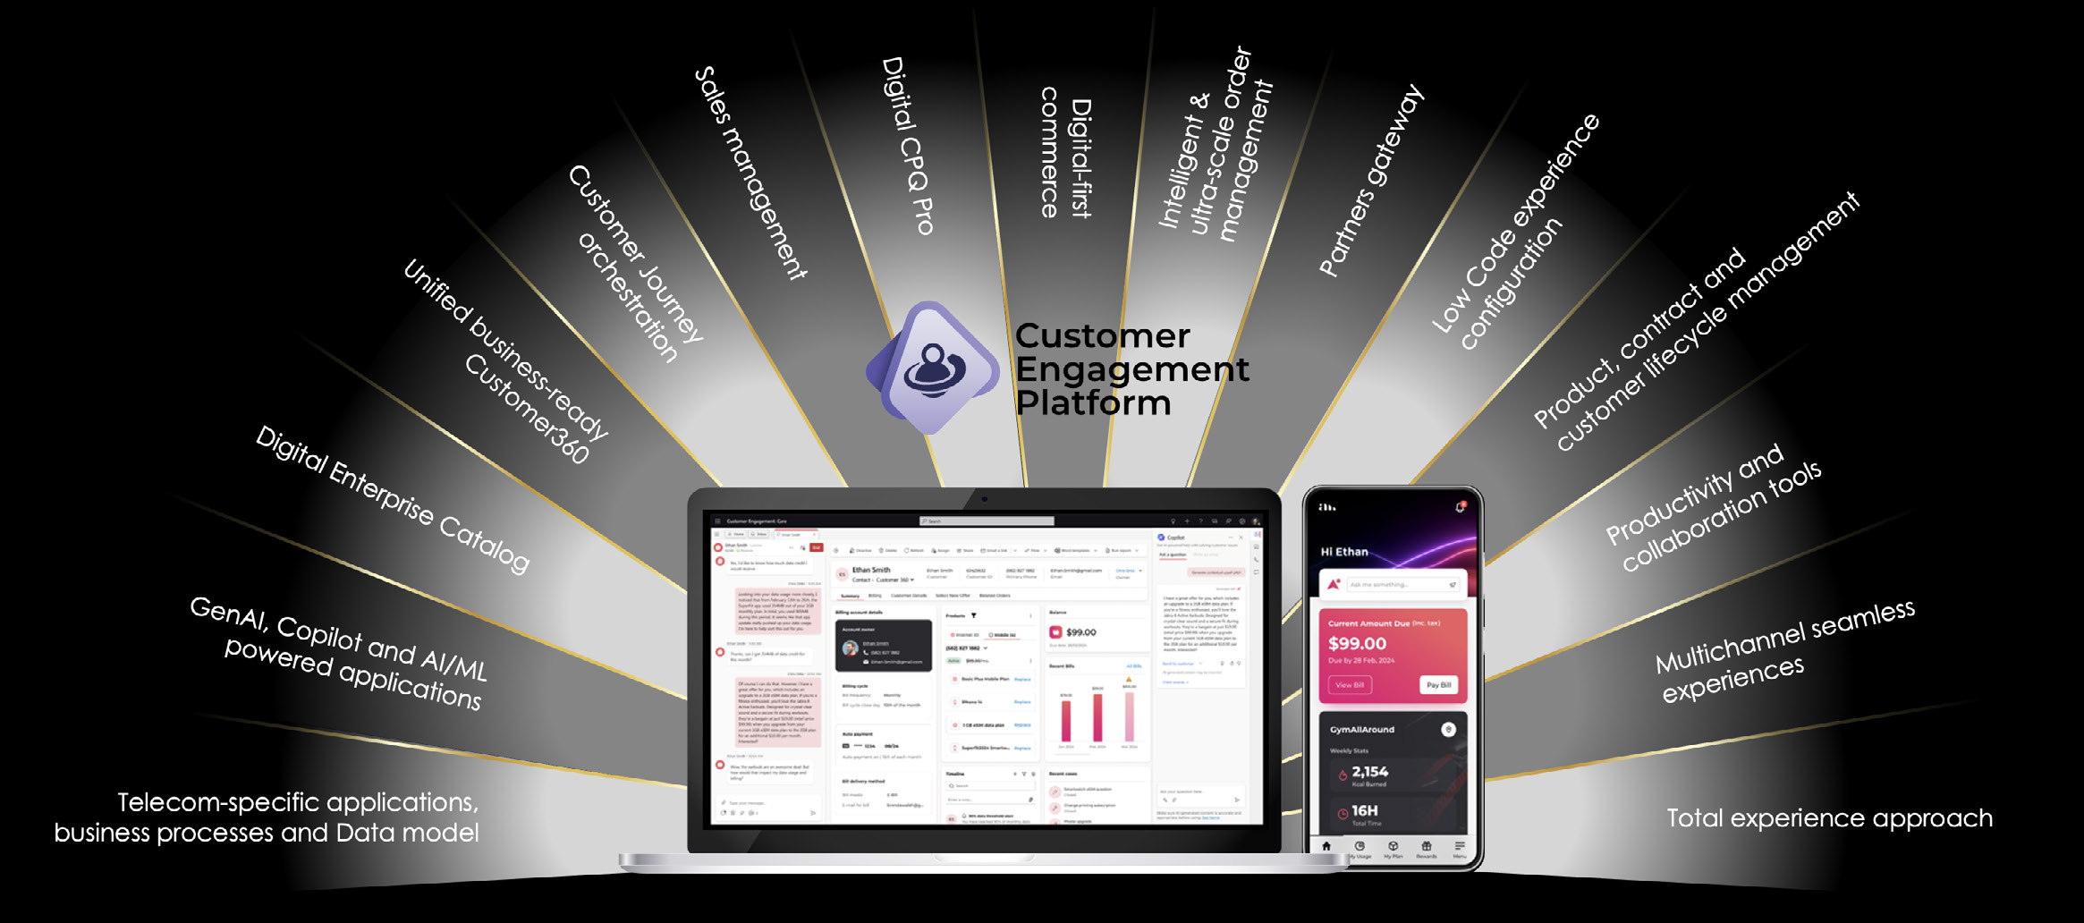
What sits around the catalog
Digital Enterprise Catalog (Amdocs) and Sales management (Dynamics) on one platform
Source: Amdocs and Microsoft Customer Engagement Platform paper, p.4
PLC study | Amdocs CatalogONE: from idea to Dynamics 365
13 / 17

Slide 14
When a product changes after launch
Versioning keeps sales and existing customers consistent
1
2
3
4
5
New version created
Approval and test
Event to Dynamics
New sales use v2
Old version retired
In CatalogONE, not in Dynamics
Same gates as a new product
New version becomes sellable
Existing customers keep v1
Disappears from sales screens
Why it works: every order records the offering ID and version, so delivery and billing always match what the customer bought.
Dynamics side: new version maps to Under Revision, then Active. Retired catalog versions are Retired in Dynamics and drop off the quote screen.
Result: a price or bundle change never breaks existing contracts.
PLC study | Amdocs CatalogONE: from idea to Dynamics 365
14 / 17

Slide 15
Mapping CatalogONE onto Dynamics 365 Sales
Study, design, test and approval stay in the catalog. Dynamics receives sellable products.
CatalogONE
TMF620 + Kafka
CEP / Dataverse
maps and syncs
Dynamics 365
product catalog
Pre-built in the Amdocs–Microsoft platform; not a custom CRM replacement
CatalogONE / TMF620 | Dynamics 365 Sales entity
Product Offering / Bundle offering | Product / Product bundle
Product Catalog / Category | Product family
Product Offering Price / Discounts | Price list item / Discount list
Related offers, add-ons | Product relationships (accessory, cross-sell, up-sell)
Status Active / Launched / Retired | Product status Active / Retired
Dynamics statuses are Draft, Active, Under Revision, Retired. Everything before Active stays in CatalogONE.
PLC study | Amdocs CatalogONE: from idea to Dynamics 365
15 / 17

Slide 16
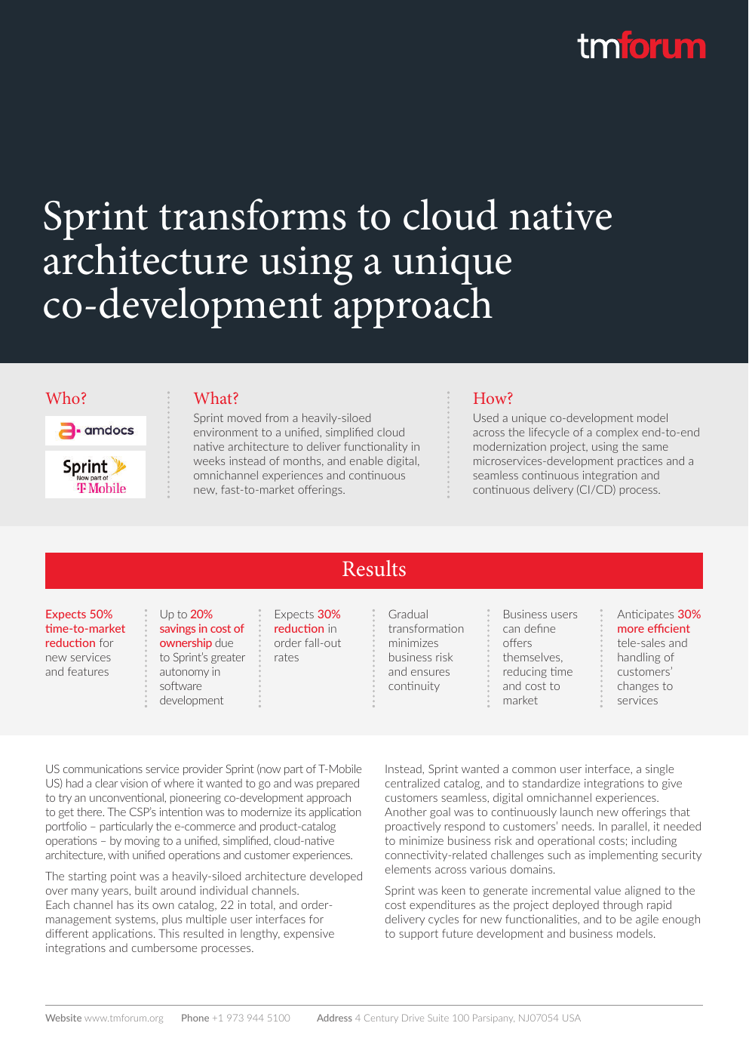
Evidence: results at real operators
European quad-play
CatalogONE unifying siloed LoBs
New offers: 9 months → 1–2 weeks. Changes in hours. 80% by configuration.
Sprint / T-Mobile US
CatalogONE + DigitalONE
Expected 50% TTM cut. 22 channel catalogs → one. Business users define offers.
KT Corporation
CatalogONE on KT private cloud
Business-driven UI; foundation to accelerate 5G consumer and enterprise offers.
Mtel (A1 Bulgaria), earlier Amdocs Master Enterprise Catalog: >80% faster TTM; complex offers idea-to-production in under three days (CTO quote).
Source: TM Forum, Sprint case study
PLC study | Amdocs CatalogONE: from idea to Dynamics 365
16 / 17

Slide 17
Summary and references
Idea to Active inside CatalogONE: eight stages, approval gates, versions, testing.
Active to Dynamics 365 through Centralized publish, Kafka and TMF620. The catalog stays the single source of truth.
CRM is not replaced. Sales, quotes and orders stay in Dynamics.
Rules and prices are enforced from the catalog, not re-typed.
Changes are versioned, so existing customers are never affected.
Proven at a European quad-play, Sprint / T-Mobile and KT.
References (full links in the document)
1. Amdocs CatalogONE datasheets (2025)
2. Amdocs, 6 Steps catalog ebook (2025)
3. Amdocs CatalogONE whitepaper (role-based UI)
4. Appledore Research, CatalogONE profile (2020)
5. Amdocs–Microsoft CEP paper and datasheet
6. Microsoft AppSource: Customer Engagement Platform
7. TM Forum Sprint / T-Mobile case study
8. Amdocs KT CatalogONE press release (Nov 2020)
9. TM Forum Open API conformance (Amdocs TMF620)
10. Microsoft Learn: Dynamics 365 product catalog
PLC study | Amdocs CatalogONE: from idea to Dynamics 365
17 / 17

