Slide 1
PLC STUDY · OPEN SOURCE
Product Lifecycle Management in DISCOBOLE
From idea to CRM — real screens, architecture and workflows
ODACAT Product Catalog · TM Forum ODA · OW2 GitLab | Prepared by: [Your name] · October 2026
Notes:
Open-source reference system. Every screenshot in this deck is from the official ODACAT UI.

Slide 2
Agenda
01
Why a PLC system
02
PLC and TM Forum in brief
What it gives an operator
The DISCOBOLE lifecycle
03
ODACAT at a glance
04
Using the system
Architecture, modules, data model
Eight stages, with the real UI
05
Integration with CRM
06
Evidence
How the product reaches the salesperson
Public code, docs and screens
PLC study | DISCOBOLE ODACAT (open source): from idea to CRM
2 / 17

Slide 3
Why a PLC system: what it gives an operator
One source of truth
A governed journey
Business users configure
Specifications, offerings, prices and policy rules are defined once. CRM and ordering read them.
inStudy → inDesign → inTest → active → launched. From active, a new version is required.
Guided cards in the Catalog Admin Portal. No development step to add an offer.
Rules travel with the product
Standard integration
Inspectable
Channel, market segment and ECA policy rules are evaluated at quote time.
TMF620, TMF701, TMF723, TMF679, TMF760, TMF622 — any CRM can consume the catalog.
Every screen, process-flow diagram and the Java source are public on OW2 GitLab.
PLC study | DISCOBOLE ODACAT (open source): from idea to CRM
3 / 17

Slide 4
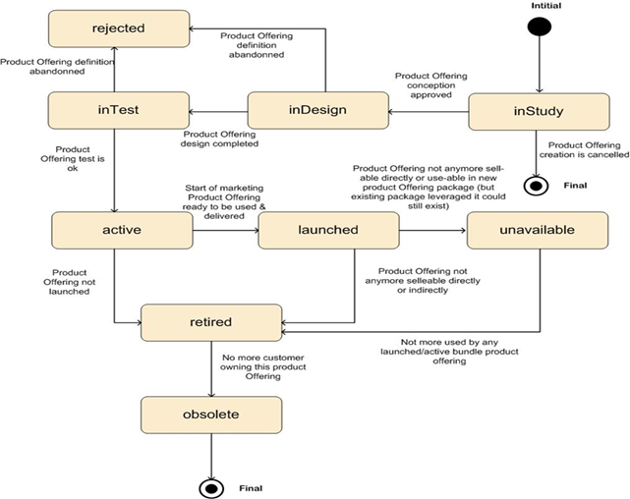
PLC and the TM Forum standard in brief
DISCOBOLE implements the TMF620 statuses with a dedicated Lifecycle Management process
inStudy / inDesign: the idea is being designed.
inTest: created in the UI; not yet sellable.
active: tested, ready to be used.
launched: start of marketing; CRM can sell it.
retired / obsolete: no new sales / no customers left.
Gate in the UI: lifecycle icon → system returns only the allowed next statuses.
Official DISCOBOLE Product Offering lifecycle
PLC study | DISCOBOLE ODACAT (open source): from idea to CRM
4 / 17

Slide 5
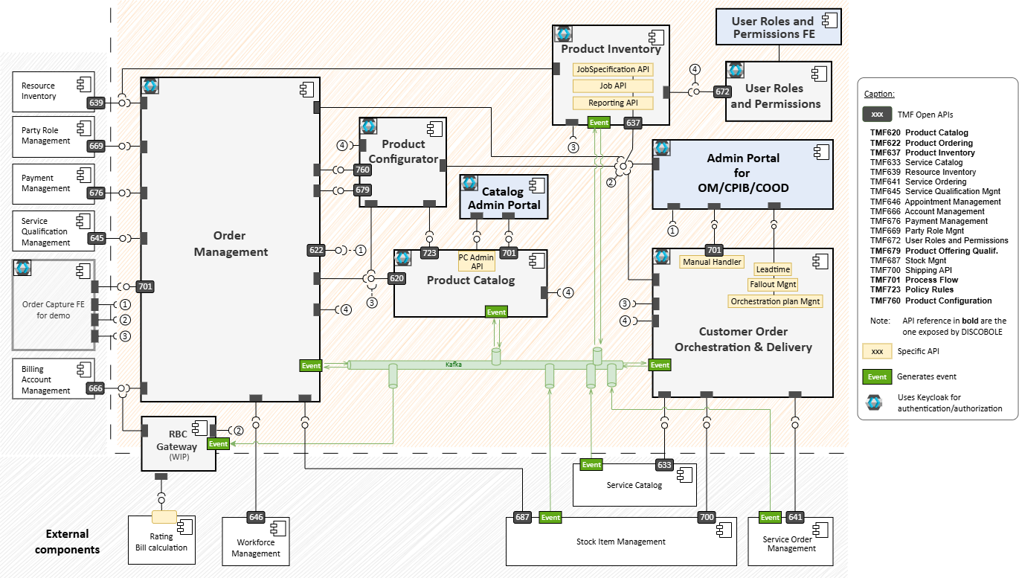
DISCOBOLE at a glance
Open-source ODA Core Commerce suite. Product Catalog (ODACAT) is the PLC.
Component | Role
ODACAT | Catalog + lifecycle
Configurator | Eligibility, discounts
Order Management | Capture & follow-up
COOD | Delivery orchestration
Product Inventory | What customers own
Roles (TMF672) | Who may approve
Admin Portal | The UI in this deck
Source: DISCOBOLE overall architecture. Bold API numbers are exposed by the suite.
PLC study | DISCOBOLE ODACAT (open source): from idea to CRM
5 / 17

Slide 6
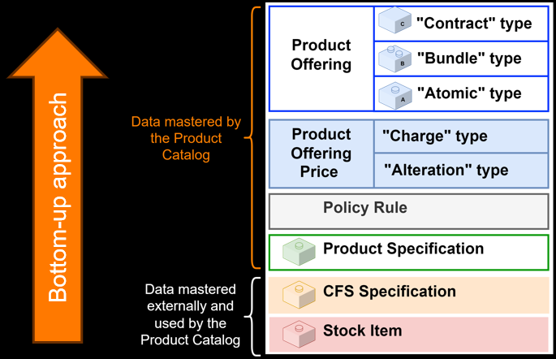
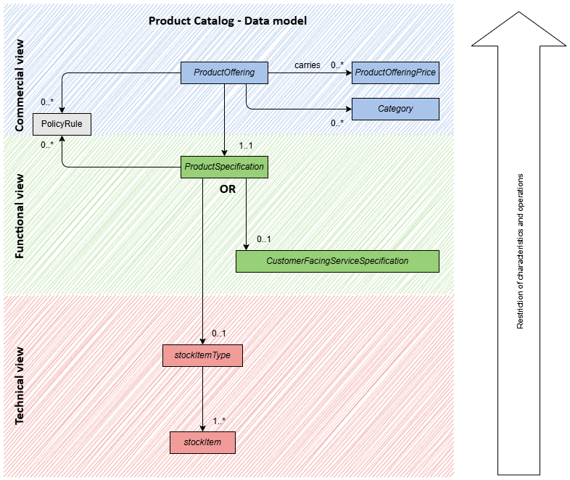
Bottom-up catalog: what the administrator builds
CFS and stock items are imported. Everything above them is mastered in ODACAT.
Official bottom-up approach
TMF620 data model: commercial / functional / technical
PLC study | DISCOBOLE ODACAT (open source): from idea to CRM
6 / 17

Slide 7
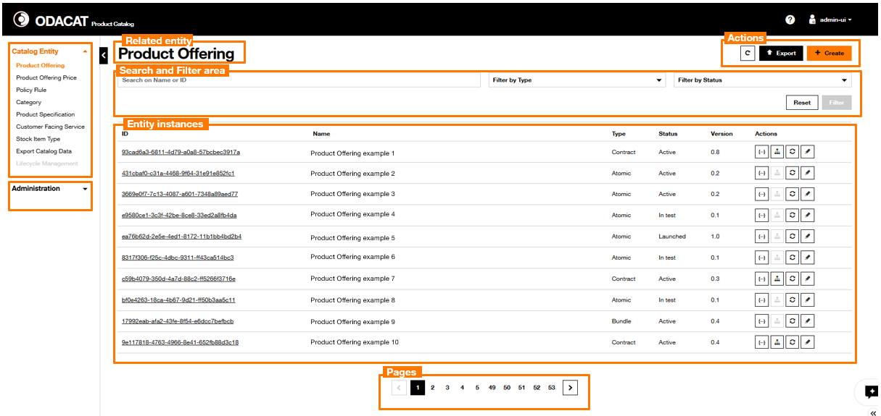
The Catalog Admin Portal — the real home screen
After login, the administrator works from one dashboard per entity
Left: Offering, Price, Policy Rule, Category, Product Specification, CFS, Stock, Lifecycle. Main: type, status, version, and actions (JSON, hierarchy, lifecycle, edit).
PLC study | DISCOBOLE ODACAT (open source): from idea to CRM
7 / 17

Slide 8
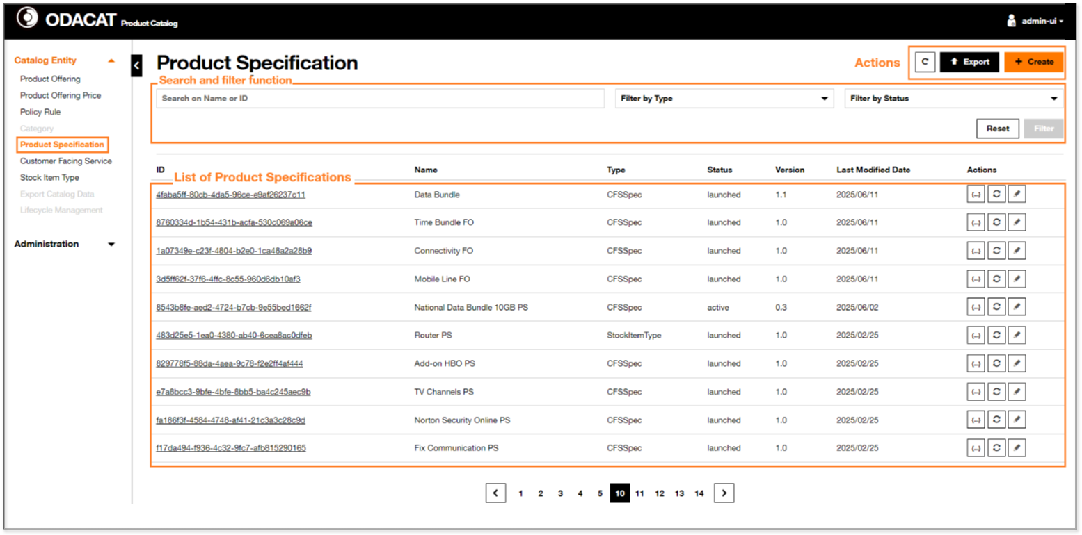
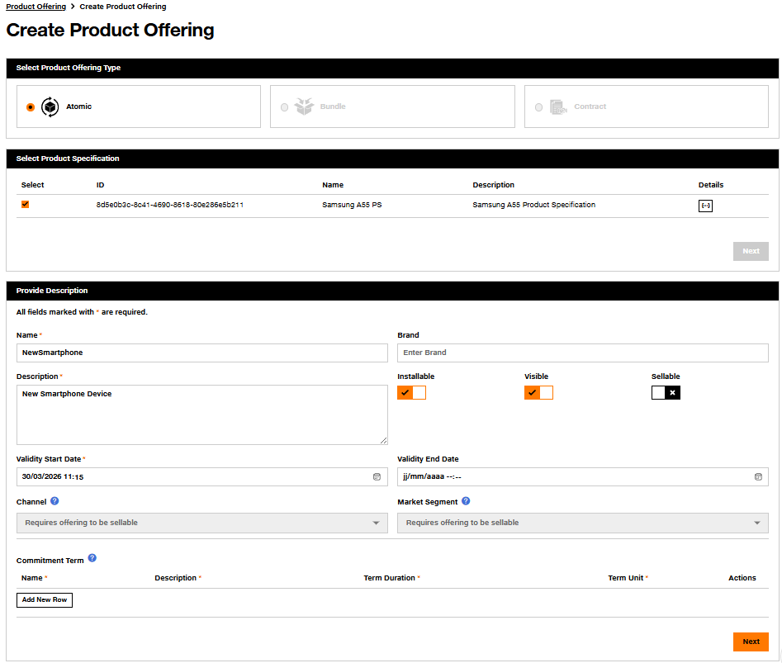
Using the system (1/2): define the product
Running example: Business Internet 100 — dedicated 100 Mbps + static IP + router + SLA
1. Product Specification. Restrict a CFS (internet) or Stock Item (router). Set characteristics (100 Mbps).
2. Product Offering. Atomic items, then a bundle, then the contract the customer signs.
Create Product Offering: Atomic / Bundle / Contract, Visible, Sellable, Channel, Market Segment, term
PLC study | DISCOBOLE ODACAT (open source): from idea to CRM
8 / 17

Slide 9
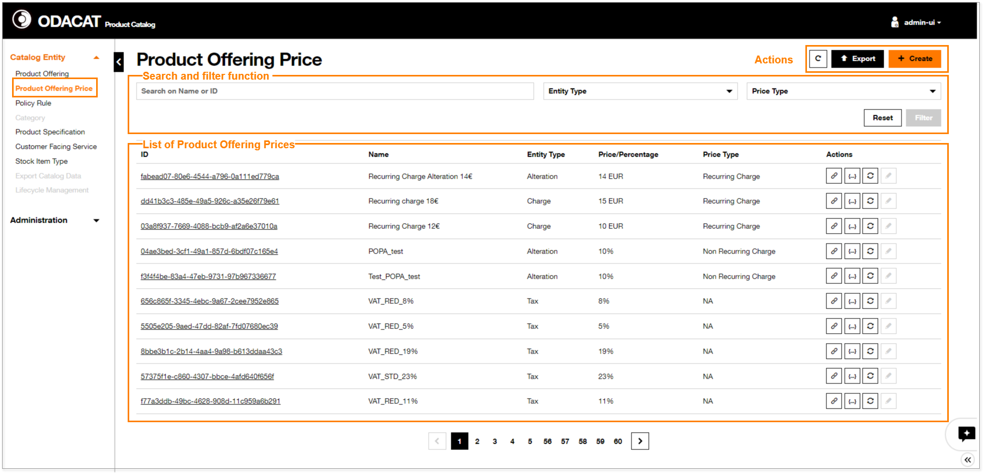
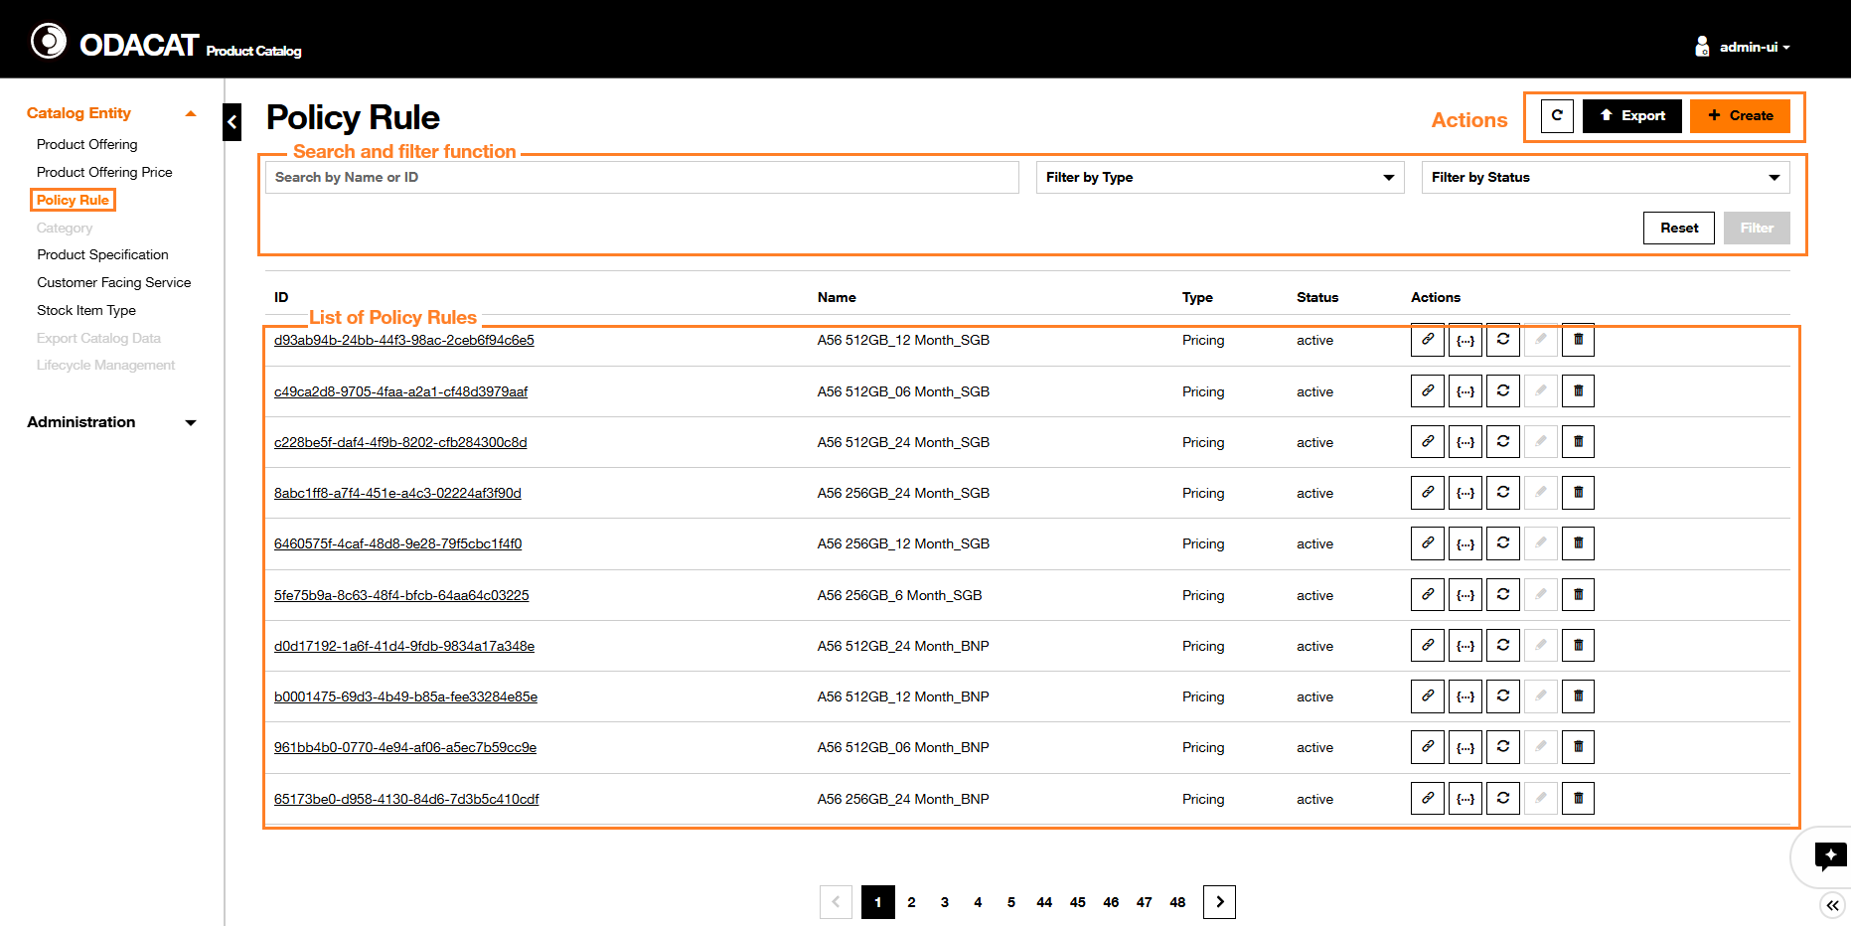
Using the system (2/2): price, rules, launch
Prices and policy rules stay in the catalog; sales never re-types them
3. Product Offering Price. Charge, Alteration (discount), Tax, Installment. Recurring monthly fee + one-time installation.
4. Policy Rule. Event–Condition–Action (TMF723). Example: 24-month term unlocks the backup-link add-on.
5. Lifecycle. inTest → active → launched. Sellable flag on. Only then does CRM see the offer.
PLC study | DISCOBOLE ODACAT (open source): from idea to CRM
9 / 17

Slide 10
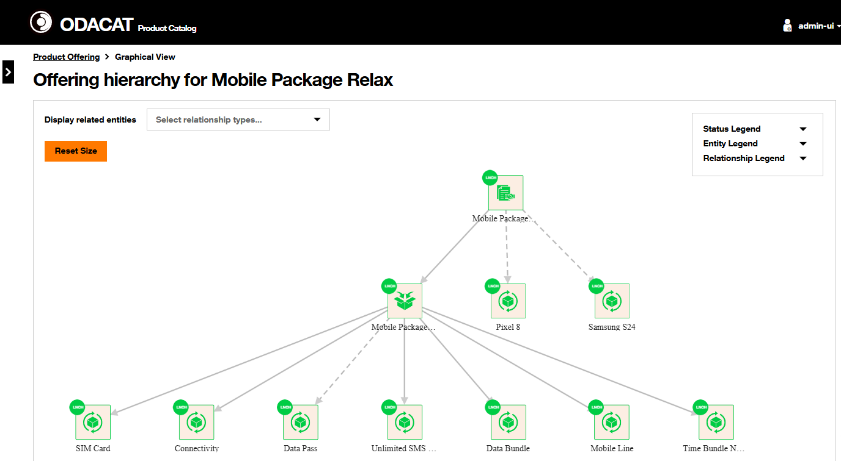
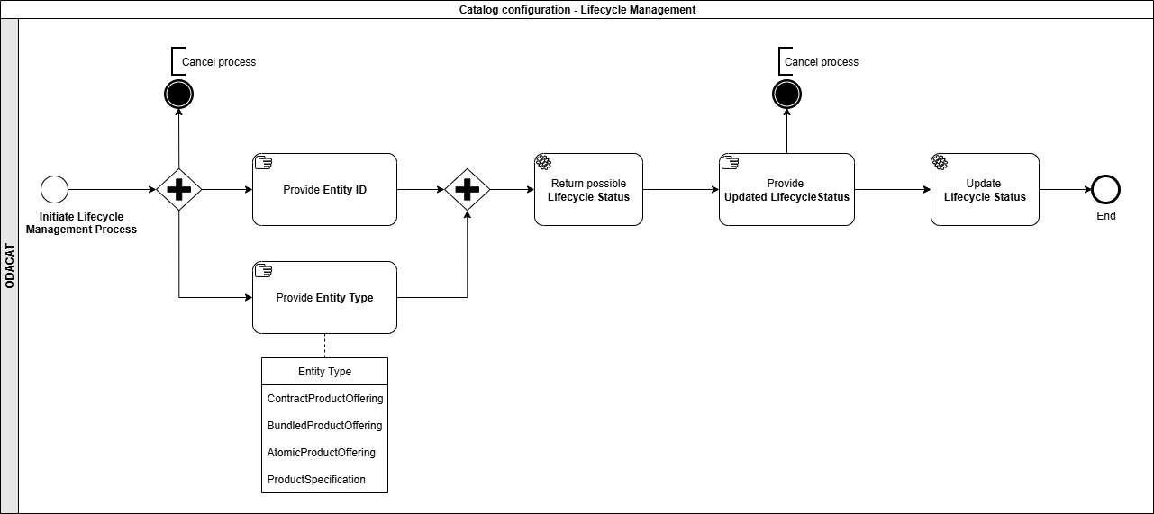
What a finished product looks like — and how its status moves
Lifecycle process: system returns allowed next statuses
Click the lifecycle icon on the dashboard.
Modal: current status + allowed targets.
Docs example: inTest → active.
Official example: contract hierarchy with lifecycle status on every node
PLC study | DISCOBOLE ODACAT (open source): from idea to CRM
10 / 17

Slide 11
Integration with CRM: the catalog is the single source of truth
Order capture consumes the approved product; it never re-creates it
What gets published
ODACAT
Product Catalog
Only launched + sellable offerings are published
CRM / Order Capture
Quote, order and contract use the catalog definition
Offering hierarchy (atomic / bundle / contract)
Prices, discounts, commitment terms
Channel, market segment, Sellable flag
Policy rules (ECA)
validFor dates
Status and version
TMF701 is how any front end — the admin portal or a CRM — is guided through create, modify and lifecycle. Kafka events keep Order Management, Inventory and the Configurator in sync.
PLC study | DISCOBOLE ODACAT (open source): from idea to CRM
11 / 17

Slide 12
How the hand-over works: TM Forum Open APIs
These are the APIs DISCOBOLE actually exposes (see architecture diagram)
API | Direction | What it does
TMF620 Product Catalog | Catalog → CRM / OM / Configurator | Read offerings, prices, specifications
TMF701 Process Flow | Any front end → catalog | Create, modify, clone, change lifecycle
TMF723 Policy Management | Catalog → Configurator | ECA rules at configuration time
TMF679 Offering Qualification | CRM → Configurator | Can this customer get this offer here?
TMF760 Product Configuration | CRM → Configurator | Allowed combinations and discounts
TMF622 Product Ordering | CRM / Order Management | Order carries offering id and version
Kafka events | Catalog → the suite | Create / change / status without polling
Offering launched
Event on Kafka
CRM reads TMF620
Configurator checks rules
Order refs version
PLC study | DISCOBOLE ODACAT (open source): from idea to CRM
12 / 17

Slide 13
What the salesperson inherits from the catalog
Channel, market segment and Sellable are defined on the offering, not in CRM
Sellable + Visible decide whether the offer appears in sales.
Channel / Market Segment are the same eligibility dimensions CRM will filter on.
Commitment Term 12 / 24 / 36 months — prices and policy can differ by term.
Policy rules are evaluated by the Configurator before a quote is submitted.
Hierarchy is what the salesperson sees as the contract plus add-ons.
Create Offering: Channel and Market Segment stay disabled until Sellable is on
PLC study | DISCOBOLE ODACAT (open source): from idea to CRM
13 / 17

Slide 14
When a product changes after launch
Live offerings are not edited in place
1
2
3
4
5
Clone or new version
inTest again
Re-approve
Event to CRM
Retire old
From launched: clone, or minor / major version
Version 0.1, name suffixed _CLONE
Prices, policy, lifecycle inTest → launched
New quotes use v2; existing orders keep v1
validFor end, or status retired
Version rules in the Lifecycle Management service: before active, edit in place; from active, a new version is required; rejected and obsolete are locked.
Minor (1.0 → 1.1): only the latest stays launched; the previous is retired via validFor.
Major (2.1 → 3.0): starts again in inStudy. Installed-base migration is a separate concern.
PLC study | DISCOBOLE ODACAT (open source): from idea to CRM
14 / 17

Slide 15
Example: connecting the catalog to Microsoft Dynamics 365
The same pattern applies to a CRM from another vendor
ODACAT
TMF620 + events
Integration layer
maps and syncs
Dynamics 365
Dataverse Web API
No ready-made connector; built on the published APIs
Catalog item (ODACAT / TMF620) | Dynamics 365 Sales entity
Atomic Product Offering | Product
Bundle / Contract Product Offering | Product bundle
Category | Product family
Product Offering Price / Alteration | Price list item / Discount list
reliesOn, add-ons | Product relationships
launched / retired | Active / Retired
inStudy, inDesign, inTest stay in ODACAT. Dynamics receives only launched, sellable offerings.
PLC study | DISCOBOLE ODACAT (open source): from idea to CRM
15 / 17

Slide 16
Evidence: why this system can be studied end to end
Real UI, documented click by click
Login, dashboards, create wizards, hierarchy graph, lifecycle modal — all in the public Catalog UI guide.
Process flows, not inferred
Create specification, create offering, create price, lifecycle: official BPMN-style diagrams.
Industry APIs, implemented
TMF620, TMF701, TMF723 in the catalog; TMF679, TMF760, TMF622 in the suite. Architecture diagram labels them.
Source you can clone
OW2 GitLab: Java 17, Spring Boot, Axon CQRS, Kafka, MongoDB, Keycloak. Designed as Orange's ODA catalog.
PLC study | DISCOBOLE ODACAT (open source): from idea to CRM
16 / 17

Slide 17
Summary and references
Idea to launched inside ODACAT: specification, offering, price, policy, lifecycle, version.
Launched to CRM through TMF620 + events. Configurator enforces the rules.
Prices and rules are not re-typed in the sales screen.
Changes are versioned, so existing customers keep what they bought.
The difference vs a closed vendor: every screen and the source are public.
References (full URLs in the document)
1. DISCOBOLE Product Catalog introduction
2. Catalog UI (login, dashboards, wizards)
3. Product Offering / Specification / Price / Policy UI
4. Overall architecture (lifecycle, processes, model)
5. Lifecycle Management service
6. DISCOBOLE suite architecture
7. OW2 GitLab: gitlab.ow2.org/discobole
8. TM Forum TMF620
9. Microsoft Learn: Dynamics 365 product catalog
PLC study | DISCOBOLE ODACAT (open source): from idea to CRM
17 / 17

