Slide 1
PLC STUDY
Product Lifecycle Management in Netcracker
From idea to CRM: how a telecom-grade PLC works
Prepared by: [Your name] | October 2026
Notes:
Purpose: walk through how a proven telecom PLC system takes a product from idea to the CRM, using Netcracker as the reference system.

Slide 2
Agenda
01
Why a PLC system
02
PLC and TM Forum in brief
What it gives an operator
The industry lifecycle model
03
Netcracker at a glance
04
Using the system
Modules and data model
Eight stages from idea to launch-ready
05
Integration with CRM
06
Evidence
How the product reaches the salesperson
Results at real operators
PLC study | Netcracker Product Management: from idea to CRM
2 / 17

Slide 3
Why a PLC system: what it gives an operator
One source of truth
A governed journey
Business users configure
Every product, price and rule is defined once. CRM, ordering and billing read it instead of keeping their own copies.
Fixed statuses and approval gates. Nothing reaches sales until it is approved and tested.
New offers are built from reusable templates and components, without development.
Rules travel with the product
Standard integration
Proven results
Eligibility by market, channel and customer category is enforced automatically when sales quotes.
The catalog is exposed through TM Forum Open APIs, so any CRM can consume it.
Zain KSA: 50% decrease in product development time.
PLC study | Netcracker Product Management: from idea to CRM
3 / 17
Notes:
These six points are what the rest of the presentation shows in practice.

Slide 4
PLC and the TM Forum standard in brief
TMF620 (Product Catalog Management) defines the statuses every catalog item goes through
Conception
approved
Design
approved
Test
approved
Start of
marketing
End of
marketing
In Study
In Design
In Test
Active
Launched
Retired
Idea studied
Being designed
Being tested
Ready, not yet sold
On sale
No new sales
Rejected (test KO)
Before CRM: defined, approved and tested inside the catalog
CRM: product is visible to sales
Netcracker is TM Forum-certified on TMF620 (June 2024), so its lifecycle follows this industry model.
PLC study | Netcracker Product Management: from idea to CRM
4 / 17

Slide 5
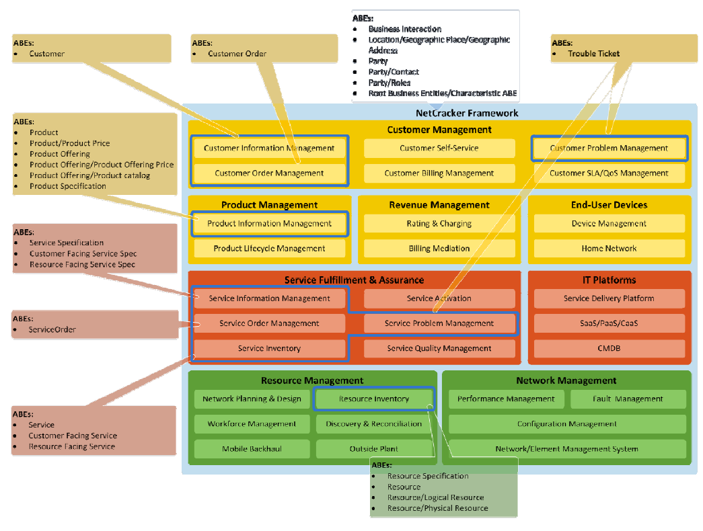
Netcracker Product Management at a glance
Two core components: Product Catalog + Product Lifecycle Management
Module | What it does
Product Lifecycle Mgmt | Concept to launch; versions; approvals
Product Offering Catalog | Offers, bundles, rules, prices
Technical Product Catalog | Specifications, delivery templates
Templates & components | Fast, reusable configuration
Pricing | Recurring, one-time, discounts, taxes
Business rules | Eligibility, dependencies, constraints
Catalog federation | Partner catalogs in one place
Open API layer | Exposes the catalog to CRM and others
Source: TM Forum SID certification report, Netcracker module map
PLC study | Netcracker Product Management: from idea to CRM
5 / 17

Slide 6
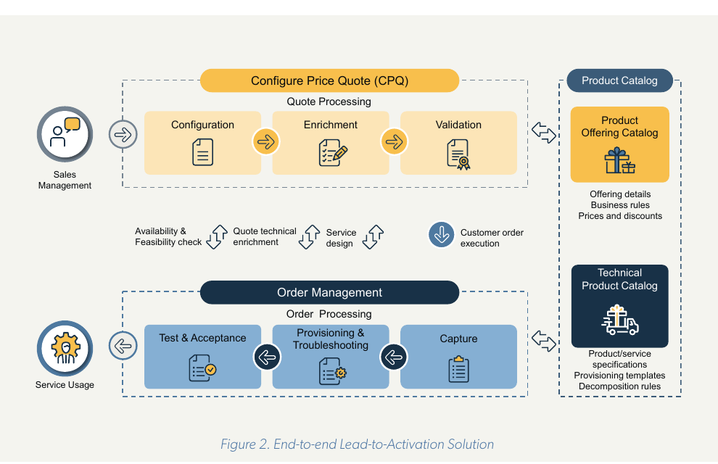
Commercial and technical catalogs
What is sold is kept separate from how it is delivered, and both feed sales and orders
Product Offering Catalog
The commercial view: offering details, business rules, prices and discounts.
Technical Product Catalog
The technical view: product and service specifications, provisioning templates and decomposition rules.
Why it matters
Marketing can create many offers on the same technical product without changing the network side.
Source: Netcracker CPQ whitepaper (2021), Figure 2
PLC study | Netcracker Product Management: from idea to CRM
6 / 17

Slide 7
Core data model, with one running example
TM Forum-certified entities in Netcracker, illustrated with "Business Internet 100"
Example (illustrative)
Product Specification
Dedicated Internet Access, 100 Mbps
What it technically is
Product Offering
"Business Internet 100" bundle
What is sold (single or bundle)
Product Offering Price
Monthly fee + installation per site
Prices attached to the offer
Product Catalog
Enterprise connectivity catalog
Grouping of offerings
Product
Company X, 3 sites
What the customer owns after sale
"Business Internet 100" = 100 Mbps dedicated internet + static IPs + managed router + SLA, on 12 / 24 / 36-month contracts.
PLC study | Netcracker Product Management: from idea to CRM
7 / 17

Slide 8
Using the system (1/2): define the product
What the user does in the system, stage by stage (screen names are illustrative)
Stage 1
Ideation & business case
Stage 2
Technical definition
Stage 3
Commercial offer
Stage 4
Pricing
In Study
In Design
In Design
In Design
Owner: Product Manager
Owner: Product Specialist
Owner: Product Manager
Owner: PM + Finance
Register the concept "Business Internet 100 for SMEs"
Attach business case: segment, sites, revenue
Use consumption analytics to size demand
Reuse existing catalog items
Submit for conception approval
Pick the "Dedicated Internet Access" spec
Set bandwidth, access type, IP block
Add router, IP block, SLA monitoring specs
Define decomposition: survey, install, configure
Create the offering from a template
Bundle internet + IPs + router + SLA
Add optional add-ons (extra IPs, backup link)
Place it in the Enterprise catalog
Monthly fee and installation per site
Prices by contract term (12 / 24 / 36)
Multi-site discount, taxes
Price validity period
PLC study | Netcracker Product Management: from idea to CRM
8 / 17
Notes:
Evidence: Netcracker PLM covers marketing concept, configuration, testing and launch; catalog covers specifications, offerings, bundles and pricing.

Slide 9
Using the system (2/2): control and release it
Rules, approvals, versions and testing decide when a product is ready
Stage 5
Rules & eligibility
Stage 6
Approval gates
Stage 7
Versioning
Stage 8
Testing & readiness
In Design
In Design to In Test
Any status
In Test to Active
Owner: Product Manager
Owner: Approvers
Owner: PM / Catalog admin
Owner: Test team / IT
Market: fiber-covered areas
Channel: enterprise account managers
Customer category: SME, corporate
Dependencies and constraints (backup link only on 24/36 months)
PM submits for design approval
Marketing, Finance, Legal / Regulatory, IT review
Approve or reject with comments
All approved: status moves to In Test
Never edit an approved product directly
Create a new version instead
New version re-runs approval and test
Old versions kept for audit
Deploy to test environment
Run test quotes and orders
Pass: Active, ready for CRM
Fail: Rejected or new version
PLC study | Netcracker Product Management: from idea to CRM
9 / 17

Slide 10
Approval gates: nothing reaches sales by accident
Each status change is a decision, recorded with who approved it and why
Gate 1
Conception approved
Gate 2
Design approved
Gate 3
Test approved
Gate 4
Start of marketing
In Study to In Design
In Design to In Test
In Test to Active
Active to Launched
Question: Is the idea worth designing?
Approvers: Product Manager, Marketing, Finance
Question: Are offer, price, rules and terms right?
Approvers: Marketing, Finance, Legal / Regulatory, IT
Question: Does it work end to end?
Approvers: Test team, IT
Question: Go on sale on the planned date
Approvers: Product Manager
Gates and statuses: TMF620 standard. Approver roles shown are an example set; they are configured per operator.
PLC study | Netcracker Product Management: from idea to CRM
10 / 17

Slide 11
Integration with CRM: the catalog is the single source of truth
CRM consumes the approved product; it never re-creates it
What gets published
Netcracker
Product Catalog + PLM
Only Active products are published
Offering and bundle structure
CRM
Sales quote, order and contract use the catalog definition
Prices, discounts, contract terms
Eligibility: market, channel, customer category
Dependencies and constraints
Validity dates (start / end of sale)
Status and version
Netcracker: the Product Catalog supports "sales, ordering and billing processes via industry-standard integration"; the lead-to-order process is "automated with a catalog-driven approach".
PLC study | Netcracker Product Management: from idea to CRM
11 / 17

Slide 12
How the hand-over works: TM Forum Open APIs
Standard interfaces between the catalog and the CRM
API | Direction | What it does | Netcracker
TMF620 Product Catalog | Catalog to CRM | CRM reads catalogs, offerings, prices, specifications | Certified
TMF620 events | Catalog to CRM | CRM is notified on create / change / status change; stays in sync | Part of TMF620
TMF679 Offering Qualification | CRM to catalog | "Can this customer get this offer here?" | TM Forum standard
TMF648 Quote Management | Within sales | Quotes built on catalog offerings and prices | Certified
TMF622 Product Ordering | CRM to order mgmt | Order carries offering ID and version | Certified
Product becomes Active
Event sent to CRM
CRM reads offer via TMF620
Salesperson quotes; rules checked
Order references offer version
PLC study | Netcracker Product Management: from idea to CRM
12 / 17

Slide 13
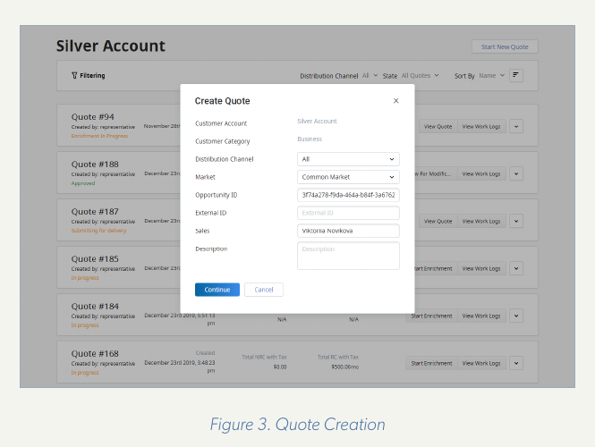
What the salesperson sees
A real Netcracker screen: the catalog drives the quote
Customer Category, Channel, Market: the same eligibility rules defined in Stage 5.
Only eligible offers appear for this customer.
Prices come from the catalog, so the quote always uses the approved price.
The offer is validated against catalog rules before the quote is submitted.
Source: Netcracker CPQ whitepaper (2021), Figure 3
PLC study | Netcracker Product Management: from idea to CRM
13 / 17

Slide 14
When a product changes after launch
Versioning keeps sales and existing customers consistent
1
2
3
4
5
New version created
Approval and test
Change event to CRM
New sales use v2
Old version retired
In the catalog, not in CRM
Same gates as a new product
New version becomes sellable
Existing customers keep v1
Disappears from sales screens
Why it works: every order records the offering ID and version, so delivery and billing always match what the customer bought.
Result: a price or bundle change never breaks existing contracts.
PLC study | Netcracker Product Management: from idea to CRM
14 / 17

Slide 15
Example: connecting the catalog to Microsoft Dynamics 365
The same pattern applies to a CRM from another vendor
Product catalog
TMF620 API
Integration layer
maps and syncs
Dynamics 365
Dataverse Web API
No ready-made Netcracker connector; built on standard APIs
Catalog item (TMF620) | Dynamics 365 Sales entity
Product Offering / Bundle offering | Product / Product bundle
Product Catalog / Category | Product family
Product Offering Price / Discounts | Price list item / Discount list
Related offers, add-ons | Product relationships (accessory, cross-sell, up-sell)
Status Active / Launched / Retired | Product status Active / Retired
Study, design, test and approval stay in the catalog; Dynamics receives only products ready to sell.
PLC study | Netcracker Product Management: from idea to CRM
15 / 17

Slide 16
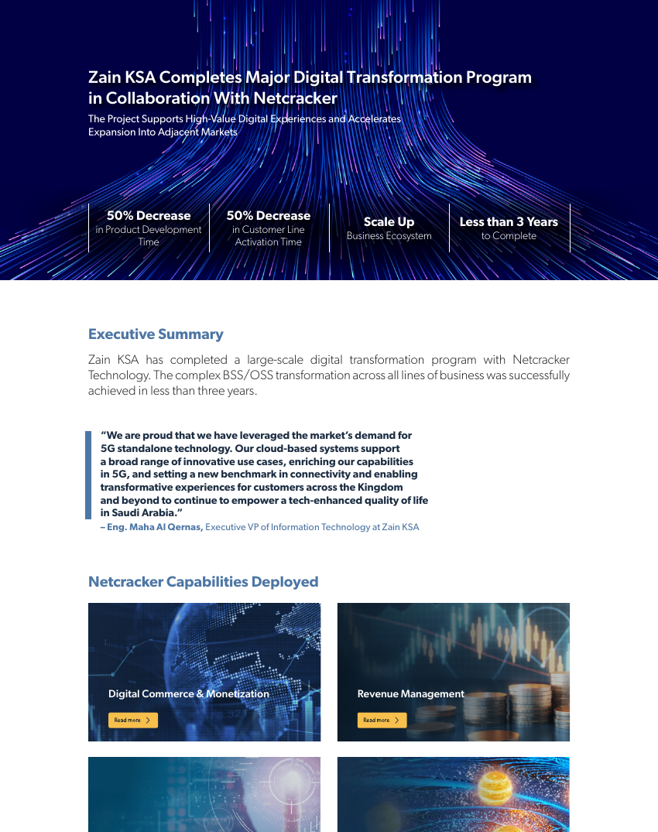
Evidence: results at real operators
Zain KSA
Full BSS/OSS including Product Catalog
50% decrease in product development time
T-Mobile Netherlands
Product Catalog + Product Lifecycle Management
Products managed "from development to production to retirement"; fewer incorrect offers
e& UAE
Full BSS including product catalog
"Groundwork for catalog-driven offers"
Source: Netcracker, Zain KSA case study
Sources: Netcracker case study and press releases with operator quotes.
PLC study | Netcracker Product Management: from idea to CRM
16 / 17

Slide 17
Summary and references
Idea to Active inside the catalog: eight stages, approval gates, versions, testing.
Active to CRM through standard APIs: the catalog stays the single source of truth.
Rules and prices are enforced in the sales screen, not re-typed.
Changes are versioned, so existing customers are never affected.
Proven at Zain KSA, T-Mobile Netherlands and e&.
References (full links in the document)
1. Netcracker Product Management (Product Catalog + PLM)
2. Netcracker Commerce Management
3. Netcracker CPQ whitepaper (2021), Figures 2 and 3
4. Netcracker Zain KSA case study
5. Netcracker T-Mobile Netherlands press release
6. Netcracker e& UAE press release (Oct 2023)
7. TM Forum SID certification report, Netcracker
8. TM Forum Open API conformance list (June 2024)
9. TM Forum TMF620 and TMF679 API specifications
10. Microsoft Learn: Dynamics 365 Sales product catalog
PLC study | Netcracker Product Management: from idea to CRM
17 / 17

