Slide 1

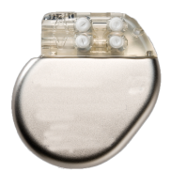

Heart 1
Pacemaker 1
Scenario 1
AS
AP
Pacemaker X
VS
VP
Heart N
Pacemaker N
Scenario N
AS
AS
VP
VP

