Slide 1

DATA ANALYTICS PROJECT
MTA Daily Ridership Data
Understanding public transport activity and recovery after COVID-19
Team 1
Abdalrahman Ashraf – Ali Abdaltawab – Ali Abdelaziz – Abdallah Hesham – Mohamed Mostafa
PROJECT PLANNING • REQUIREMENTS • DATA ANALYSIS
Source: MTA Daily Ridership dataset and data dictionary

Slide 2
01 • PROJECT OVERVIEW
Project at a glance
A data-driven look at daily activity across New York’s MTA transportation network.
1,706
15
4+ years
7
daily observations
columns in supplied CSV
Mar 2020 – Oct 2024
service / traffic measures
Core question
Project deliverables
How did ridership and traffic change over time, and how close did each service get to comparable pre-pandemic levels?
Data overview, data-quality checks, trend comparisons, stakeholder requirements, project risks, findings, and recommendations.
Scope note: the supplied CSV contains daily aggregate measures; it does not identify individual passengers.
MTA DAILY RIDERSHIP • 02

Slide 3
01 • PROJECT OVERVIEW
Project proposal: problem, objectives & scope
Define the problem and the boundaries of the analysis.
Problem statement
Objectives
Scope & exclusions
Daily counts are difficult to interpret without context. Services differ in scale, collection methods, and how they compare with pre-pandemic activity.
• Organize and inspect the dataset
• Compare service trends over time
• Review pre-pandemic comparisons
• Identify missing data and caveats
• Communicate findings clearly
Included: daily aggregate data, time-series trends, comparison percentages, and data-quality checks.
Excluded: individual passenger tracking and causal claims about why patterns changed.
Expected value: support informed discussion about service demand and recovery; provide a reproducible analysis foundation.
MTA DAILY RIDERSHIP • 03

Slide 4
02 • DATA UNDERSTANDING
Dataset & service coverage
Source: MTA Daily Ridership Data Overview, supplied CSV, and data dictionary.
Service / field group | What it represents
Subways | Estimated daily subway ridership
Buses | Estimated daily bus ridership
LIRR | Long Island Rail Road ridership
Metro-North | Metro-North Railroad ridership
Access-A-Ride | Scheduled trips as a demand indicator
Bridges & Tunnels | Preliminary total traffic volume
Staten Island Railway | Estimated daily railway ridership
Date coverage
1 Mar 2020 – 31 Oct 2024
Daily structure
One daily network snapshot per date
Coverage caveat
LIRR and Metro-North start later in the published dataset (from 1 Apr 2020).
MTA DAILY RIDERSHIP • 04

Slide 5
03 • PROJECT PLANNING & MANAGEMENT
Project plan & Gantt-style timeline
Illustrative four-week schedule — replace with the team’s actual dates.
Workstream | Week 1 | Week 2 | Week 3 | Week 4 | Milestone / deliverable
Scope & requirements | ● |  |  |  | Proposal + requirements
Data audit & cleaning |  | ● |  |  | Clean, validated dataset
Exploration & analysis |  |  | ● |  | Charts + key findings
Dashboard & presentation |  |  |  | ● | Final presentation
Key milestones
• M1 — Scope and success criteria agreed
• M2 — Data checks documented and issues reviewed
• M3 — Analysis outputs validated
• M4 — Presentation reviewed and rehearsed
MTA DAILY RIDERSHIP • 05

Slide 6
03 • PROJECT PLANNING & MANAGEMENT
Resource allocation & deliverables
Suggested planning assumptions; update to match what the team actually used.
Resource | Allocation / use | Expected output
People | 5 team members; assign one primary owner per workstream | Named responsibility matrix
Data | MTA Daily Ridership CSV + data dictionary | Documented source and field definitions
Software | Python / Jupyter, SQL engine, visualization tool, GitHub (as applicable) | Reproducible workflow
Time | Illustrative estimate: 8–10 hours per person per week | Work completed within schedule
Deliverable 1
Deliverable 2
Validated dataset and quality-check notes
Charts, interpretations, and final presentation
MTA DAILY RIDERSHIP • 06

Slide 7
03 • PROJECT PLANNING & MANAGEMENT
Task assignment: five-person team
Replace [Member 1–5] with names and adjust assignments to reflect actual contributions.
Team member | Primary responsibilities | Concrete deliverables
Mohamed Mostafa | Project coordination; proposal; scope; timeline; final integration | Project proposal, timeline, meeting / progress notes
Abdalrahman Ashraf | Dataset understanding; data dictionary; source definitions; stakeholder requirements | Dataset overview, stakeholder analysis, requirements list
Abdallah Hesham | Data cleaning; missing values; duplicates; data types; validation checks | Data-quality checklist, cleaning log, validation summary
Ali Abdelaziz | Exploratory analysis; time trends; pre-pandemic comparisons; chart design | Analysis charts, metric definitions, key findings
Ali Abdaltawab | Recommendations; limitations; presentation design; rehearsal and Q&A coordination | Recommendations, slide consistency, speaker notes / Q&A
Shared responsibility: all members review calculations, verify claims, and prepare to explain the full project.
MTA DAILY RIDERSHIP • 07

Slide 8
03 • PROJECT PLANNING & MANAGEMENT
Roles, risks & mitigation plan
Suggested structure; confirm ownership with the team.
Risk | Potential impact | Mitigation / response | Owner
Missing or revised figures | Misleading summaries | Document caveats; recheck source release notes | Member 3
Unfair comparisons | Wrong conclusions across services | Compare matching months and day types | Member 4
Overclaiming causality | Unsupported explanations | Describe patterns; do not claim cause from trends alone | Member 1 + 4
Time pressure | Incomplete deliverables | Prioritize core outputs; check progress weekly | Member 1
Inconsistent definitions | Confusing interpretation | Use data dictionary; label units and sources | Member 2
Risk status should be reviewed at each milestone; update the owner column to match the final task table.
MTA DAILY RIDERSHIP • 08

Slide 9
03 • PROJECT PLANNING & MANAGEMENT
KPIs & project success criteria
Use measurable checks rather than vague statements of success.
Completeness
Missing values and affected fields reported
Accuracy
Key summaries cross-checked against source data
Clarity
Each chart has one main takeaway and clear labels
Reproducibility
Steps, definitions, and transformations documented
Timeliness
Milestones and presentation completed on schedule
Success is demonstrated by documented checks and traceable outputs—not by chart appearance alone.
MTA DAILY RIDERSHIP • 09

Slide 10
04 • REQUIREMENTS GATHERING
Stakeholder analysis & needs
Identify who uses the analysis and what they need from it.
Stakeholder | Likely need | How the project supports it
Transit planners / operations | Understand changes in service demand | Time trends and comparable-period summaries
Public officials / policy teams | Clear, defensible evidence | Traceable metrics and visible caveats
Researchers / students | Understand dataset structure and limitations | Field definitions and reproducible methodology
Journalists / public users | Interpret figures responsibly | Plain-language labels and source notes
MTA data users | Compare service activity over time | Service-level filters and comparisons
Stakeholder needs above are inferred from the dataset’s public purpose; validate them with actual project stakeholders when possible.
MTA DAILY RIDERSHIP • 10

Slide 11
04 • REQUIREMENTS GATHERING
Functional & non-functional requirements
Functional requirements define what the analysis does; non-functional requirements define its quality.
Functional requirements
Non-functional requirements
FR1 — Load the daily CSV and data dictionary
FR2 — Filter and summarize by date and service
FR3 — Compare daily activity over time
FR4 — Display pre-pandemic comparison percentages
FR5 — Flag missing data and explain caveats
NFR1 — Calculations must be accurate and traceable
NFR2 — Charts must be readable and labeled
NFR3 — Workflow should be reproducible
NFR4 — Definitions and limitations must be clear
NFR5 — Analysis should run efficiently for a classroom demonstration
Acceptance criterion: every chart states units, date coverage, source, and known caveats.
MTA DAILY RIDERSHIP • 11

Slide 12
04 • REQUIREMENTS GATHERING
User stories & use cases
Example user stories derived from the dataset’s purpose.
As a planner…
As a researcher…
As a public user…
I want to compare service activity across dates so I can spot changes in demand.
I want comparable pre-pandemic percentages so I can contextualize current activity.
I want clear definitions and caveats so I can interpret values responsibly.
PRIMARY USE CASE
Input: daily MTA dataset → Action: choose a service and time period → Output: trend chart + comparison context → Use: identify patterns for further investigation
Scope boundary: aggregate trend analysis only; no individual journey tracking.
MTA DAILY RIDERSHIP • 12

Slide 13
05 • DATA PREPARATION
Data quality & methodology
Quality checks should preserve source meaning instead of hiding uncertainty.
Step | Check / action | Why it matters
1 | Parse Date as a date field | Enables reliable time-series analysis
2 | Convert numeric measures safely | Avoids text values being treated as numbers
3 | Check duplicate dates and date gaps | Confirms daily coverage and uniqueness
4 | Profile missing values by column | Separates missing from zero
5 | Inspect unusual values and sudden changes | Flags possible anomalies or revisions
6 | Keep a transformation log | Makes the workflow reproducible
Do not silently replace missing values with zero; missing can mean unavailable or inapplicable.
MTA DAILY RIDERSHIP • 13

Slide 14
05 • DATA PREPARATION
Source caveats & comparison methodology
Keep definitions visible when interpreting service measures.
Source caveats
Pre-pandemic comparison
• Subway counts use MetroCard and OMNY taps/swipes
• Some bus figures were model-estimated during 2020
• Rail ridership is estimated from ticket sales
• Access-A-Ride measures scheduled trips
• Recent figures may be revised
The MTA comparison uses 2019 monthly average ridership for the same day type (weekday, Saturday, Sunday/holiday) and equivalent month.
The methodology was updated in February 2023.
A published daily estimate may differ from official totals reported elsewhere by the MTA.
Counts are service-specific measures and should not be added together as if they were one uniform passenger total.
MTA DAILY RIDERSHIP • 14

Slide 15
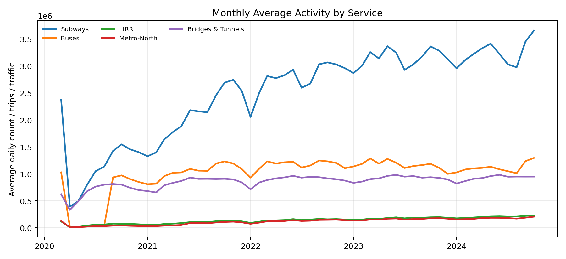
06 • FINDINGS
Read the chart
Exploratory analysis: trends over time
Look for broad changes over time, not explanations of cause.
Monthly averages can smooth daily volatility; services operate at different scales.
Scale matters
Subway and bus volumes are much larger than some other services; separate scales may be needed.
Next step
Chart placeholder
Insert your verified monthly trend chart(s) here. Label axes, units, date coverage, and source.
Compare the same months and day types before drawing operational conclusions.
Do not infer causation from a trend alone.
MTA DAILY RIDERSHIP • 15

Slide 16
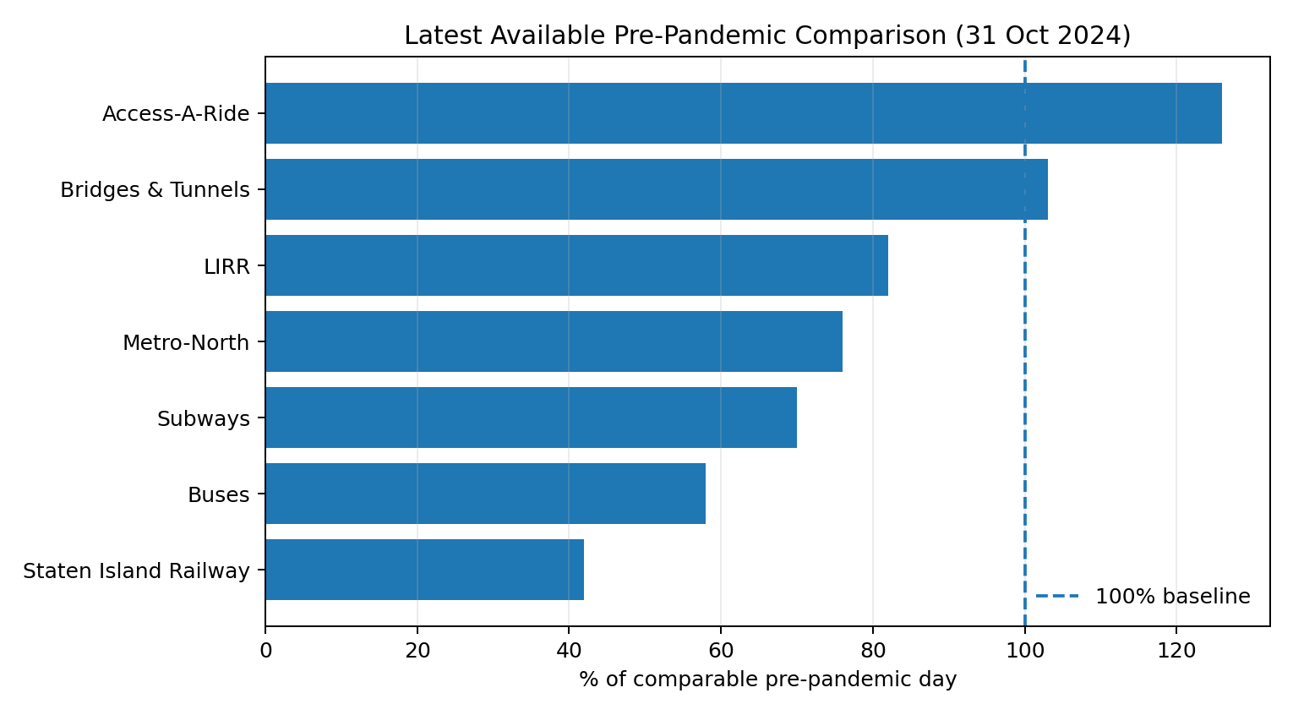
06 • FINDINGS
Subways
Pre-pandemic comparison
Latest row in supplied file: 70% of comparable pre-pandemic level.
Percentages compare each service with a comparable pre-pandemic day; 100% is the reference level.
Buses
Latest row in supplied file: 58% of comparable pre-pandemic level.
Interpretation
Above 100% means the measure exceeds its reference level.
Important date note
The latest row in the supplied file is 31 Oct 2024. It is not necessarily today’s live MTA data.
Verify these percentages against the supplied CSV before presenting; refresh if your working file differs.
MTA DAILY RIDERSHIP • 16

Slide 17
06 • FINDINGS
Data quality: audit results & validation
Report observed checks separately from recommended checks.
Observed audit
Recommended handling
Validation checks
The current draft reports no missing values in selected service fields.
Keep missing distinct from zero; report coverage by service and time period.
Check duplicate dates, date gaps, negative counts, and sudden jumps.
Evidence to include
Add the actual null-count table, duplicate-date result, and any corrections made during cleaning.
Only report '0 missing values' if you have re-run and confirmed the audit on the final dataset.
MTA DAILY RIDERSHIP • 17

Slide 18
07 • LITERATURE REVIEW & EVALUATION
Source review, feedback & suggested improvements
This is a project-focused review of supplied source documentation, not a systematic academic literature search.
What the source provides
Evaluation questions
Suggested improvements
• Publicly documented dataset
• Daily estimates across services
• Pre-pandemic comparison measures
• Data dictionary and collection notes
• Caveats about revisions
• Are service definitions consistent?
• Are missing values explained?
• Are comparisons fair across day types?
• Are charts easy to interpret?
• Are claims traceable to source fields?
• Add interactive service/date filters
• Annotate verified event dates
• Separate weekdays and weekends
• Automate data-quality checks
• Track source versions
Lecturer feedback: [Insert actual feedback here, or write “Pending” if no feedback has been received.]
MTA DAILY RIDERSHIP • 18

Slide 19
08 • CONCLUSION
Recommendations & limitations
Use the analysis as a starting point for investigation, not a complete explanation of transit behavior.
Recommendations
Limitations
1. Compare service trends on consistent scales.
2. Separate weekdays, Saturdays, and Sundays/holidays.
3. Document missing data and revision windows.
4. Build a dashboard with service/date filters.
5. Add external context only when verified and cited.
• Aggregate data cannot explain individual behavior.
• Collection methods vary by service.
• Recent values may be revised.
• Access-A-Ride is scheduled trips, not completed trips.
• A trend or percentage alone does not establish causation.
Bottom line: the dataset is useful for monitoring broad patterns—provided definitions and caveats stay visible.
MTA DAILY RIDERSHIP • 20

Slide 20
APPENDIX
Key definitions for discussion
Use these definitions consistently during the presentation and Q&A.
Term | Definition
Total estimated ridership | Daily estimated ridership for the relevant service; collection method differs by service.
Comparable pre-pandemic day (%) | Percentage against a matching 2019 day type and equivalent month under MTA methodology.
Access-A-Ride scheduled trips | Demand indicator based on scheduled trips, not completed trips.
Bridges & Tunnels traffic | Preliminary total traffic volume collected through toll systems at seven bridges and two tunnels.
KPI | Key Performance Indicator: a measurable criterion used to assess project quality or progress.
Functional requirement | A capability or task the analytical solution must perform.
Non-functional requirement | A quality constraint, such as accuracy, readability, reliability, or reproducibility.
MTA DAILY RIDERSHIP • 21

