Slide 1

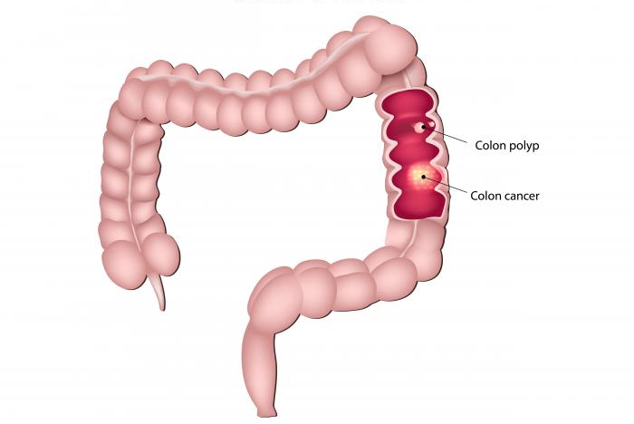
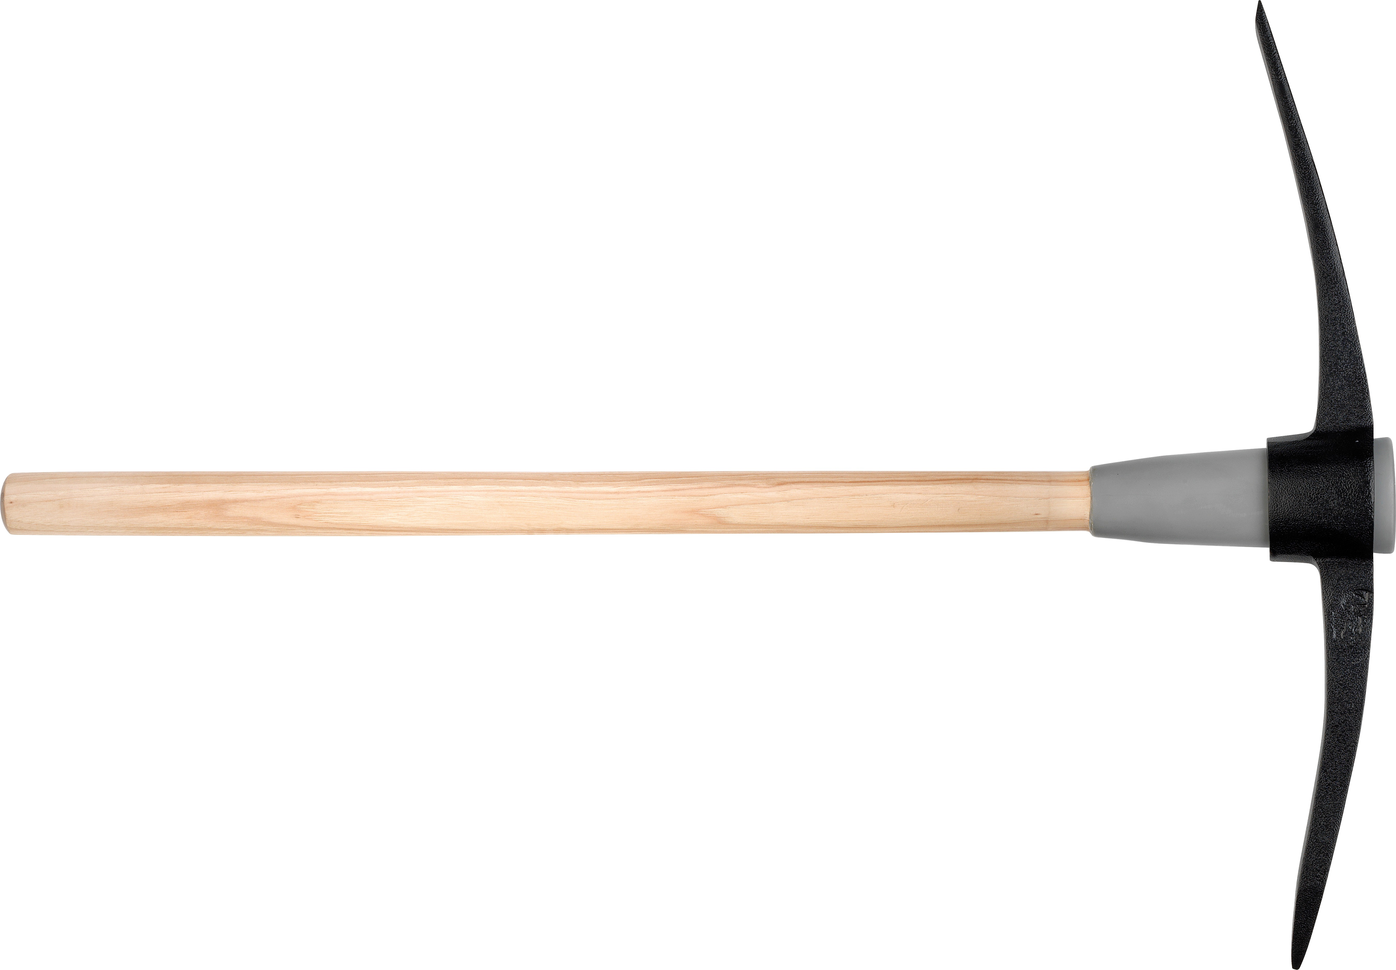
Data Mining the Colorectal Cancer Genome for Microbiota Anders Dohlman // anders.dohlman@duke.edu // Shen Lab

Slide 2
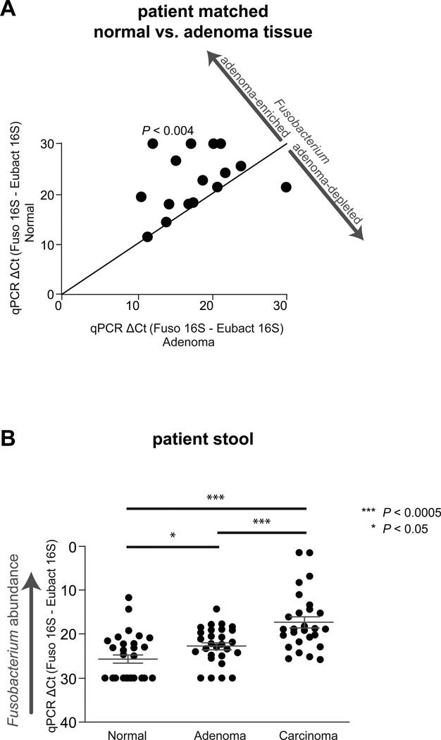
Microbiome & Colorectal Cancer
Mutation + Inflammation → CRC
⇒ Role of fungi in potentiating CRC?
⇒ Effect on immune microenvironment?
⇒ Biomarker for CRC stage & progression?
⇒ Interactions between fungi & bacteria?
Notes:
Mutation: APC / Wnt
Infection: recruits inflammatory response, but does not exacerbate
Expected that bacteria recruit tumor-infiltrated immune cells, generating proinflammatory microenvironment
98% of GI microbiota are bacteria, 2% fungi / virus / protist
Fungi interact closely with GI bacteria, help maintain microbiome homeostasis

Slide 3
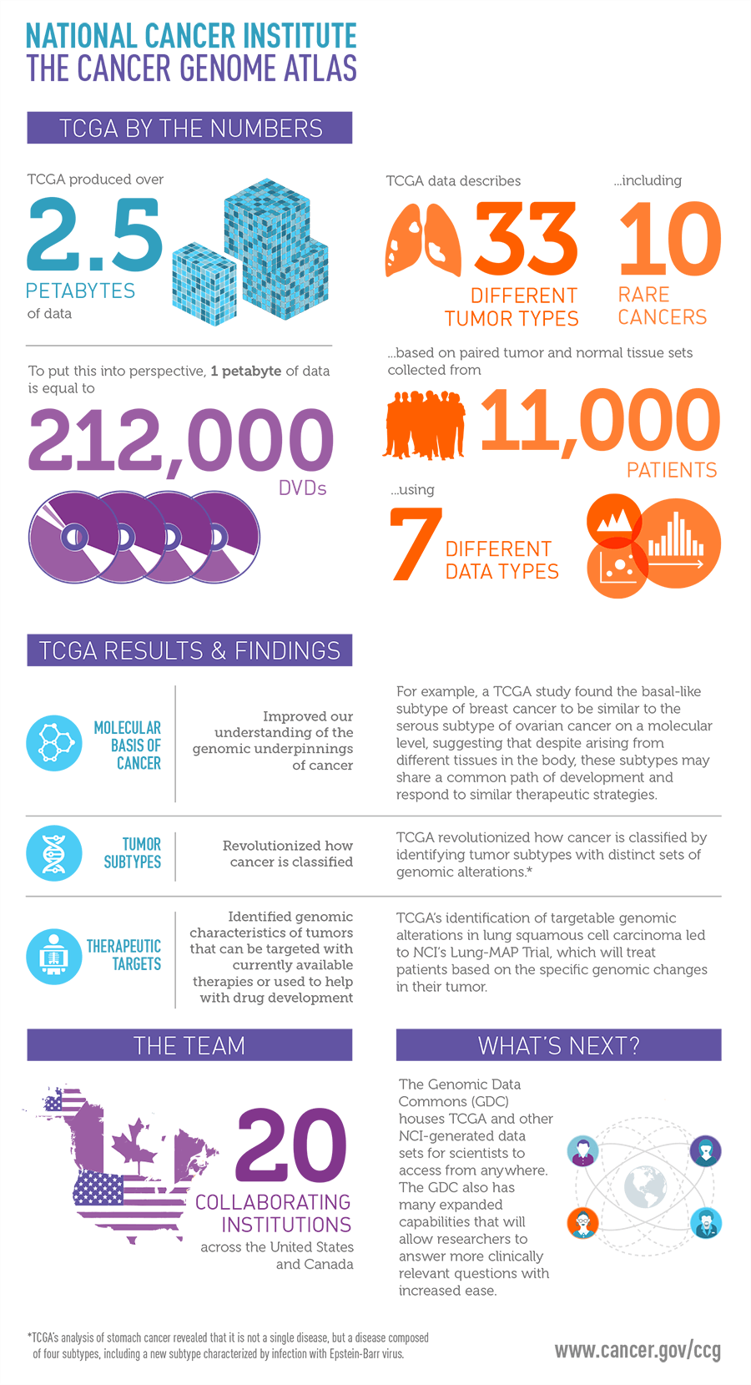
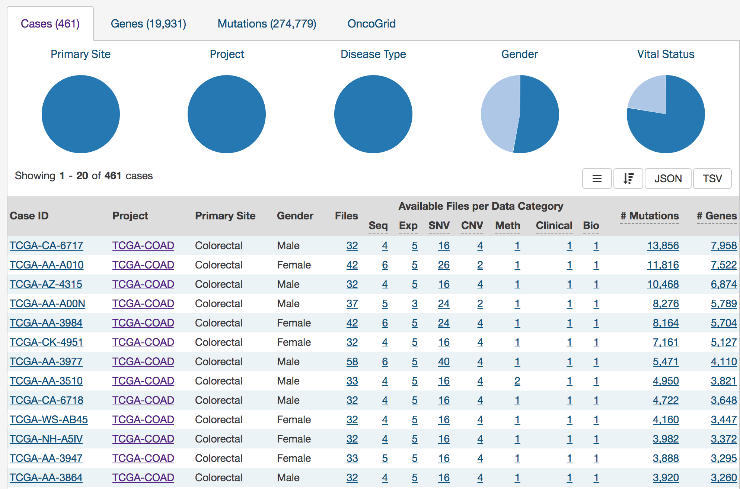
The Cancer Genome Atlas (TCGA)
NCI & NHGRI
20 collaborating institutions
> 400 sequenced CRC samples
https://portal.gdc.cancer.gov/
Notes:
Mutation: APC / Wnt
Infection: recruits inflammatory response, but does not exacerbate
Expected that bacteria recruit tumor-infiltrated immune cells, generating proinflammatory microenvironment
98% of GI microbiota are bacteria, 2% fungi / virus / protist
Fungi interact closely with GI bacteria, help maintain microbiome homeostasis

Slide 4
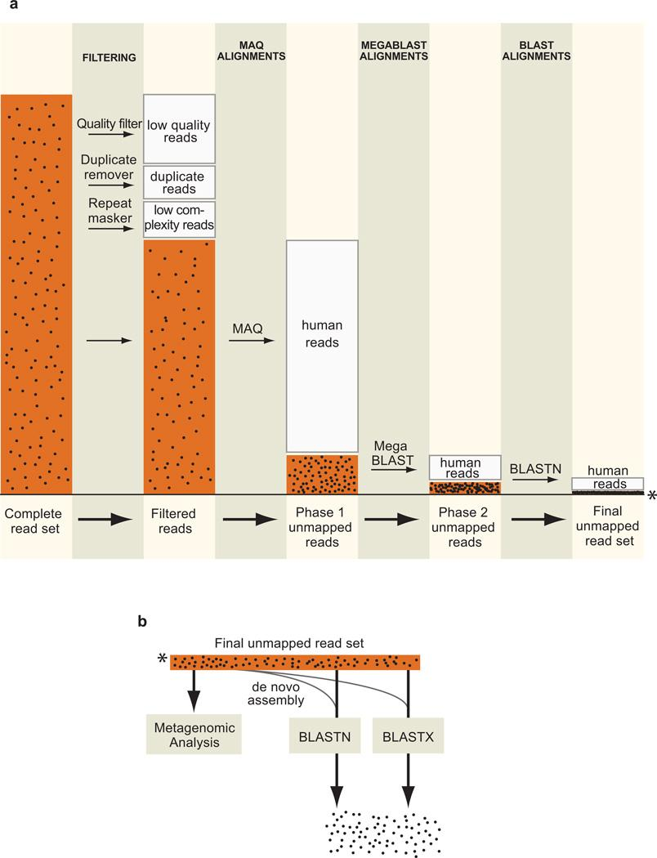
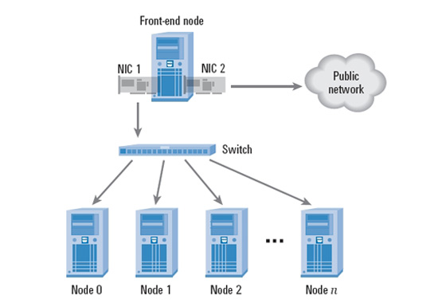
Data Processing Pipeline
Pathseq uses filters uses multiple filtering steps to identify non-human sequences
Input:
Host reference genome
Pathogen reference genome
CRC Sequencing data
Output:
Microbe species counts
Notes:
Increasingly stringent filtering steps:
Filter out low quality reads, duplicates, repeats
Remove MAQ alignments to human
Remove MegaBLAST alignments to human
Remove BLASTN alignments to human
Map unmapped reads to microbiota

Slide 5
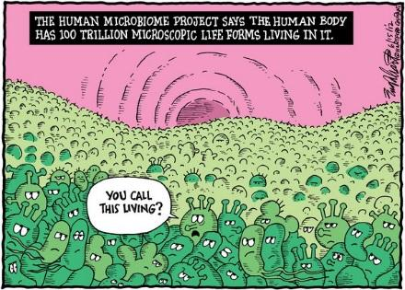
Thank you

